Slide 1


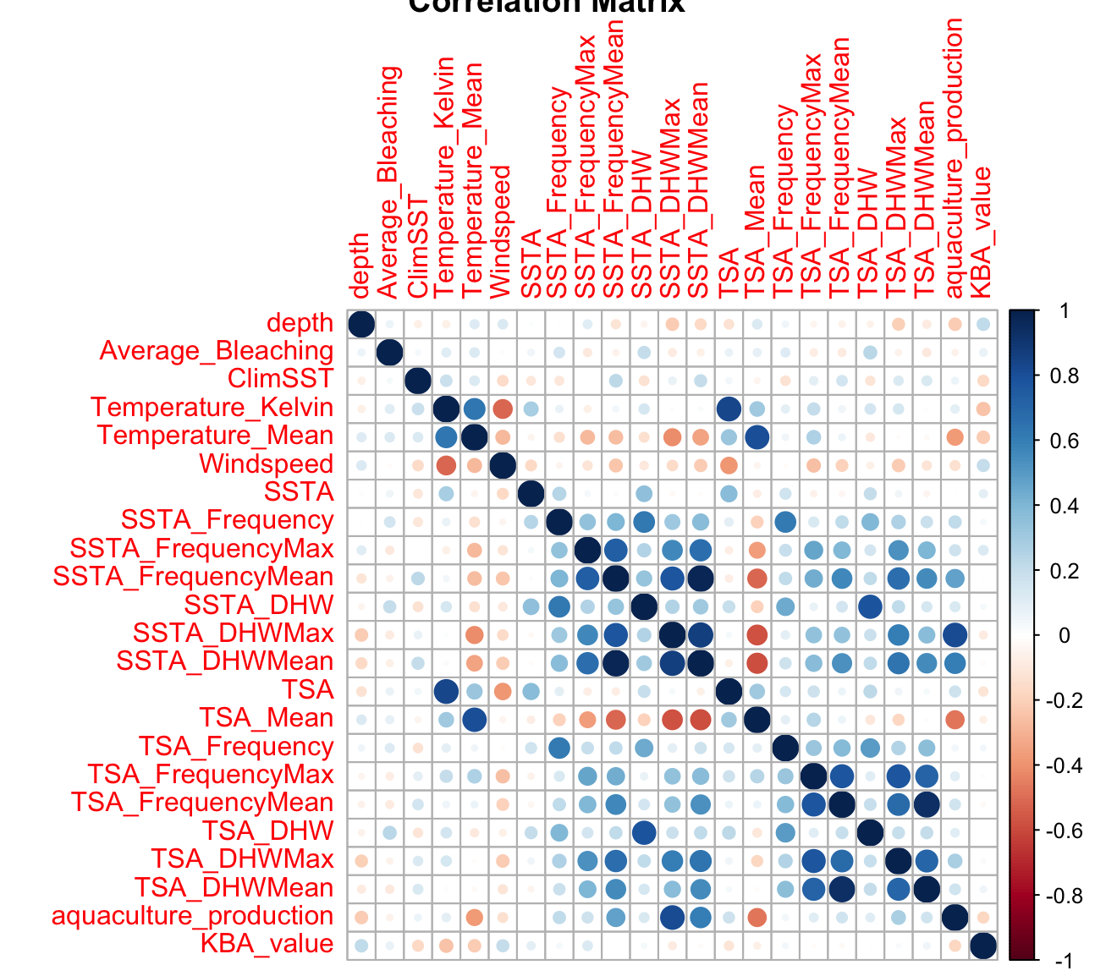
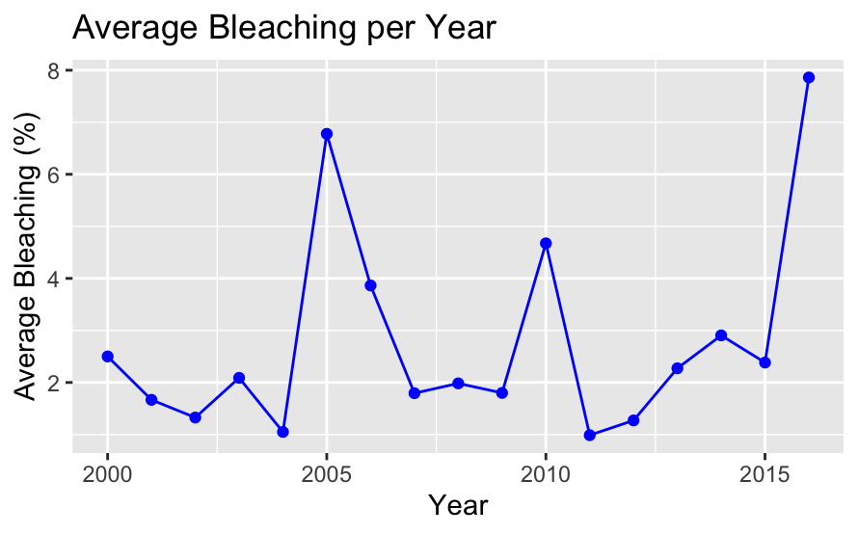
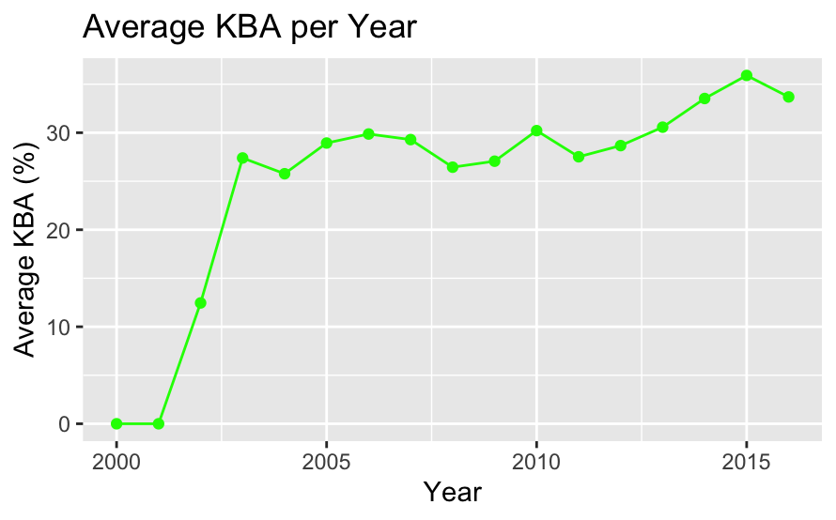
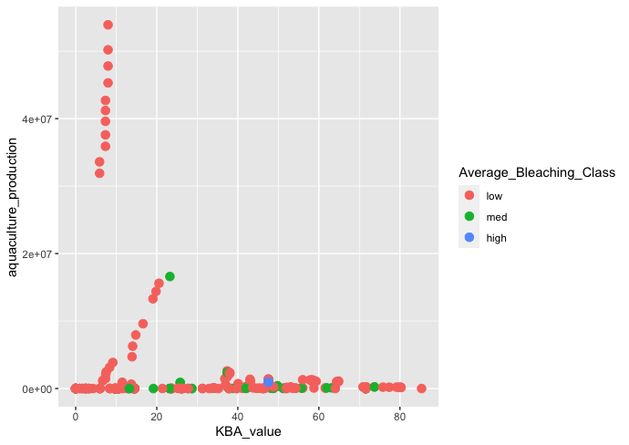
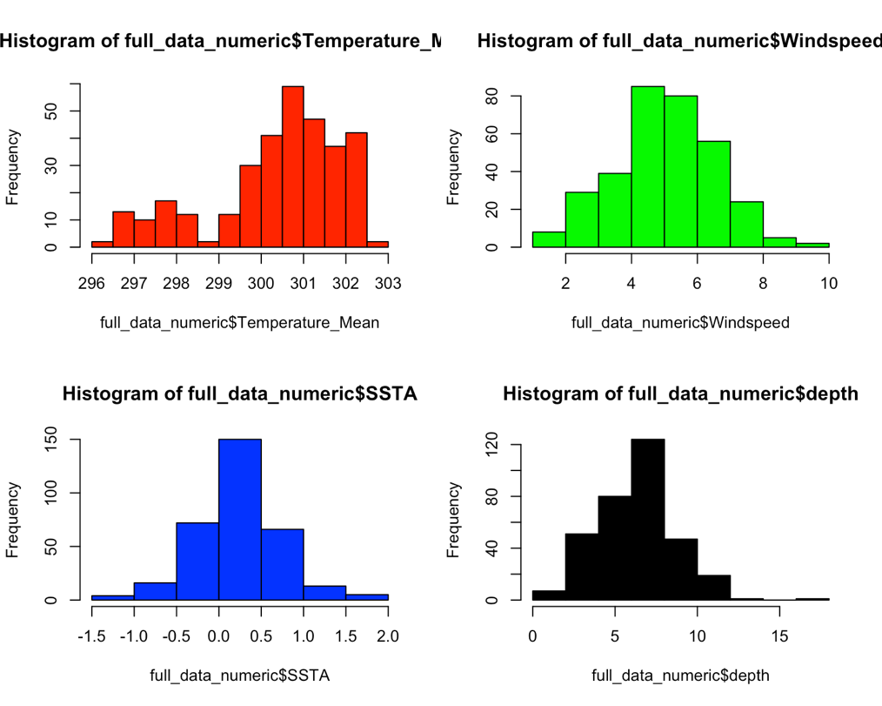
Effects of Marine Coral Bleaching on Aquaculture Production and Coverage of Key Biological Areas
Sebastian Castillo-Sanchez castis2@rpi.edu
Rensselaer Polytechnic Institute 110 8th St., Troy, NY, 12180 United States
Abstract
Exploratory Data Analysis
Modeling
As 80% of the world is covered by water, the resources that the oceans provide comes in large quantities. However, due to the exploitation of these key resources and global warming, these resources are diminishing rapidly. Coral reef bleaching is one of many effects and it could have a long-lasting impact on the oceans. Marine life relies on these coral reefs for food, general ecosystems, etc. . In turn, many people around the world rely on marine life and coral reefs for food, jobs, etc. Therefore, it should be important to analyze the effects of coral reef bleaching on areas such as aquaculture production and biodiversity. As the UN has specified “Life Under Water” as one of their Sustainability Goals for the next few years, there is starting to be more insight into what is happening around the world.
This poster will give an overview of the problem being looked at and its approaches. A brief introduction about the data sources used as well as how the datasets were used alongside each other. Next, explanatory data analysis (EDA) will be shown to explain the data more visually with plots and graphs. Then, the process of modeling, optimization, and tuning will be shown to further analyze.
For cleaning, a lot of data needed to be converted to numerical data as the numerical data in some of the attributes was specified as a character variable. The coral bleaching dataset had a date format for their data, so I converted the date column into a date type as well as extracting the year into a new column for merging later. Since all the data in this dataset start from 2000, the merging of all three datasets will rely on the last two decades to have more unified, clean data.
Correlation Matrix:
The correlation matrix provides different levels of correlation amongst all the numeric variables. From the plot, some interesting insights that come out is that neither of the Average_Bleaching or the KBA_values columns have very high or very low correlations amongst them.
Key variables averages per year
The figure on the left shows that there is a lot of rises and drops when it comes to the percentage of average coral reef bleaching throughout the years. There are huge rises in 2005, 2010 and 2016. This could be due to rising temperatures across the world or temperature of the ocean surface. However, the rise in 2016 is the largest and most recent rise which should bring some concern and worry. Figure 3 shows that there is a positive result in the average KBA percentage per year. From 2001, the KBA percentage increased by almost 30% and has slowly increased ever since.
Distributions of environmental variables:
The first histogram (red) is a distribution of the Temperature_Mean column that measures the average temperature in degrees Kelvin. The distribution is more rightly skewed which means more of the temperatures are high (hotter). Most of the data is in the 300-302 range which equates to around 80 degrees Fahrenheit. The second distribution (green) measures the windspeed in meters per hour. This one is more of a normal distribution. The blue colored distribution measures the distribution of SSTA which is described as the Sea Surface Temperature Anomaly frequency. This attribute measures the weekly Sea Surface Temperature (SST) subtracted by the weekly climatological SST. This is a very normal distribution. Lastly the distribution (black) measures the distribution of the depth attribute which is the distance from surface to study site (in meters) according to the data description. This distribution is a little more left skewed which means more of the observations are more shallow depths.
Since all the variables in the full dataset that we wanted to focus on were mostly numeric as well as continuous, regression analysis was the best method to create models for this data. To find the best results for the data, three different regression models were developed. Then after performing regression and analyzing the results, a clustering analysis was performed using the data. For the following regression models, a train-test split was created for the numeric-only data. The split created using the sample function had a 70-30 percentage split for the train and test data. This was done to train the models on the training data while testing it after with the test data while creating predictions. The three different regression models created were:
•Linear Regression
•Decision Tree
•SVM Regression
For this project, I decided to use the “caret” R package which makes it more efficient to perform machine learning models. The method for decision trees incorporated the “rpart” package and the train function is what controlled the modeling. For the best results, cross-validation is performed in the modeling process using the trainControl function. This cross-validation consisted of 10-fold cross-validation that repeated 3 times. Results from the regression models showed low significance between bleaching with aquaculture production and KBA coverage but high significance with other climate and environmental-related variables.
For all these regression models, predictions could be created using the training fits and it is tested on the testing set. For the train sets, each model was trained using 224 observations and the testing/predictions were done on 98 observations in the testing set. The predictions were done using the respective models as well as the predict function in R. Since this was a regression problem, the predictions are not done by accuracy but by plotting the actual values on the predicted values
The plot above shows the created classes are split into three different types being “low”, “medium”, and “high” depending on the value of Average_Bleaching which was 0-5, 5-20, 20-80 respectively. This visualization is very helpful in visualizing how each of the variables affects the other.
K-Means Clustering was also performed on the data. To find the optimal number of clusters, a plot finding within the sum of squares was created. The plot showed that 3 clusters could be the most optimal number of clusters. The K-Means Clustering was done using the kmeans R function using normalized (scaled) data of the numeric data and 3 clusters. The data was then aggregated using the mean function and aggregated by the different clusters that were created.
Problem Statement
The problem that this project will dive deeper into is if marine coral bleaching present in different countries around the world affects the country’s aquaculture production as well as their respective Key Biological Areas. With climate change, as well as global warming, increasing largely every year, we can hypothesize that marine coral bleaching is affecting marine life.
Data Sources
This project used three different data sources to analyze different aspects:
Coral Bleaching data: From the BCO-DMO (Biological-Chemical Oceanography Data Management Office)
Environmental Data (Windspeed, Temperature, SSTA, etc.)
Coral bleaching amount (Average)
Location data: coordinates, region, country, ocean, etc.
Aquaculture Production; From Our World In Data
Aquaculture production by country measured in metric tons
UN Sustainability Goal 14: From UN Sustainability Goals Website
Indicator 14.5.1
Percent of coverage in KBAs (Key Biological Areas)
By country
Outcomes
This project was to see if there were any effects of marine coral bleaching on aquaculture production as well as coverage percentage of Key Biodiversity Areas (KBA). From looking at the results from analysis and several different types of models, the conclusion is that there is no clear impact of the average amount of coral bleaching in the countries that were in the dataset on these two areas. However, the results from analysis and modeling showed that different variables have an impact on the two key dependent variables. The variables came from the original coral bleaching dataset and were mostly SSTA variables that measure Sea Surface Temperature Anomalies or TSA variables that measured Thermal Stress Anomalies.
Poster:
Glossary:
RPI – Rensselaer Polytechnic Institute
UN – United Nations
KBA – Key Biological Areas
Resources:
Sully, S., Burkepile, D.E., Donovan, M.K. et al. A global analysis of coral bleaching over the past two decades. Nat Commun 10, 1264 (2019). https://doi.org/10.1038/s41467-019-09238-2
Hannah Ritchie and Max Roser (2019) - "Seafood Production". Published online at OurWorldInData.org. Retrieved from: 'https://ourworldindata.org/seafood-production' [Online Resource]
https://unstats-undesa.opendata.arcgis.com/datasets/indicator-14-5-1-average-proportion-of-marine-key-biodiversity-areas-kbas-covered-by-protected-areas-percent-5/data?geometry=136.385%2C-32.368%2C-133.615%2C66.033&page=6
Acknowledgments:
Professor Thilanka Munasinghe from Rensselaer Polytechnic Institute

