Slide 1




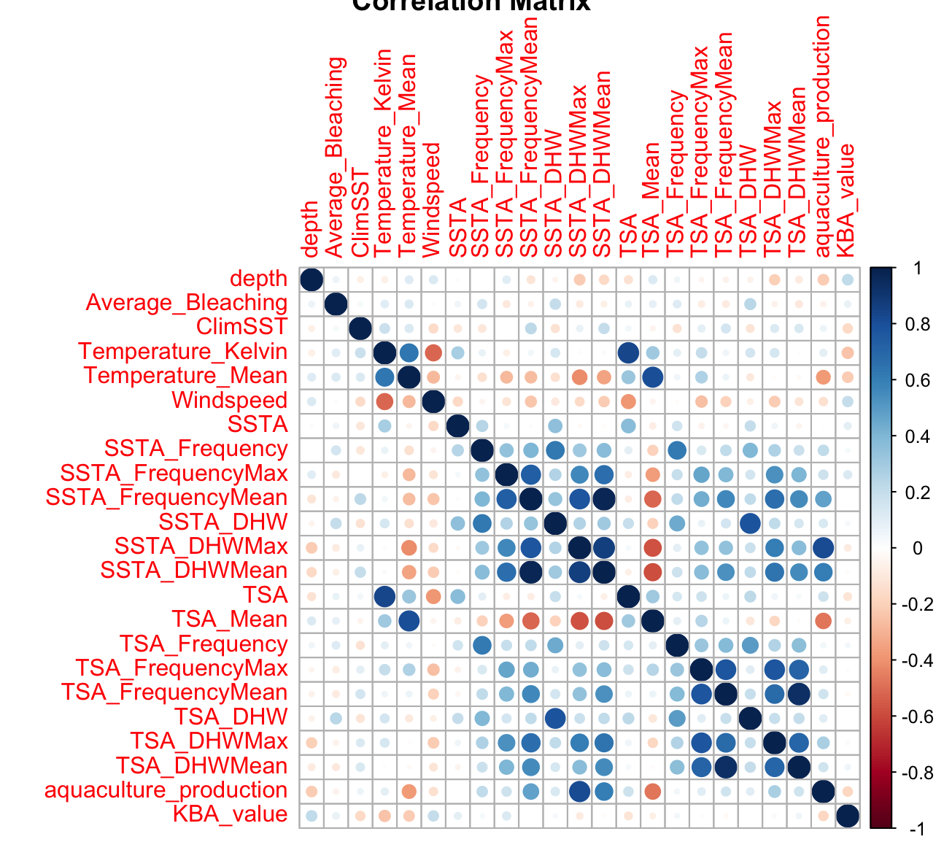
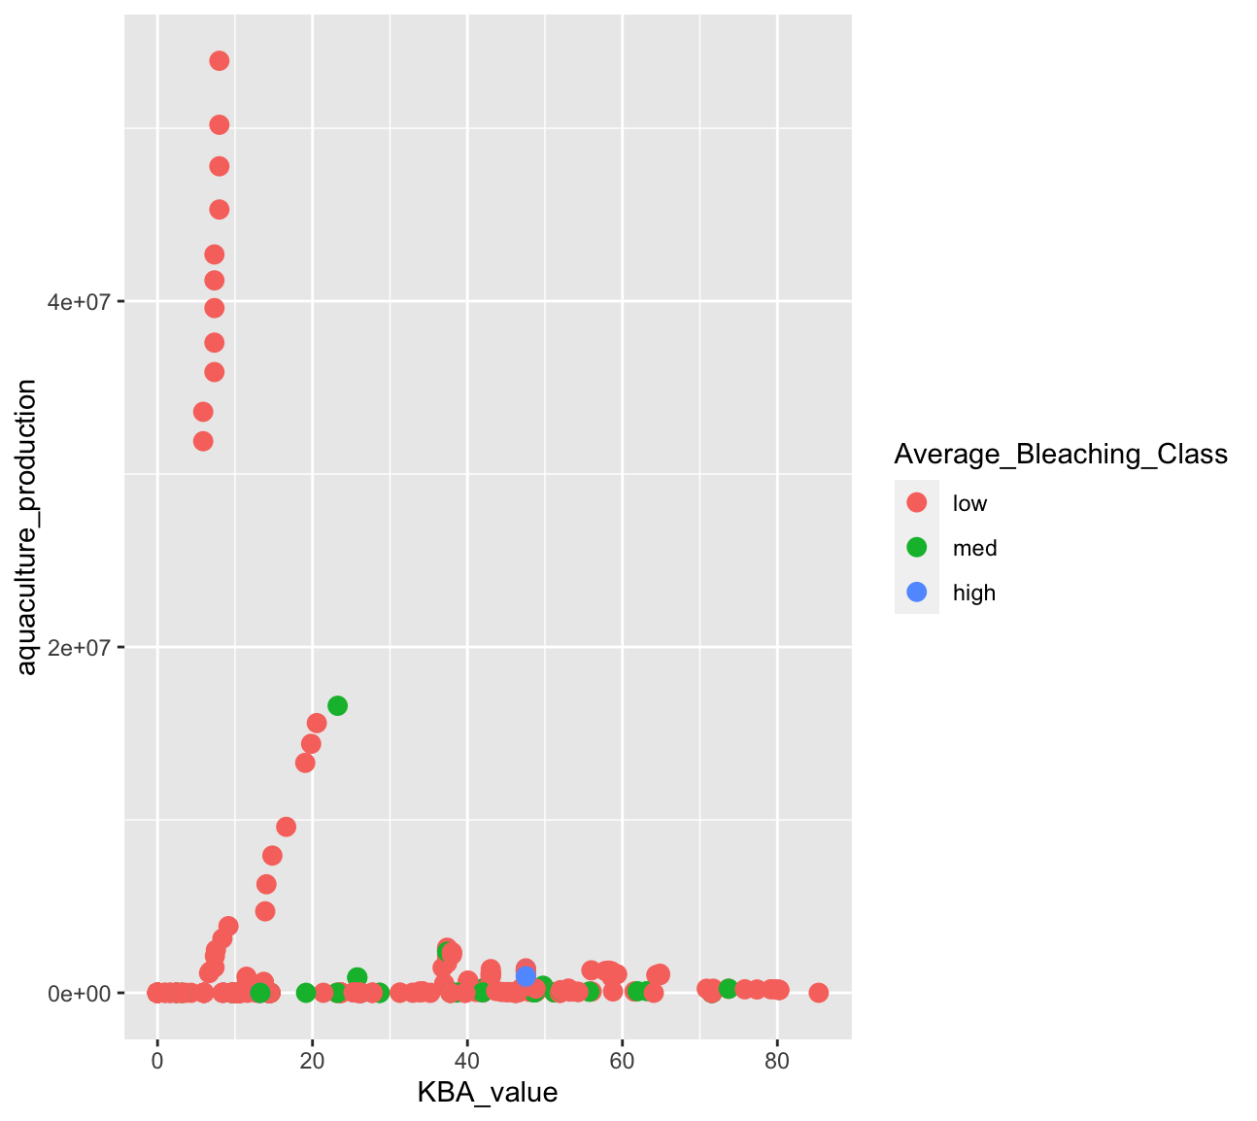
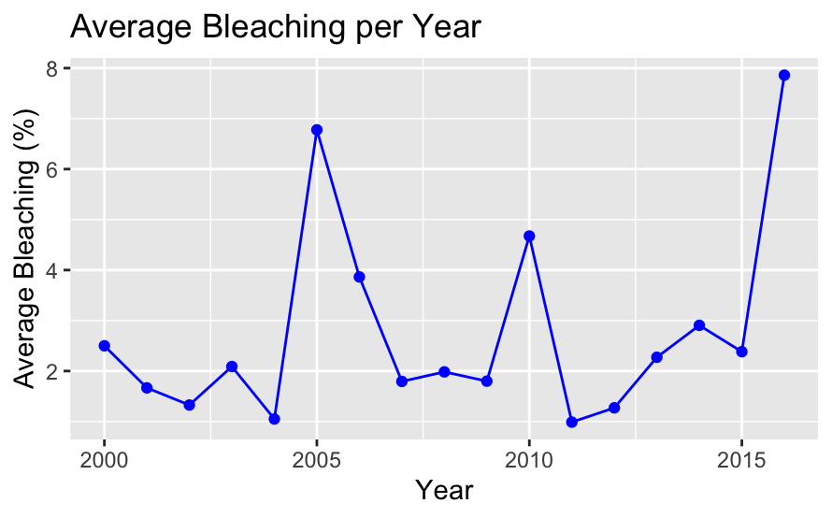
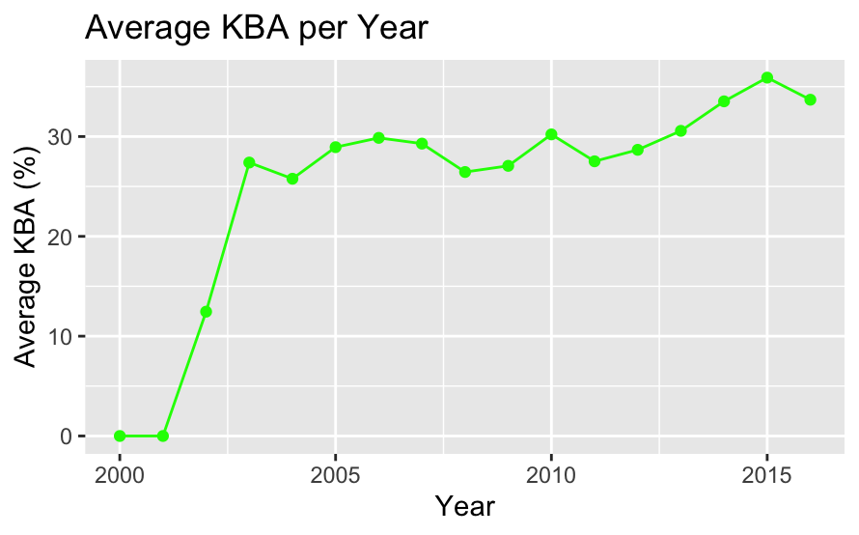
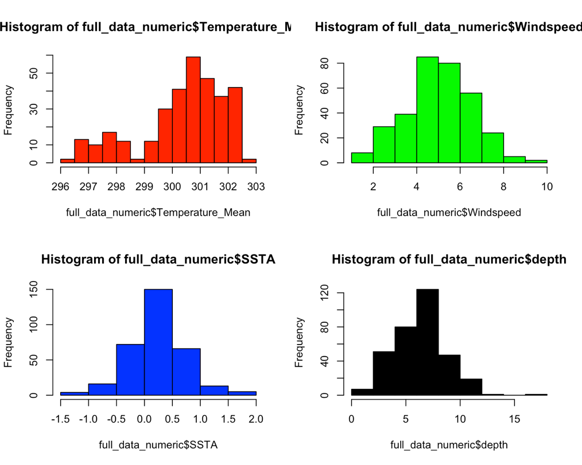
Effects of Marine Coral Bleaching on Aquaculture Production and Key Biological Areas
Sebastian Castillo-Sanchez castis2@rpi.edu
Rensselaer Polytechnic Institute 110 8th St., Troy, NY, 12180 United States
Abstract
Exploratory Data Analysis
Modeling
As 80% of the world is covered by water, the resources that the oceans provide comes in large quantities. However, due to exploitation of these key resources and global warming, these resources are diminishing rapidly. Coral reef bleaching is one of many resulting effects and it could have a long-lasting impact to the oceans. Marine life rely on these coral reefs for food, general ecosystems, etc. . In turn, many people around the world rely on marine life and coral reefs for food, jobs, etc. Therefore, it should be important to analyze the effects of coral reef bleaching on areas such as aquaculture production and biodiversity. As the UN has specified “Life Under Water” as one of their Sustainability Goals for the next few years, there is starting to be more insight into what is happening around the world.
This poster will give an overview of the problem being looked at and its approaches. A brief introduction about the data sources used as well as how the datasets were used alongside each other. Next, explanatory data analysis (EDA) will be shown to explain the data in a more visual way with plots and graphs. Then, the process of modeling, optimization and tuning will be shown to further analyze.
Correlation Matrix:
Different
Problem Statement
The problem that this project will dive deeper into is if marine coral bleaching present in different countries around the world affect the country’s aquaculture production as well as their respective Key Biological Areas. With climate change as well as global warming increasing largely every year, we can hypothesize that marine coral bleaching is affecting marine life.
Data Sources
This project used three different data sources to analyze different aspects:
Coral Bleaching data: From the BCO-DMO (Biological-Chemical Oceanography Data Management Office)
Environmental Data (Windspeed, Temperature, SST, etc.)
Coral bleaching amounts by region, country, ocean, etc.
Aquaculture Production; From Our World In Data
Aquaculture production by country measured in metric tons
UN Sustainability Goal 14: From UN Sustainability Goals Website
Indicator 14.5.1
Percent of coverage in KBAs (Key Biological Areas)
Poster:
Glossary:
RPI – Rensselaer Polytechnic Institute
UN – United Nations
Resources:
Acknowledgments:
Professor Thilanka Munasinghe from Rensselaer Polytechnic Institute

