Slide 1
NewIt!
I knew it! It was NewIt!

Slide 2
WORKFLOW

Slide 3
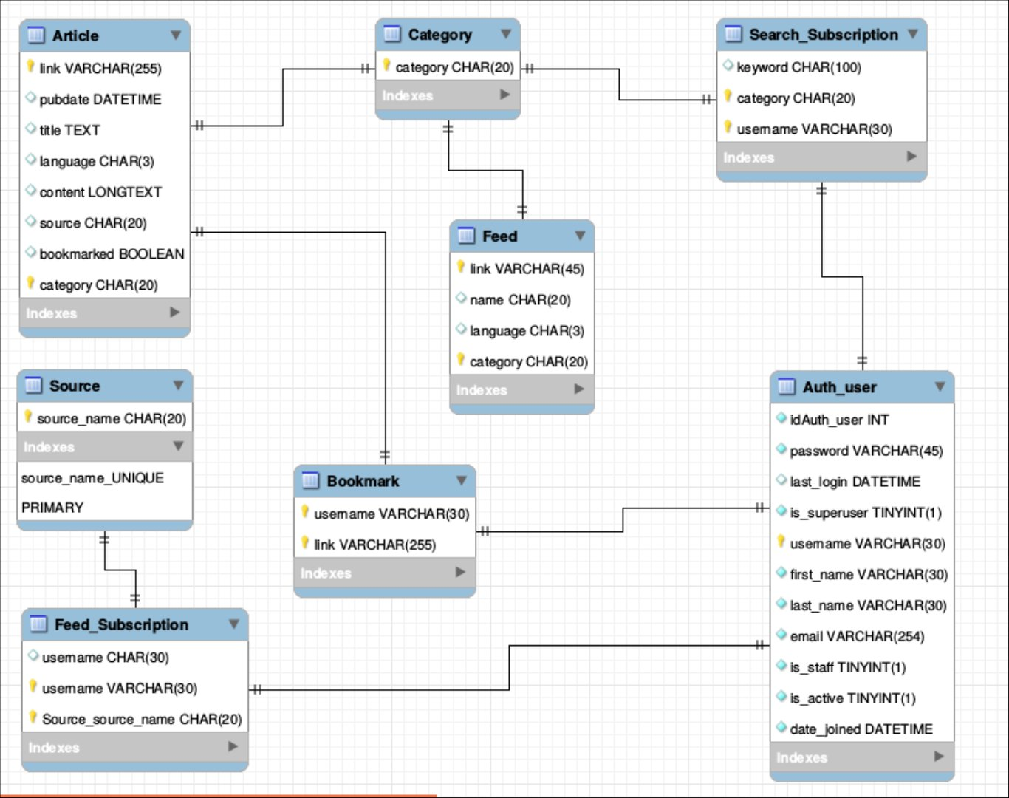
DATABASE DESIGN

