Slide 1
Unit 1 Data Types and Combinational Logic
EL-GY 9463: Introduction to Hardware Design
ProfS. Sundeep Rangan, Siddharth Garg

Slide 2
Learning Objectives
Represent signals in SystemVerilog of various types:
Logical vectors and signed and unsigned integers
Implement arithmetic operations (additions, multiplications, bit operations)
Identify cases for overflow and truncation
Create simple combinational logic modules to implement functions
Draw a block diagram representation of the module

Slide 3
Outline
Basic Data Types: Logic and Integers
Truncation and Overflows
Bit Shifts
Simple Combinational Logic

Slide 4
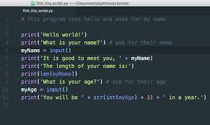
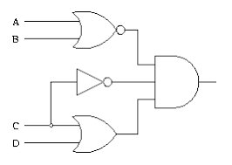
Hardware Description Language
Hardware Description Language (HDL)
Example: Verilog, SystemVerilog
Describes hardware structure and behavior
Items natively run in parallel
Code is synthesized
Code becomes to logic elements, registers, …
Also become testbenches
Software
Example: C, python
Describes sequential behavior
One instruction after another
Code is compiled
Becomes machine code for a processor

Slide 5
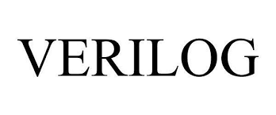

System Verilog vs Verilog
Verilog
Created in 1983-84
Standardized in 1995. Became mainstream RTL
Largely used for legacy designs
System Verilog (this unit)
Developed in 2002
Extends Verilog
Better abstraction, parameterization
Significantly improved testbench
Overwhelming design choice today

Slide 6

Logic and Logic Vectors
Logic: Basic data type in System Verilog
Value 0, 1, X or Z
X = unknown or unspecified
Z = not connected
We will discuss X and Z later
Logic vector
A group of log bits
Each vector has a bit width.

Slide 7
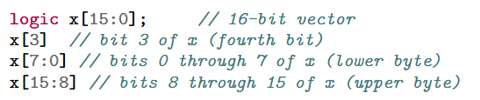
Bitwise Operations
System Verilog has natural ways to pack and unpack bits
Note bits are always counted from 0

Slide 8
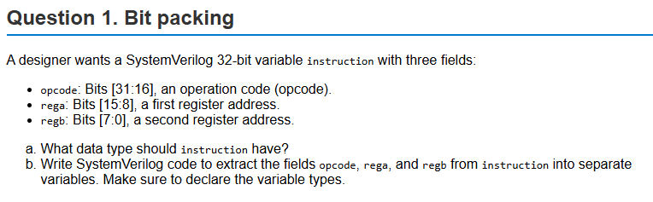
Example Problem

Slide 9
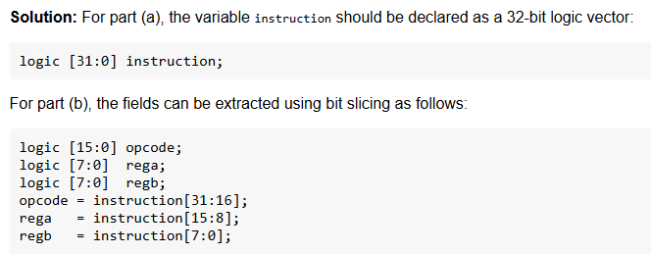
Solution

Slide 10

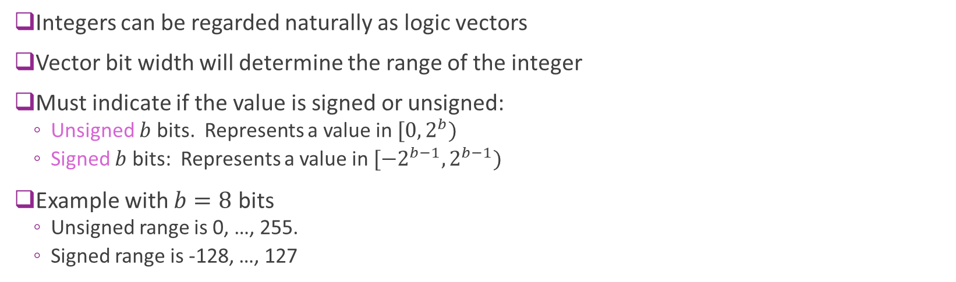
Integers
Integers can be regarded naturally as logic vectors
Vector bit width will determine the range of the integer
Must indicate if the value is signed or unsigned:
Unsigned $b$ bits. Represents a value in $[0, 2^{b})$
Signed $b$ bits: Represents a value in $[−2^{b−1}, 2^{b−1})$
Example with $b=8$ bits
Unsigned range is 0, …, 255.
Signed range is -128, …, 127

Slide 11
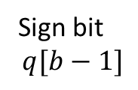
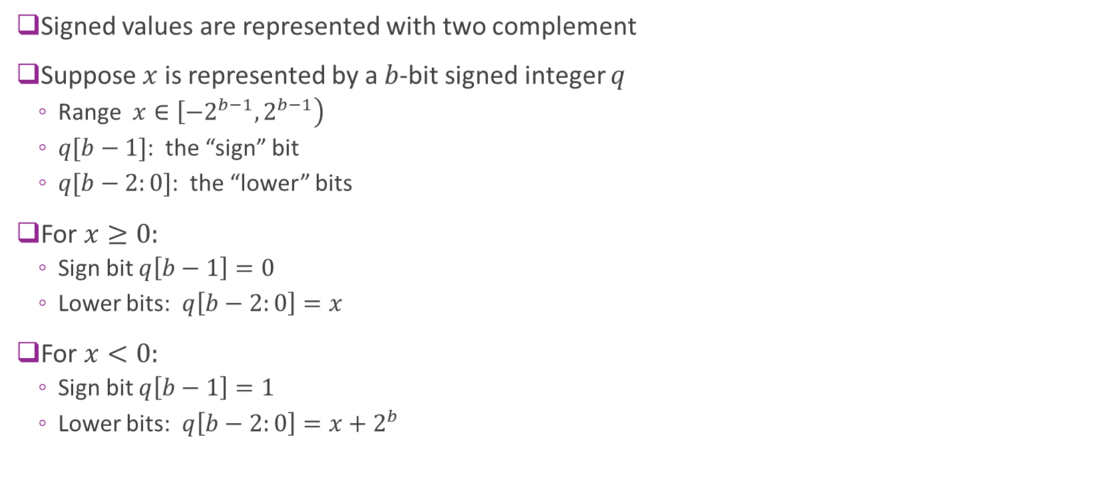
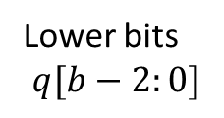
Two Complement
Signed values are represented with two complement
Suppose $x$ is represented by a $b$-bit signed integer $q$
Range $x∈\left[−2^{b−1},2^{b−1}\right)$
$q[b−1]$: the “sign” bit
$q[b−2:0]$: the “lower” bits
For $x≥0:$
Sign bit $q\left[b−1\right]=0$
Lower bits: $q\left[b−2:0\right]=x$
For $x<0:$
Sign bit $q\left[b−1\right]=1$
Lower bits: $q\left[b−2:0\right]=x+2^{b}$
Sign bit $$q[b−1]$$
Lower bits $$q[b−2:0]$$

Slide 12
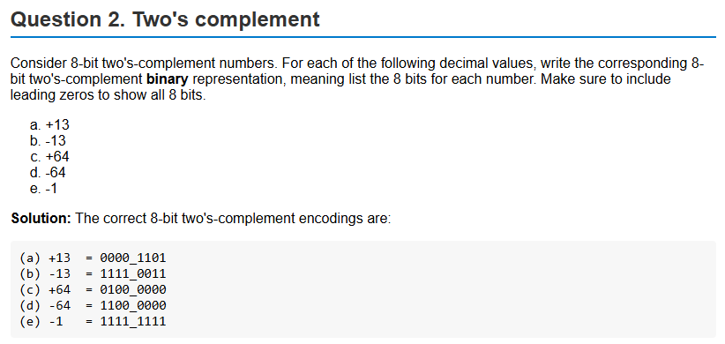
Example Problem

Slide 13
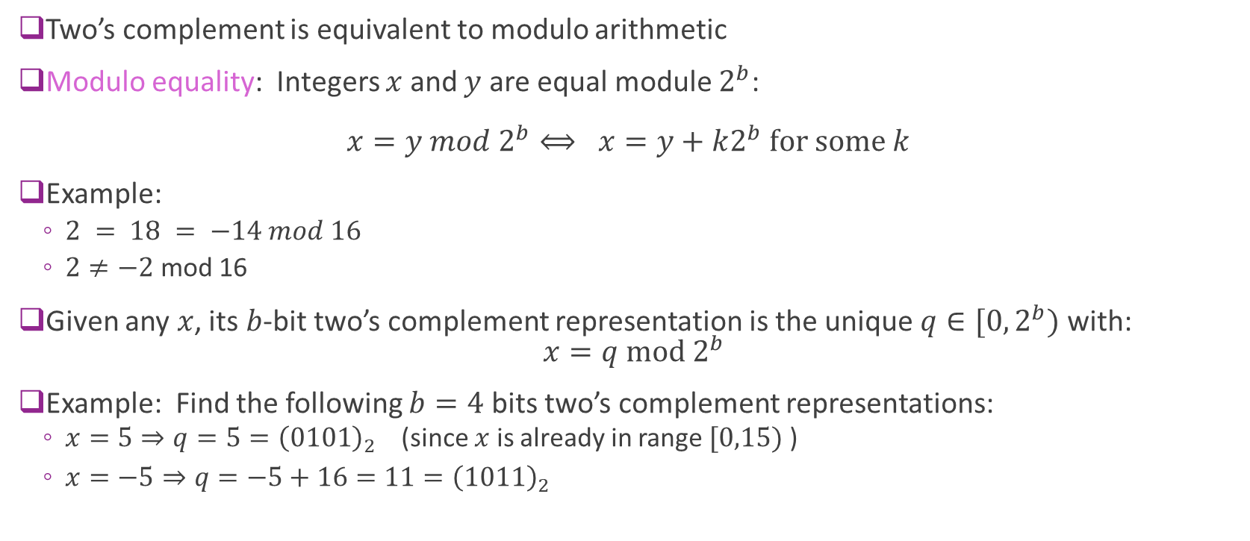
Two’s Complement = Modulo Arithmetic
Two’s complement is equivalent to modulo arithmetic
Modulo equality: Integers $x$ and $y$ are equal module $2^{b}$: $x=y mod 2^{b}⟺ x=y+k2^{b} for some k$
Example:
$2 = 18 = −14 mod 16$
$2≠−2$ mod 16
Given any $x$, its $b$-bit two’s complement representation is the unique $q∈[0,2^{b})$ with: $x=q mod 2^{b}$
Example: Find the following $b=4$ bits two’s complement representations:
$x=5⇒q=5={\left(0101\right)}_{2}$ (since $x$ is already in range $[0,15)$ )
$x=−5⇒q=−5+16=11={\left(1011\right)}_{2}$

Slide 14
System Verilog Literals and Constants
Literal: A value written directly in code (not stored in a storage element)
Constant. Does not change
SV has a specific syntax: <size>'<base><digits>
<size> = number of bits. If omitted, takes a default value, typically 32-bits
<base> = b, o, d, h : binary, octal, decimal, hex
<digits> = value
Examples:
8'd13 → 8‑bit decimal 13
8'b0101_1010 → 8‑bit binary
4'hF → 4‑bit hex (1111)
16'd8 → 16‑bit decimal 8
8'b0101 → 8‑bit binary 0101
-8'd5 → 5-bit two-complement decimal -5 (11111011)

Slide 15
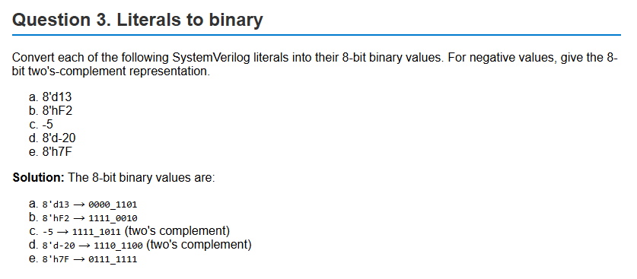
Example Problem

Slide 16
Outline
Basic Data Types: Logic and Integers
Truncation and Overflows
Bit Shifts
Simple Combinational Logic

Slide 17
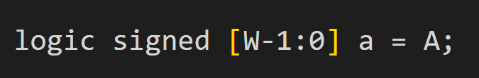
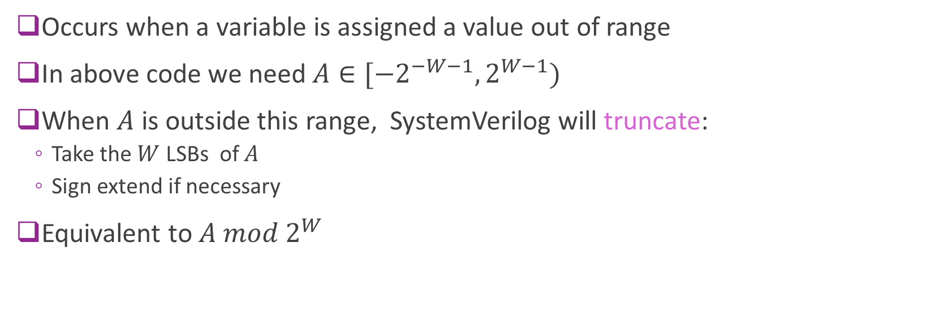
Truncation
Occurs when a variable is assigned a value out of range
In above code we need $A∈[{−2}^{−W−1},2^{W−1})$
When $A$ is outside this range, SystemVerilog will truncate:
Take the $W$ LSBs of $A$
Sign extend if necessary
Equivalent to $A mod 2^{W}$

Slide 18
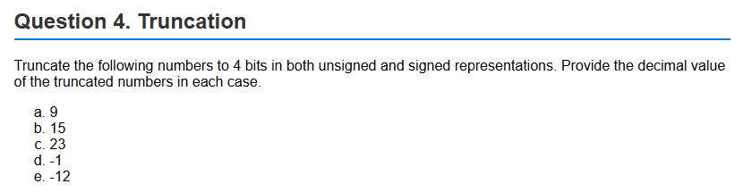
Sample Problem

Slide 19
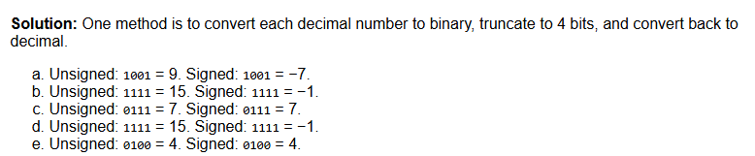
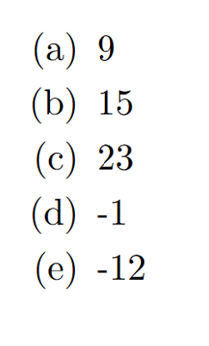
Solution using Binary Representations

Slide 20
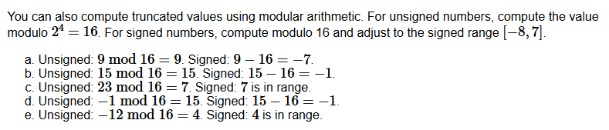
Solution using Modulo Arithmetic

Slide 21
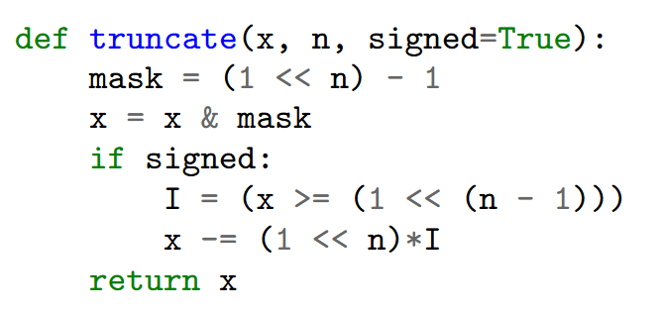

Simulating Truncation in Python
This code works for numpy arrays
Mask the $n$ LSB
Then sign extend if necessary

Slide 22
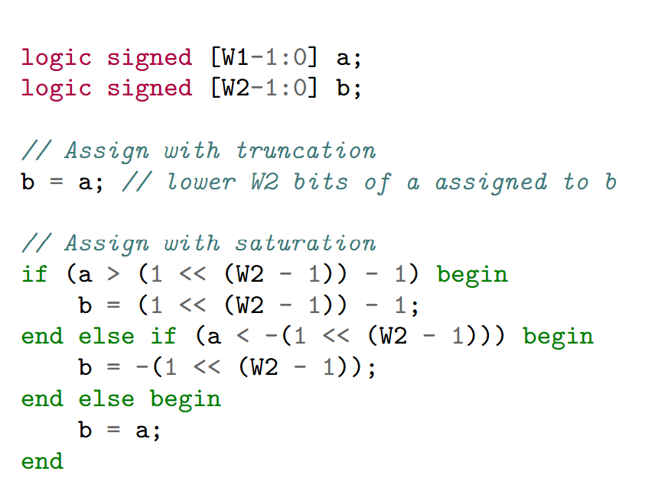

Saturation
Truncation results in values far different from original
Ex: Truncate $9$ to 4 signed bits $⇒9−16=−7$
Alternatively, can saturate
Clip to max or min values before assignment
Ex: Truncate 9 to 7
Provides less approximation error
But adds a bit of extra logic
Example to right: $W_{2}<W_{1}$
Want to assign $b=a$

Slide 23
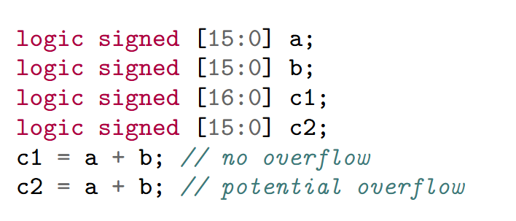
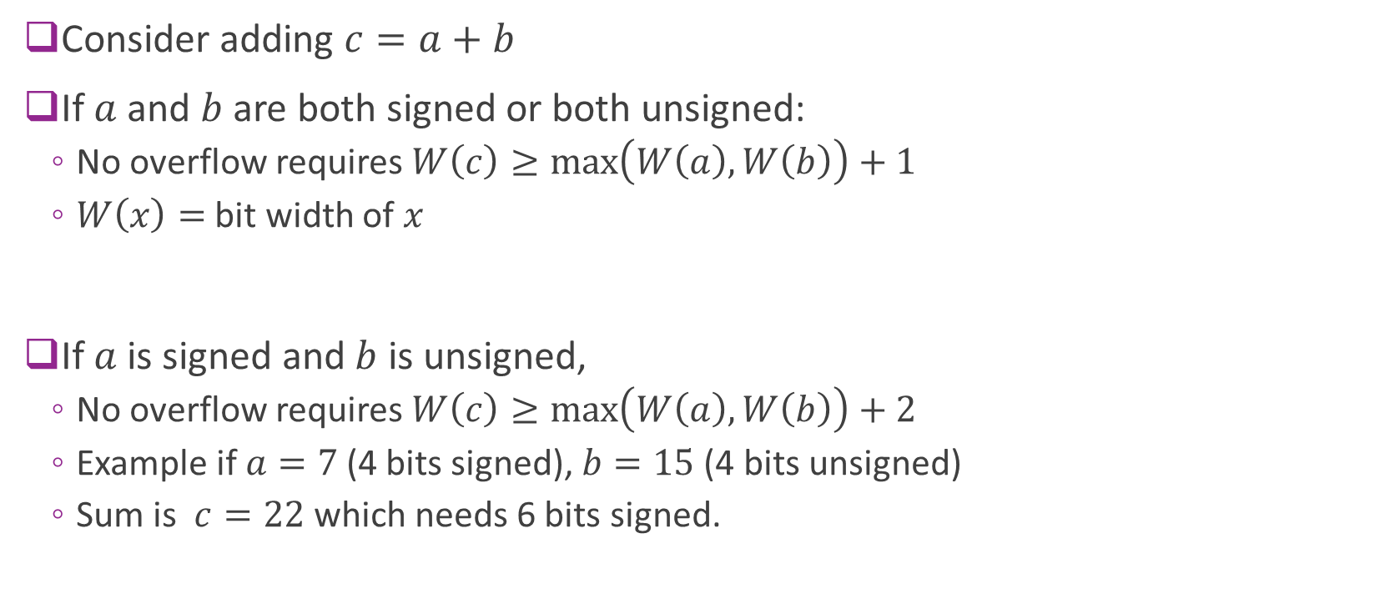
Addition Overflow Rules
Consider adding $c=a+b$
If $a$ and $b$ are both signed or both unsigned:
No overflow requires $W\left(c\right)≥\max\left(W\left(a\right),W\left(b\right)\right)+1$
$W\left(x\right)=$ bit width of $x$
If $a$ is signed and $b$ is unsigned,
No overflow requires $W\left(c\right)≥\max\left(W\left(a\right),W\left(b\right)\right)+2$
Example if $a=7$ (4 bits signed), $b=15$ (4 bits unsigned)
Sum is $c=22$ which needs 6 bits signed.

Slide 24
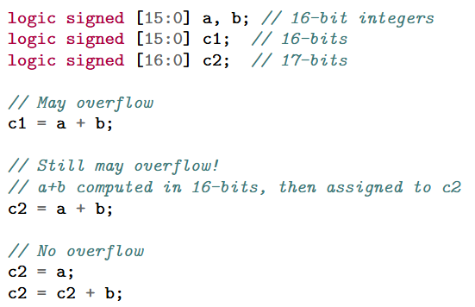
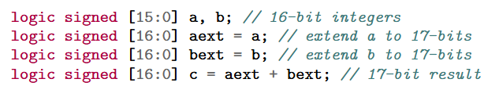

Addition in System Verilog
SV does not auto-promote with addition
Adding $a+b$ in SV:
Sum is stored in temporary $t$
$W\left(t\right)=\max\left\{ W\left(a\right), W\left(b\right)\right\}$
No additional bit
May overflow before assignment
To avoid overflow:
Method 1: Add one term at a time
Method 2: Extend then add

Slide 25
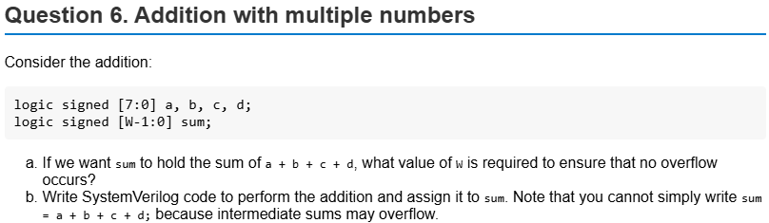
Sample Problem

Slide 26
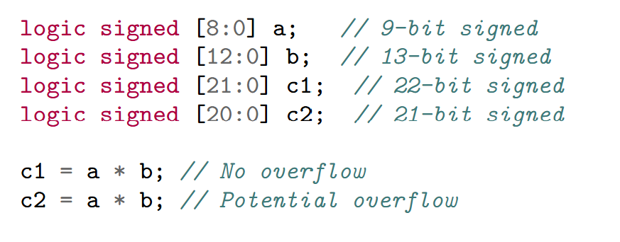
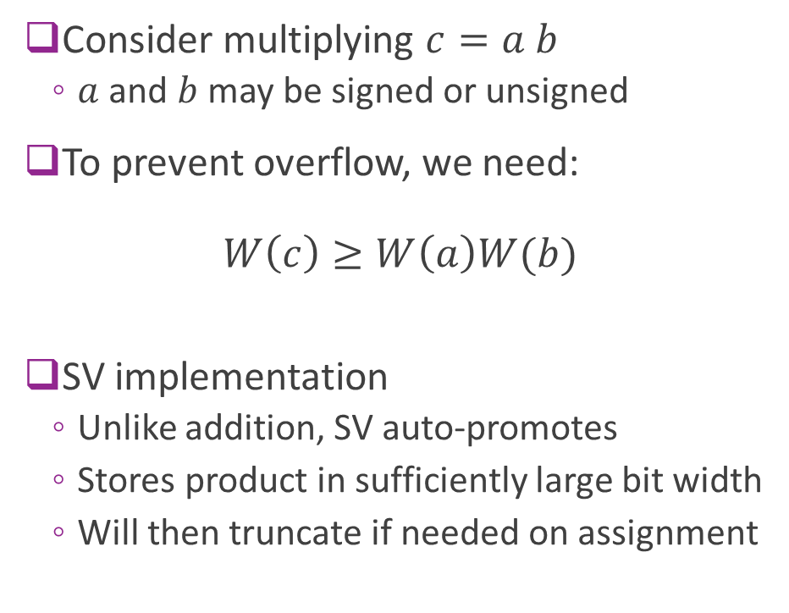
Multiplication Overflow
Consider multiplying $c=a b$
$a$ and $b$ may be signed or unsigned
To prevent overflow, we need: $W\left(c\right)≥W\left(a\right)W(b)$
SV implementation
Unlike addition, SV auto-promotes
Stores product in sufficiently large bit width
Will then truncate if needed on assignment

Slide 27
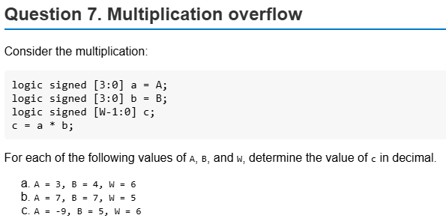
Sample Problem

Slide 28
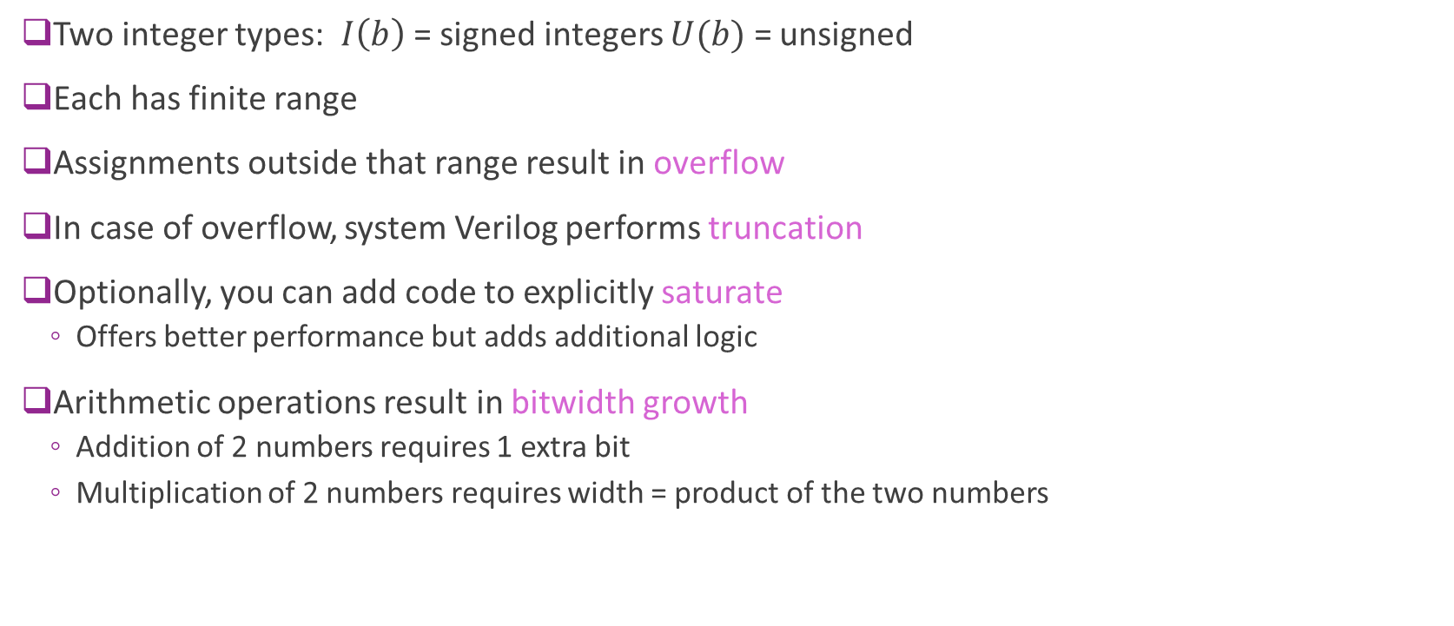
Summary
Two integer types: $I\left(b\right)$ = signed integers $U(b)$ = unsigned
Each has finite range
Assignments outside that range result in overflow
In case of overflow, system Verilog performs truncation
Optionally, you can add code to explicitly saturate
Offers better performance but adds additional logic
Arithmetic operations result in bitwidth growth
Addition of 2 numbers requires 1 extra bit
Multiplication of 2 numbers requires width = product of the two numbers

Slide 29
Outline
Basic Data Types: Logic and Integers
Truncation and Overflows
Bit Shifts
Simple Combinational Logic

Slide 30

Logical Bit Shift
Bit shift operators:
$x≫b$ and $x≪b$ Right and left shift by $b$ bits
Fills in with zeros
Bit widths always stay the same.
Hence, bits may be lost
Examples:
($1011 0110)≫4=\left(0000 1011\right)$
($1011 0110)≪3=\left(1011 0000\right)$

Slide 31
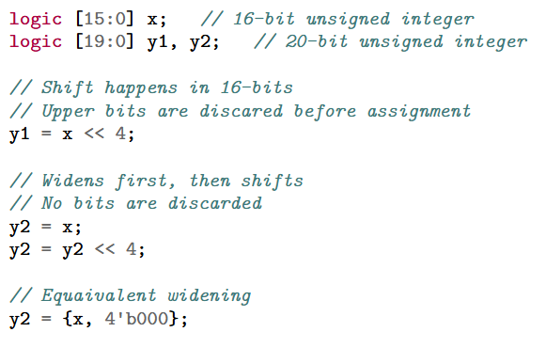
Logical Shift and Bit Widths
Caution:
Logical bit shifts do not change width
Some bits may be discarded
To avoid discarding:
Widen first, then shift

Slide 32
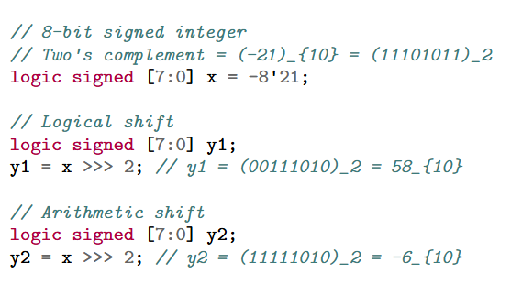
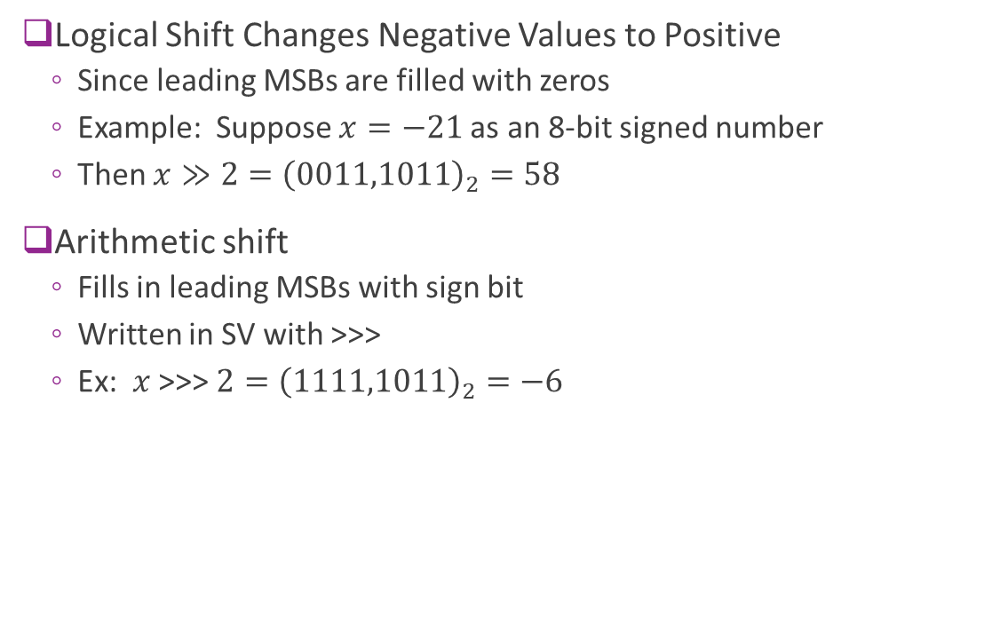
Arithmetic Shift
Logical Shift Changes Negative Values to Positive
Since leading MSBs are filled with zeros
Example: Suppose $x=−21$as an 8-bit signed number
Then $x≫2={\left(0011,1011\right)}_{2}=58$
Arithmetic shift
Fills in leading MSBs with sign bit
Written in SV with >>>
Ex: $x$ >>> $2={\left(1111,1011\right)}_{2}=−6$

Slide 33

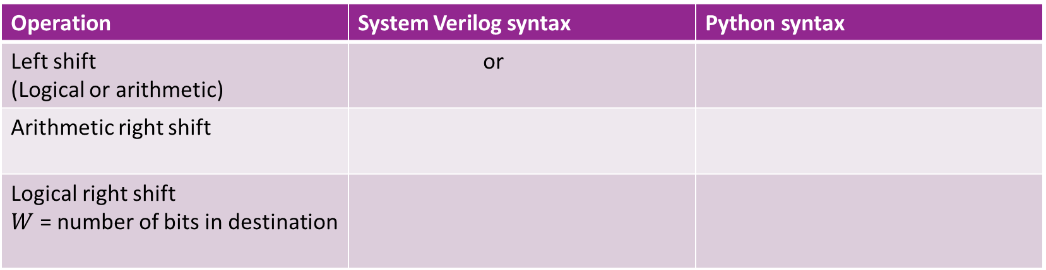
Python vs. SV
Operation | System Verilog syntax | Python syntax
Left shift (Logical or arithmetic) | or
Arithmetic right shift
Logical right shift $W$ = number of bits in destination
Note: All shifts in python are arithmetic
To emulate logical right shift need a mask

Slide 34
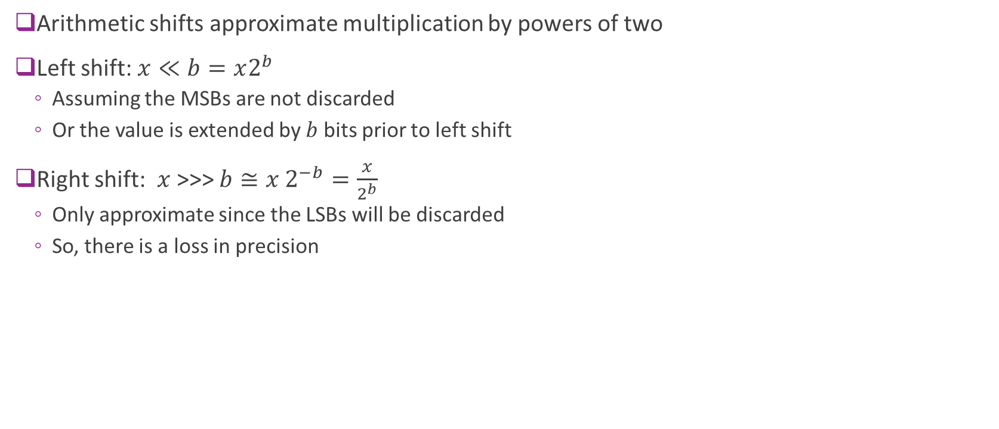
Arithmetic Shift and Powers of Two
Arithmetic shifts approximate multiplication by powers of two
Left shift: $x≪b=x2^{b}$
Assuming the MSBs are not discarded
Or the value is extended by $b$ bits prior to left shift
Right shift: $x$>>> $b≅x 2^{−b}=\frac{x}{2^{b}}$
Only approximate since the LSBs will be discarded
So, there is a loss in precision

Slide 35
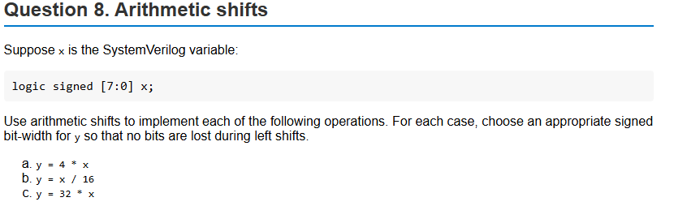
Example Problem

Slide 36
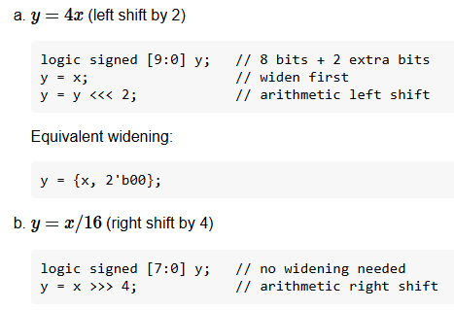
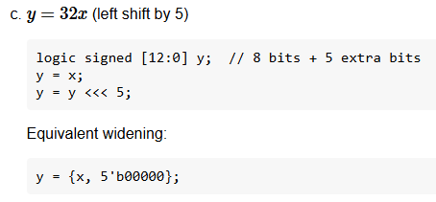
Solution

Slide 37
Outline
Basic Data Types: Logic and Integers
Truncation and Overflows
Bit Shifts
Simple Combinational Logic

Slide 38
Module and Combinational Logic
Module: A named circuit block with some inputs and outputs
Fully self-contained
Takes some input signals and produces some outputs
May have sub-modules
Combinational logic: Outputs depend only on current inputs
No memory
No storage
We will contrast this type of module with sequential logic in the next unit

Slide 39





Simple Example: ReLU + Linear
Goal: Implement a combinational logic module for the function $$y=\max\left\{ax+b, 0\right\}$$
Linear function + ReLU
Used widely in machine learning
$$x$$
Input ports
$$a$$
$$y$$
Output port
$$b$$

Slide 40
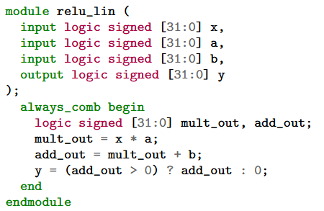
SystemVerilog Description
Each block is a module
Has inputs and outputs
Logical mapping from inputs to outputs
Description is behavioral only
Does not say how it will be implemented
We discuss that later

Slide 41
Module Components in SV
Module name
Ports:
Defines inputs and outputs
Each has a type (more detail later)
Behavioral description
In this case, a combinational block
Sequence of operations
From input to output

Slide 42
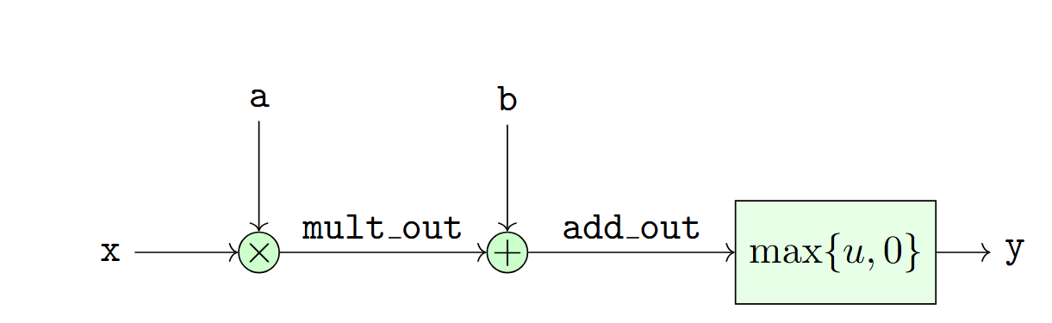
Block Diagram
Function of a module typically represented by a block diagram
Graphical representation of a potential implementation
Typically, diagram is at high-level
Adders, multipliers not low-level details components like gates

Slide 43
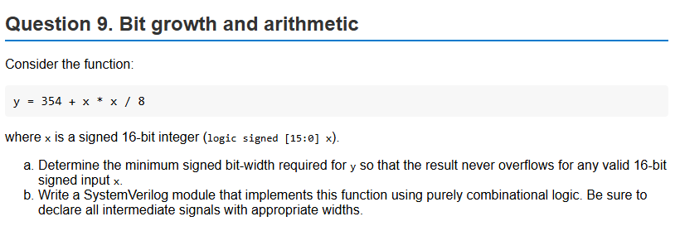
Problem
Assigned as homework
Note there is a conservative and more precise bit width analysis
Both will receive full credit

