Slide 1
Number Systems
Unit 2

Slide 2
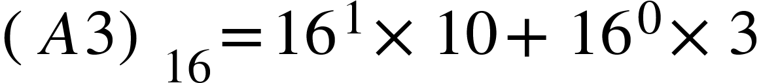

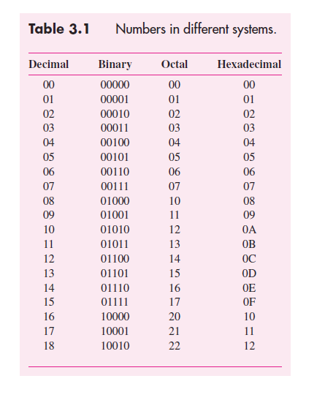
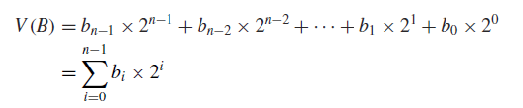
Base-n representations
Base 16 (Hex) Representation
Numbers in range 0,1..9,A,B..F
Example:
Base 2 (Binary) Representation
Base 8 (Octal) Representation
Numbers in range 0,1,2,...7
Example:

Slide 3
Hex used as shorthand for binary
Computers used binary representations. For examples, “ints” in C are 32-bit binary numbers.
But writing down 32-bits is tedious, so we often use a hexadecimal representation instead.
Q: How many hexadecimal numbers needed to represent a 32-bit binary value? Hint: how many binary numbers do you need for a single hex number?

Slide 4


Example
Convert the following binary value to hexadecimal.
Strategy: group into sets of 4 bits each. Convert each set of 4 bits into hex equivalent.

Slide 5
Adding binary values
Binary additions are very similar to the way we perform decimal additions!
+1 +1 +1
1 1 0 1 = 13
0 1 0 1 =+ 5
-----------------------
1 0 0 1 0 = 18

Slide 6
Adding binary values
Binary additions are very similar to the way we perform decimal additions!
+1 +1 +1
1 1 0 1 = 13
1 1 0 1 =+13
-----------------------
1 1 0 1 0 = 26

Slide 7
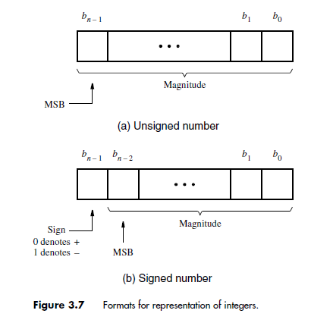
Signed arithmetic
What about negative numbers?
Sign magnitude representation
The most-significant bit (MSB) is zero for positive numbers and 1 for negative numbers
The remaining bits indicate the magnitude

Slide 8
Example
Write down the numbers 2 and -7 using 6-bit SMR representation.
2 = 000010
-7 = 100111
What is the minimum number of bits needed to represent all integers in range [-7,7]?
You need 4 bits!

Slide 9
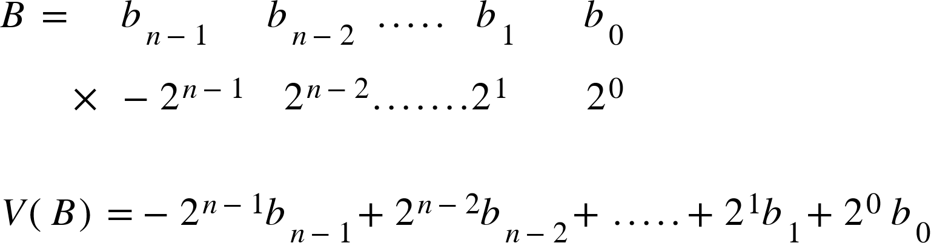
2s complement representation
The SMR representation is super inefficient for arithmetic operations. Instead the 2s complement representation is very commonly used in modern computer systems.
MSB multiplied
By negative number!

Slide 10
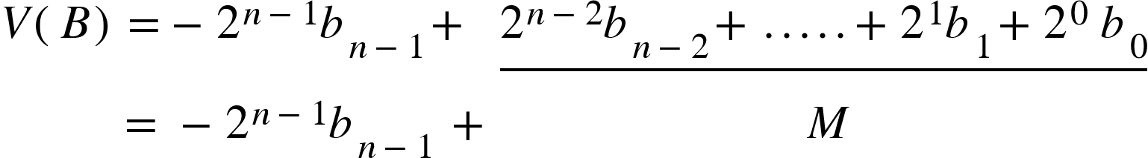
Interpreting 2s complement
The SMR representation is super inefficient for arithmetic operations. Instead the 2s complement representation is very commonly used in modern computer systems.
If MSB (sign bit) is zero, V(B) = M
If MSB (sign bit) is 1, V(B) = -[2^(n-1)-M]

Slide 11
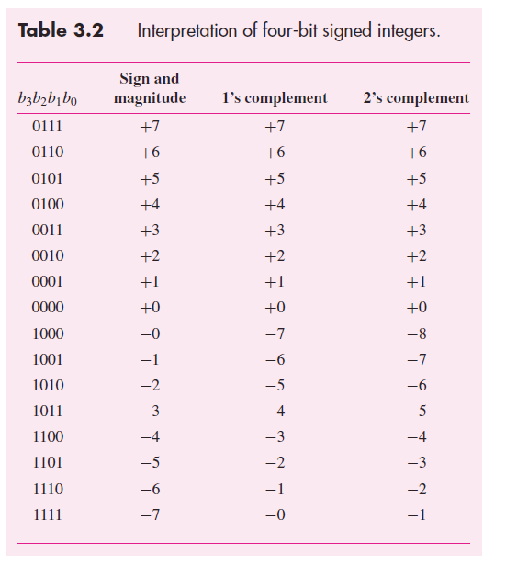
Interpretation of signed numbers

Slide 12
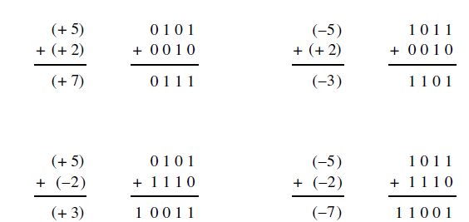
Additions using twos complement
Add the two numbers as if they were regular unsigned values and ignore carry-out bit from the MSB. What do you observe?
Adding two numbers in 2s complement format yields the result also in 2s complement format (if we ignore carry-outs from MSBs)!

Slide 13
Dealing with Overflows
Say we want to add -8 + -7. These can be represented as 4-bit 2s complement numbers. BUT, the result -15 cannot be represented in 4-bits. We call this an “overflow”
How can we detect that overflow has occurred?
Overflow can only occur when adding two positive numbers or two negative numbers.
If the sign of the result is incorrect, then an overflow has occurred!

Slide 14
Overflow Example
+1
1 0 0 0 = -8
1 0 0 1 = -7
-----------------------
1 0 0 0 1 = 1 (??!)
I added two negative numbers and got a positive result. What happened here? OVERFLOW!

Slide 15
Overflow Example
+1 +1
0 1 1 1 = 7
0 0 1 0 = 2
-----------------------
1 0 0 1 = -7
I added two positive numbers and got a negative result. What happened here? OVERFLOW!

