Slide 1
Unit 3 Floating and Fixed Point Numbers
EL-GY 9463: Introduction to Hardware Design
ProfS. Sundeep Rangan, Siddharth Garg

Slide 2
Today’s Lecture
The world is continuous and infinite, but computers are finite
How do we represent numeric values in a finite numbers of bits?
More generally, how can values be compressed?
What representations are computationally simple?
What representations result in good computational approximations?

Slide 3
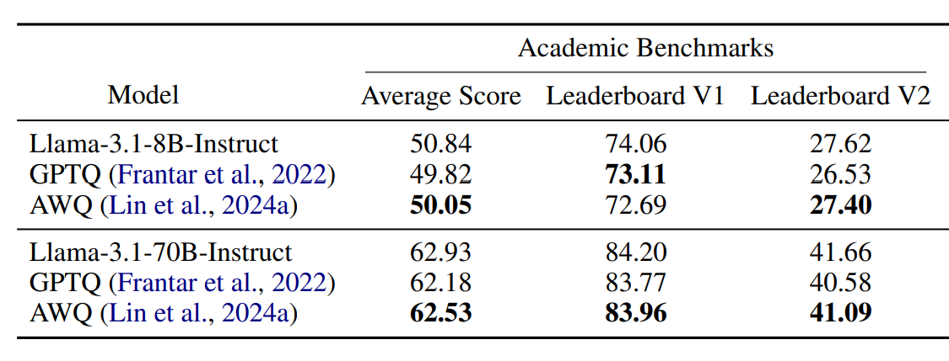

Example 1: Embedded LLMs
Full LLMs require massive amounts of memory
Cannot work on embedded devices
Quantization
Aggressive reduction in number of bits / parameter
Ex: INT4 vs. FP32
New techniques have enabled very low footprint
Often 1 to 1.5 GB
Fits on commercial smartphones
Performance often remains excellent
With judicious choice of approximation techniques
Kurtic, Eldar, et al. "“Give Me BF16 or Give Me Death”? Accuracy-Performance Trade-Offs in LLM Quantization." Proceedings of the 63rd Annual Meeting of the Association for Computational Linguistics (Volume 1: Long Papers). 2025.

Slide 4
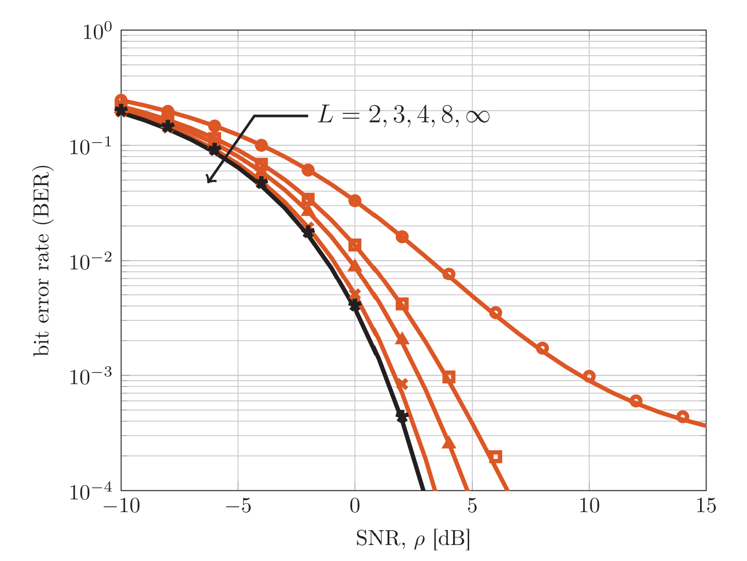
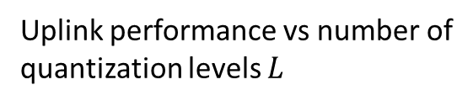
Example 2: Next-Generation Wireless
Massive MIMO systems in cellular base stations
100s – 1000s of antennas
Each antenna gets data at ~1 Gsamp/s
Data rate and processing is overwhelming
Very low-rate quantization has been key
2- 4 bits per antenna
Uplink performance vs number of quantization levels $L$
Jacobsson, S., Durisi, G., Coldrey, M., Gustavsson, U., & Studer, C. (2017). Throughput analysis of massive MIMO uplink with low-resolution ADCs. IEEE Transactions on Wireless Communications, 16(6), 4038-4051.

Slide 5

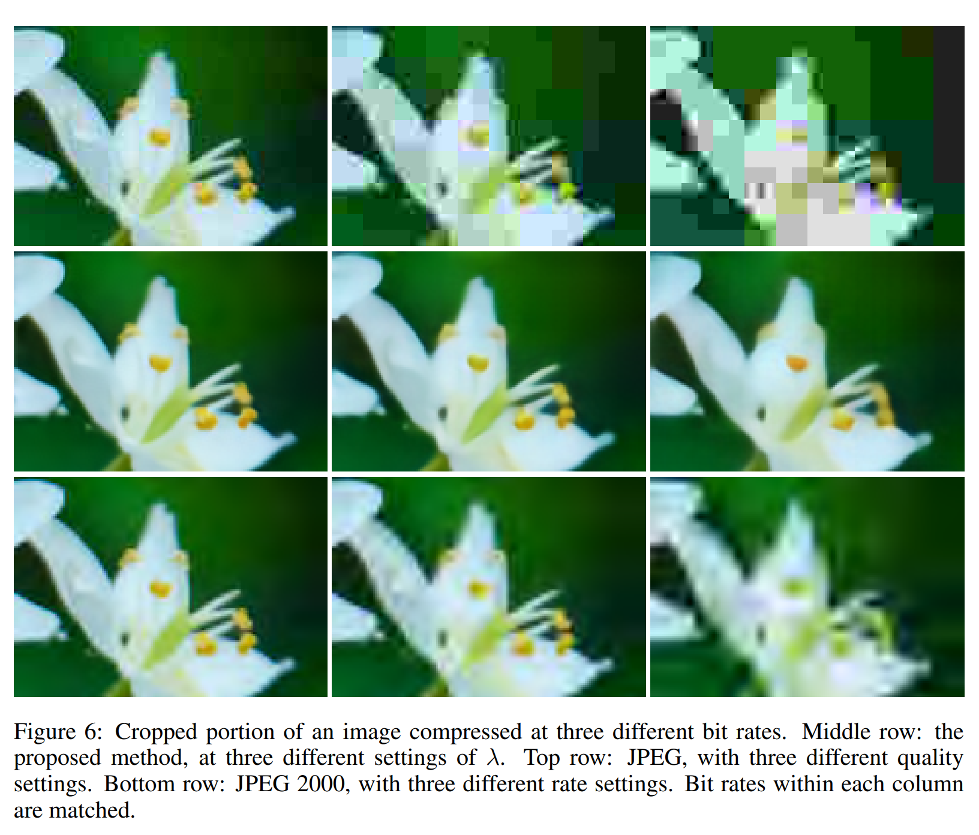
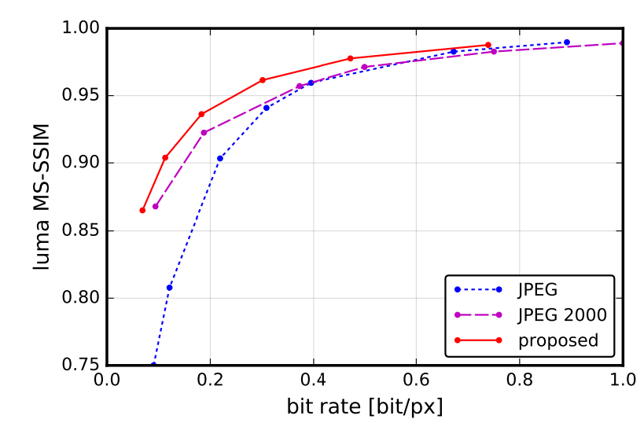
Compression Research at NYU
Ballé, J., Laparra, V., & Simoncelli, E. P. (2016). End-to-end optimized image compression. arXiv preprint arXiv:1611.01704.
ML techniques at the forefront for learning new compression
NYU has several leading researchers in the area
Jona Balle, NYU

Slide 6
Learning Objectives
Represent numbers in floating point and fixed point
Implement arithmetic operations efficiently in these formats
Identify cases for overflow
Evaluate approximation errors via simulation
Optimally select scaling factors and parameters for the formats
Convert floating point algorithms to fixed point

Slide 7
Outline
Floating Point Numbers
Fixed Point Numbers
Optimal Scaling of Fix Point Numbers
Converting Floating Point Algorithms to Fixed Point

Slide 8
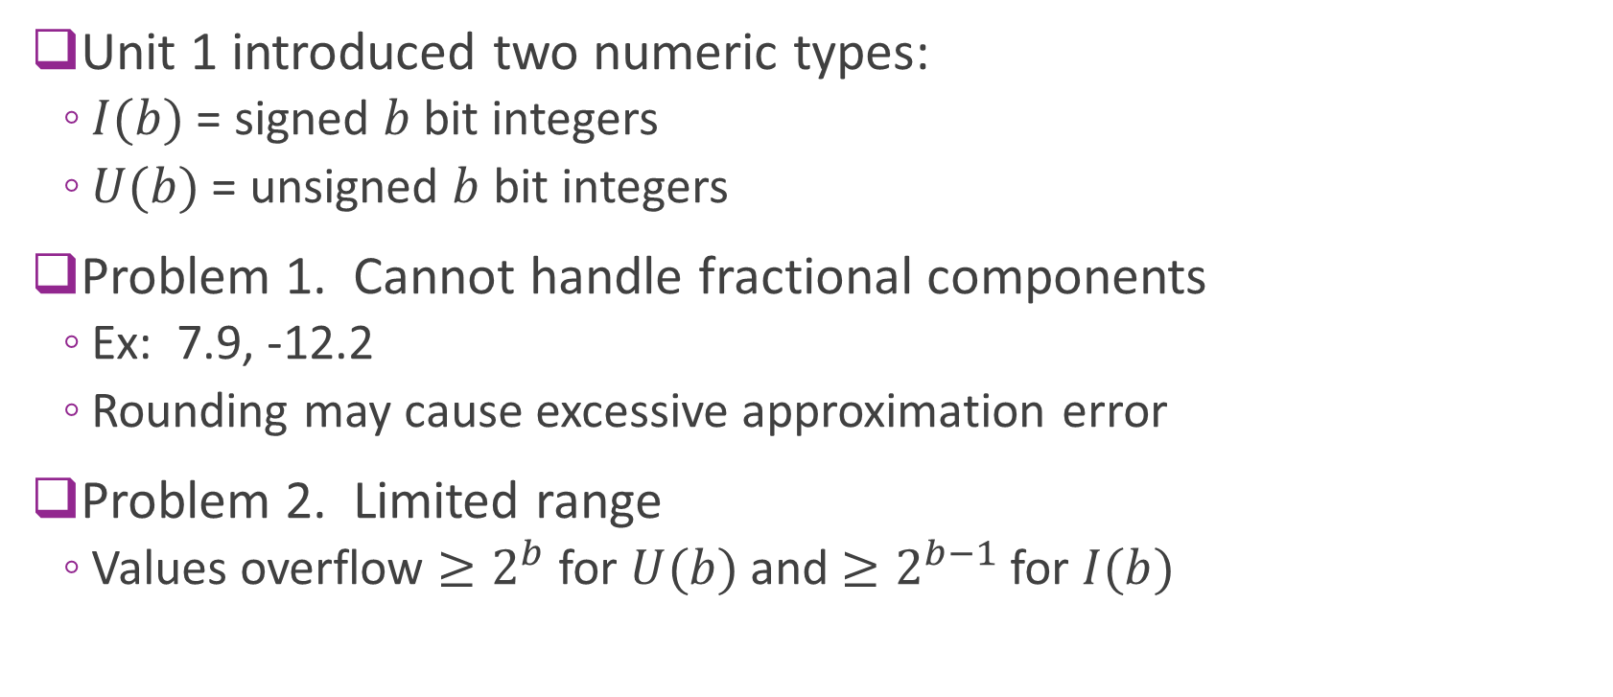
Limitations of Integers
Unit 1 introduced two numeric types:
$I(b)$ = signed $b$ bit integers
$U(b)$ = unsigned $b$ bit integers
Problem 1. Cannot handle fractional components
Ex: 7.9, -12.2
Rounding may cause excessive approximation error
Problem 2. Limited range
Values overflow $≥2^{b}$ for $U(b)$ and $≥2^{b−1}$ for $I(b)$

Slide 9

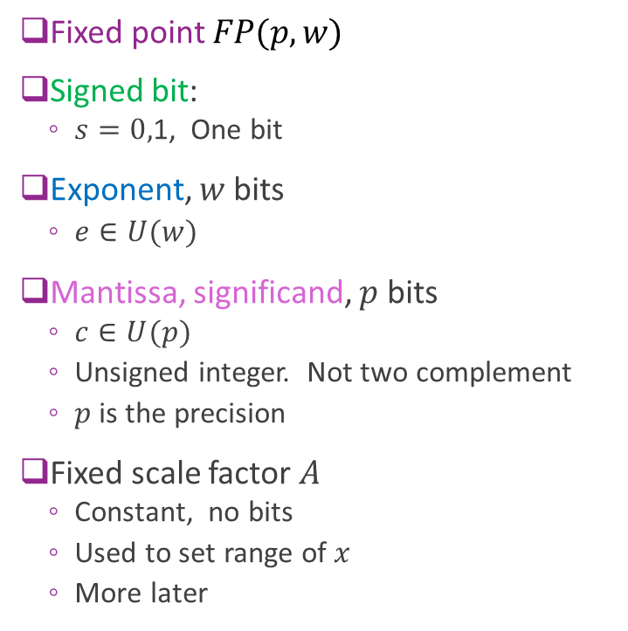
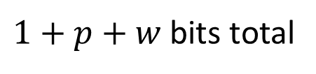


Simple Floating Point
Fixed point $FP(p,w)$
Signed bit:
$s=0,$1, One bit
Exponent, $w$ bits
$e∈U(w)$
Mantissa, significand, $p$ bits
$c∈U(p)$
Unsigned integer. Not two complement
$p$ is the precision
Fixed scale factor $A$
Constant, no bits
Used to set range of $x$
More later
$x=A{\left(−1\right)}^{s} 2^{e}$ $c$
Bits=
1
$$w$$
$$p$$
$1+p+w$ bits total

Slide 10
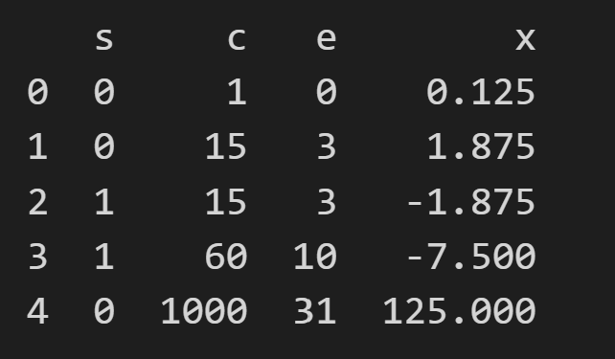
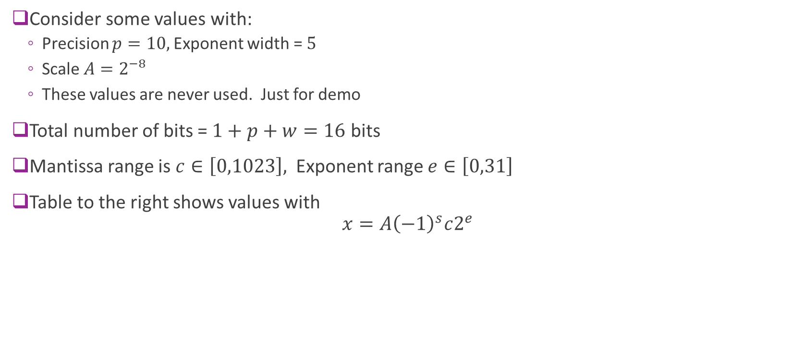
Example
Consider some values with:
Precision $p=10,$Exponent width = $5$
Scale $A=2^{−8}$
These values are never used. Just for demo
Total number of bits = $1+p+w=16$ bits
Mantissa range is $c∈\left[0,1023\right],$ Exponent range $e∈\left[0,31\right]$
Table to the right shows values with $x=A{\left(−1\right)}^{s}c2^{e}$

Slide 11
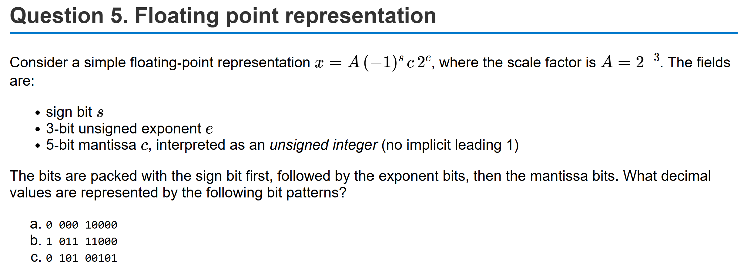
Example Problem

Slide 12
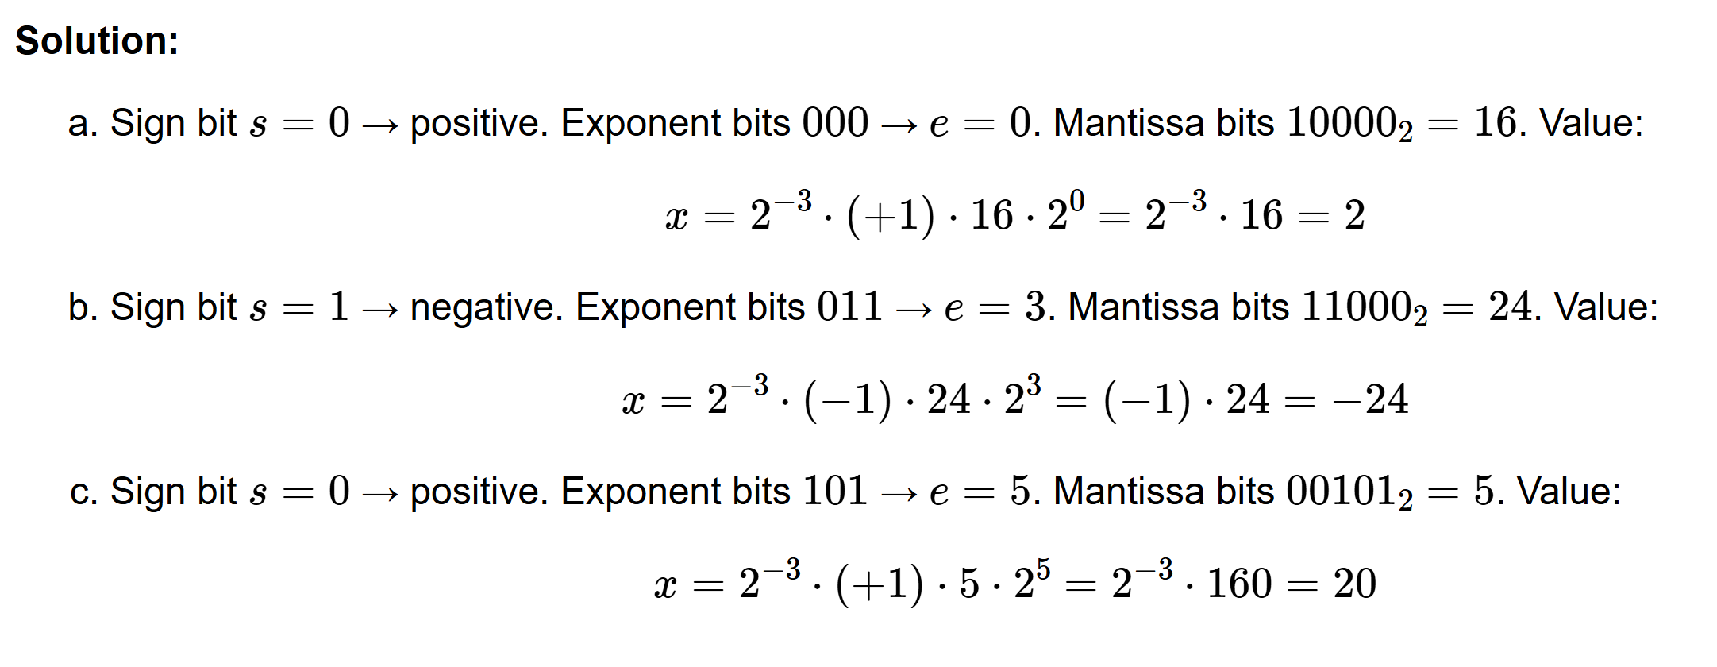
Solution

Slide 13
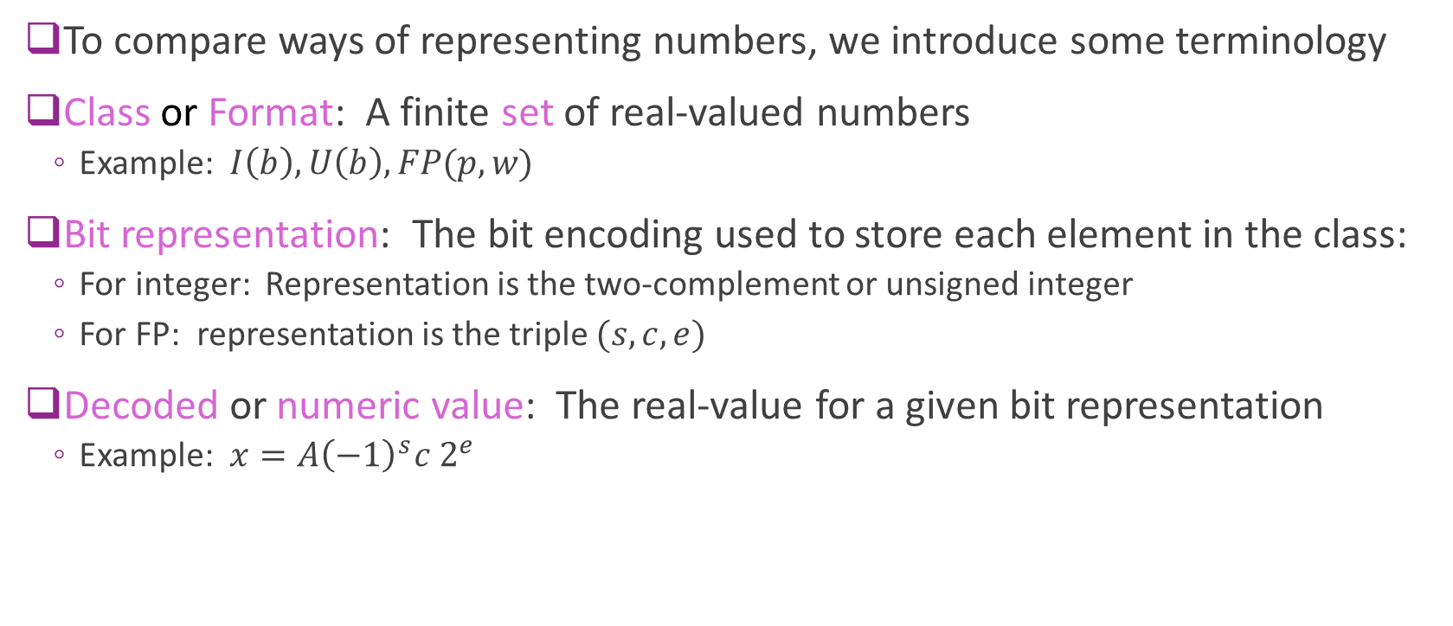
Terminology
To compare ways of representing numbers, we introduce some terminology
Class or Format: A finite set of real-valued numbers
Example: $I\left(b\right), U\left(b\right), FP(p,w)$
Bit representation: The bit encoding used to store each element in the class:
For integer: Representation is the two-complement or unsigned integer
For FP: representation is the triple $(s, c, e)$
Decoded or numeric value: The real-value for a given bit representation
Example: $x=A{\left(−1\right)}^{s}c 2^{e}$

Slide 14
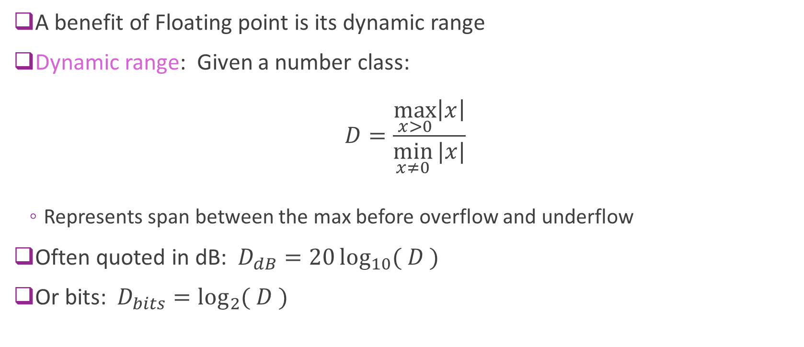
Dynamic Range
A benefit of Floating point is its dynamic range
Dynamic range: Given a number class: $D=\frac{\max_{x>0}\left|x\right|}{\min_{x≠0}{|x|}}$
Represents span between the max before overflow and underflow
Often quoted in dB: $D_{dB}=20\log_{10}{( D )}$
Or bits: $D_{bits}=\log_{2}{( D )}$

Slide 15
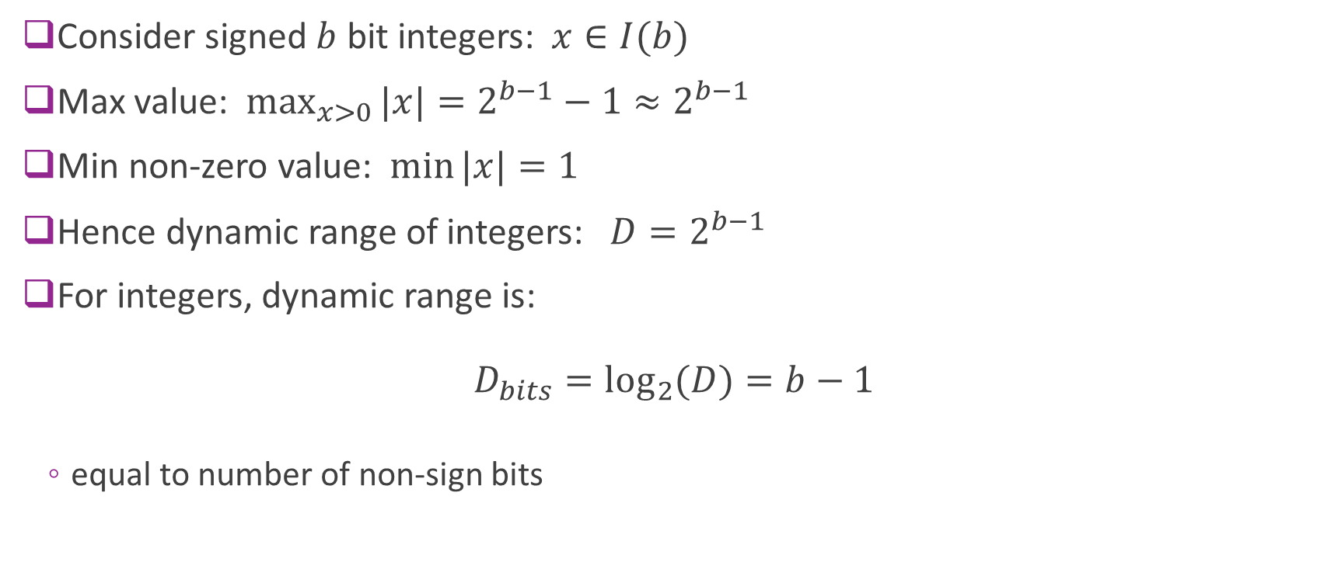
Dynamic Range of Integers
Consider signed $b$ bit integers: $x∈I(b)$
Max value: $\max_{x>0}{|x|}=2^{b−1}−1≈2^{b−1}$
Min non-zero value: $\min{|x|}=1$
Hence dynamic range of integers: $D=2^{b−1}$
For integers, dynamic range is: $D_{bits}=\log_{2}{(D)}=b−1$
equal to number of non-sign bits

Slide 16
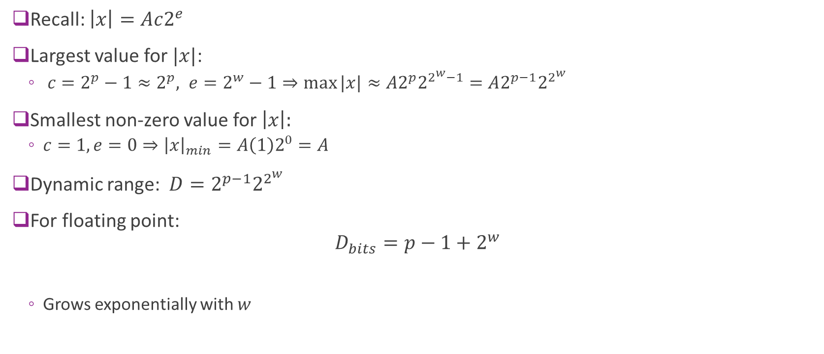
Floating-Point Dynamic Range
Recall: $\left|x\right|=Ac2^{e}$
Largest value for $|x|$:
$c=2^{p}−1≈2^{p}, e=2^{w}−1⇒\max{|x|}≈A2^{p}2^{2^{w}−1}=A2^{p−1}2^{2^{w}}$
Smallest non-zero value for $\left|x\right|:$
$c=1, e=0⇒{\left|x\right|}_{min}=A\left(1\right)2^{0}=A$
Dynamic range: $D=2^{p−1}2^{2^{w}}$
For floating point: $D_{bits}=p−1+2^{w}$
Grows exponentially with $w$

Slide 17
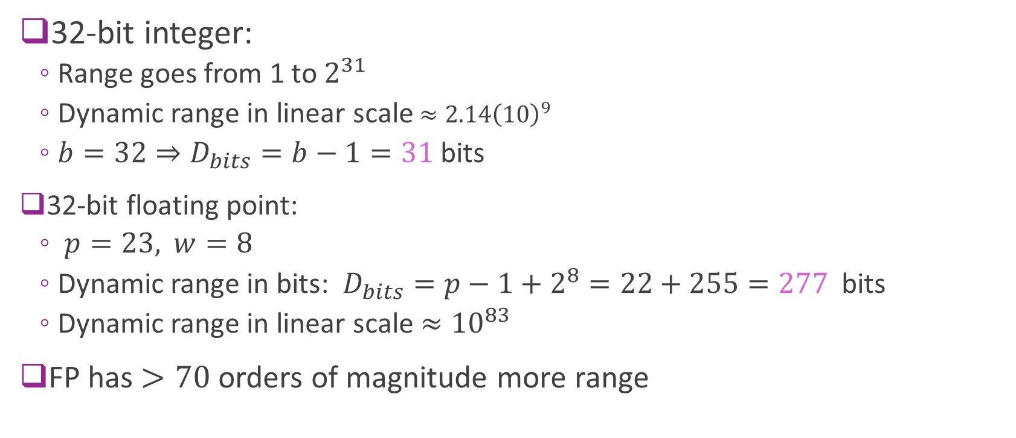
Example Comparison
32-bit integer:
Range goes from 1 to $2^{31}$
Dynamic range in linear scale $≈{2.14\left(10\right)}^{9}$
$b=32⇒D_{bits}=b−1=31$ bits
32-bit floating point:
$p=23,$ $w=8$
Dynamic range in bits: $D_{bits}=p−1+2^{8}=22+255=277$ bits
Dynamic range in linear scale $≈{10}^{83}$
FP has $>70$ orders of magnitude more range

Slide 18
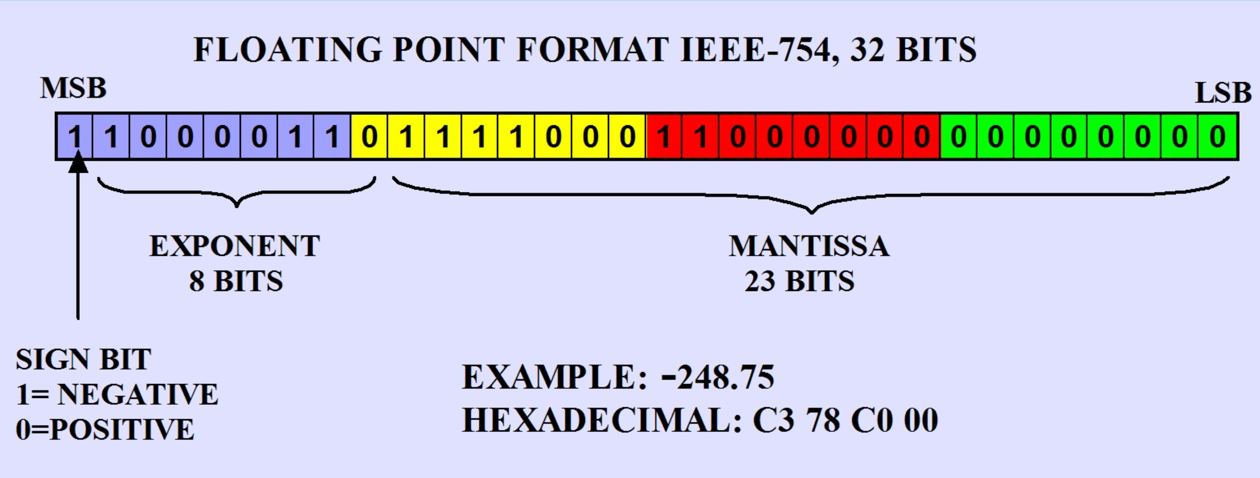
IEEE-754 Floating Point Standard
Format | Mantissa bits (stored) | Significand precision (with implicit 1) | Exponent bits
FP16 (half) | 10 | 11 | 5
FP32 (single) | 23 | 24 | 8
FP64 (double) | 52 | 53 | 11

Slide 19
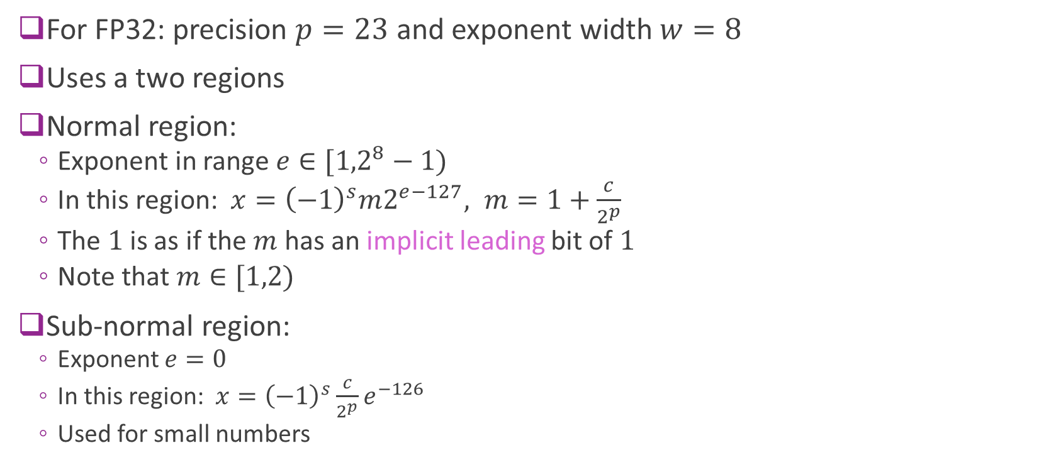
IEEE 754 Normal and Sub-Normal
For FP32: precision $p=23$ and exponent width $w=8$
Uses a two regions
Normal region:
Exponent in range $e∈[{1,2}^{8}−1)$
In this region: $x={\left(−1\right)}^{s}m2^{e−127}, m=1+\frac{c}{2^{p}}$
The $1$is as if the $m$ has an implicit leading bit of $1$
Note that $m∈[1,2)$
Sub-normal region:
Exponent $e=0$
In this region: $x={\left(−1\right)}^{s}\frac{c}{2^{p}}e^{−126}$
Used for small numbers

Slide 20

IEEE 754 Properties
Single precision (FP32):
Largest normal $≈3.4{\left(10\right)}^{38}$
Smallest normal $≈1.18{\left(10\right)}^{−38}$
Smallest sub-normal $≈{\left(10\right)}^{−45}$
Vastly greater range than 32-bit integers
Double precision (FP64):
Largest normal $≈1.80{\left(10\right)}^{308}$
Smallest normal $≈2.23{\left(10\right)}^{−308}$
Smallest sub-normal $≈{5\left(10\right)}^{−324}$

Slide 21
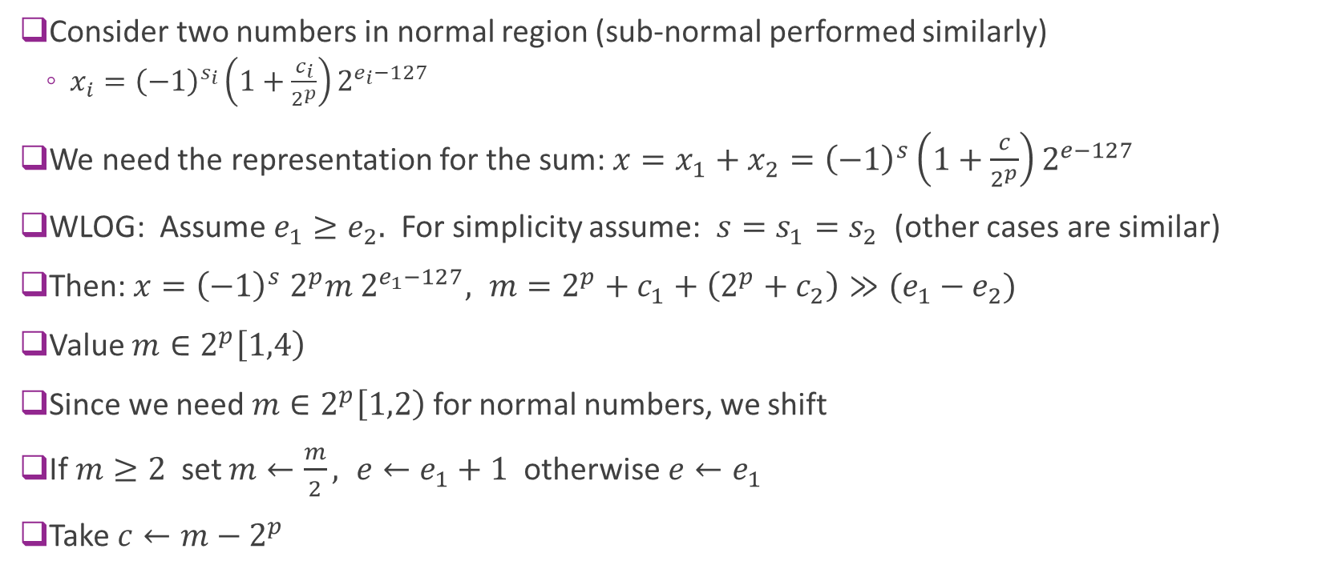
Floating Point Addition
Consider two numbers in normal region (sub-normal performed similarly)
$x_{i}={\left(−1\right)}^{s_{i}}\left(1+\frac{c_{i}}{2^{p}}\right)2^{e_{i}−127}$
We need the representation for the sum: $x=x_{1}+x_{2}={\left(−1\right)}^{s}\left(1+\frac{c}{2^{p}}\right)2^{e−127}$
WLOG: Assume $e_{1}≥e_{2}.$ For simplicity assume: $s=s_{1}=s_{2}$ (other cases are similar)
Then: $x={\left(−1\right)}^{s} 2^{p}m 2^{e_{1}−127}, m=2^{p}+c_{1}+\left(2^{p}+c_{2}\right)≫(e_{1}−e_{2})$
Value $m∈2^{p}\left[1,4\right)$
Since we need $m∈2^{p}\left[1,2\right)$ for normal numbers, we shift
If $m≥2$ set $m←\frac{m}{2}, e←e_{1}+1$ otherwise $e←e_{1}$
Take $c←m−2^{p}$

Slide 22
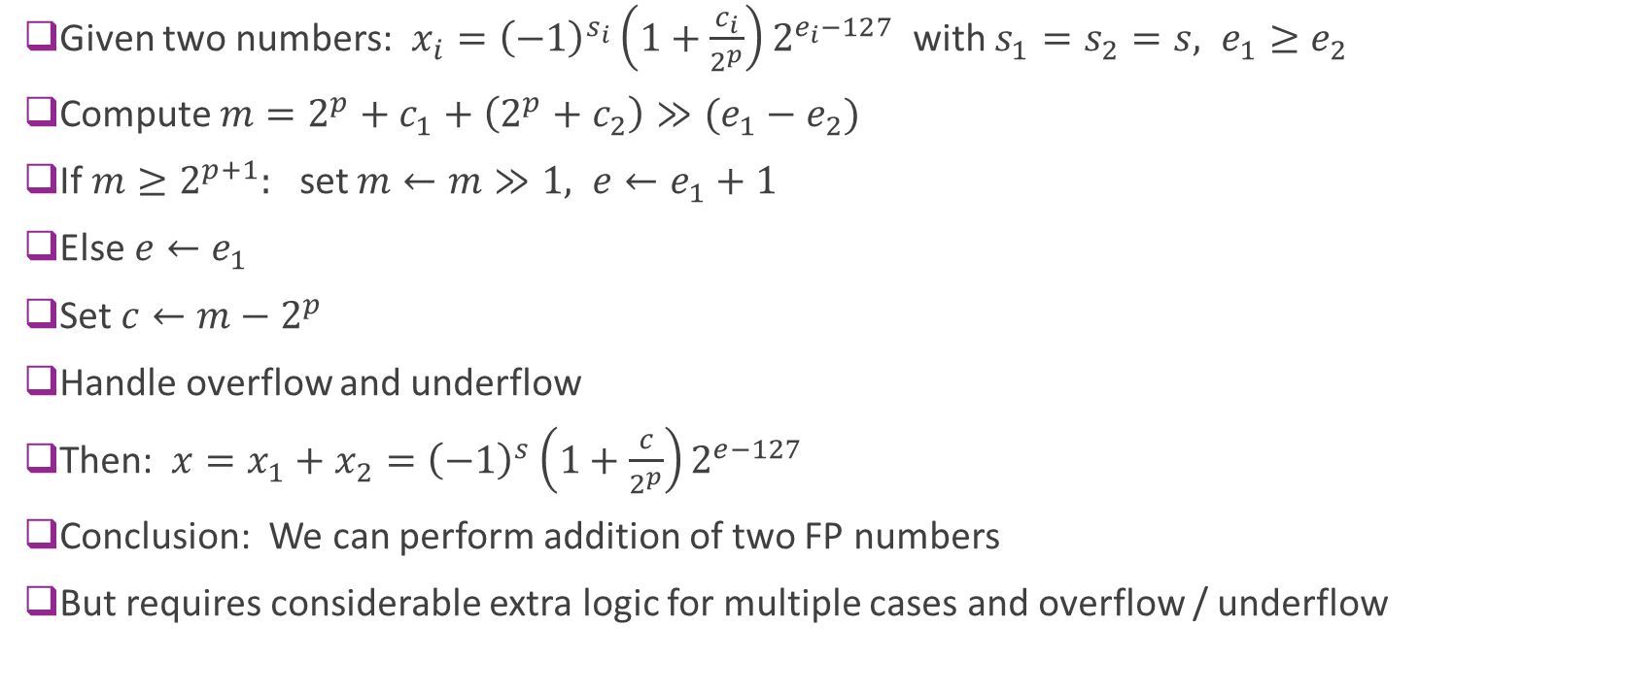
Resulting Algorithm
Given two numbers: $x_{i}={\left(−1\right)}^{s_{i}}\left(1+\frac{c_{i}}{2^{p}}\right)2^{e_{i}−127}$ with $s_{1}=s_{2}=s, e_{1}≥e_{2}$
Compute $m=2^{p}+c_{1}+\left(2^{p}+c_{2}\right)≫(e_{1}−e_{2})$
If $m≥2^{p+1}:$ set $m←m≫1, e←e_{1}+1$
Else $e←e_{1}$
Set $c←m−2^{p}$
Handle overflow and underflow
Then: $x=x_{1}+x_{2}={\left(−1\right)}^{s}\left(1+\frac{c}{2^{p}}\right)2^{e−127}$
Conclusion: We can perform addition of two FP numbers
But requires considerable extra logic for multiple cases and overflow / underflow

Slide 23
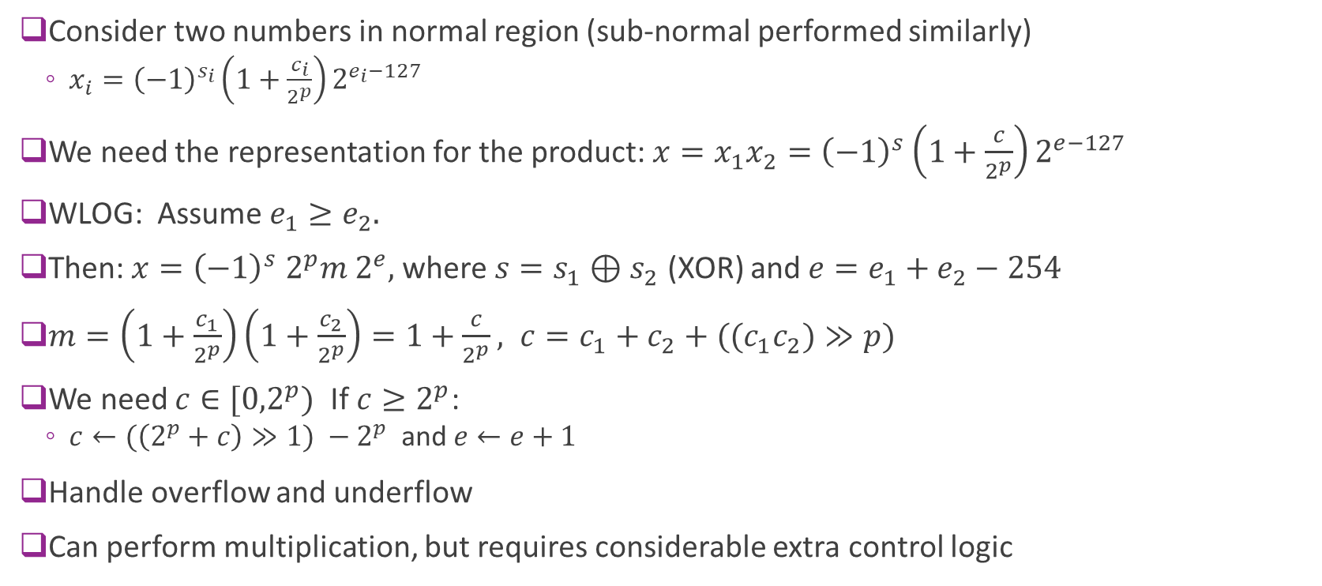
Floating Point Multiplication
Consider two numbers in normal region (sub-normal performed similarly)
$x_{i}={\left(−1\right)}^{s_{i}}\left(1+\frac{c_{i}}{2^{p}}\right)2^{e_{i}−127}$
We need the representation for the product: $x=x_{1}x_{2}={\left(−1\right)}^{s}\left(1+\frac{c}{2^{p}}\right)2^{e−127}$
WLOG: Assume $e_{1}≥e_{2}.$
Then: $x={\left(−1\right)}^{s} 2^{p}m 2^{e},$where $s=s_{1}⊕s_{2}$ (XOR) and $e=e_{1}+e_{2}−254$
$m=\left(1+\frac{c_{1}}{2^{p}}\right)\left(1+\frac{c_{2}}{2^{p}}\right)=1+\frac{c}{2^{p}}, c=c_{1}+c_{2}+((c_{1}c_{2})≫p)$
We need $c∈[{0,2}^{p})$ If $c≥2^{p}$:
$c←(\left(2^{p}+c\right)≫1) −2^{p}$ and $e←e+1$
Handle overflow and underflow
Can perform multiplication, but requires considerable extra control logic

Slide 24
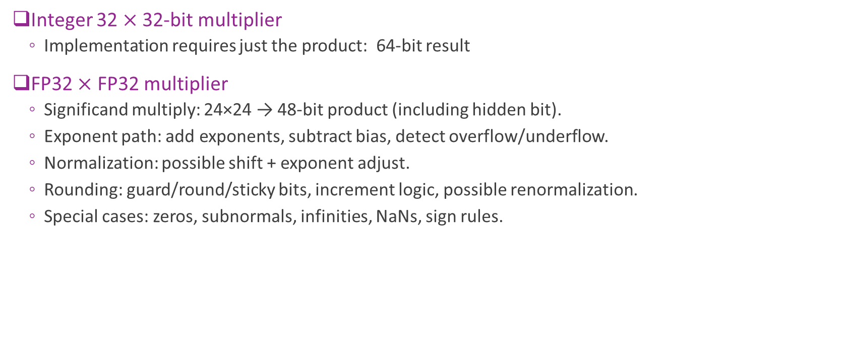
Comparison
Integer 32 $×$ 32-bit multiplier
Implementation requires just the product: 64-bit result
FP32 $×$ FP32 multiplier
Significand multiply: 24×24 → 48‑bit product (including hidden bit).
Exponent path: add exponents, subtract bias, detect overflow/underflow.
Normalization: possible shift + exponent adjust.
Rounding: guard/round/sticky bits, increment logic, possible renormalization.
Special cases: zeros, subnormals, infinities, NaNs, sign rules.
FP multiplication typically takes 2 to 4 $×$ complexity

Slide 25
Outline
Floating Point Numbers
Fixed Point Numbers
Optimal Scaling of FixP Numbers
Converting Floating Point Algorithms to Fixed Point

Slide 26
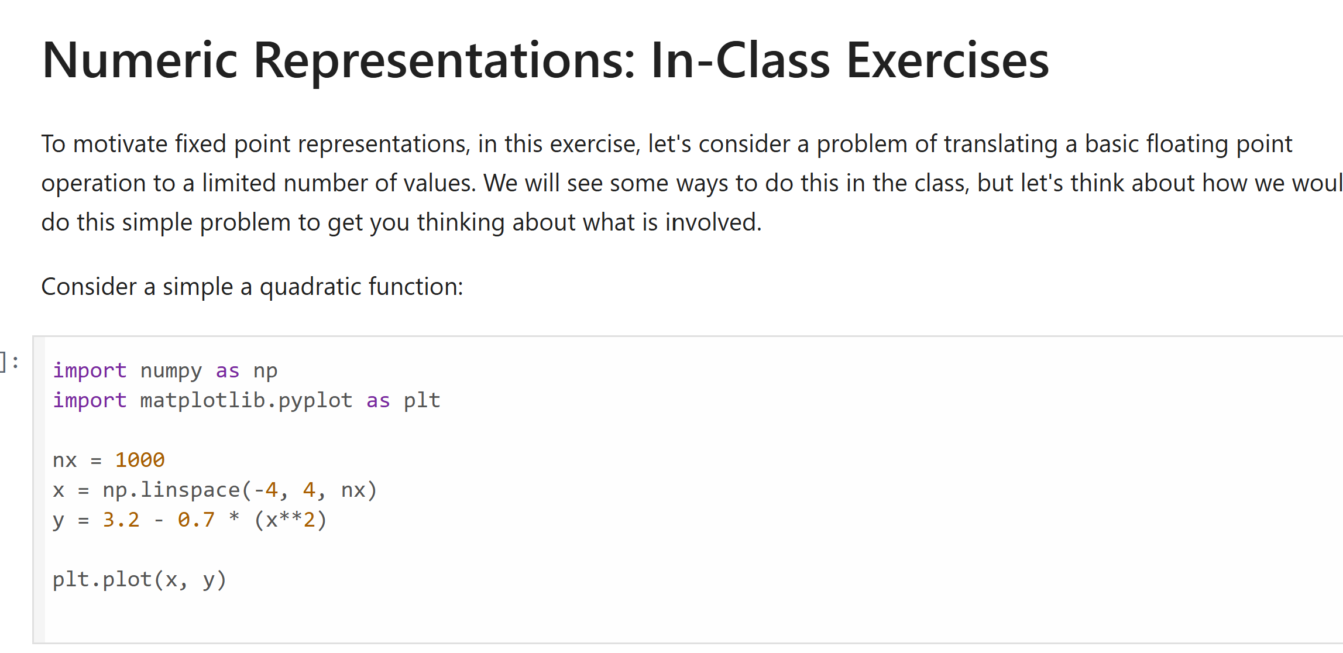
Motivating In-Class Exercise
Try the following jupyter notebook

Slide 27
Integers vs. Floating Point
Integers:
Pro: Easy arithmetic. No extra bits for exponent
Cons: Do not natively handle fractional components.
Cons: Limited dynamic range
Floating point:
Pro: Large dynamic range, handles fractional components
Cons: Arithmetic is harder, some loss of precision to store exponent
Is there a way to handle fractions without increased computation overhead?

Slide 28
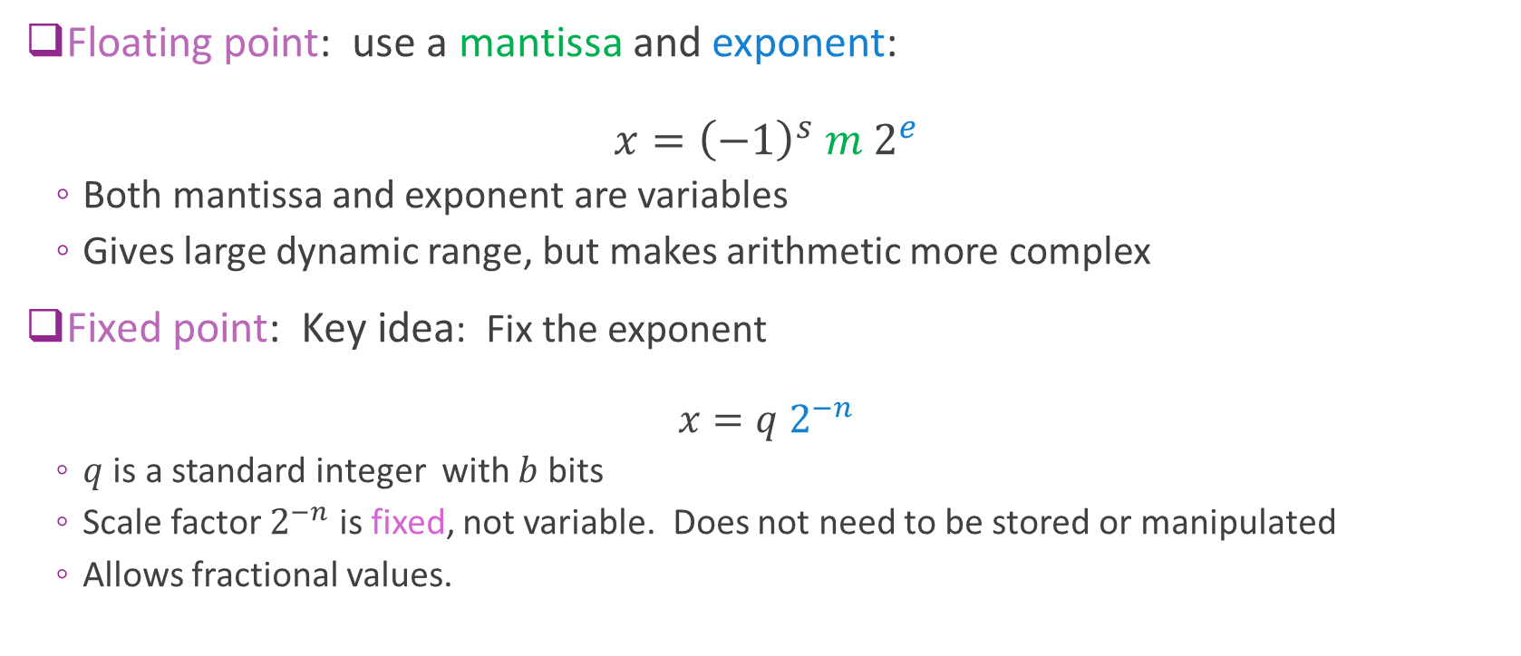
Fixed Point
Floating point: use a mantissa and exponent: $x={\left(−1\right)}^{s} m 2^{e}$
Both mantissa and exponent are variables
Gives large dynamic range, but makes arithmetic more complex
Fixed point: Key idea: Fix the exponent $x=q 2^{−n}$
$q$ is a standard integer with $b$ bits
Scale factor $2^{−n}$ is fixed, not variable. Does not need to be stored or manipulated
Allows fractional values.

Slide 29
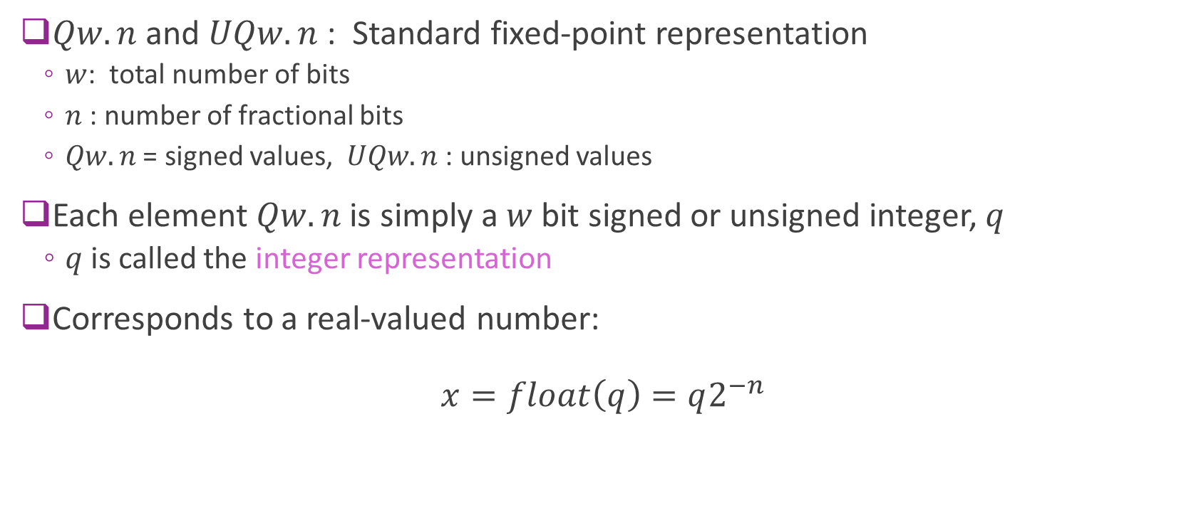
Fixed Point Q Notation
$Qw.n$ and $UQw.n$ : Standard fixed-point representation
$w$: total number of bits
$n$ : number of fractional bits
$Qw.n$ = signed values, $UQw.n$: unsigned values
Each element $Qw.n$ is simply a $w$ bit signed or unsigned integer, $q$
$q$ is called the integer representation
Corresponds to a real-valued number: $x=float\left(q\right)=q2^{−n}$

Slide 30
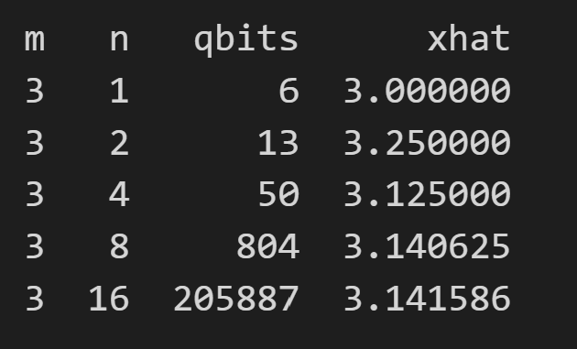
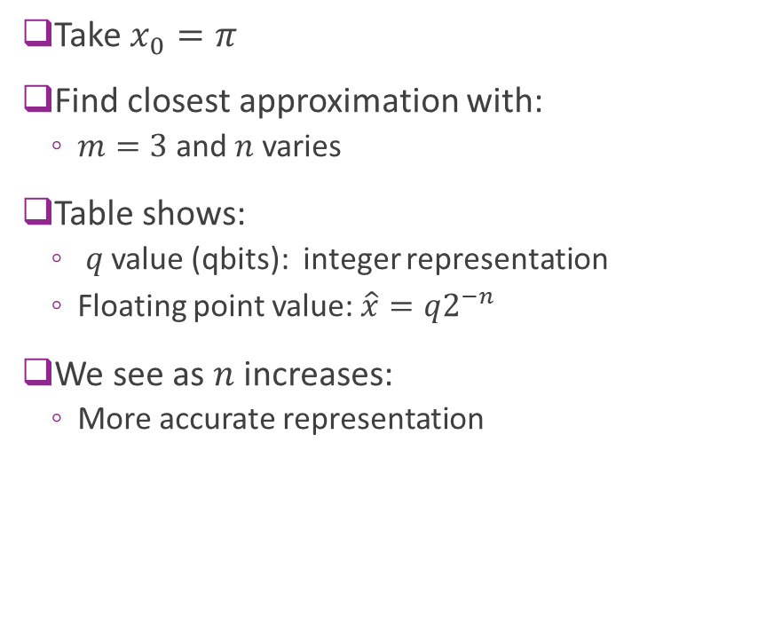
Examples
Take $x_{0}=π$
Find closest approximation with:
$m=3$ and $n$ varies
Table shows:
$q$ value (qbits): integer representation
Floating point value: $\hat{x}=q2^{−n}$
We see as $n$ increases:
More accurate representation

Slide 31
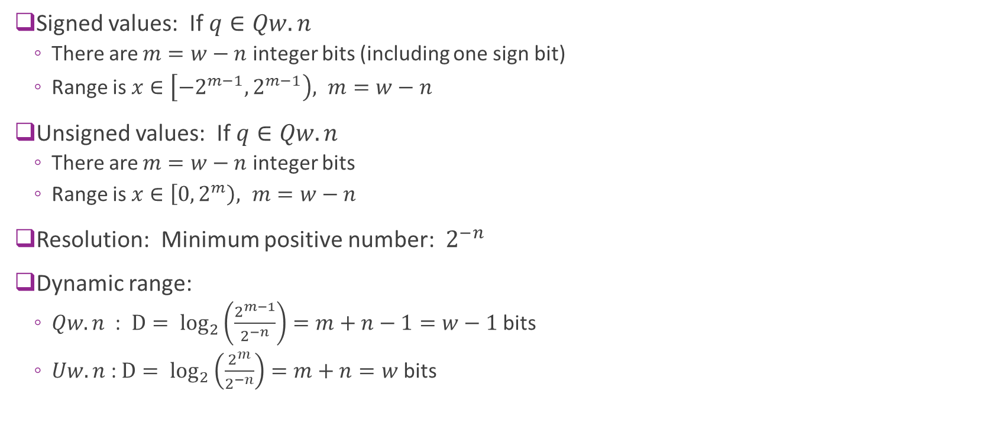
Properties
Signed values: If $q∈Qw.n$
There are $m=w−n$ integer bits (including one sign bit)
Range is $x∈\left[−2^{m−1},2^{m−1}\right), m=w−n$
Unsigned values: If $q∈Qw.n$
There are $m=w−n$ integer bits
Range is $x∈\left[0,2^{m}\right), m=w−n$
Resolution: Minimum positive number: $2^{−n}$
Dynamic range:
$Qw.n$ : $D= \log_{2}\left(\frac{2^{m−1}}{2^{−n}}\right)=m+n−1=w−1$ bits
$Uw.n$ : $D= \log_{2}\left(\frac{2^{m}}{2^{−n}}\right)=m+n=w$ bits

Slide 32
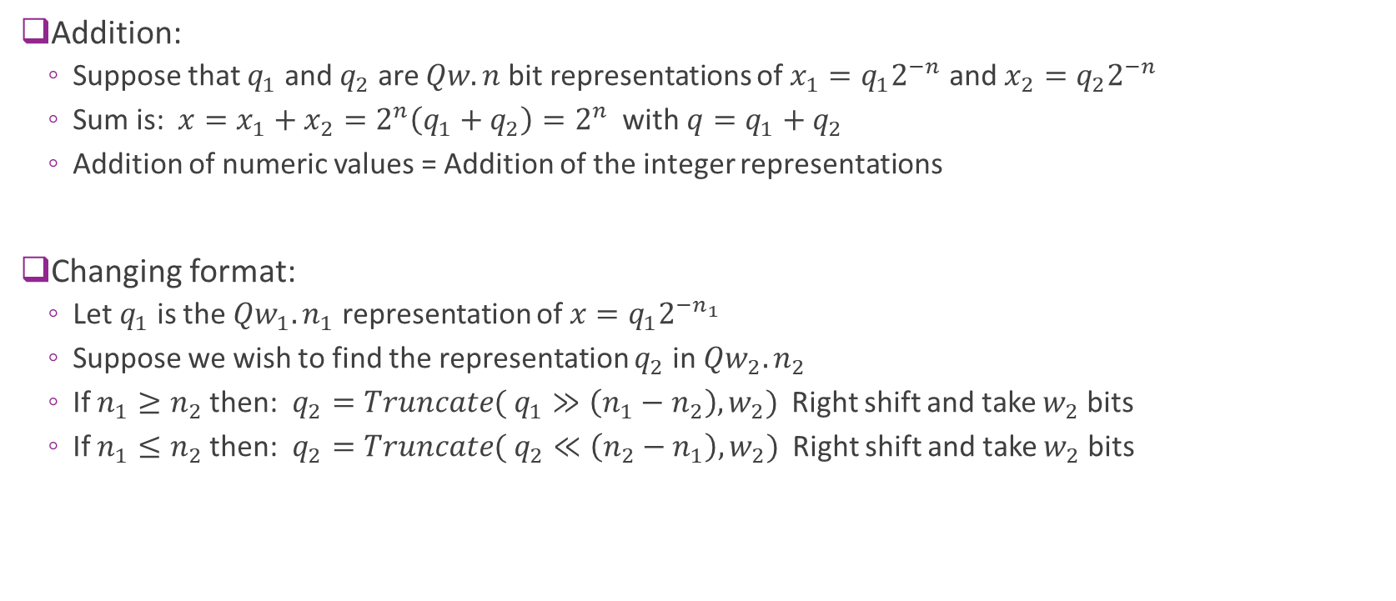
Addition and Type Casting Operations
Addition:
Suppose that $q_{1}$ and $q_{2}$ are $Qw.n$ bit representations of $x_{1}=q_{1}2^{−n}$ and $x_{2}=q_{2}2^{−n}$
Sum is: $x=x_{1}+x_{2}=2^{n}\left(q_{1}+q_{2}\right)=2^{n}$ with $q=q_{1}+q_{2}$
Addition of numeric values = Addition of the integer representations
Changing format:
Let $q_{1}$ is the $Qw_{1}.n_{1}$ representation of $x=q_{1}2^{−n_{1}}$
Suppose we wish to find the representation $q_{2}$ in $Qw_{2}.n_{2}$
If $n_{1}≥n_{2}$ then: $q_{2}=Truncate( q_{1}≫\left(n_{1}−n_{2}\right), w_{2})$ Right shift and take $w_{2}$ bits
If $n_{1}≤n_{2}$ then: $q_{2}=Truncate( q_{2}≪\left(n_{2}−n_{1}\right), w_{2})$ Right shift and take $w_{2}$ bits

Slide 33
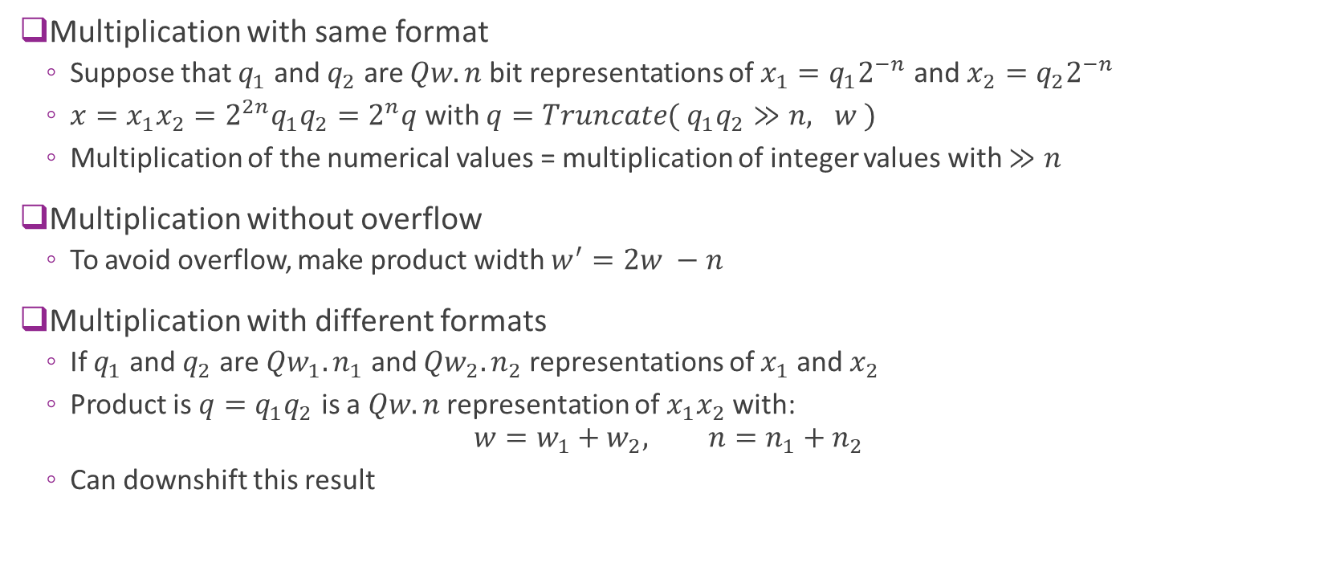
Multiplication
Multiplication with same format
Suppose that $q_{1}$ and $q_{2}$ are $Qw.n$ bit representations of $x_{1}=q_{1}2^{−n}$ and $x_{2}=q_{2}2^{−n}$
$x=x_{1}x_{2}=2^{2n}q_{1}q_{2}=2^{n}q$ with $q=Truncate( q_{1}q_{2}≫n, w )$
Multiplication of the numerical values = multiplication of integer values with $≫n$
Multiplication without overflow
To avoid overflow, make product width $w^{′}=2w −n$
Multiplication with different formats
If $q_{1}$ and $q_{2}$ are $Qw_{1}.n_{1}$ and $Qw_{2}.n_{2}$ representations of $x_{1}$ and $x_{2}$
Product is $q=q_{1}q_{2}$ is a $Qw.n$ representation of $x_{1}x_{2}$ with: $w=w_{1}+w_{2}, n=n_{1}+n_{2}$
Can downshift this result

Slide 34
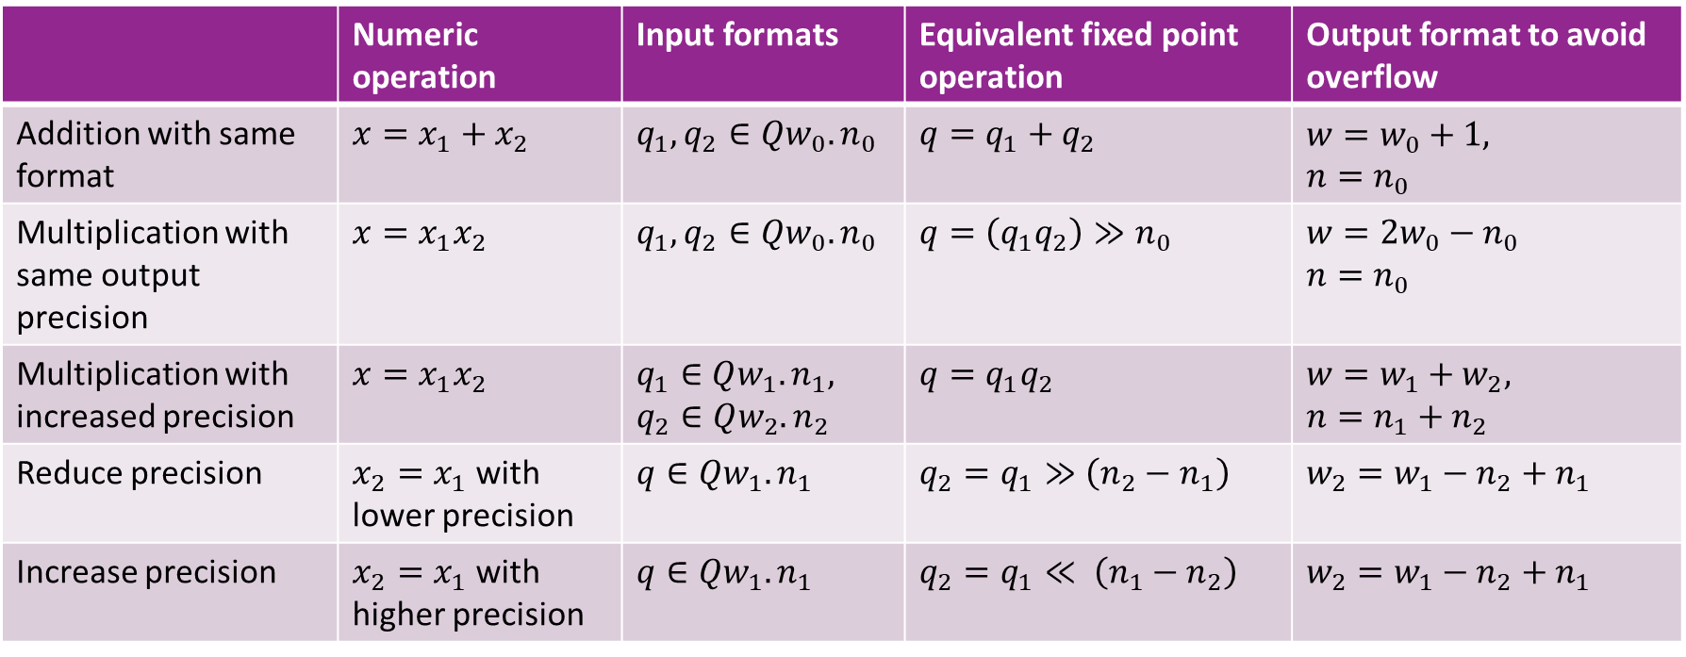
Summary
 | Numeric operation | Input formats | Equivalent fixed point operation | Output format to avoid overflow
Addition with same format | $x=x_{1}+x_{2}$ | $q_{1},q_{2}∈Qw_{0}.n_{0}$ | $q=q_{1}+q_{2}$ | $w=w_{0}+1,$ $n=n_{0}$
Multiplication with same output precision | $x=x_{1}x_{2}$ | $q_{1},q_{2}∈Qw_{0}.n_{0}$ | $q=\left(q_{1}q_{2}\right)≫n_{0}$ | $w=2w_{0}−n_{0}$ $n=n_{0}$
Multiplication with increased precision | $x=x_{1}x_{2}$ | $q_{1}∈Qw_{1}.n_{1},$ $q_{2}∈Qw_{2}.n_{2}$ | $q=q_{1}q_{2}$ | $w=w_{1}+w_{2},$ $n=n_{1}+n_{2}$
Reduce precision | $x_{2}=x_{1}$ with lower precision | $q∈Qw_{1}.n_{1}$ | $q_{2}=q_{1}≫\left(n_{2}−n_{1}\right)$ | $w_{2}=w_{1}−n_{2}+n_{1}$
Increase precision | $x_{2}=x_{1}$ with higher precision | $q∈Qw_{1}.n_{1}$ | $q_{2}=q_{1}≪ \left(n_{1}−n_{2}\right)$ | $w_{2}=w_{1}−n_{2}+n_{1}$

Slide 35
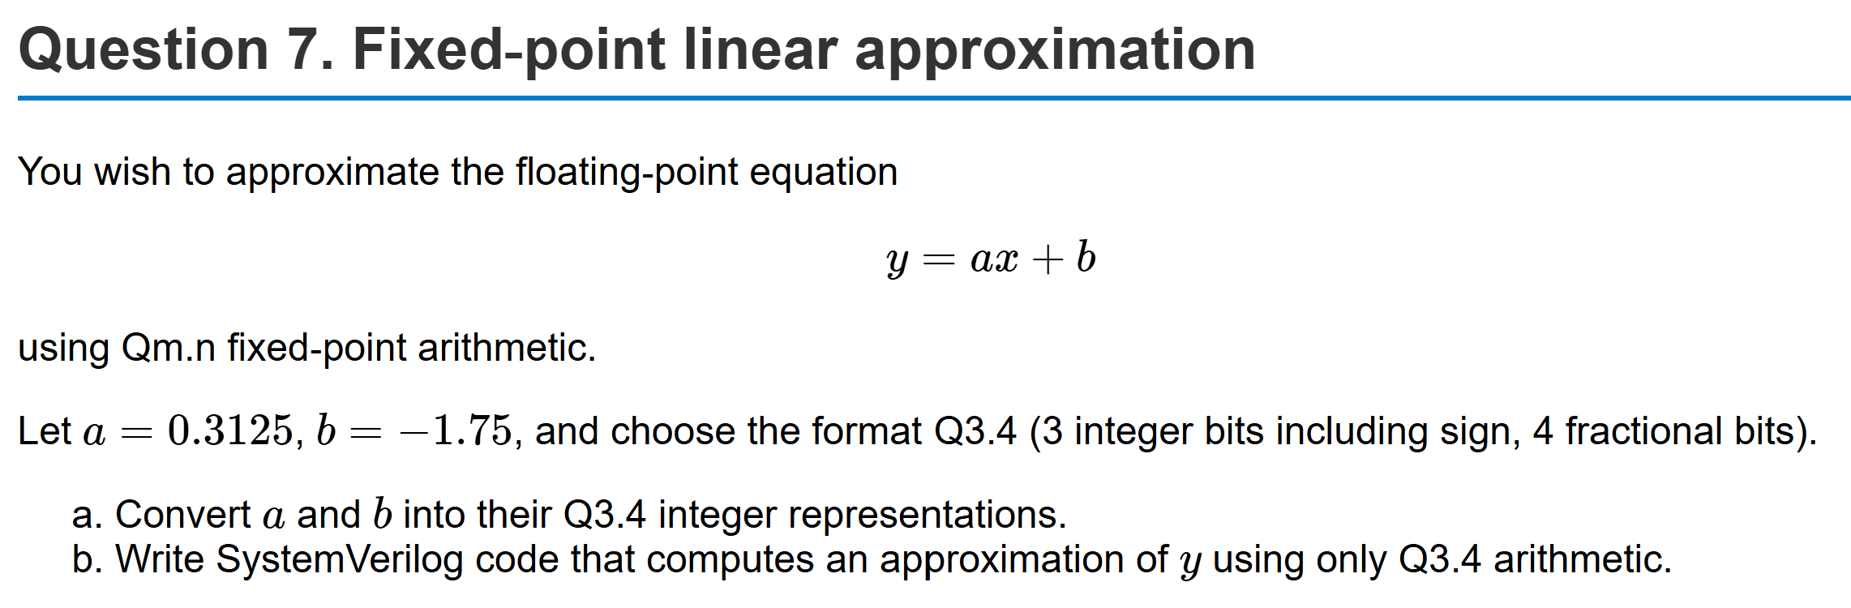
Example Problem

Slide 36
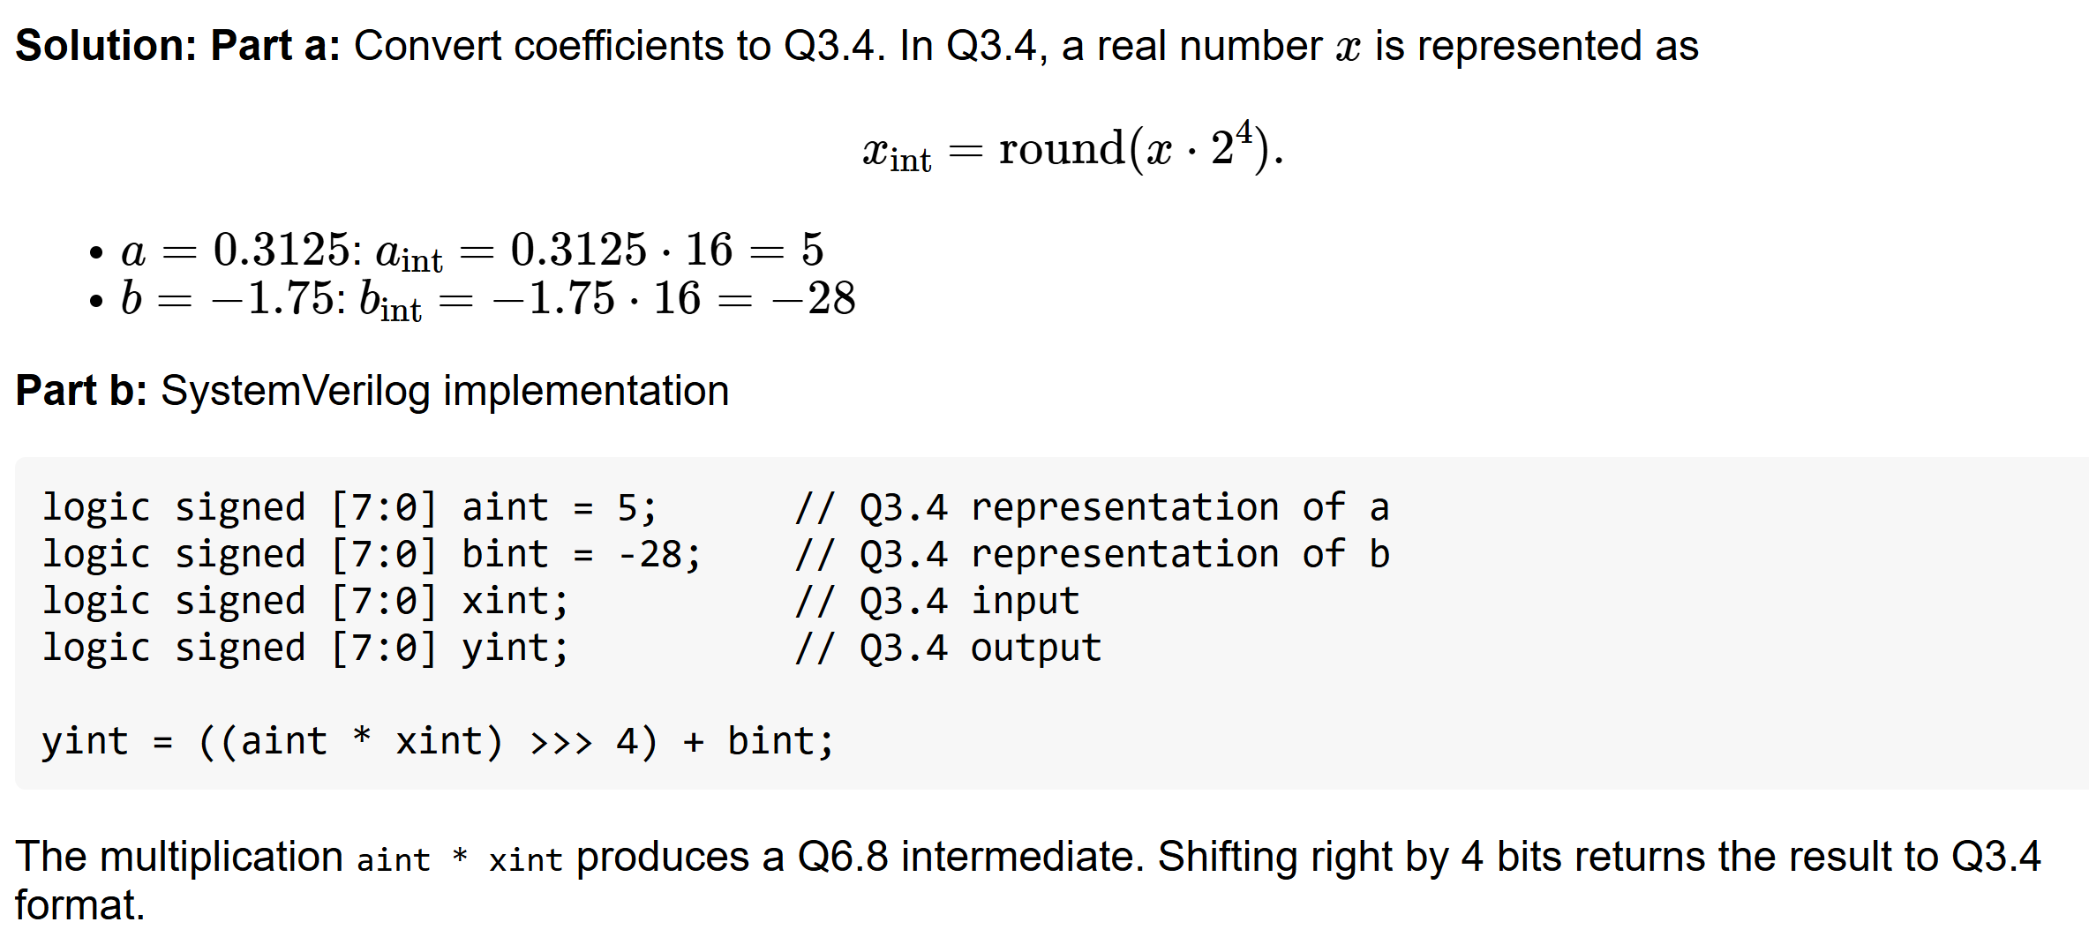
Solution

Slide 37
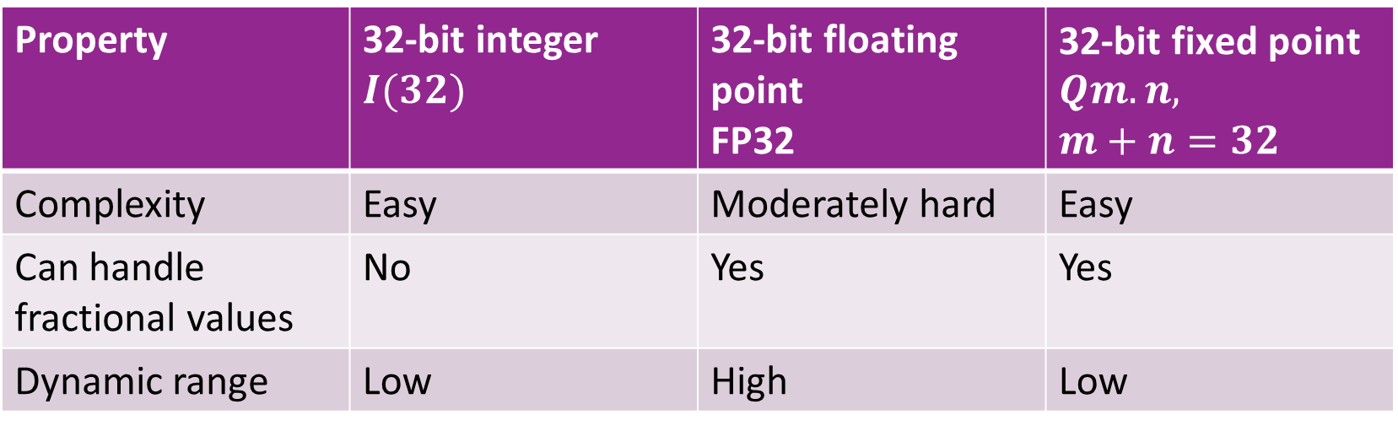
Comparison
Property | 32-bit integer $I(32)$ | 32-bit floating point FP32 | $\text{32−}\text{bit} \text{fixed} \text{point}$ $Qm.n,$ $m+n=32$
Complexity | Easy | Moderately hard | Easy
Can handle fractional values | No | Yes | Yes
Dynamic range | Low | High | Low

Slide 38
Outline
Floating Point Numbers
Fixed Point Numbers
Optimal Scaling of FixP Numbers
Converting Floating Point Algorithms to Fixed Point

Slide 39

Selecting the Precision
Suppose we have a real-valued number $x$
Want to represent as $q$ in $Qw.n$
How do we select $w$ and $n$?
Total width $w$ determined by storage and complexity
How do we select $n$ ?

Slide 40
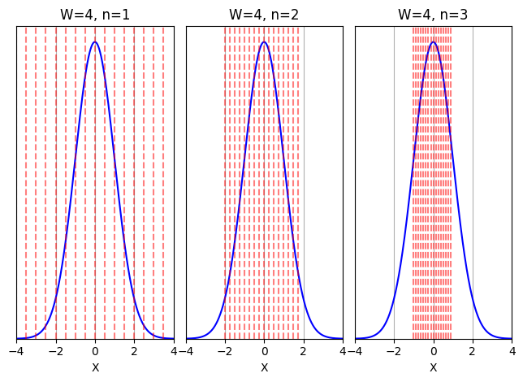

Probabilistic Analysis
Let $X=$ variable to quantize
Model $X$ as a random variable
The HW will see different values over time
Example to right: $X\sim N(0,1)$
Blue = PDF of $X$
Fixed $W$= total bitwidth
Red lines = Qunatization bins for $Qw.n$
Selecting $n$
Tradeoff of overflow and precision
More integer bits
More fractional bits
Minimal overflow Low precision
High overflow High precision

Slide 41


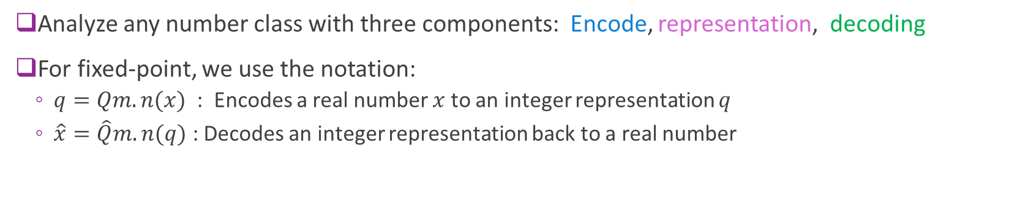



Encoding, Representation, and Decoding
Encode
Representation
Decode
Real value
Quantized
Real value
$$x$$
$$\hat{x}$$
Ex: $Qm.n(⋅)$
$$q$$
$\hat{Q}m.n(⋅)$
Analyze any number class with three components: Encode, representation, decoding
For fixed-point, we use the notation:
$q=Qm.n(x)$ : Encodes a real number $x$ to an integer representation $q$
$\hat{x}=\hat{Q}m.n(q)$ : Decodes an integer representation back to a real number

Slide 42

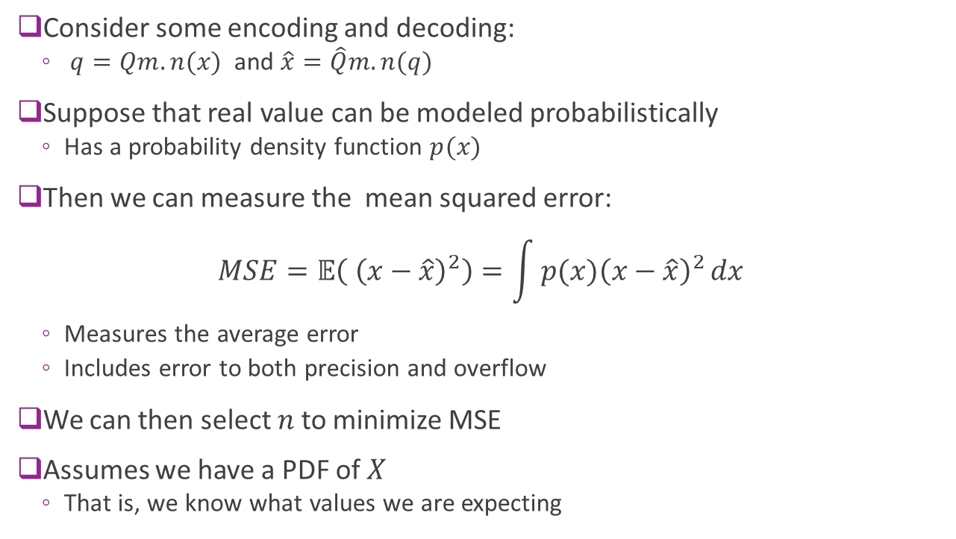


Mean Squared Error
Consider some encoding and decoding:
$q=Qm.n(x)$ and $\hat{x}=\hat{Q}m.n(q)$
Suppose that real value can be modeled probabilistically
Has a probability density function $p(x)$
Then we can measure the mean squared error: $MSE=𝔼\left( {\left(x−\hat{x}\right)}^{2}\right)=\int{p(x){\left(x−\hat{x}\right)}^{2}}dx$
Measures the average error
Includes error to both precision and overflow
We can then select $n$ to minimize MSE
Assumes we have a PDF of $X$
That is, we know what values we are expecting
$$x$$
$$\hat{x}$$
$$q$$

Slide 43
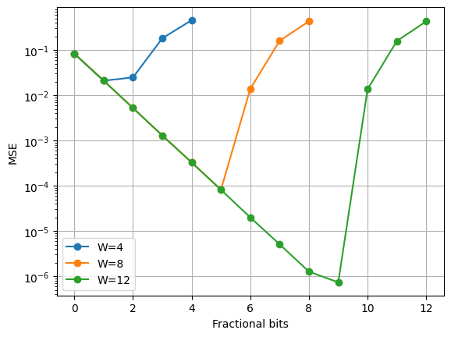
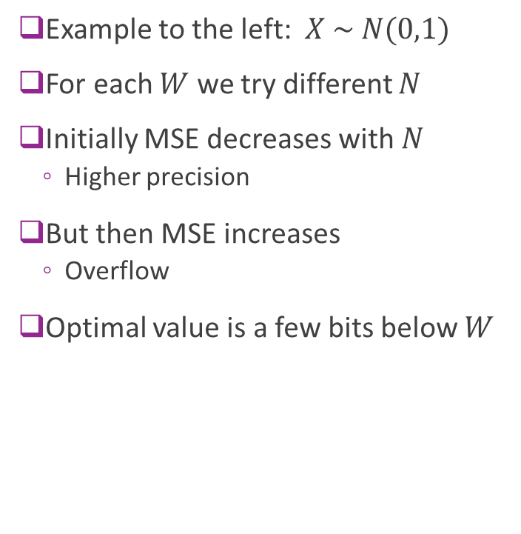
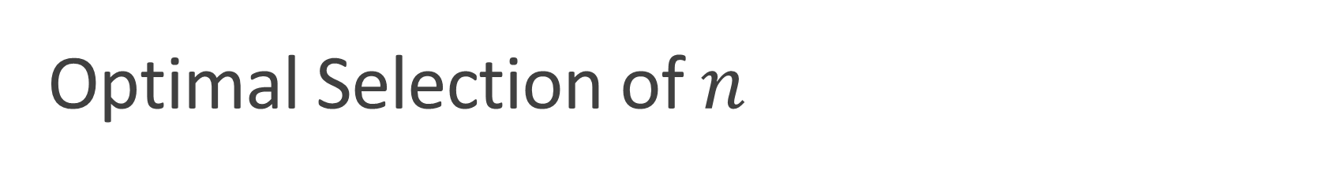
Optimal Selection of $n$
Example to the left: $X \sim N(0,1)$
For each $W$ we try different $N$
Initially MSE decreases with $N$
Higher precision
But then MSE increases
Overflow
Optimal value is a few bits below $W$

Slide 44
Outline
Floating Point Numbers
Fixed Point Numbers
Optimal Scaling of FixP Numbers
Converting Floating Point Algorithms to Fixed Point

Slide 45
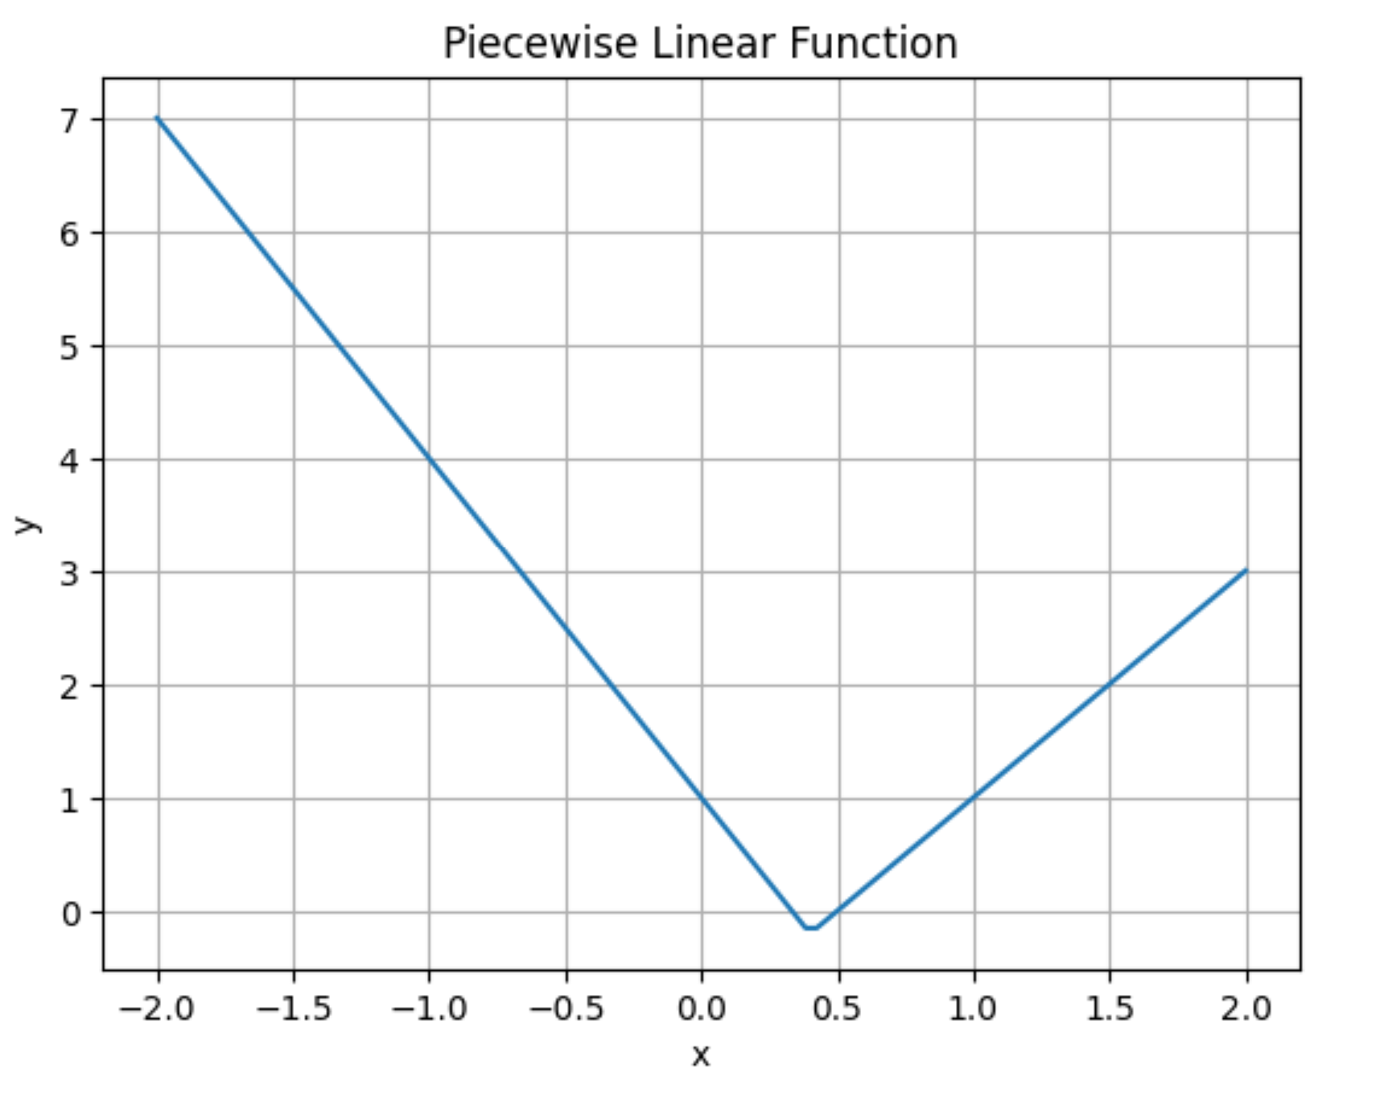

Example: Piecewise Function
See Jupyter notebook
Consider piecewise linear function: $y=max⁡\{ a_{0}x+a_{1}, a_{2}x+a_{3}\}$
How do we convert this to floating point

Slide 46
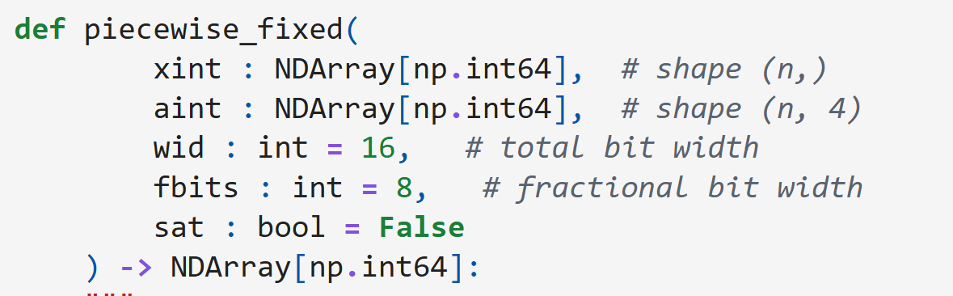
Python Model
Create a python model
Function has
Width and fractional bits
Inputs are integer representations
Variable stored as np.int64
Enables simply python processing
But actual numbers will only use smaller number of bits

Slide 47
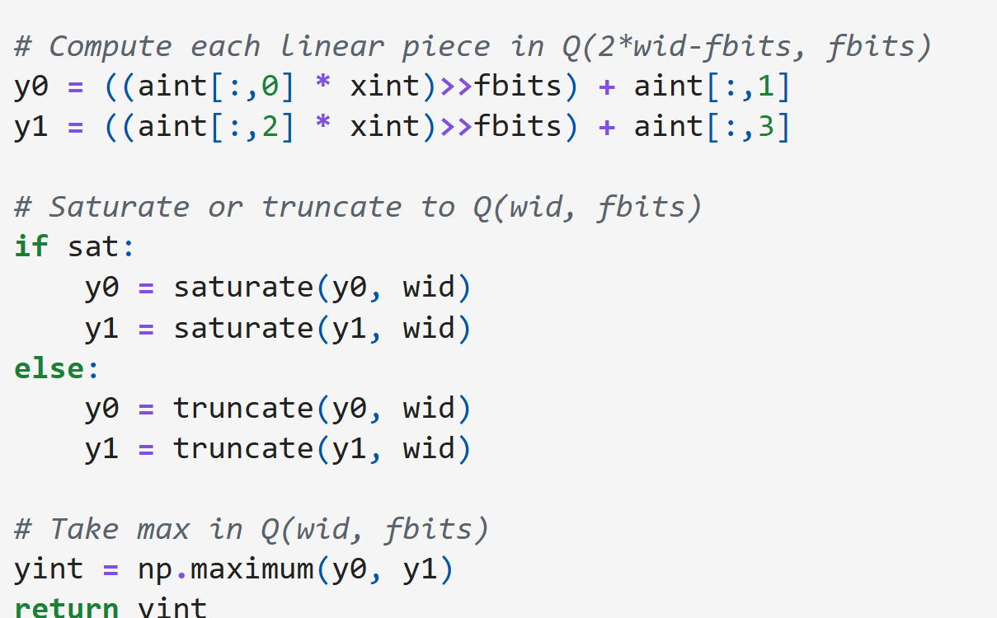
Python Implementation
Direct operations using FP rules
Can truncate or saturate

Slide 48
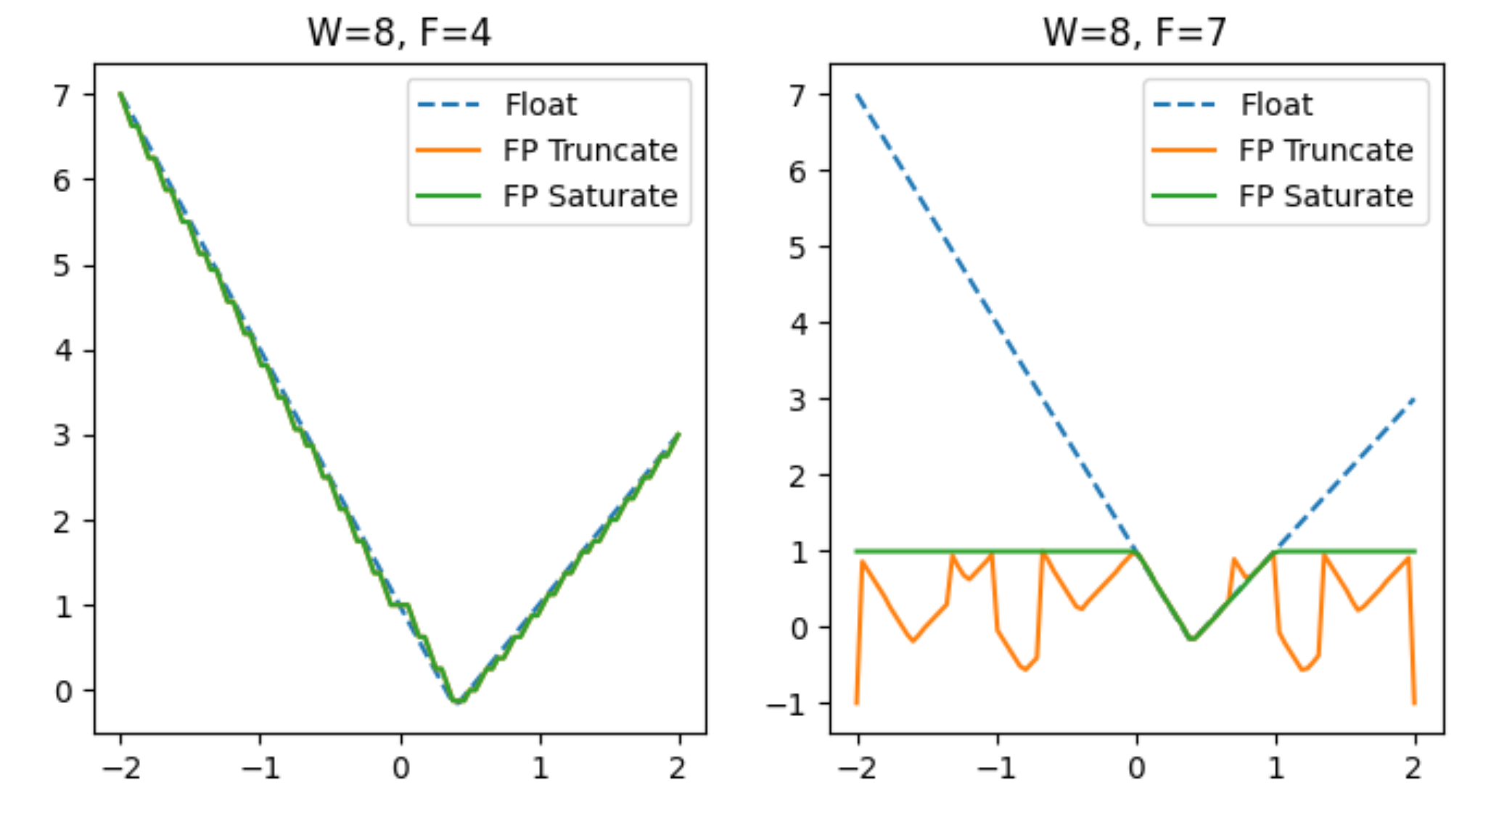
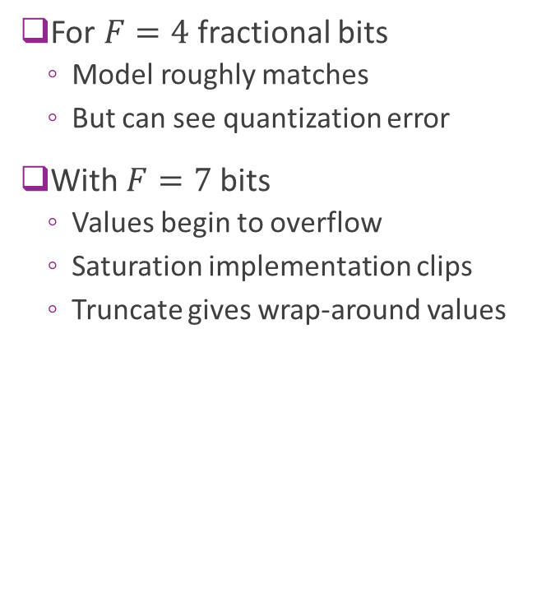
Quantization Examples
For $F=4$fractional bits
Model roughly matches
But can see quantization error
With $F=7$bits
Values begin to overflow
Saturation implementation clips
Truncate gives wrap-around values

Slide 49


Optimizing the MSE
Initially increase $F$:
Increases precision
Lower MSE
But eventually
Reduces number of integer bits
Begins to overflow
Fast increase in error

Slide 50

System Verilog Module Declaration
Define width parameters
Integer inputs
Optional saturation logic

Slide 51




Implementation
Register inputs (not shown)
Compute $y_{0}$ and $y_{1}$ in high precision
Optionally saturate
Final max

