Slide 1
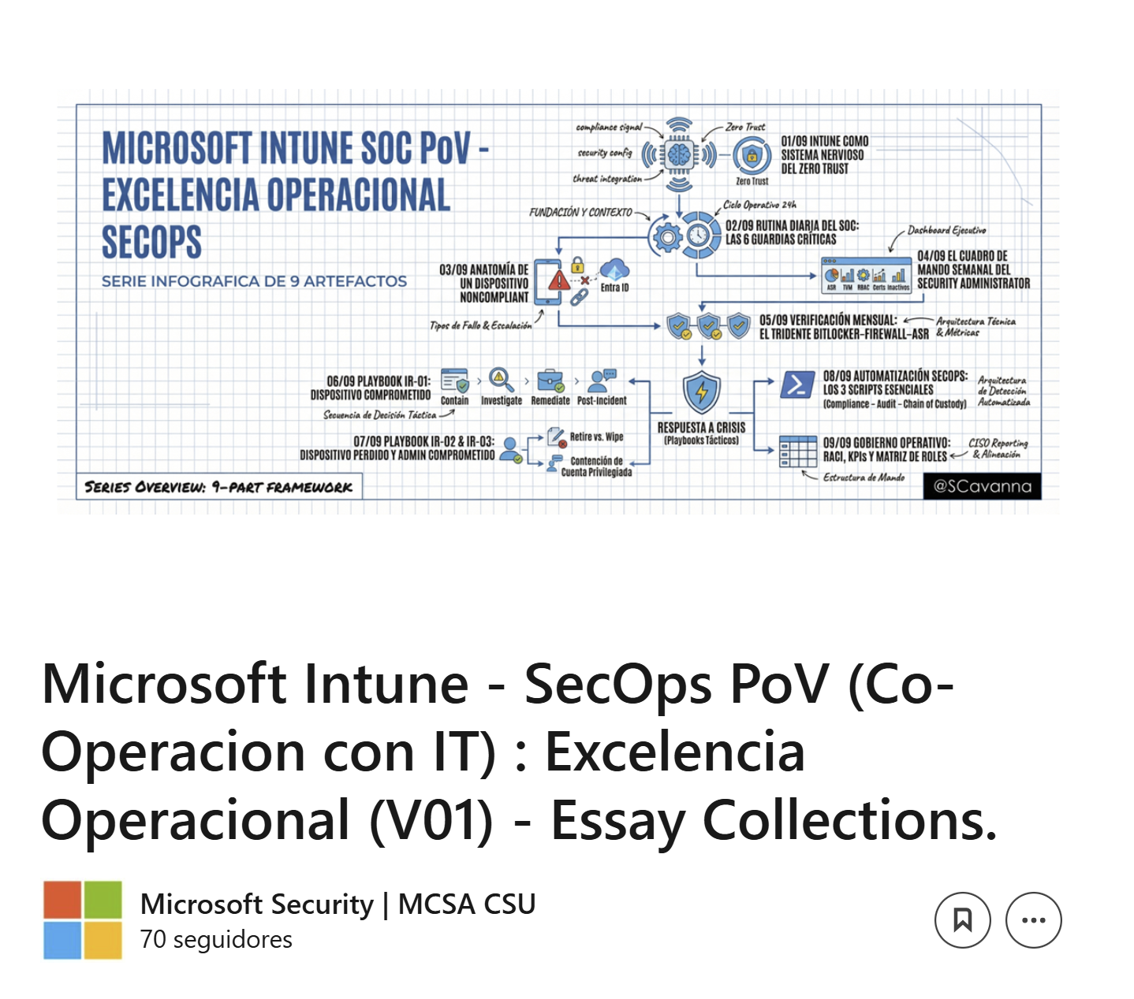
DLP
https://www.linkedin.com/....

