Slide 1
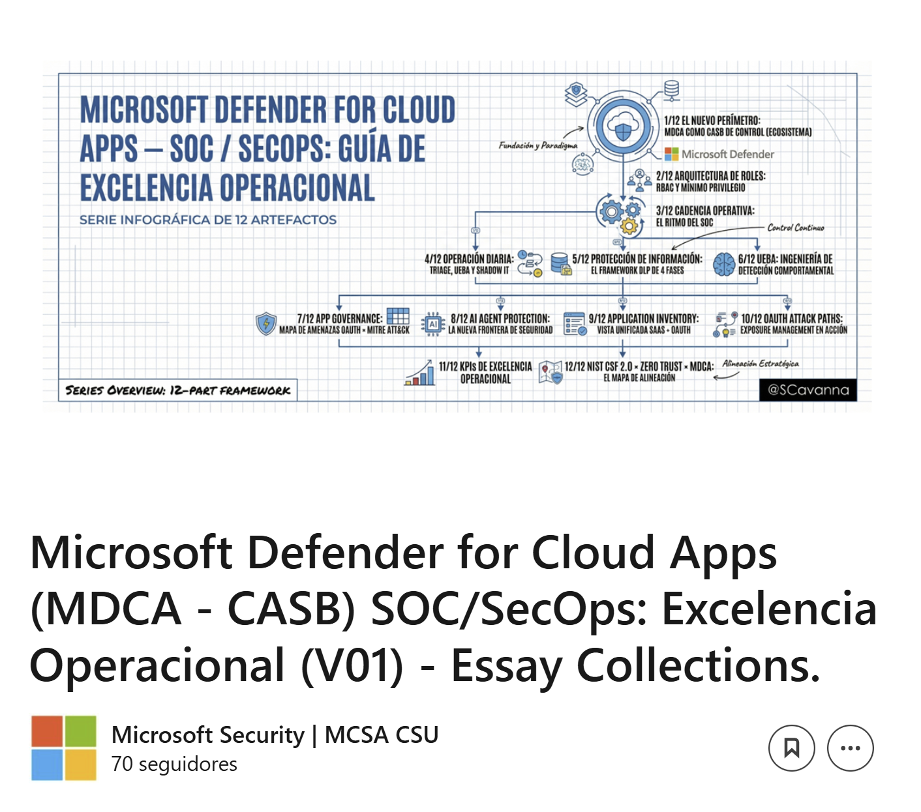
https://www.linkedin.com/pulse/microsoft-defender-cloud-apps-mdca-casb-abzvf

Slide 2
