Slide 1
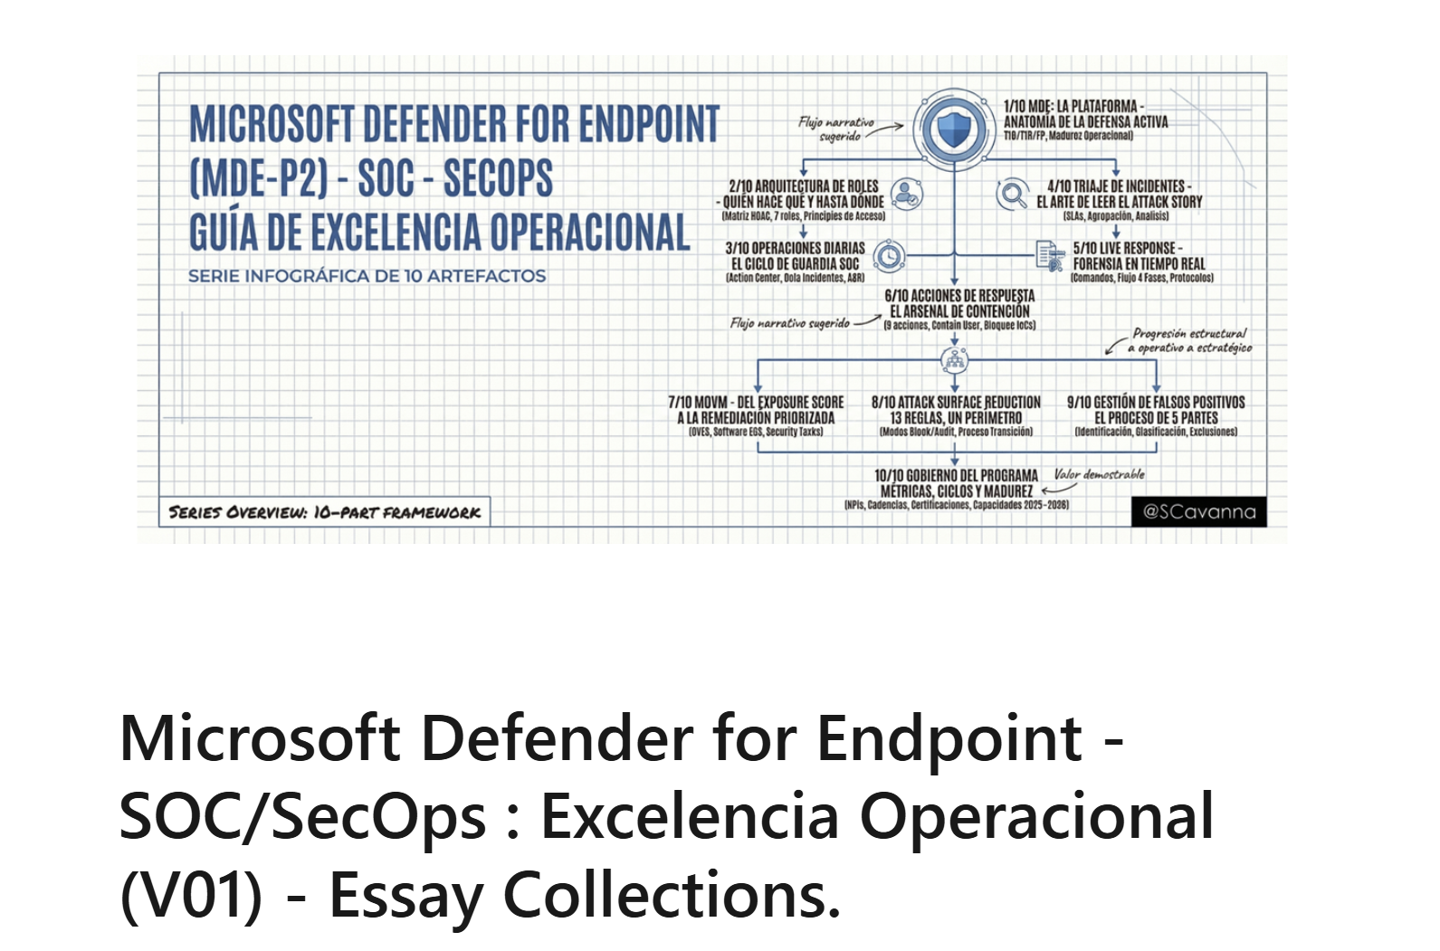
https://www.linkedin.com/pulse/microsoft-defender-endpoint-secops-excelencia-mgo8f

Slide 2
