Slide 1
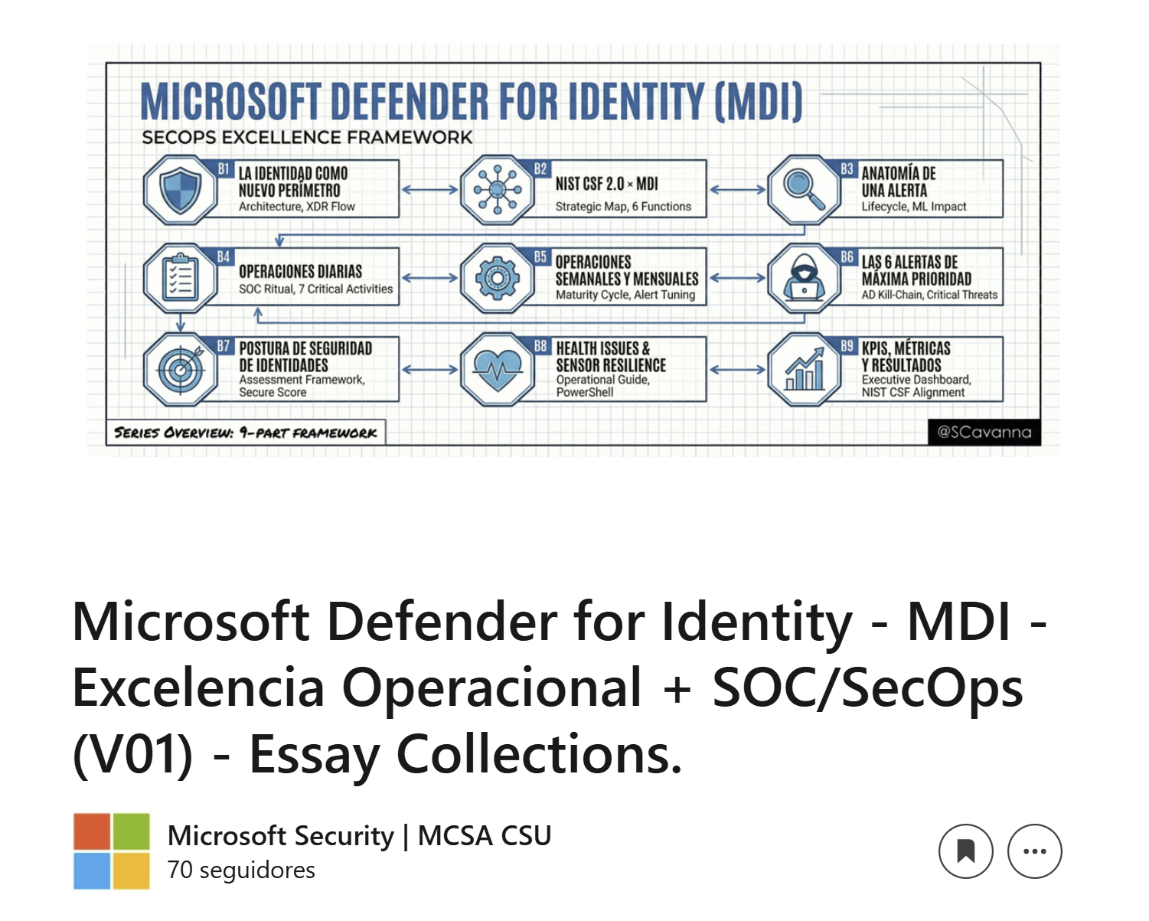
https://www.linkedin.com/pulse/microsoft-sentinel-socsecops-excelencia-26vcf/

Slide 2
