Slide 1
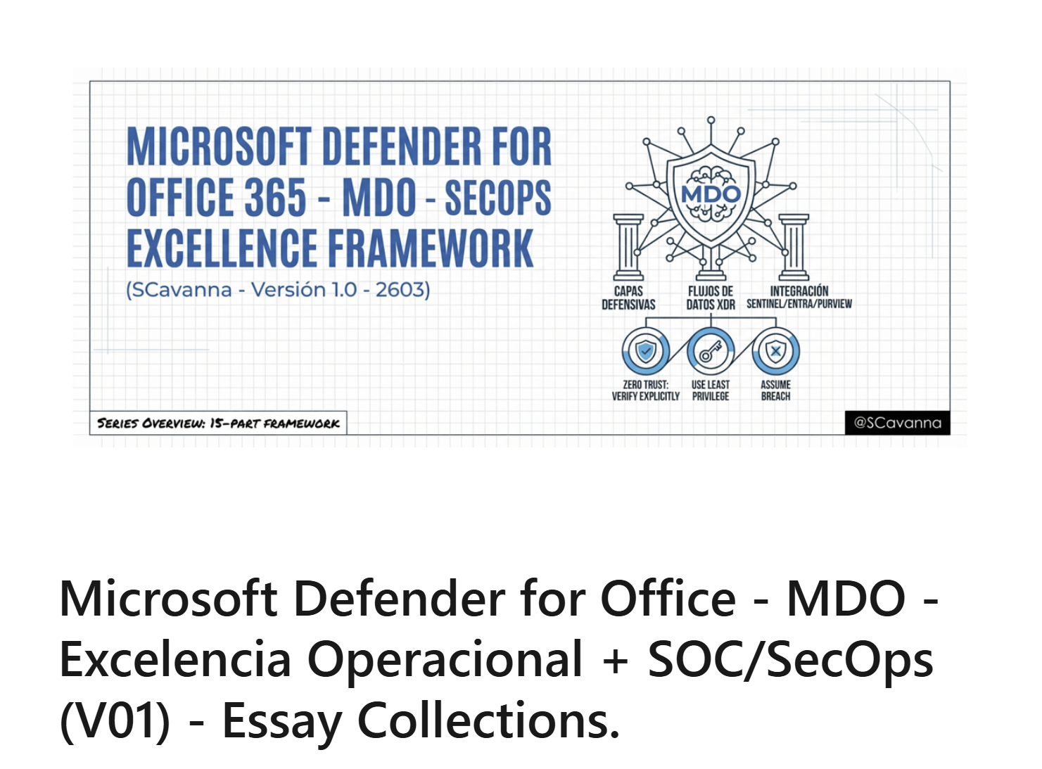
https://www.linkedin.com/pulse/microsoft-defender-office-mdo-excelencia-wnpqf/

Slide 2
