Slide 1
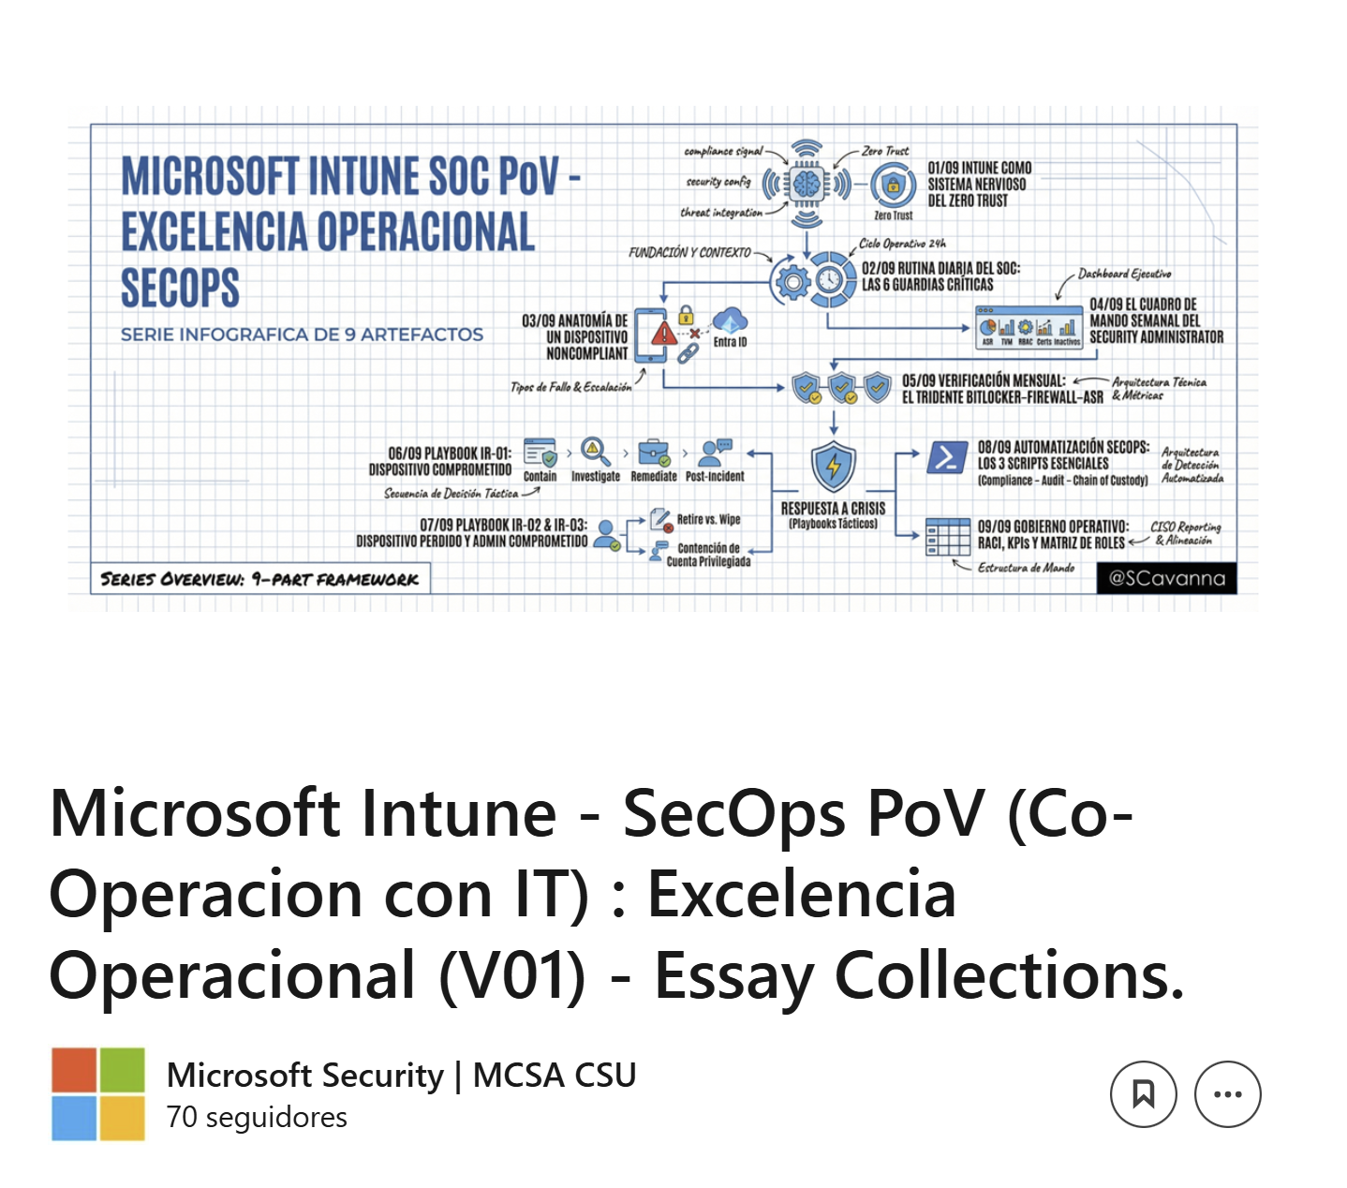
https://www.linkedin.com/pulse/microsoft-intune-secops-pov-co-operacion-xfisf/

Slide 2
