Slide 1
Inferring the individual-level distribution of SARS-CoV-2 viral shedding into wastewater
Perkins lab meeting
May 14, 2020
Sean Cavany, Aaron Bivins, Kyle Bibby, Alex Perkins

Slide 2
Outline
Background
Data & infection reconstruction
Shedding distribution
Questions, discussion

Slide 3
Outline
Background
Data & infection reconstruction
Shedding distribution
Questions, discussion

Slide 4


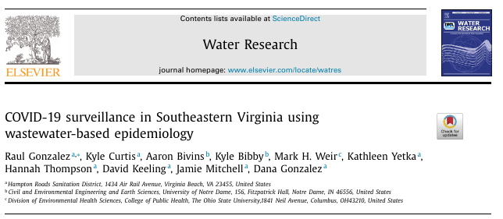


Wastewater-based epidemiology (WBE)

Slide 5
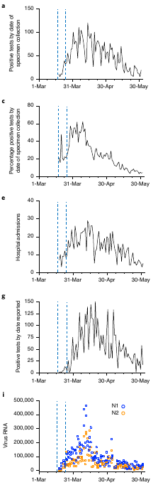
Wastewater-based epidemiology (WBE)

Slide 6
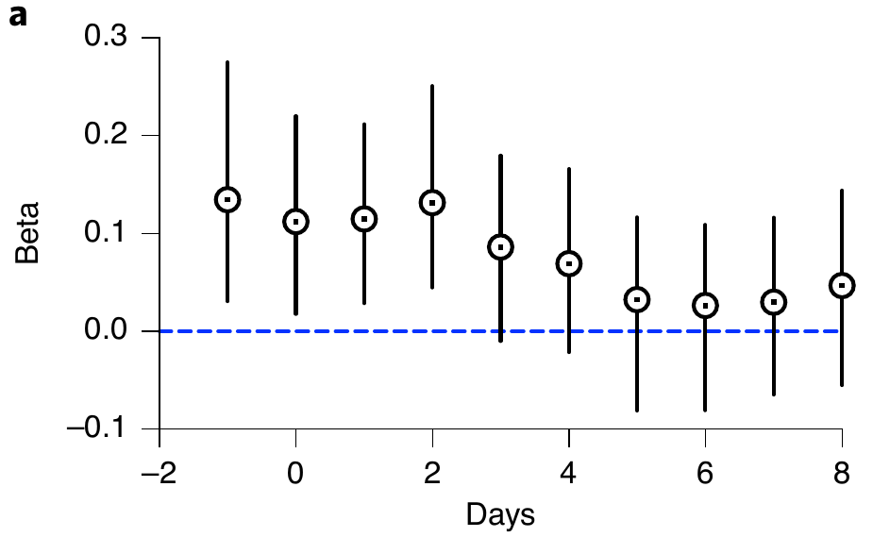
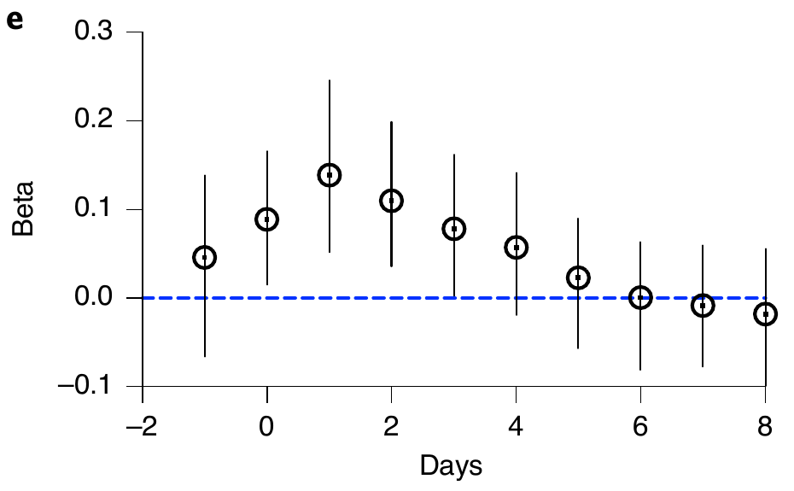
Wastewater-based epidemiology (WBE)
Positive tests (by test date)
Hospitalizations

Slide 7
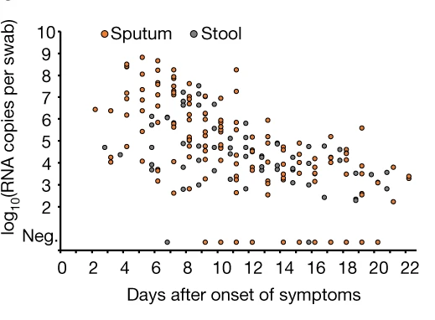
Key unknown: shedding period
Woelfel et al., Nature, 2020
“Mean duration of SARS-CoV-2 shedding was ... 17.2 days in stool.”
Cevik et al., Lancet Microbe, 2020

Slide 8
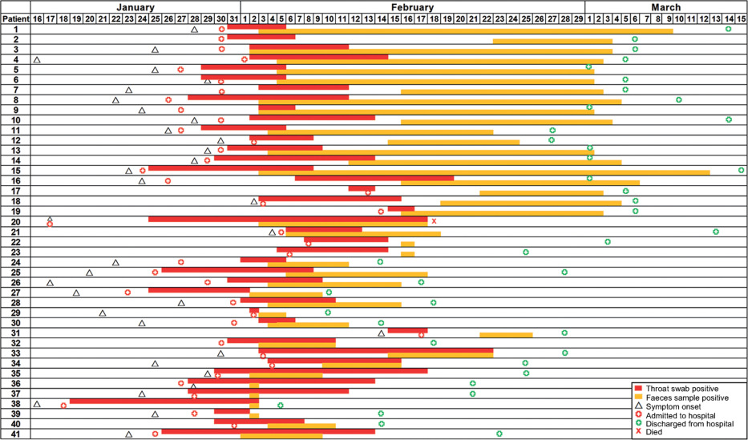
Key unknown: shedding period
Woelfel et al., Nature, 2020
“Mean duration of SARS-CoV-2 shedding was ... 17.2 days in stool.”
Cevik et al., Lancet Microbe, 2020
Wu et al., Lancet Gastroenterology & Hepatology, 2020

Slide 9
Outline
Background
Data & infection reconstruction
Shedding distribution
Questions, discussion

Slide 10
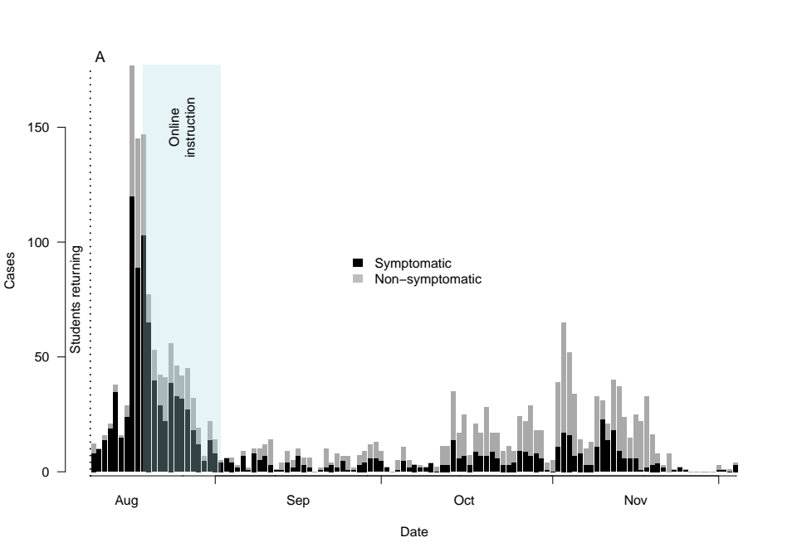
Student cases @ ND

Slide 11
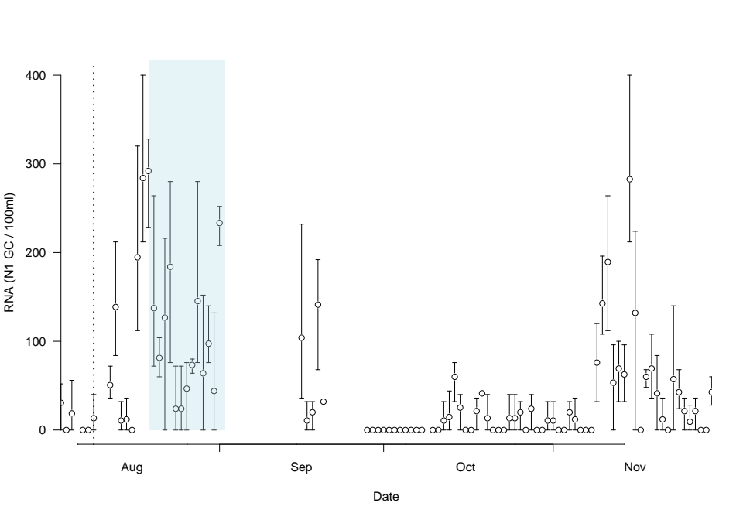
RNA concentration in wastewater

Slide 12
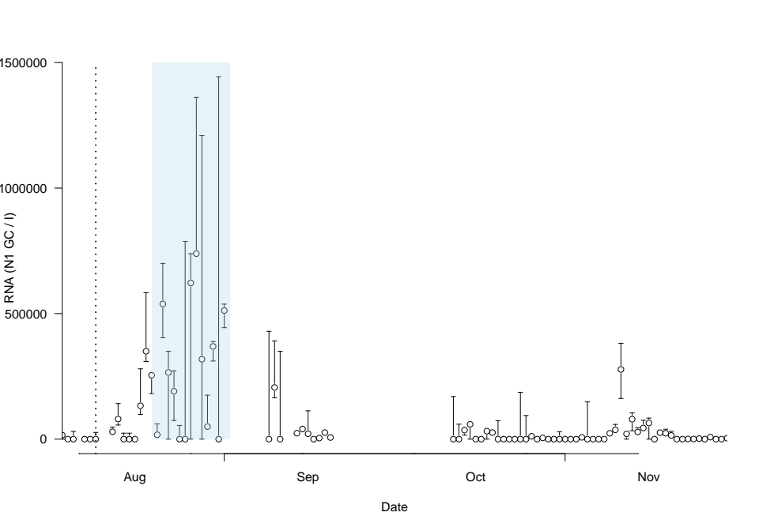
RNA concentration in wastewater
Recovery Corrected

Slide 13
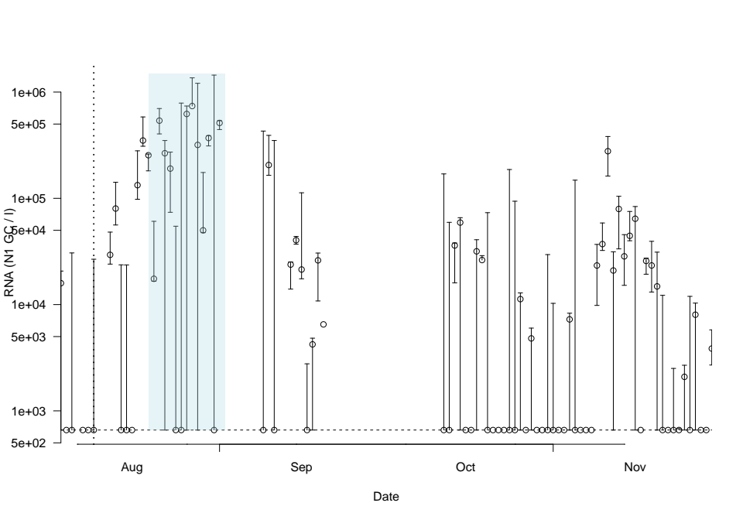
RNA concentration in wastewater
Recovery Corrected, log scale

Slide 14
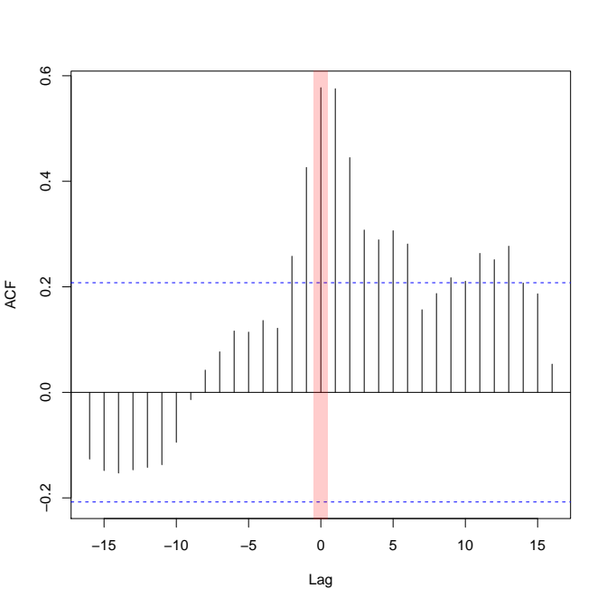
RNA concentration in wastewater
Cross-correlation between cases and SARS-CoV-2 RNA suggest wastewater of limited value as leading indicator

Slide 15
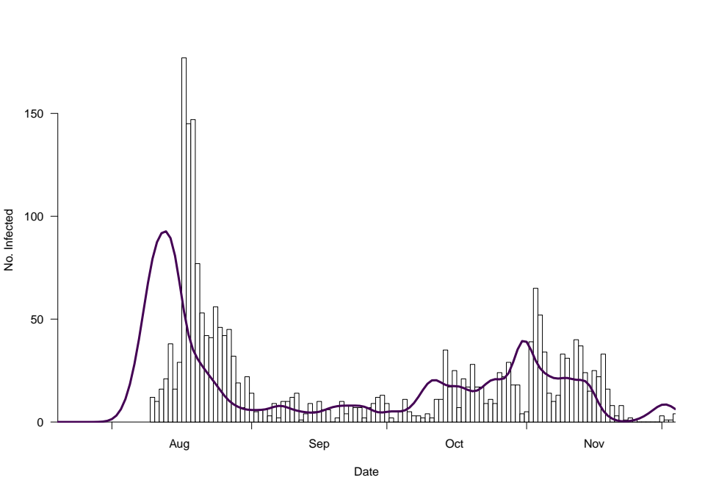
Infection reconstruction
Incubation period
~ Log-normal(μ=1.62,σ=0.42)
Delay from symptom onset to test result
~ Poisson(λ=2)
(λ varied in sensitivity analysis)

Slide 16
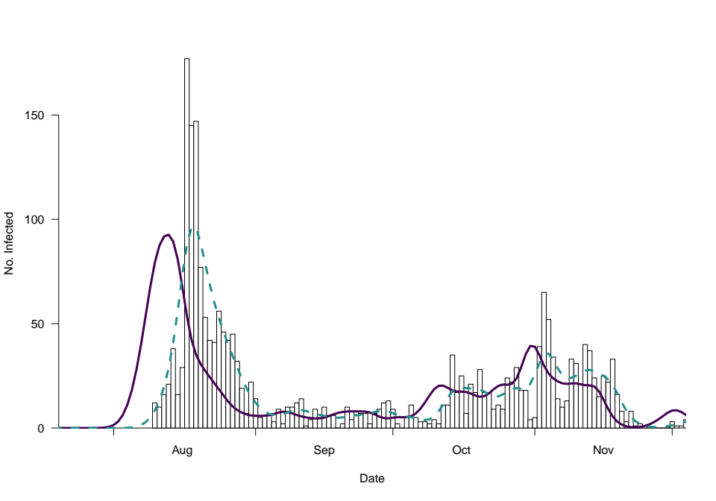
Infection reconstruction
Incubation period
~ Log-normal(μ=1.62,σ=0.42)
Delay from symptom onset to test result
~ Poisson(λ=2)
(λ varied in sensitivity analysis)

Slide 17
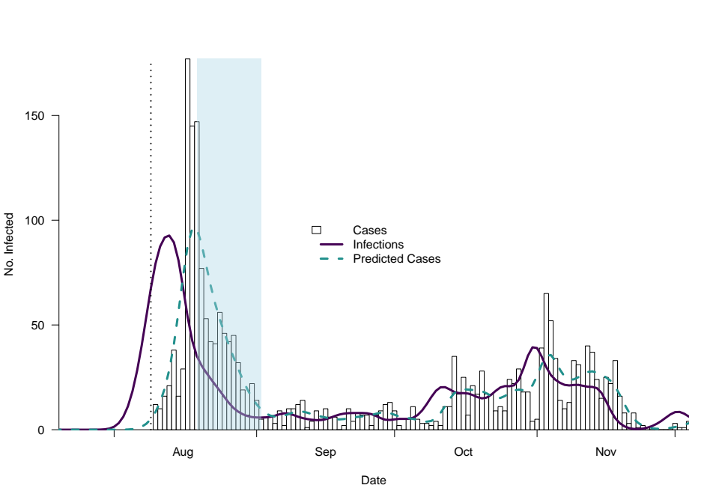
Infection reconstruction
Incubation period
~ Log-normal(μ=1.62,σ=0.42)
Delay from symptom onset to test result
~ Poisson(λ=2)
(λ varied in sensitivity analysis)

Slide 18
Outline
Background
Data & infection reconstruction
Shedding distribution
Questions, discussion

Slide 19
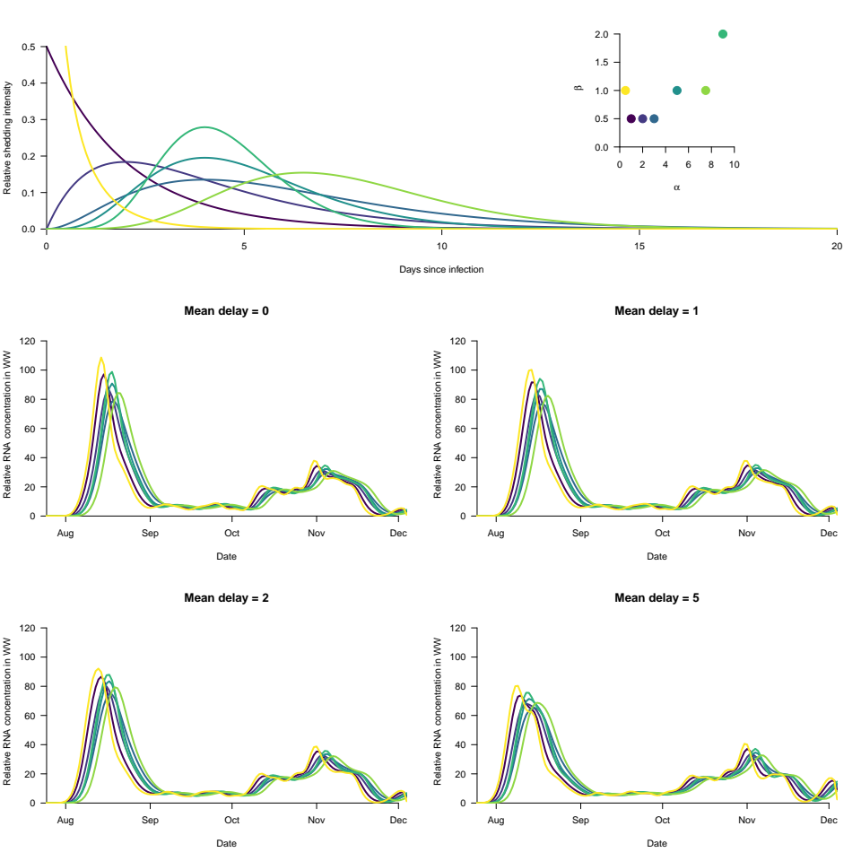
Reconstruct RNA in wastewater

Slide 20
Reconstruct RNA in wastewater

Slide 21
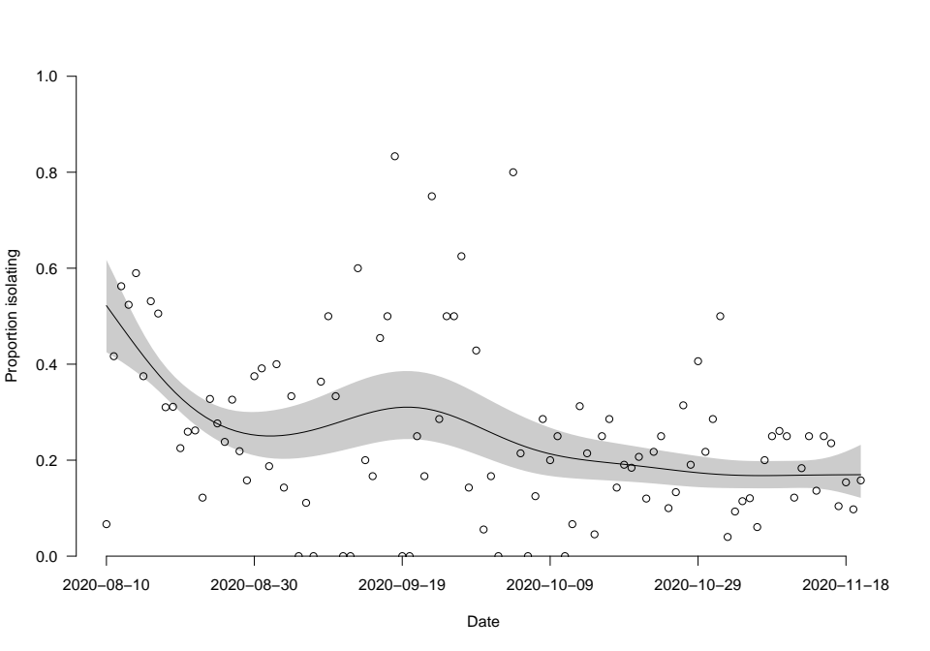
Proportion isolating off-campus

Slide 22
Proportion isolating off-campus
shedding with isolation =
shedding
x
(1 + P(q) * (P(enter) – P(exit)))
where
P(q) is probability of isolation
P(enter) comes from the cumulative prob of positive test
P(exit) is the same but lagged by 10 days (length of quarantine)

Slide 23
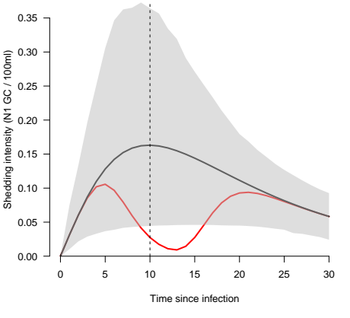
Proportion isolating off-campus
shedding with isolation =
shedding
x
(1 + P(q) * (P(enter) – P(exit)))
where
P(q) is probability of isolation
P(enter) comes from the cumulative prob of positive test
P(exit) is the same but lagged by 10 days (length of quarantine)

Slide 24
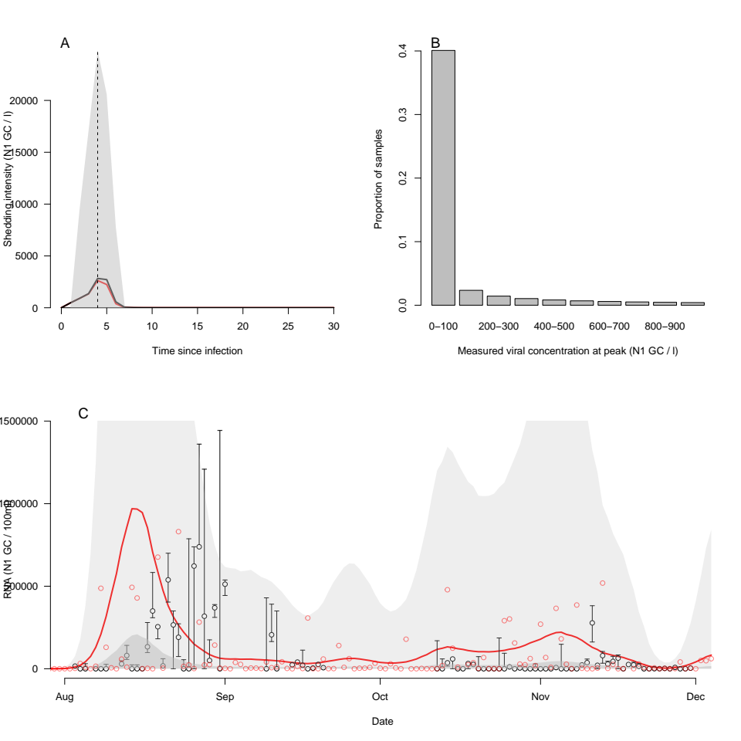
Shedding distribution

Slide 25
Shedding distribution

Slide 26
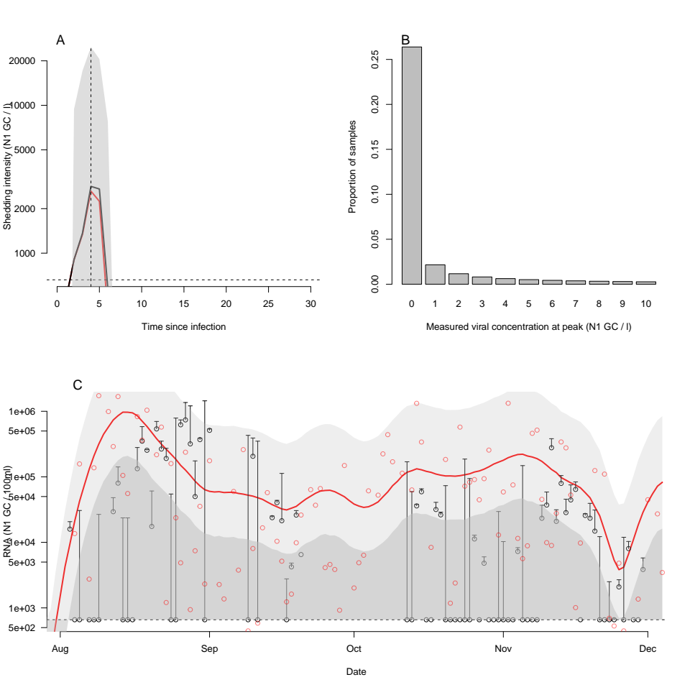
Shedding distribution

Slide 27
Predicted RNA timeseries

Slide 28
Predicted RNA timeseries

Slide 29
Outline
Background
Data & infection reconstruction
Shedding distribution
Questions, discussion

Slide 30
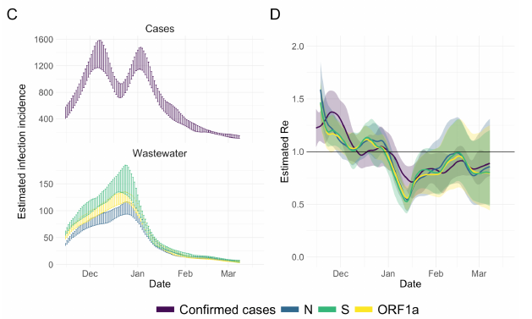
Comparison to Huisman et al
Estimating R

Slide 31
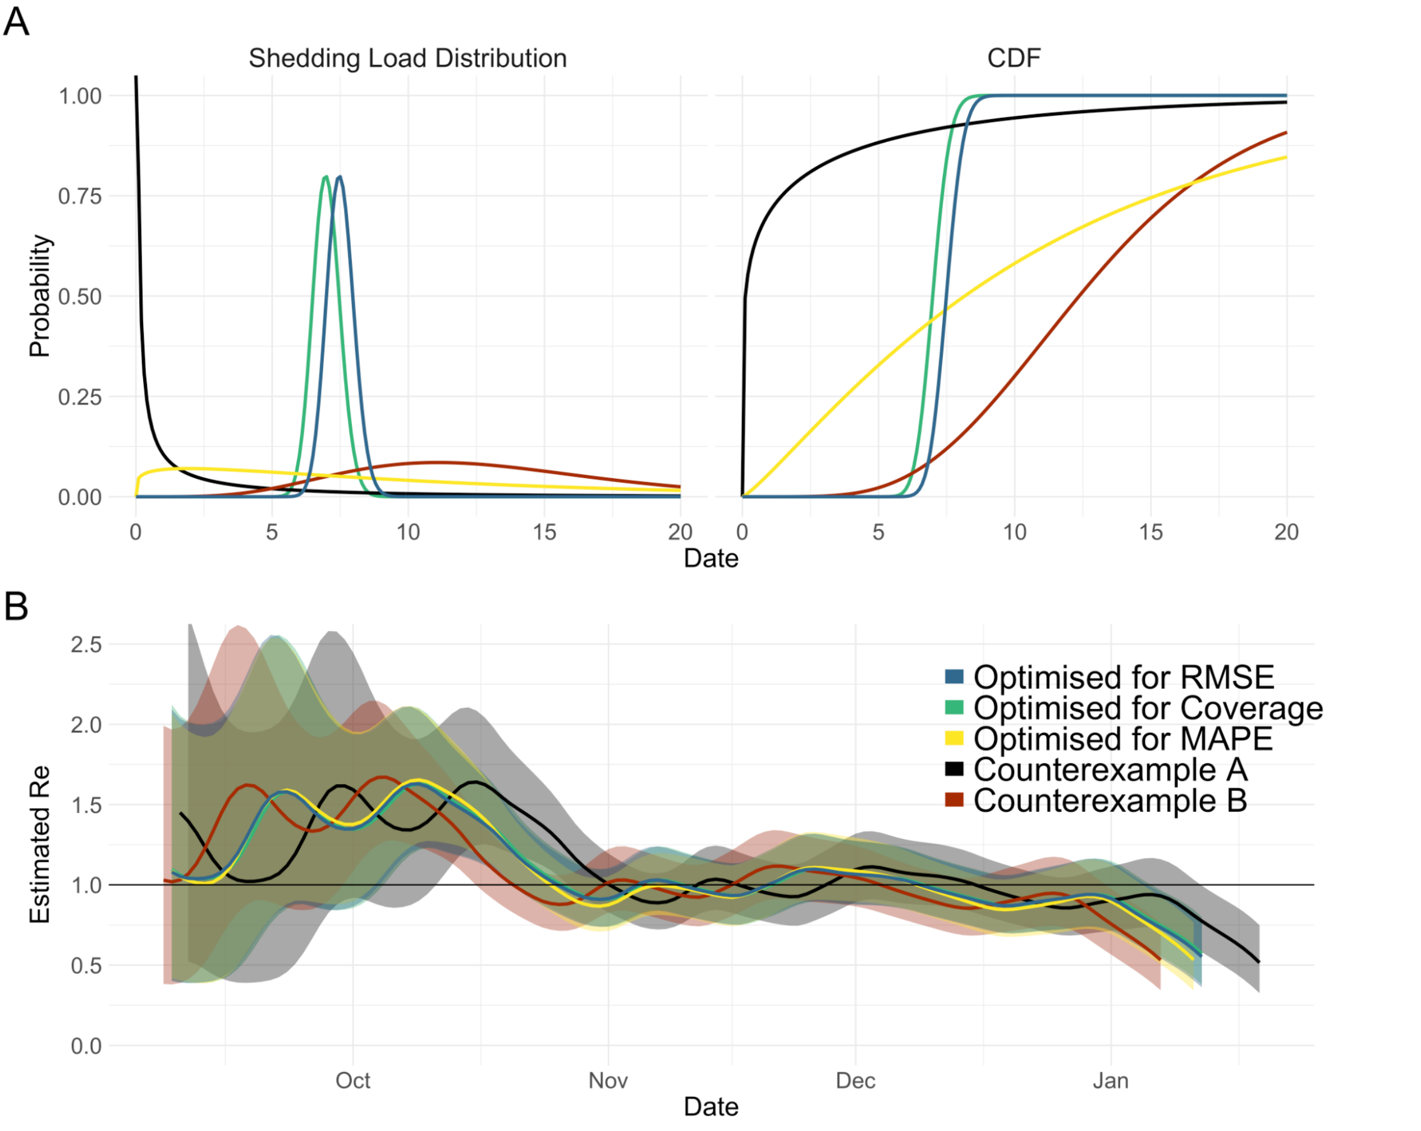
Comparison to Huisman et al
Estimating R
Inferred shedding distribution

Slide 32
Thanks!
Questions?

