Slide 1

Sacramento Estate

Slide 2
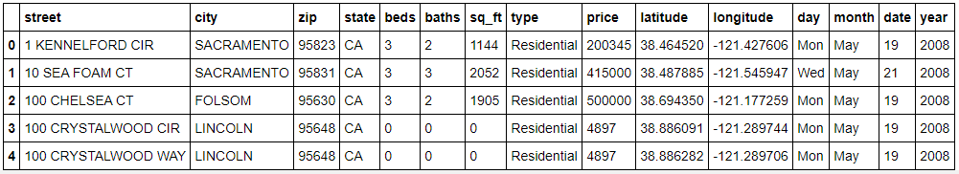
The start up
Our first step in this project was to clean up all the data. We had to make sure there were no empty slots or strange discrepancies. We then cleaned it up to make sure there are no repeated locations or if the location had no square feet. We made sure that the data was clean with a few tests, and all checked out.

Slide 3

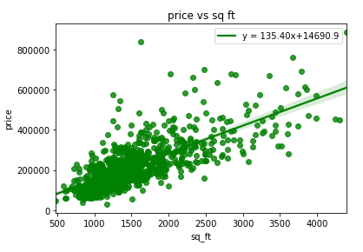
The average price and square foot
Next, after the cleanup, we made several graphs that would show us results for average payment over square foot, and how many rooms did houses have. First, we made a scatter chart that would show where most people are willing to spend their money for land. We were able to find that the average household price that was sold was about $207,000. The average square feet that were also founded were about 1500 feet.

Slide 4

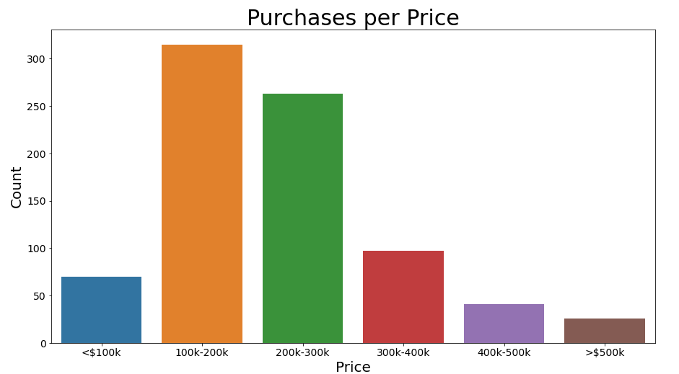
The average rooms
We then made bar chart on how many houses were being purchased from and how many rooms do they have. The conclusion from this chart was that the average room count was about 3 bedrooms per household. The average bathroom was about 2.

Slide 5
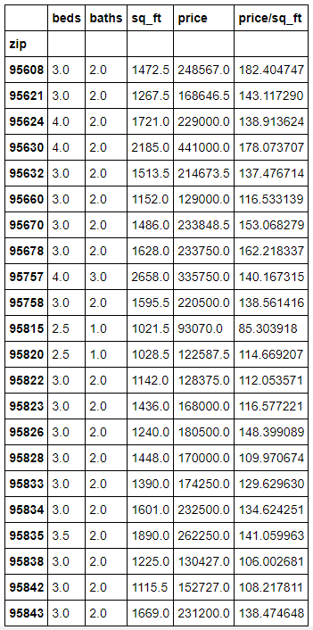
Average zip code
A box graph was then made to find where the average zip code had the most average amount of people populated. The data found the zip code area 95362 filled these criteria.

Slide 6


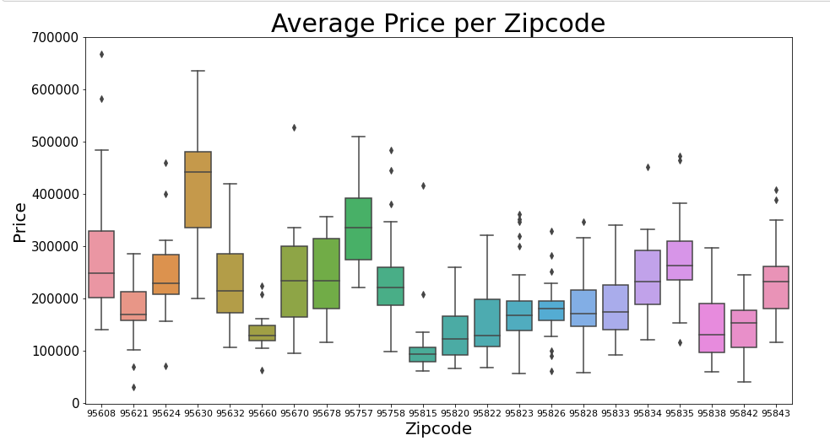
The conclusion
With all the data that was founded, the average household that filled nearly all this criterion lives in area code 95362, had 3 bedrooms 2 baths, a square foot of 1513 ft., and is priced at $214,613.50.

