Slide 1

Implementing a Consistent Look and Feel Using Layouts
Let us view an animation, which explains how to implement a consistent look and feel using layouts

Slide 2
Implementing a Consistent Look and Feel Using Layouts
What is Layout?
The layouts are like the master pages in WebForms applications. The common UI code, which can be used in many views can go into a common view called Layout.
Why do we need Layout View in ASP.NET Core MVC?
Nowadays, almost all web applications have the following sections.
Website Header
Website Footer
Navigation Menus
Main Content Area
Please have a look at the following image which shows the above mentioned four areas on a website

Slide 3
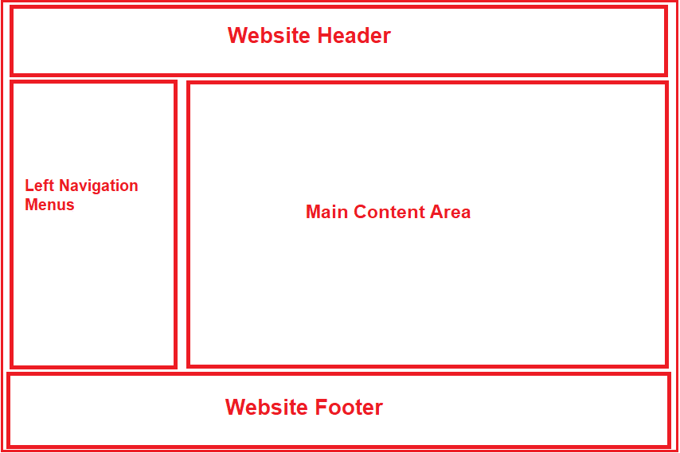
Implementing a Consistent Look and Feel Using Layouts

Slide 4
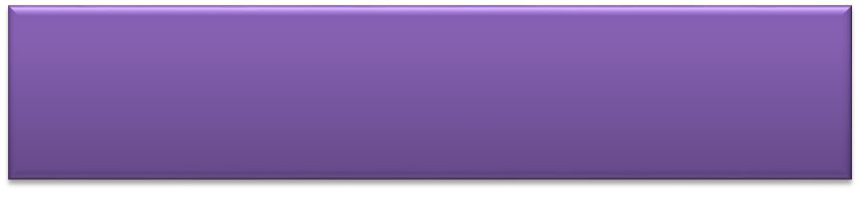

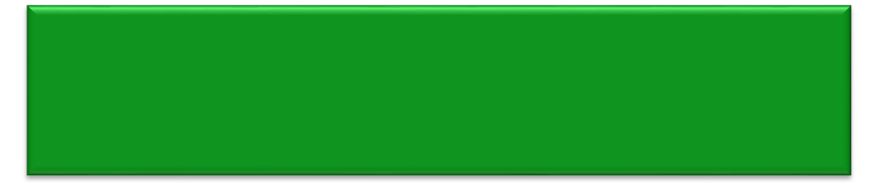

Implementing a Consistent Look and Feel Using Layouts (Contd.)
Is a feature that enables you to specify a common site template to be used across the views of a website.
Layout
Defines the structure and common ingredients of the views.
Can be used with the selected views in a website or with all the views in a website.

Slide 5
The _Layout.cshtml File
The _Layout.cshtml file:
    Is a default layout file that is included as part of the ASP.NET Core MVC project created by using any template except the Empty template.
    Represents the layout that can be applied to the selected views or to all the views.
    Is located in the Shared folder under the Views folder of the application.
    Contains the basic structure of a view.
    The leading underscore in the file name indicates that these files are not intended to be served directly by the browser.
    In ASP.NET Core MVC, it is also possible to create multiple layout files for a single application. For example, you may have one layout file for the admin users and another layout file for non-admin users of your application.
    The following embedded Word document contains the code of the _Layout.cshtml file available in a project created by using the Internet template.
Let us see how to create a Layout

Slide 6

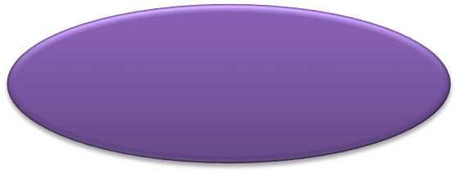
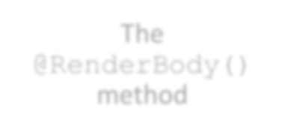
Creating a Custom Layout (Contd.)
To define the content for the body and section in a layout, you need to design a view.
Example:
<p>This is the main content!</p>
@section Section1 {
This is Section1.
}
To render the unique content associated with a view in the layout, the following methods can be used:
The @RenderBody() method
The @RenderSection() method

Slide 7
Creating a Custom Layout (Contd.)
The @RenderBody() method:
    Enables you to define a placeholder in the layout to insert the main content of the view.
    Can be used only once in a layout.
  Example:
<!DOCTYPE html>
<html lang="en">
<head>
<meta charset="utf-8" />
<title>@ViewBag.Title - My ASP.NET MVC Application</title>
</head>
<body>
<div id="body">
@RenderBody()
</div>
</body>
</html>

Slide 8
Creating Section in a Custom Layout or Sections in Layout View
The Sections in a layout view are used to organize where certain page elements should be placed. The sections in a layout view can be optional or mandatory.
    The @RenderSection() method
    Can be used to create multiple sections in a layout.
    Enables you to render a section specified in the view.
  Example:
<!DOCTYPE html>
<html>
<head><title>@ViewBag.Title</title></head>
<body>
<h1>@ViewBag.Title</h1>
<div id="main-content">@RenderBody()</div>
<div>@RenderSection("Section1")</div>
</body>
</html>

Slide 9
Creating Section in a Custom Layout or Sections in Layout View
The sections specified in a layout must be defined in all the views that use the layout.
If you do not want to use those sections in some of the views, you can use an overloaded version of the @RenderSection method, as shown in the following code snippet:
    <div>@RenderSection(“Top", required: false)</div>
  It is recommended to use some default value, instead of failing to define a section in a view.
    Example:
<div>
@if (IsSectionDefined(“Top")) {
RenderSection(“Top");
}
else {
<span>This is the default section content</span>
}
</div>

Slide 10

Understanding the need for Sections with an Example
Let us first create a custom javascript file. First, create a folder at the root level of the application with the name “wwwroot”.
In generally all the static files we need to be placed within this folder. Once you created the “wwwroot” folder create a subfolder within this with the name “js” and then add a javascript file with the name “CustomJavascript.js” within the js folder as shown in the below image.

Slide 11
Understanding the need for Sections with an Example contd.
Use JavaScript in 2 ways
First
If we have a custom javascript file (i.e. CustomJavascript.js) and that file is being required by all the views of our application, then we need to place it in the Layout View of our application as shown below
Example
<!DOCTYPE html>
<html>
<head>
<meta name="viewport" content="width=device-width" />
<title>@ViewBag.Title</title>
</head>
<body>
<table border="1" style="width:800px; font-family:Arial">
<tr>
<td colspan="2" style="text-align:center">
<h3>Website Header</h3>
</td>
</tr>
<tr>
<td style="width:200px">
<h3>Left Navigation Menus</h3>
</td>
<td style="width:600px">
@RenderBody()
</td>
</tr>
<tr>
<td colspan="2" style="text-align:center; font-size:x-small">
<h3>Website Footer</h3>
</td>
</tr>
</table>
<script src="~/js/CustomJavascript.js"></script>
</body>
</html>

Slide 12
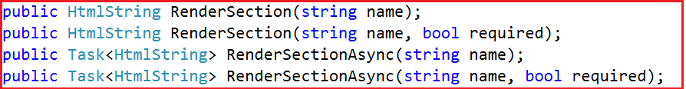
Understanding the need for Sections with an Example contd.
Second
If you have a custom javascript file (i.e. CustomJavascript.js) and you want that file in some specific views. Let assume you want that file in the Index view but not in the Details view of Home Controller. In such scenarios, you can make use of the section.
Understanding the RenderSection Method
Let us have a look at the signature of the RenderSection() method which is shown below
There are two overloaded versions of the RenderSection Method. The same is the case for the RenderSectionAsync method.
The first Render section method takes a single parameter (i.e. name) which specifies the name of the section. The second overloaded method takes two parameters.
The first parameter (name) specifies the name of the section while the second parameter (required) specifies whether the section is required or optional.

Slide 13
Understanding the need for Sections with an Example contd.
How to use the RenderSection Method in ASP.NET Core MVC?
Call the RenderSection() method at the location where you want the section content to be rendered. In our example, we want the script file to be included just before the closing </body> tag. So, we are calling the @RenderSection() method just before the closing </body> tag as shown below.
Example
<!DOCTYPE html>
<html>
<head>
<meta name="viewport" content="width=device-width" />
<title>@ViewBag.Title</title>
</head>
<body>
<table border="1" style="width:800px; font-family:Arial">
<tr>
<td colspan="2" style="text-align:center">
<h3>Website Header</h3>
</td>
</tr>
<tr>
<td style="width:200px">
<h3>Left Navigation Menus</h3>
</td>
<td style="width:600px">
@RenderBody()
</td>
</tr>
<tr>
<td colspan="2" style="text-align:center; font-size:x-small">
<h3>Website Footer</h3>
</td>
</tr>
</table>
@RenderSection("Scripts")
</body>
</html>

Slide 14
Creating a Custom Layout (Contd.)
Let us see how to create a layout

Slide 15
Specifying a Layout for a View
You can specify a layout for either each individual view or for all the views on a website.
A layout can be specified for a view by using the Layout property, as shown in the following code snippet:
@{
Layout = "~/Views/Shared/MyLayout.cshtml";
}
If you want to specify a particular layout for all the views, you can specify the layout to be used in the _ViewStart.cshtml file, available in the Views folder.
    The sections specified in a layout must be defined in all the views that use the layout.

Slide 16
Specifying a Layout for a View (Contd.)
When you create a default ASP.NET Core MVC project by using any template except the Empty template, an _ViewStart.cshtml file is already present in the Views folder.
This file specifies the default layout to be used, as shown in the following code snippet:
@{
Layout = "~/Views/Shared/_Layout.cshtml";
}
    The sections specified in a layout must be defined in all the views that use the layout.

Slide 17
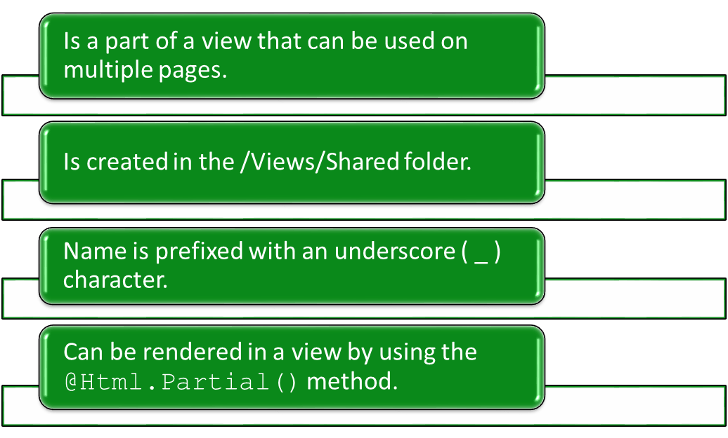
Using Partial Views
A partial view:

Slide 18
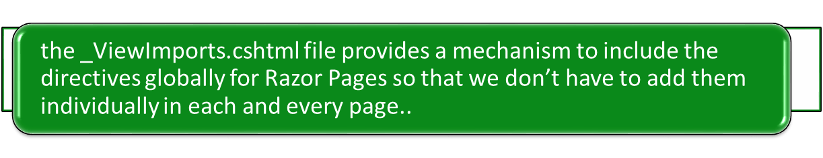
Using Viewimports
A ViewImports
Try out the activity for the _viewImports
Load the Activity File

Slide 19
Using Partial Views (Contd.)
The following code snippet renders a partial view named _partialsummary within a view:
    <div>@Html.Partial(“_partialsummary”)</div>
Let us see how to create a partial view

