Slide 1

Objectives
In this session, you will learn to:
    Work with View
      What are Views in ASP.NET Core MVC Application?
      Where View Files are Stored in ASP.NET Core MVC Application?
      How to create View in ASP.NET Core?
      What are the difference between View() and View(object model) Extension Methods?
      How to specify the Absolute view file path?
      Using Strong Type View
      Using ViewModel
      Partial View

Slide 2
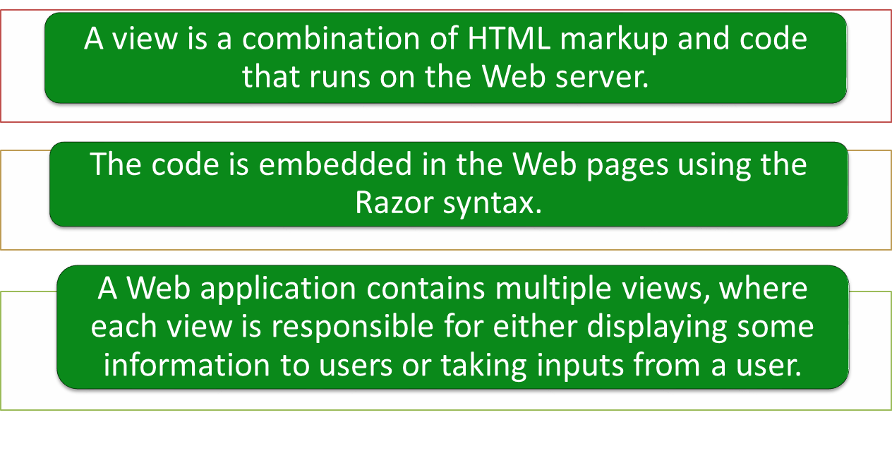
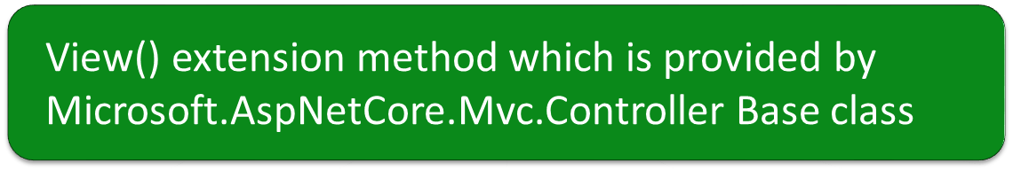
here we are using the View() extension method which is provided by Microsoft.AspNetCore.Mvc.Controller Base class
Working with Views

Slide 3
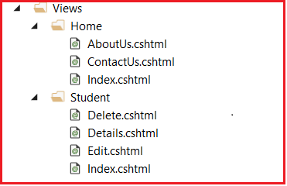
Where View Files are Stored in ASP.NET Core MVC Application?
In ASP.NET Core MVC, views are having a “.cshtml” extension if the programming language is C# with Razor mark-up.
Usually, each controller will have its own folder in which the controller-specific view files are going to be stored.
The controller-specific folders are going to be created within the Views folder.
The point that you need to remember is the view file name is the same as the action method name of a controller with .cshtml extension.
The following is the folder and file structure of the Views

Slide 4
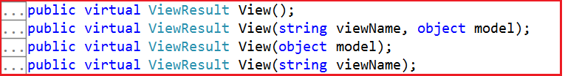
Specifying the View for an Action
If you go to the definition of Controller base class, then you will find there four overload versions of the View method as shown in the below image.

Slide 5
Specifying the View for an Action
Once a request is processed, a controller renders an appropriate view that is shown to the user.
For this, an action method needs to return a view.
Example:
    You can return a view from within the Index() action method of the Home controller as shown in the following code snippet: So in this case, by default.
public class HomeController : Controller
{
public ActionResult Index()
{
return View();
}
}

Slide 6
Specifying the View for an Action (Contd.)
When a view is returned without specifying any name for the view MVC searches for the view:
    With the same name as the action method
    Within the /Views/<ControllerName> folder
You can also specify the name of the view as a parameter of the View() method, as shown in the following code snippet:
      public class HomeController : Controller
      {
      public ActionResult Index()
      {
      return View("NewIndex");
      }
      }

Slide 7
Specifying the View for an Action (Contd.)
You can also render a view defined in a different folder other than the default folder created by MVC for every controller, as shown in the following code snippet:
        public class HomeController : Controller
        {
        public ActionResult Index()
        {
        return View("~/Views/Special/Index.cshtml");
        }
        }
This is the Absolute view file path
Let us see how to create a view

Slide 8
Passing Data from a Controller to a View
The following two common techniques are used to pass data from a controller to a view:
    ViewData:
      Is a dictionary of objects derived from the ViewDataDictionary class.
      Uses key/value pairs, where each key must be a string.
      String data from the ViewData dictionary can be access without casting the data to string type. But, other data than the string type need to explicitly cast the data to the type expecting
      Define it in the controller action method to set values, as shown in the following code snippet:
      To access string data
ViewData["Message"] = "Welcome to our website";
ViewData["ServerTime"] = DateTime.Now;
      Allows to access the added values in a view by using the Razor syntax, as shown in the following code snippet:
<p>
The message is: @ViewData["Message"]
The Date and Time is: @ViewData["ServerTime"]
</p>

Slide 9
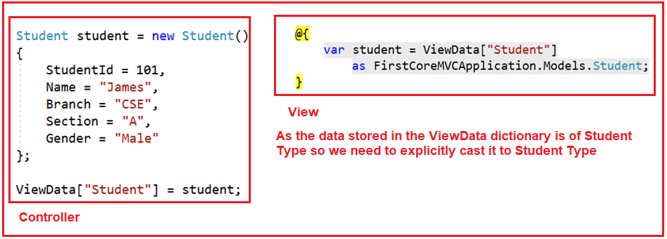
Passing Data from a Controller to a View
Accessing Student Data:
public ViewResult Details()
{
//String string Data
ViewData["Title"] = "Student Details Page";
ViewData["Header"] = "Student Details";
Student student = new Student()
{
StudentId = 101,
Name = "James",
Branch = "CSE",
Section = "A",
Gender = "Male"
};
//storing Student Data
ViewData["Student"] = student;
return View();
}
}
<h1>@ViewData["Header"]</h1>
@{
var student = ViewData["Student"]
as FirstCoreMVCApplication.Models.Student;
}
<div>
StudentId : @student.StudentId
</div>
<div>
Name : @student.Name
</div>
<div>
Branch : @student.Branch
</div>
<div>
Section : @student.Section
</div>
<div>
Gender : @student.Gender
</div>

Slide 10
Passing Data from a Controller to a View (Contd.)
    ViewBag:
      ViewBag is a dynamic property of the Controller base class. It is very much similar to the var keyword that means we can store any type of value in it but the type will be decided at run time rather than compile-time
      Allows to add properties of multiple types and their values in a controller action method as shown in the following code snippet:
ViewBag.Message = "Welcome to our website";
ViewBag.ServerTime = DateTime.Now;
      Allows to access the added values in a view as shown in the following code snippet:
<p>
The message is: @ViewBag.Message
The Date and Time is: @ViewBag.ServerTime
</p>
      Works only in those cases where the key being accessed is a valid C#
      identifier.

Slide 11
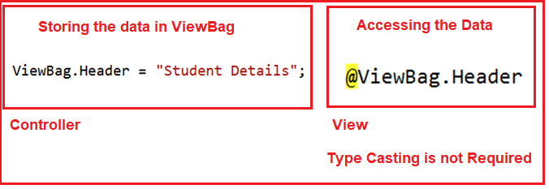
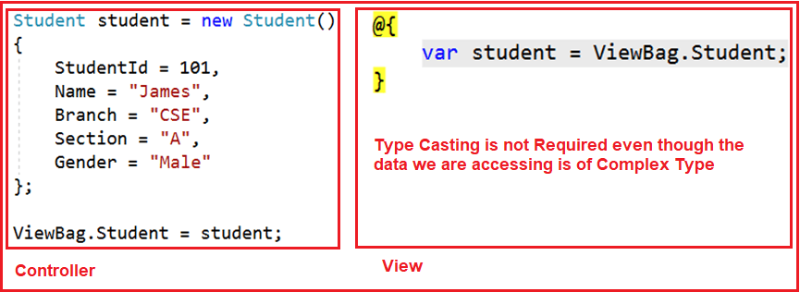
Passing Data from a Controller to a View (Contd.)
    Keep in mind is, ViewBag is operating on the dynamic data type. So, typecasting don’t require while accessing the data from a ViewBag. It does not matter whether the data accessing is of type string or any complex type.
  ViewBag in ASP.NET Core MVC with String Type
ViewBag in ASP.NET Core MVC with Complex Type

Slide 12
Passing Data from a Controller to a View (Contd.)
ViewBag in ASP.NET Core MVC with Complex Type
Accessing the ViewBag in a View in ASP.NET Core MVC
public class HomeController : Controller
{
public ViewResult Details()
{
ViewBag.Title = "Student Details Page";
ViewBag.Header = "Student Details";
Student student = new Student()
{
StudentId = 101,
Name = "James",
Branch = "CSE",
Section = "A",
Gender = "Male"
};
ViewBag.Student = student;
return View();
}
}
<h1>@ViewBag.Header</h1>
@{
var student = ViewBag.Student;
}
<div>
StudentId : @student.StudentId
</div>
<div>
Name : @student.Name
</div>
<div>
Branch : @student.Branch
</div>
<div>
Section : @student.Section
</div>
<div>
Gender : @student.Gender
</div>

Slide 13
The Razor View Engine
Defining Razor
    Markup syntax that allows you to embed server-side code (written in C# or VB) in an HTML markup
    The following are the Razor syntax rules:
      The @ character indicates a transition from markup to code.
      Razor code statements end with semicolon (;).
      The C# code is case-sensitive.
      Variables should be declared by using the var keyword.
      Strings should be enclosed within quotation marks.

Slide 14
Passing Data from a Controller to a View (Contd.)
    The syntax for including various types of code elements in a Razor markup
      Including Code Expressions
      For example: <h1>Displaying @myList.length items.</h1>
      <The time is @DateTime.Now.</h1>
      Including Code Blocks
For example: @{//Server-side codes
----------------------
}
      Combining Code and Markup
For example: @foreach (var item in products)
{
<li> The item name is @item.</li>
}
      Including Comments
      For example: @* Your comment goes here. *@

Slide 15
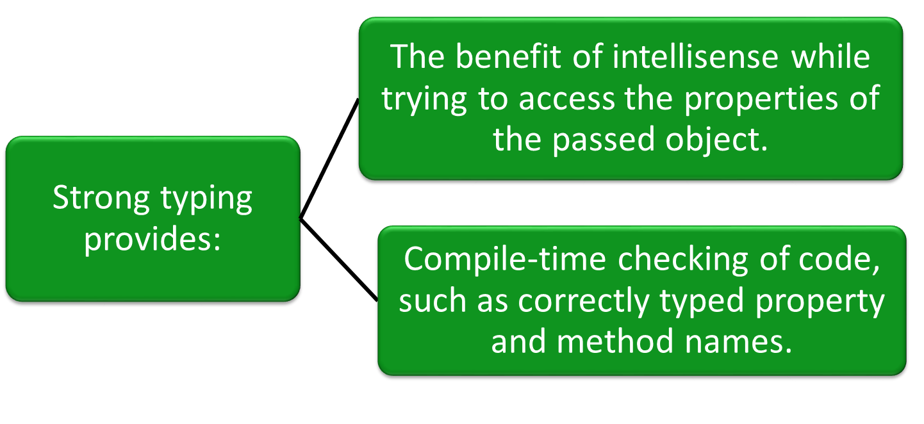
Using Strong Type View in ASP.NET Core

Slide 16
Using Strong Typing (Contd.)
To implement strong typing, you can typecast the model data to a specific type, as shown in the following code snippet:
@{
var product = Model as Newbay.Models.Product;
}
@product.name <br/>
@product.price <br/>
Further, you can avoid explicit type casting of the model object by creating a strongly typed view.
A strongly typed view specifies the type of model it expects by using the @model declaration, as shown in the following code snippet:
@model Newbay.Models.Product
Now, you can access the properties of the model object by using the
following code snippet:
@Model.name <br/>
@Model.price <br/>

Slide 17
Using Strong Typing (Contd.)
To avoid specifying a fully qualified type name for the model, you can use the @using declaration, as shown in the following code snippet:
@using Newbay.Models
@model Product
You can implement strong typing while passing a collection of objects by using the IEnumerable interface, as shown in the following code snippet:
@model IEnumerable<Newbay.Models.Product>
Controller
View
public class HomeController : Controller
{
public ViewResult Details()
{
ViewBag.Title = "Student Details Page";
ViewBag.Header = "Student Details";
Student student = new Student()
{
StudentId = 101,
Name = "James",
Branch = "CSE",
Section = "A",
Gender = "Male"
};
return View(student);
}
}
@model FirstCoreMVCApplication.Models.Student
<html xmlns="http://www.w3.org/1999/xhtml">
<head>
<title>@ViewBag.Title</title>
</head>
<body>
<h1>@ViewBag.Header</h1>
<div>
StudentId : @Model.StudentId
</div>
<div>
Name : @Model.Name
</div>
<div>
Branch : @Model.Branch
</div>
<div>
Section : @Model.Section
</div>
<div>
Gender : @Model.Gender
</div>
</body>
</html>

Slide 18
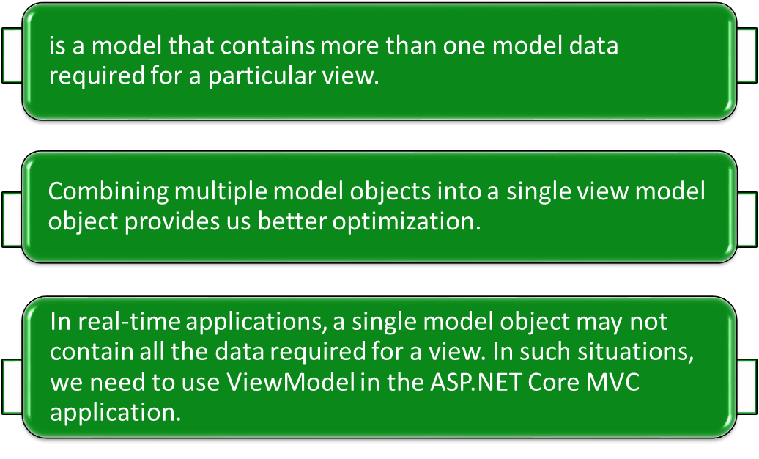
Using ViewModel
A ViewModel:

Slide 19
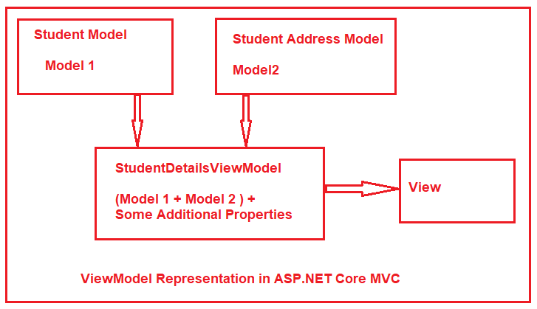
Understanding the ViewModel in ASP.NET Core MVC
The following diagram shows the visual representation of a view model in the ASP.NET Core MVC application.
Now, to display the student details in a view. We have two different models to represent the student data. The Student Model is used to represent the student basic details where the Address model is used to represent the address of the student. Along with the above two models, we also required some static information like page header and page title in the view.
If this is the requirement then we need to create a view model let say StudentDetailsViewModel and that view model will contain both the models (Student and Address) as well as properties to store the page title and page header.
Let us see how to create a ViewModel

Slide 20
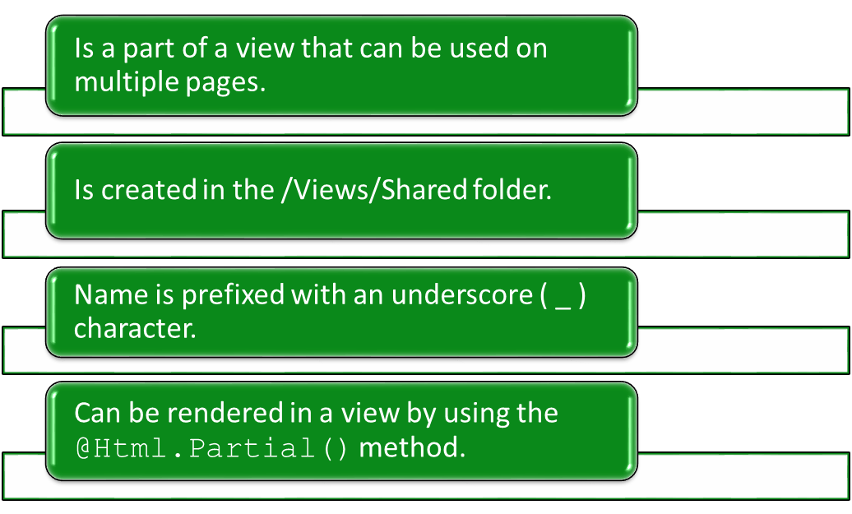
Using Partial Views
A partial view:

Slide 21
Using Partial Views (Contd.)
The following code snippet renders a partial view named _partialsummary within a view:
    <div>@Html.Partial(“_partialsummary”)</div>
Let us see how to create a partial view

Slide 22
Just a Minute
Which one of the following options is used to pass information from a controller to a view in an ASP.NET MVC application?
    Caching
    Routing
    ViewData

Slide 23
Just a Minute (Contd.)
Solution:
    ViewData

