Slide 1

Objectives
In this session, you will learn to:
    Work with models

Slide 2
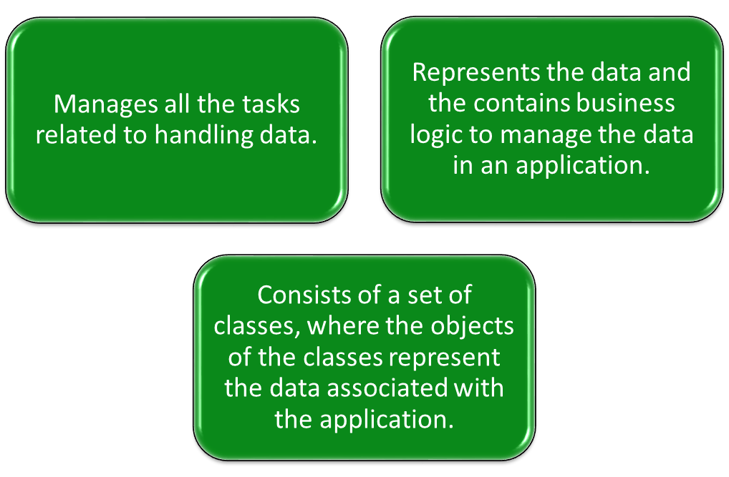
Working with Models
A model:

Slide 3
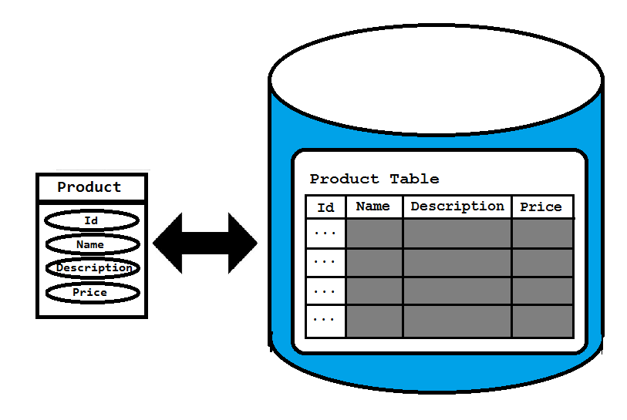
Working with Models (Contd.)
Suppose you have the data of products, which includes product name, description, and price.
To represent this data, you need to create a model class named Product with properties, such as Id, name, description, and price.
The structure of the model class should be similar to the structure of the Product table in the database as shown in the following figure.

Slide 4
Working with Models (Contd.)
The direct mapping between the properties of the Product class and
the fields of the Product table is called object-relational mapping -ORM.

Slide 5
Creating a Model
Suppose you need to add a class in the model that defines the properties of the product, such as Id, product name, description, and price.
The following code snippet declares the model class:
public class Product
{
public long Id {get; set;}
public string name {get; set;}
public string description {get; set;}
public int price {get; set;}
}
All model classes are stored in the Models folder within an ASP.NET MVC application.
Let us see how to create a model

Slide 6
Accessing a Model Within a Controller
You need to create an object of the model class in the Product action method, as shown in the following code snippet:
public ActionResult Product()
{
var product = new Newbay.Models.Product();
product.name = "Samsung 5676 Mobile";
product.description = "Newly launched with touch screen";
product.price = 15000;
return View();
}
To refer to the Product model class, the qualifier, Newbay.Models, is used.
This qualifier can be omitted by including the namespace, Newbay.Models, at the top of the controller class, as shown in the following code snippet:
using Newbay.Models

Slide 7
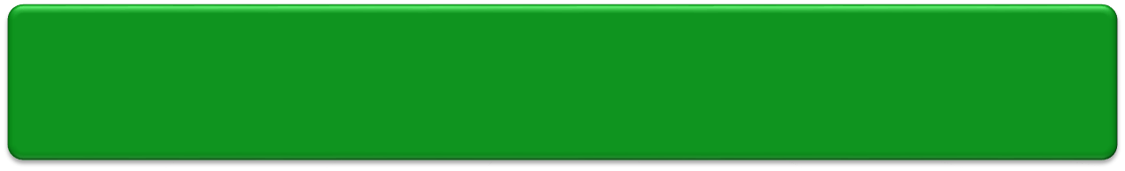
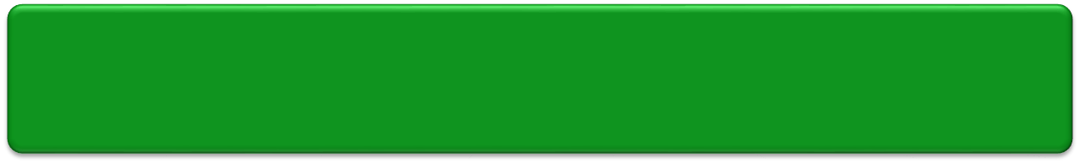
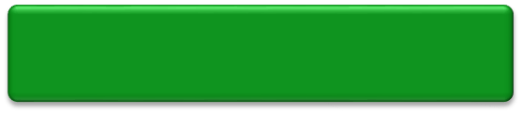
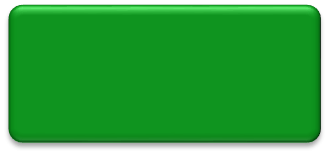
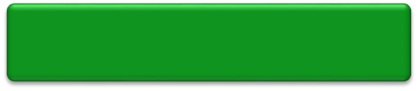
Passing Model Data from a Controller to a View
Model data needs to be made accessible to a view so that it can be displayed to the users.
For this, the controller can pass the model data to the view at the time of invoking the view.
Single object
Model data
Collection of objects

Slide 8
Passing Model Data from a Controller to a View using ViewBag
You can pass the model data from a controller to a view by using ViewBag.
  Example:
    public IActionResult Product(){
    var product = new Product();
    product.name = "Samsung 5676 Mobile";
    product.price = 15000;
    ViewBag.product = product;
    return View();
    }
    You can access the passed data on the corresponding view with the help of ViewBag, as shown in the following code snippet:
    @ViewBag.product.name<br/>
    @ViewBag.product.price<br/>

Slide 9
Passing Model Data from a Controller to a View by passing the Object
    Alternatively, you can pass the data to a view by passing the object as a parameter to the view, as shown in the following code snippet:
    public IActionResult Product()
    {
    var product = new Product();
    product.name = "Samsung 5676 Mobile";
    product.price = 15000;
    return View(product);
    }
    When you pass data object as a parameter to the view, you can use @Model to access the passed data on corresponding view.
    Example:
    @Model.name <br/>
    @Model.price <br/>

Slide 10
Passing Model Data from a Controller to a View
Pass a collection of objects using ViewBag
Similar to a single object, you can pass a collection of objects from a controller to a view by using ViewBag.
Example:
public IActionResult Productlist()
{
var products = new List<Product>();
var product1 = new Product();
product1.name = "Samsung 5676 Mobile";
product1.price = 15000;
var product2 = new Product();
product2.name = "Dell Inspiron 1545 laptop";
product2.price = 40000;
products.Add(product1);
products.Add(product2);
ViewBag.products = products;
return View();
}

Slide 11
Passing Model Data from a Controller to a View
Pass a collection of objects using ViewBag
To access the passed data on corresponding view, you need to iterate through the collection of objects stored in ViewBag.
Example:
@{
var products = ViewBag.products;
}
@foreach (var p in products)
{
@p.name<br />
@p.price<br />
<br />
}

Slide 12
Passing Model Data from a Controller to a View
Passing a collection of objects as a parameter
Alternatively, you can pass the data to a view by passing a collection of objects as a parameter to the view.
Example:
public IActionResult Productlist()
{
var products = new List<Product>();
var product1 = new Product();
product1.name = "Samsung 5676 Mobile";
product1.price = 15000;
var product2 = new Product();
product2.name = "Dell Inspiron 1545 laptop";
product2.price = 40000;
products.Add(product1);
products.Add(product2);
      return View(products);
}

Slide 13
Passing Model Data from a Controller to a View (Contd.)
Passing a collection of objects as a parameter
When you pass collection of objects as a parameter to the view, you can use model to access the passed data on corresponding view.
Example:
@{
var products = Model;
}
@foreach(var p in products)
{
@p.name <br />
@p.price <br />
<br/>
}

Slide 14
Passing Model Data from a Controller to a View (Contd.)
Let us see how to pass model data from a controller to a view
Zoom Me Application using Interface and a Student Repository class – Initialize Data in a repository
AlfaOneTech Application by creating an in-memory collection of objects. This isn’t useful in a real application because the student data will be lost when the application is stopped or restarted.

Slide 15
Asynchronous code
Asynchronous programming is the default mode for ASP.NET Core and EF Core.
A web server has a limited number of threads available, and in high load situations all of the available threads might be in use.
When that happens, the server can't process new requests until the threads are freed up.
With synchronous code, many threads may be tied up while they aren't actually doing any work because they're waiting for I/O to complete.
With asynchronous code, when a process is waiting for I/O to complete, its thread is freed up for the server to use for processing other requests.
As a result, asynchronous code enables server resources to be used more efficiently, and the server is enabled to handle more traffic without delays.
Asynchronous code does introduce a small amount of overhead at run time, but for low traffic situations the performance hit is negligible, while for high traffic situations, the potential performance improvement is substantial.

Slide 17
Introduction to Scaffolding
Scaffolding
Allows you to create auto-generated controllers and their corresponding views.
Uses a predefined convention for naming controllers and views.
Knows where to place auto-generated codes for the application to work.

Slide 18
Introduction to Scaffolding (Contd.)
Empty MVC controller
MVC controller with empty read/write actions
Scaffolding templates
API controller with empty read/write actions
MVC controller with read/write actions and views using Entity Framework

Slide 19


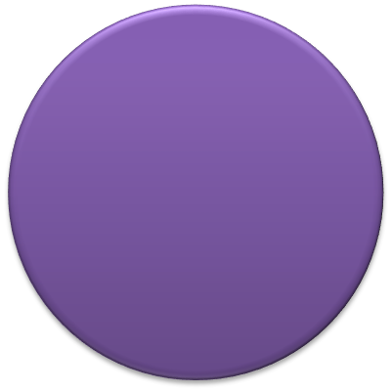






Introduction to Scaffolding (Contd.)
In addition, scaffolding provides various templates for creating views.
List
Delete
Templates for Creating Views
Create
Details
Edit

Slide 20
Introduction to Scaffolding (Contd.)
Let us see how to create views using scaffolding templates

Slide 21
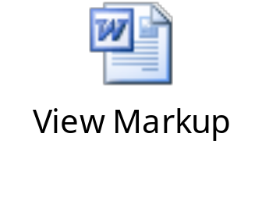
The List Template
The List template is used to create a view that displays a list of model objects.
This list is passed to the view through a controller action, as shown in the following code snippet:
public ActionResult Index()
{
var products = new List<Product>();
//Code to populate the products collection
return View(products);
}
The following embedded Word document contains the markup generated, when you create a view for the Product model using the List template.

Slide 22
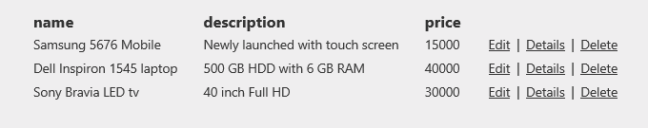
The List Template (Contd.)
The sample output generated by the preceding markup is displayed in the following figure.

Slide 23
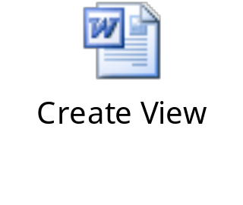
The Create Template
The Create template can be used to generate a view that needs to be used for accepting the details of a new object to be stored in a data store.
To render a view based on the Create template, you need to create an action method, as shown in the following code snippet:
public ActionResult Create()
{
return View();
}
The following embedded Word document contains the markup generated, when you create a view named Create for the Product model using the Create template.

Slide 24
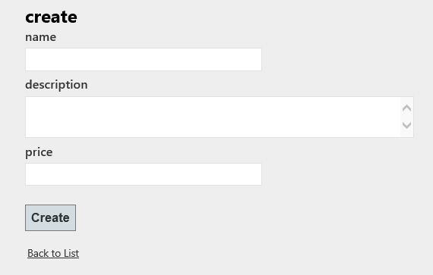
The Create Template (Contd.)
The preceding markup will generate a view, as shown in the following figure.

Slide 25
The Create Template (Contd.)
Further, to handle the HTTP POST request, another action method named Create needs to be created as shown in the following code snippet:
[HttpPost]
public ActionResult Create(Product product)
{
/*Code to save the details of the product object to a data
store and return an appropriate view. */
}
In addition, the originally created Create method can be decorated with the HttpGet attribute, as shown in the following code snippet:
[HttpGet]
public ActionResult Create()
{
return View();
}

Slide 26
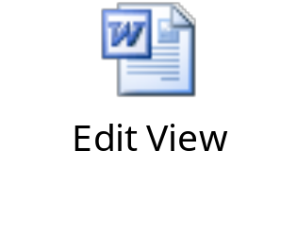
The Edit Template
The Edit template can be used to generate a view that needs to be used for modifying the details of an existing object stored in a data store.
To render a view, you need to create an action method that passes the model object to be edited to the view.
The following embedded Word document contains the markup generated, when you create a view named Edit for the Product model using the Edit template.

Slide 27
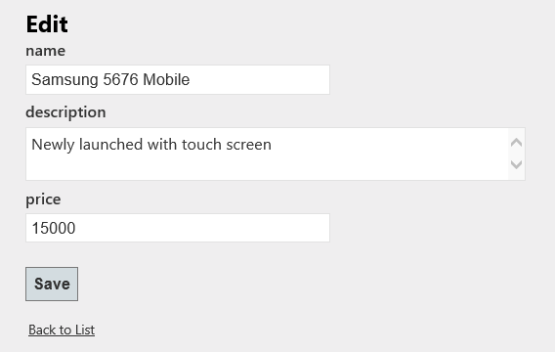
The Edit Template (Contd.)
The preceding markup will generate the view, as shown in the following figure.
To handle the HTTP POST request of the preceding view,
you need to create another action method named Edit()
with an HttpPost attribute.

Slide 28
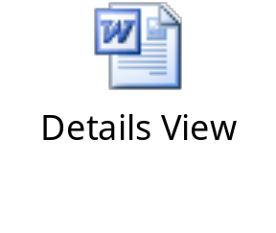
The Details Template
The Details template is used to create a view that displays details of a model object.
The details of the model object are passed to the view through a controller action.
The following embedded Word document contains the markup generated, when you create a view for the Product model using the Details template.

Slide 29
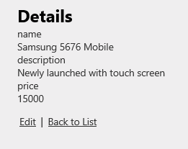
The Details Template (Contd.)
The preceding markup will generate the view, as shown in the following figure.

Slide 30
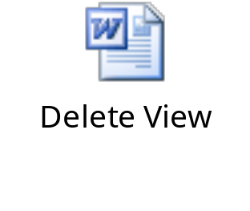
The Delete Template
The Delete template can be used to generate a view that needs to be used for deleting an existing object from a data store.
To render a view, you need to create an action method that passes the model object to be deleted to the view.
The following embedded Word document contains the markup generated, when you create a view for the Product model using the Delete template.

Slide 31
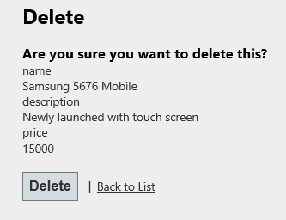
The Delete Template (Contd.)
The preceding markup will generate the following interface.
To handle the HTTP POST requests of the preceding view,
another action method named DeleteConfirmed() needs
to be created with an HttpPost attribute.

Slide 33
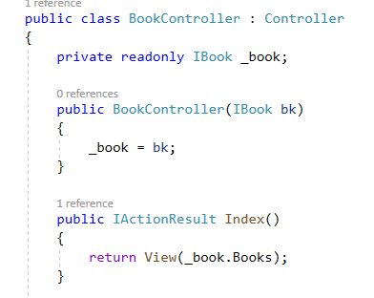
ASP.NET Core Dependency Injection
What is Dependency Injection
    The Dependency Injection a process of injecting the object of a class into a class that depends on it.
    The Dependency Injection is the most commonly used design pattern nowadays to remove the dependencies between the objects.
    So, the Dependency Injection design pattern allows us to develop loosely coupled software components.

Slide 34
Register a Service with Dependency Injection Container
    There is need to register a service with Dependency Injection Container within the ConfigureServices() method of the Startup class
    It is important to understand the lifetime of service
    When a class receives the dependency object through dependency injection, then whether the instance it receives is unique to that instance of the class or not depends on the lifetime of the service.
    Setting the lifetime of the dependency object determines how many times the dependency object needs to be created.
3 methods to register a service
  AddSingleton:- It means a single instance of that service is created and that singleton instance is shared among all the components of the application that require it. That singleton service is created when we requested for the first time.
  AddScoped:- It means, an instance of the service is created once per each HTTP request and uses that instance in other calls of the same request.
  AddTransient:- It means a new instance of the specified service is created each time when it is requested and they are never shared.

Slide 35
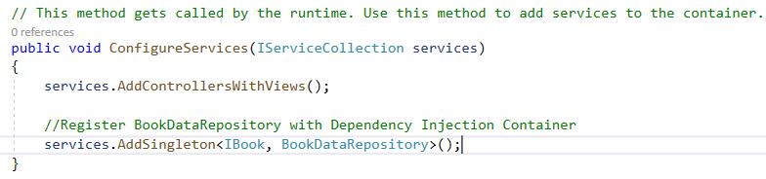
Register a Service with Dependency Injection Container
Note:
In the real-time applications, you need to register the components such as application-wide configuration as Singleton.
The Database access classes like Entity Framework contexts are recommended to be registered as Scoped so that the connection can be re-used.
And, if you want to run anything in parallel then it is better to register the component as Transient.
Registering the BookDataRepository with Dependency Injection

Slide 37
Introduction to Entity Framework Core
Entity Framework Core
    Framework (EF) Core is an ORM (Object-Relational Mapper) Framework for data access in .Net. It was released along with .NET Core and is an extensible, lightweight, Open Source, and cross-platform version of Entity Framework data access technology. It works on multiple operating systems like Windows, Mac, and Linus
What is ORM
The term ORM stands for Object-Relational Mapper and it automatically creates classes based on database tables and the vice versa. That is, it can also generate the necessary SQL to create the database based on the classes.
As a developer, we mostly work with the application business objects and the ORM Framework generates the necessary SQL (to perform the CRUD operation) that the underlying database can understand.
So, in simple words, we can say that the ORM Framework eliminates the need for most of the data access code that as a developer we generally write.

Slide 38
Introduction to Entity Framework Core
Why we need to use an ORM
Suppose we want to develop an application to manage the students of a college.
In order to do this, we may need to create classes such as Student, Department, Address, etc. Technically we called these classes as Domain classes.
Without using ORM Framework like Entity Framework or EF Core, we have to write lots of data access code to perform the CRUD operations i.e. store and retrieve the Student, Department and Address data from the underlying database tables.
For example, in order to perform CRUD operations i.e. read, insert, update or delete from a database table, we generally need to write custom code in our application to generate the required SQL statements which can be understood by the underlying database.
Again, when we want to read the data from the database into our application, then also we have to write some custom code to map the database data to our model classes like Student, Department, Address, etc. This is a very common task as a developer for us that we do almost in every application.
An ORM Framework like Entity framework or EF Core can do all of the above for us and saves a lot of time if we provide the necessary required information to the ORM Framework.
The ORM Framework sits between our application code and the Database. It eliminates the need for most of the custom data-access code that we usually write without an ORM

Slide 39
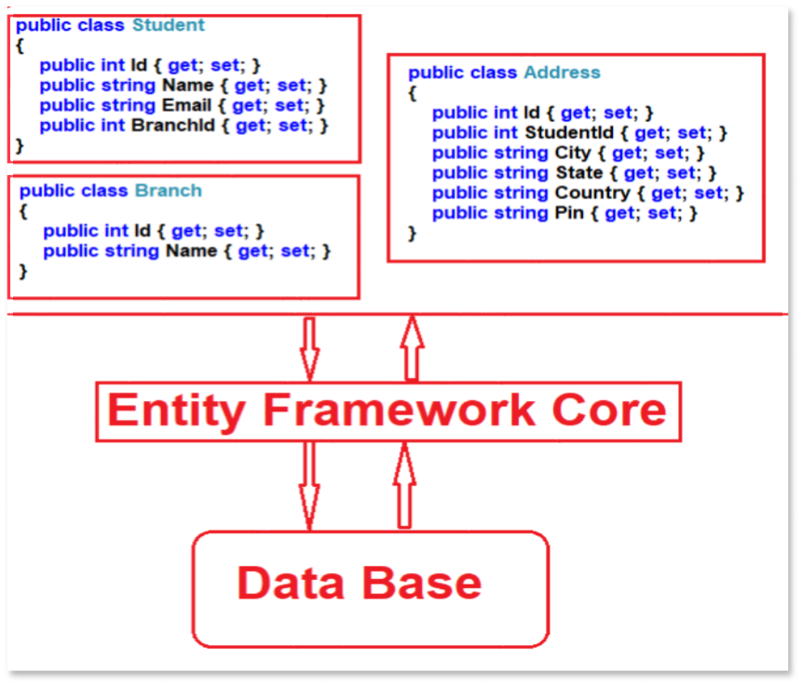
Introduction to Entity Framework Core

Slide 40
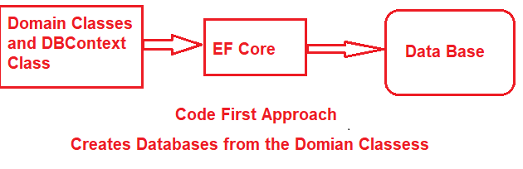
Introduction to Entity Framework Core
EF Core Approaches
They are as follows:
Code-First Approach
Database-First Approach
EF Core mainly targets the code-first approach and provides little support for the database-first approach at the moment.
EF Core Code First Approach
In the EF Core, Code First Approach, you need to create application domain classes such as Student, Branch, Address, etc. and a special class that derives from Entity Framework DB Context class. Then based on the application domain classes and DBContext class, the EF Core creates the database and related tables

Slide 41
Introduction to Entity Framework Core
Code-First Approach
Out of the box, in the code-first approach, the EF Core API creates the database and tables using migration based on the default conventions and configuration. If you want then you can also change the default conventions used to create the database and its related tables.
This approach is useful in Domain-Driven Design (DDD).

Slide 42
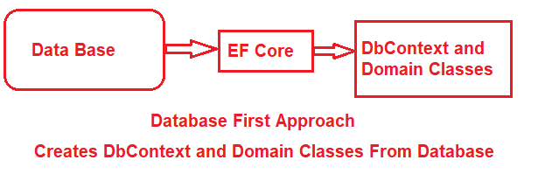
Introduction to Entity Framework Core
EF Core Database First Approach
If you have an existing database and database tables are already there, then you need to use the EF Core Database First Approach. In the database-first approach, the EF Core creates the DBContext and Domain classes based on the existing database schema using EF Core Command

Slide 43
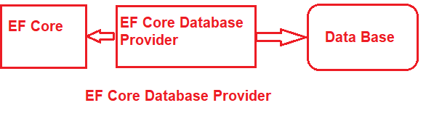
Introduction to Entity Framework Core
EF Core Database Providers
The EF Core supports both relational and non-relational databases and this is possible due to database providers. The database providers are available as NuGet packages. The Database Provider sits between the EF Core and the database it supports
The EF Core database provider usually contains the functionality specific to the database it supports.
Functionality that is common to all the databases is in the EF Core component.
Functionality that is specific to a database, for example, Microsoft SQL Server-specific functionality is with-in the SQL Server provider for EF Core.

Slide 44
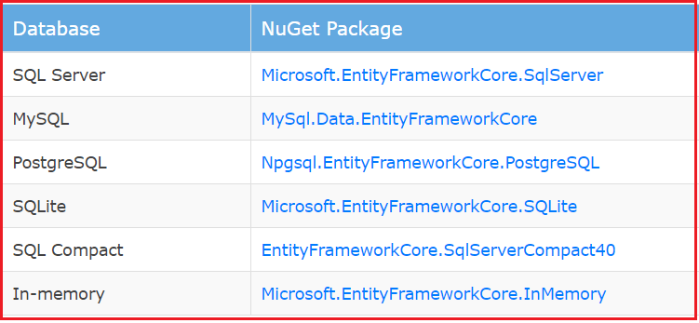
Introduction to Entity Framework Core
EF Core Database Providers
The following image shows the database providers and the NuGet packages for EF Core

Slide 45
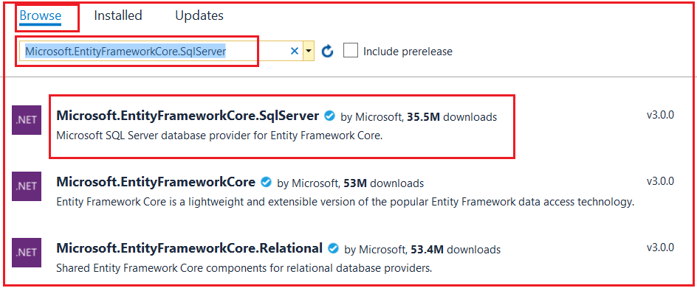
Introduction to Entity Framework Core
Install Entity Framework Core
The following image shows the database providers and the NuGet packages for EF Core

