Slide 1

Objectives
In this session, you will learn to:
    Work with models

Slide 2
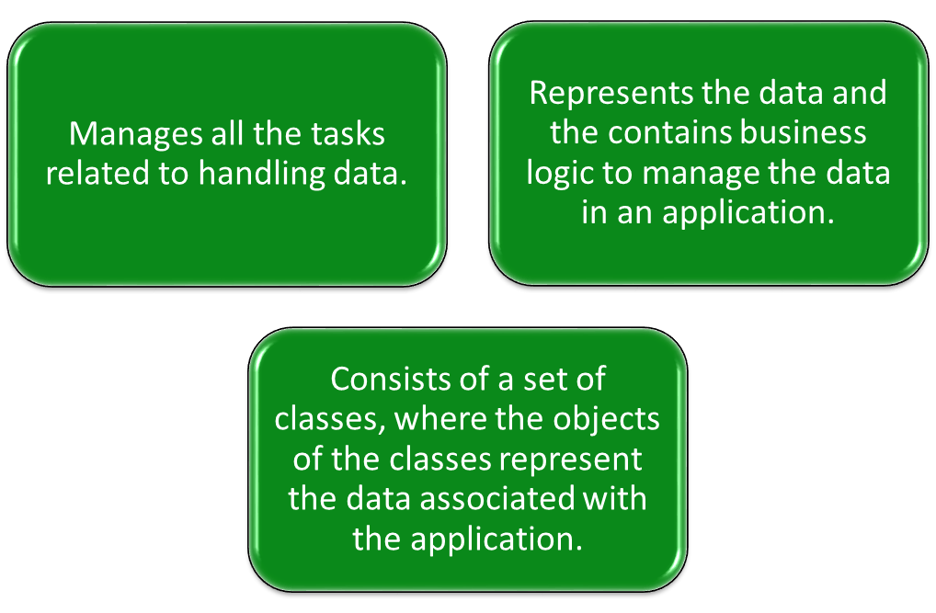
Working with Models
A model:

Slide 3
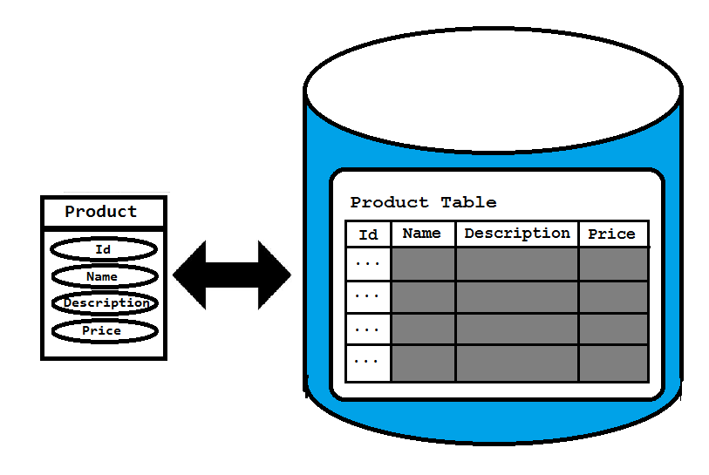
Working with Models (Contd.)
Suppose you have the data of products, which includes product name, description, and price.
To represent this data, you need to create a model class named Product with properties, such as Id, name, description, and price.
The structure of the model class should be similar to the structure of the Product table in the database as shown in the following figure.

Slide 4
Working with Models (Contd.)
The direct mapping between the properties of the Product class and
the fields of the Product table is called object-relational mapping -ORM.

Slide 5
Creating a Model
Suppose you need to add a class in the model that defines the properties of the product, such as Id, product name, description, and price.
The following code snippet declares the model class:
public class Product
{
public long Id {get; set;}
public string name {get; set;}
public string description {get; set;}
public int price {get; set;}
}
All model classes are stored in the Models folder within an ASP.NET MVC application.
Let us see how to create a model

Slide 6
Accessing a Model Within a Controller
You need to create an object of the model class in the Product action method, as shown in the following code snippet:
public ActionResult Product()
{
var product = new Newbay.Models.Product();
product.name = "Samsung 5676 Mobile";
product.description = "Newly launched with touch screen";
product.price = 15000;
return View();
}
To refer to the Product model class, the qualifier, Newbay.Models, is used.
This qualifier can be omitted by including the namespace, Newbay.Models, at the top of the controller class, as shown in the following code snippet:
using Newbay.Models

Slide 7
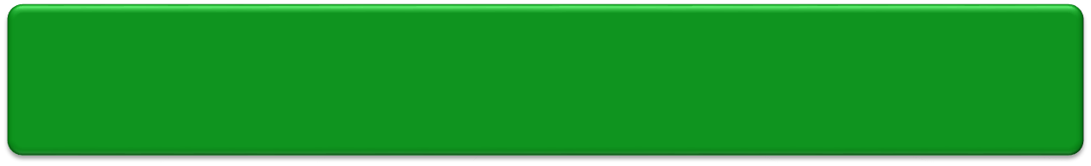
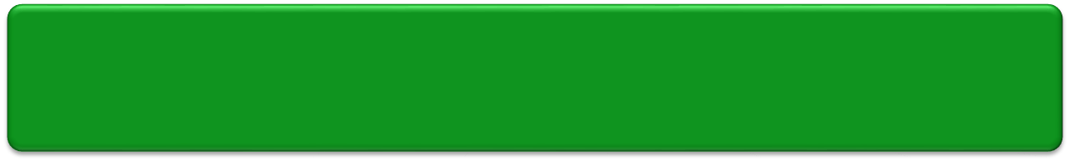
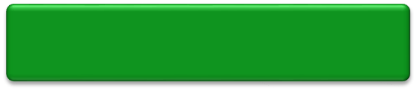
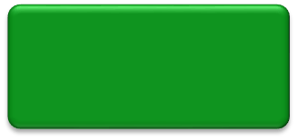
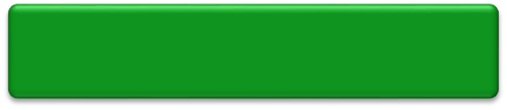
Passing Model Data from a Controller to a View
Model data needs to be made accessible to a view so that it can be displayed to the users.
For this, the controller can pass the model data to the view at the time of invoking the view.
Single object
Model data
Collection of objects

Slide 8
Passing Model Data from a Controller to a View using ViewBag
You can pass the model data from a controller to a view by using ViewBag.
  Example:
    public IActionResult Product(){
    var product = new Product();
    product.name = "Samsung 5676 Mobile";
    product.price = 15000;
    ViewBag.product = product;
    return View();
    }
    You can access the passed data on the corresponding view with the help of ViewBag, as shown in the following code snippet:
    @ViewBag.product.name<br/>
    @ViewBag.product.price<br/>

Slide 9
Passing Model Data from a Controller to a View by passing the Object
    Alternatively, you can pass the data to a view by passing the object as a parameter to the view, as shown in the following code snippet:
    public IActionResult Product()
    {
    var product = new Product();
    product.name = "Samsung 5676 Mobile";
    product.price = 15000;
    return View(product);
    }
    When you pass data object as a parameter to the view, you can use @Model to access the passed data on corresponding view.
    Example:
    @Model.name <br/>
    @Model.price <br/>

Slide 10
Passing Model Data from a Controller to a View
Pass a collection of objects using ViewBag
Similar to a single object, you can pass a collection of objects from a controller to a view by using ViewBag.
Example:
public IActionResult Productlist()
{
var products = new List<Product>();
var product1 = new Product();
product1.name = "Samsung 5676 Mobile";
product1.price = 15000;
var product2 = new Product();
product2.name = "Dell Inspiron 1545 laptop";
product2.price = 40000;
products.Add(product1);
products.Add(product2);
ViewBag.products = products;
return View();
}

Slide 11
Passing Model Data from a Controller to a View
Pass a collection of objects using ViewBag
To access the passed data on corresponding view, you need to iterate through the collection of objects stored in ViewBag.
Example:
@{
var products = ViewBag.products;
}
@foreach (var p in products)
{
@p.name<br />
@p.price<br />
<br />
}

Slide 12
Passing Model Data from a Controller to a View
Passing a collection of objects as a parameter
Alternatively, you can pass the data to a view by passing a collection of objects as a parameter to the view.
Example:
public IActionResult Productlist()
{
var products = new List<Product>();
var product1 = new Product();
product1.name = "Samsung 5676 Mobile";
product1.price = 15000;
var product2 = new Product();
product2.name = "Dell Inspiron 1545 laptop";
product2.price = 40000;
products.Add(product1);
products.Add(product2);
      return View(products);
}

Slide 13
Passing Model Data from a Controller to a View (Contd.)
Passing a collection of objects as a parameter
When you pass collection of objects as a parameter to the view, you can use model to access the passed data on corresponding view.
Example:
@{
var products = Model;
}
@foreach(var p in products)
{
@p.name <br />
@p.price <br />
<br/>
}

Slide 14
Passing Model Data from a Controller to a View (Contd.)
Let us see how to pass model data from a controller to a view
Zoom Me Application using Interface and a Student Repository class – Initialize Data in a repository
AlfaOneTech Application by creating an in-memory collection of objects. This isn’t useful in a real application because the student data will be lost when the application is stopped or restarted.

Slide 15
Asynchronous code
Asynchronous programming is the default mode for ASP.NET Core and EF Core.
A web server has a limited number of threads available, and in high load situations all of the available threads might be in use.
When that happens, the server can't process new requests until the threads are freed up.
With synchronous code, many threads may be tied up while they aren't actually doing any work because they're waiting for I/O to complete.
With asynchronous code, when a process is waiting for I/O to complete, its thread is freed up for the server to use for processing other requests.
As a result, asynchronous code enables server resources to be used more efficiently, and the server is enabled to handle more traffic without delays.
Asynchronous code does introduce a small amount of overhead at run time, but for low traffic situations the performance hit is negligible, while for high traffic situations, the potential performance improvement is substantial.

Slide 16
Summary
In this session, you learned that:
    The following two common techniques are used to pass data from a controller to a view:
      ViewData
      ViewBag
    ViewData is a dictionary of objects derived from the ViewDataDictionary class.
    ViewBag is just a dynamic wrapper over the ViewData dictionary.
    A partial view is a part of a view that can be used on multiple pages.
    You can render a partial view in a view by using the @Html.Partial() method.
    In an MVC application, the component that enables interaction with data is called model.
    A model consists of a set of classes, where the objects of the classes represent the data associated with the application.

Slide 17
Introduction to Scaffolding
Scaffolding
Allows you to create auto-generated controllers and their corresponding views.
Uses a predefined convention for naming controllers and views.
Knows where to place auto-generated codes for the application to work.

Slide 18
Introduction to Scaffolding (Contd.)
Empty MVC controller
MVC controller with empty read/write actions
Scaffolding templates
API controller with empty read/write actions
MVC controller with read/write actions and views using Entity Framework

Slide 19
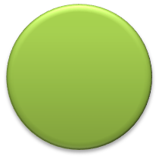
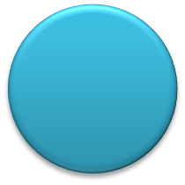
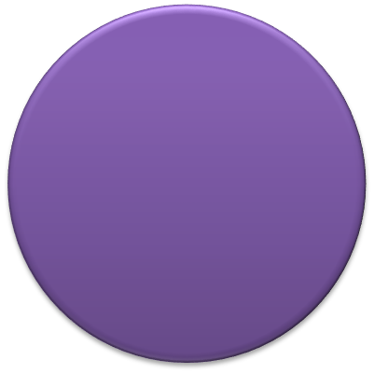
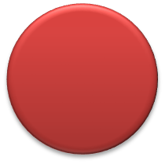
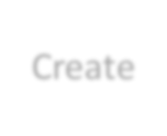
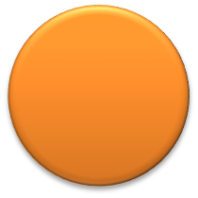
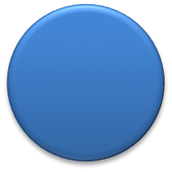
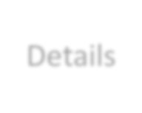
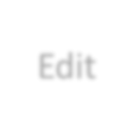
Introduction to Scaffolding (Contd.)
In addition, scaffolding provides various templates for creating views.
List
Delete
Templates for Creating Views
Create
Details
Edit

Slide 20
Introduction to Scaffolding (Contd.)
Let us see how to create views using scaffolding templates

Slide 21
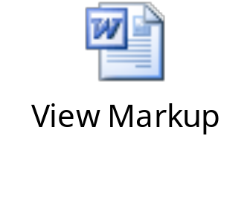
The List Template
The List template is used to create a view that displays a list of model objects.
This list is passed to the view through a controller action, as shown in the following code snippet:
public ActionResult Index()
{
var products = new List<Product>();
//Code to populate the products collection
return View(products);
}
The following embedded Word document contains the markup generated, when you create a view for the Product model using the List template.

Slide 22
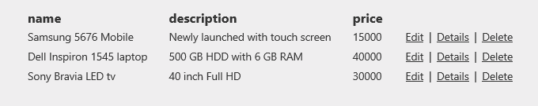
The List Template (Contd.)
The sample output generated by the preceding markup is displayed in the following figure.

Slide 23
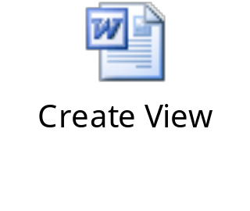
The Create Template
The Create template can be used to generate a view that needs to be used for accepting the details of a new object to be stored in a data store.
To render a view based on the Create template, you need to create an action method, as shown in the following code snippet:
public ActionResult Create()
{
return View();
}
The following embedded Word document contains the markup generated, when you create a view named Create for the Product model using the Create template.

Slide 24
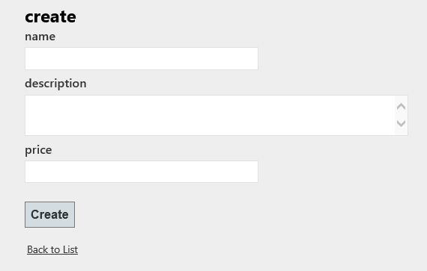
The Create Template (Contd.)
The preceding markup will generate a view, as shown in the following figure.

Slide 25
The Create Template (Contd.)
Further, to handle the HTTP POST request, another action method named Create needs to be created as shown in the following code snippet:
[HttpPost]
public ActionResult Create(Product product)
{
/*Code to save the details of the product object to a data
store and return an appropriate view. */
}
In addition, the originally created Create method can be decorated with the HttpGet attribute, as shown in the following code snippet:
[HttpGet]
public ActionResult Create()
{
return View();
}

Slide 26
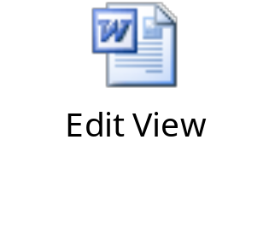
The Edit Template
The Edit template can be used to generate a view that needs to be used for modifying the details of an existing object stored in a data store.
To render a view, you need to create an action method that passes the model object to be edited to the view.
The following embedded Word document contains the markup generated, when you create a view named Edit for the Product model using the Edit template.

Slide 27
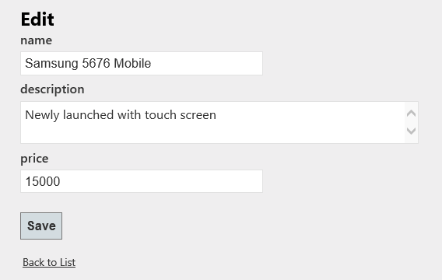
The Edit Template (Contd.)
The preceding markup will generate the view, as shown in the following figure.
To handle the HTTP POST request of the preceding view,
you need to create another action method named Edit()
with an HttpPost attribute.

Slide 28
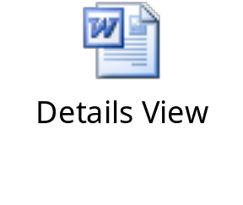
The Details Template
The Details template is used to create a view that displays details of a model object.
The details of the model object are passed to the view through a controller action.
The following embedded Word document contains the markup generated, when you create a view for the Product model using the Details template.

Slide 29
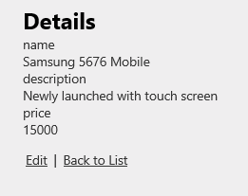
The Details Template (Contd.)
The preceding markup will generate the view, as shown in the following figure.

Slide 30
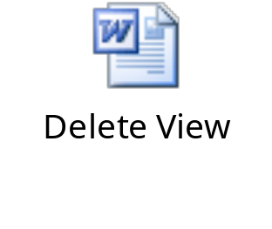
The Delete Template
The Delete template can be used to generate a view that needs to be used for deleting an existing object from a data store.
To render a view, you need to create an action method that passes the model object to be deleted to the view.
The following embedded Word document contains the markup generated, when you create a view for the Product model using the Delete template.

Slide 31
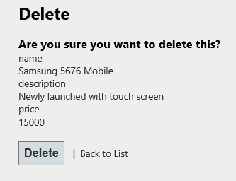
The Delete Template (Contd.)
The preceding markup will generate the following interface.
To handle the HTTP POST requests of the preceding view,
another action method named DeleteConfirmed() needs
to be created with an HttpPost attribute.

