Slide 1

Objectives
In this session, you will learn to:
    Identify the fundamentals of LINQ
    Access data from disparate data sources

Slide 2

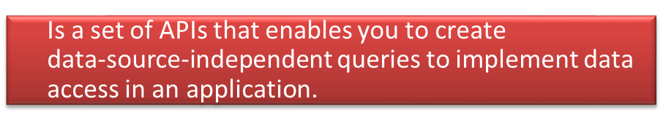



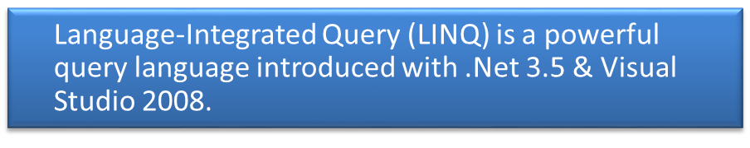
Introduction to LINQ
LINQ
Has a programming model that provides the standard query syntax to query different types of data sources.

Slide 3
Using a Simple LINQ Query
LINQ offers a consistent programming model to query data from different data sources.
All LINQ query operations consist of the following three distinct actions:
Obtain the data source
Create the query
Execute the query

Slide 4



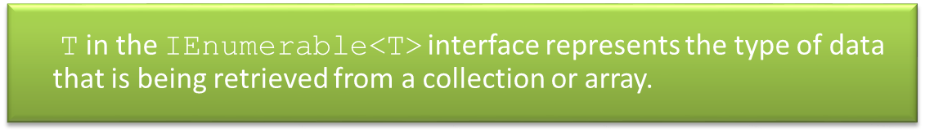

Using a Simple LINQ Query (Contd.)
The IEnumerable<T> interface is available in the System.Collections namespace.

Slide 5




Using a Simple LINQ Query (Contd.)
A query specifies the type of information to be retrieved from the data source.
A query is written by using a query expression that uses the standard query syntax, and is stored in a query variable.
The query variable stores the information that is required to produce the results when the query is executed.
Example:
IQueryable<Customer> q = from s in db.customers select s;

Slide 6




Using a Simple LINQ Query (Contd.)
It is useful in situations where the database is constantly updated.
Example:
string names = "";
IQueryable<Customer> q = from s in db.customers
select s;
foreach (var cust in q){
names = names+" "+cust.Name;
}
ViewBag.Name = names;

Slide 7
Using a Simple LINQ Query (Contd.)
Queries that perform aggregate functions over a range of source elements, execute without explicitly using the foreach loop and return a single value.
These queries are executed at the time of their definition, which is referred to as immediate execution.
    Example:
int customerCount = (from s in db.customers select s).Count();
ViewBag.Count = customerCount;
    You can also force immediate execution of a query by calling the ToList<TSource>() or ToArray<TSource>() method.
    Example:
    List<string> names = (from s in db.customers select s.Name).ToList();

Slide 8
Using a Simple LINQ Query (Contd.)
    The ToArray<TSource>() method forces immediate query execution and returns an array that caches the query results.
    Example:
string[] names = (from s in db.customers select s.Name).ToArray();

Slide 9
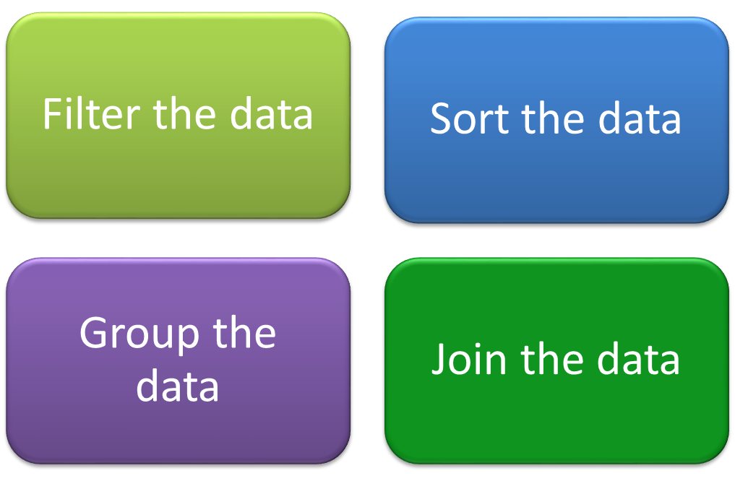
Using LINQ Queries to Filter, Sort, Group, and Join Data
Apart from selecting data, a query can perform the following operations on data:

Slide 10
Using LINQ Queries to Filter, Sort, Group, and Join Data (Contd.)
Filtering the data:
    Filtering:
      Refers to the operation of restricting the result set to contain only those elements that satisfy a specified condition.
      Can be used effectively to filter out a set of objects from a list of objects.
    Example:
IQueryable<Customer> q = from s in db.customers where s.City
== "Tokyo” select s;
    You can use the logical operators, such as AND (&&) and OR (||), to apply multiple filters as necessary in the where clause.
    Example:
IQueryable<Customer> q = from s in db.customers
where s.City == "Tokyo" && s.Name == "Tom” select s;

Slide 11
Using LINQ Queries to Filter, Sort, Group, and Join Data (Contd.)
Sorting the data:
    LINQ queries can also be used to retrieve data and display it in a sorted manner.
    For this, you need to use the orderby clause.
    The orderby clause specifies the order in which the result of the query should be sorted.
    The default sort order is ascending.
    Example:
IQueryable<Customer> q = from s in db.customers
where s.City == "Tokyo” orderby s.Name descending select s;

Slide 12
Using LINQ Queries to Filter, Sort, Group, and Join Data (Contd.)
Grouping the data:
    The group clause enables you to group the results based on a key that you specify.
    Example:
    var q = from s in db.customers group s by s.City;
    The result returned by a group clause is a list of lists.
    Each element in the list is an object that has a member named Key.
    In addition, it contains a list of elements that are grouped under that key.
    To execute a query that contains the group clause, you need to use nested foreach loops, as shown in the following code snippet:
    var result = "";
foreach (var group in q){
result += group.Key + " : ";
foreach (var entry in group){
result += entry.Name + " ";
}
result += " | ";
}

Slide 13
Using LINQ Queries to Filter, Sort, Group, and Join Data (Contd.)
Joining the data:
    In LINQ, you can use the join clause to associate the elements in one table with the elements in another table, where the two tables share a common attribute.
    It enables you to retrieve the elements from different tables on the basis of a common attribute.
    You need to use the equals keyword to compare the data in the common attribute.
    Example:
var customers = db.customers;
var orderdetails = db.orderdetails;
var list = (from s in customers join t in orderdetails on
s.Name equals t.Customer where s.Gender == "M“
select new {Customer=s.Name, Product=t.Product}).ToList();
var orders = "";
foreach (var order in list){
orders += order.Customer + " : " + order.Product
+ " “; }

Slide 14
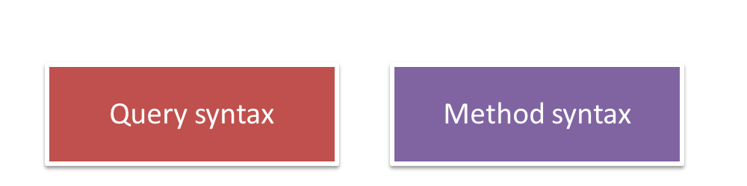
Syntax of LINQ Queries
LINQ queries in C# can be written by using two different syntaxes:
A query expression written by using the query syntax is translated into method calls at the time of compilation.
The method calls finally invoke the standard query operators, such as Where, Select, and GroupBy.

Slide 15
Syntax of LINQ Queries (Contd.)
You can directly invoke the query operators by using the method syntax.
The method syntax:
    Specifies an exact order in which the methods in a query are to be called.
    Uses the standard method invocation, using which the standard query operators are directly called.
    Is used in cases where a single numeric value is returned, such as Sum, Max, Min, and Average.
Example:
IEnumerable<Customer> q = db.customers.Where(C =>
C.City=="Tokyo").OrderBy(C => C.Name);
foreach (var cust in q)
{
names = names + " " + cust.Name;
}
ViewBag.Name = names;

Slide 16
Just a Minute
Which one of the following clauses is used to order the elements in a proper sequence?
    Sort
    Join
    Group

Slide 17
Just a Minute (Contd.)
Solution:
    Sort

Slide 18
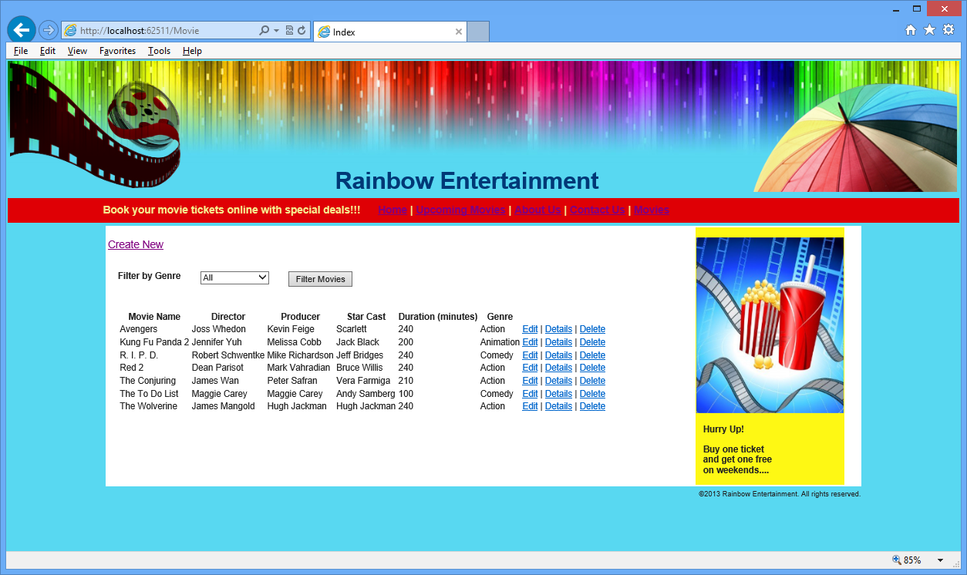
Demo: Using LINQ Queries
Problem Statement:
    As a member of the development team at GlobalIT, you have developed a Web application for Rainbow Entertainment. Now, you have been assigned a task to allow users to filter the movies based on their genre. For this, the existing Movie page is modified, as shown in the following figure.

Slide 19
Demo: Using LINQ Queries (Contd.)
    The user can filter the movie details by selecting a genre from the Filter by Genre drop-down list, and then clicking the Filter Movies button. When this is done, the details of only those movies that belong to the selected genre are displayed on the Movie page.
    In addition, the movie details on the Movie page should be displayed in the ascending order of movie name.
    Now, you need to help your teammates to accomplish the preceding task.

Slide 20
Demo: Using LINQ Queries (Contd.)
  Solution:
    To implement the preceding functionality, you need to perform the following tasks:
      Update the controller.
      Update the view.
      Execute the application and verify the output.

Slide 21
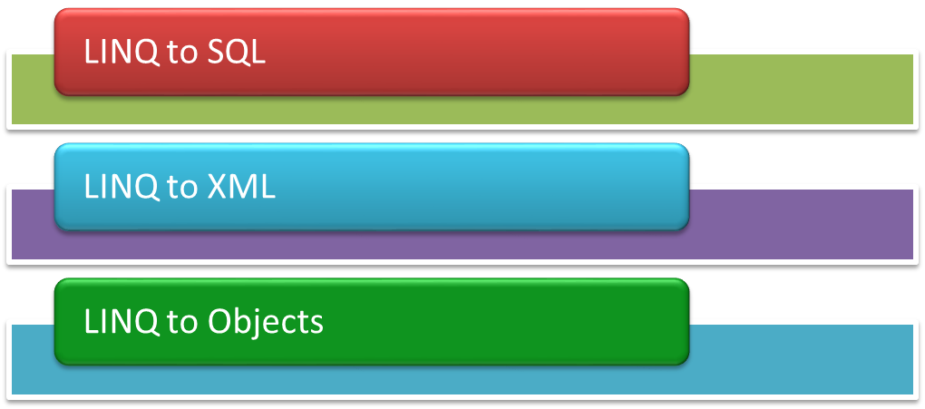
Accessing Data from Disparate Data Sources
LINQ provides a consistent programming model using which you can create the standard query syntax to query different types of data sources.
For this, LINQ provides the various LINQ providers, such as:

Slide 22
LINQ to SQL
The LINQ to SQL provider enables you to access SQL-complaint databases and makes data available as objects in an application.
On executing a LINQ to SQL query to retrieve the data from a database, the LINQ to SQL queries are converted into SQL queries.
These queries are sent to the database where the database query execution engine executes the queries and returns the results.
The results are converted back to objects by using LINQ to SQL, and then sent to the application.
LINQ to SQL uses an instance of the data context class of the application to cache the data retrieved from the database and send the data to the application.

Slide 23
LINQ to SQL (Contd.)
LINQ to SQL uses the instances of the model class to represent the tables of the database in the application.
Example:
    string names = "";
IQueryable<Customer> q = from s in db.customers select s;
foreach (var cust in q)
{
names += " " + cust.Name;
}

Slide 24
LINQ to XML
LINQ to XML:
    Is a LINQ-enabled, in-memory XML programming interface that enables you to work with XML from within the .NET Framework programming languages.
    Enables you to access data stored in XML files.
  Example:
    Consider the following XML content:
    <CustomersDetails>
<Customer>
<CustomerID>C001</CustomerID>
<Name>Svetlana</Name>
<City>London</City>
</Customer>
<Customer>
<CustomerID>C002</CustomerID>
<Name>Claire</Name>
<City >Paris</City>
</Customer>
</CustomersDetails>

Slide 25
LINQ to XML (Contd.)
    To access the data from the preceding XML content, you need to write the following code snippet:
string result = "";
XDocument xmlDoc =
Document.Load("D:\\CustomerDetails.xml");
var q = from c in xmlDoc.Descendants("Customer")
select (string)c.Element("CustomerID") + "-" +
(string)c.Element("Name") + "-" + (string)c.Element
("City") ;
foreach (string entry in q){
result += entry + " | ";
}

Slide 26
Summary
In this session, you learned that:
    LINQ offers a consistent programming model to query data from different data sources.
    All LINQ query operations consist of the following three distinct actions:
      Obtain the data source
      Create the query
      Execute the query
    In addition to selecting data, a query can perform the following operations on data:
      Filter the data
      Sort the data
      Group the data
      Join the data
    LINQ queries in C# can be written by using two different syntaxes:
      Query syntax
      Method syntax

Slide 27
Summary (Contd.)
    LINQ provides a consistent programming model using which you can create the standard query syntax to query different types of data sources.
    Some LINQ providers are:
      LINQ to SQL
      LINQ to XML
      LINQ to Objects

