Slide 1
Documents Management
8th September 2008

Slide 2
AGENDA
Introduction
Module 1. Document Repository Structure. (15 minutes)
  What is in the repository
  Explanation of each folder
Module 2. Management documents. (30 minutes)
  Online help modules states spreadsheet.
  Training materials inventory.
  Training materials states spreadsheet.
Notes:
©2005 Microsoft Corporation. All rights reserved.
This presentation is for informational purposes only. Microsoft makes no warranties, express or implied, in this summary.

Slide 3
Introduction
Context
  This presentation is aimed at providing a practical development on the training materials management process.
Audience
  This module is designed to provide guidance to the training materials maintainers.
Notes:
©2005 Microsoft Corporation. All rights reserved.
This presentation is for informational purposes only. Microsoft makes no warranties, express or implied, in this summary.

Slide 4
Introduction
Purpose
  This module introduces the training materials management process.
Notes:
©2005 Microsoft Corporation. All rights reserved.
This presentation is for informational purposes only. Microsoft makes no warranties, express or implied, in this summary.

Slide 5
Questions?
Next:
Module 1. Document Repository Structure.
Notes:
©2005 Microsoft Corporation. All rights reserved.
This presentation is for informational purposes only. Microsoft makes no warranties, express or implied, in this summary.

Slide 6
MODULE 1. New information needs to be added to MO10.
What you will learn from this module:
  Where to find the different documents inside the repository.
Notes:
©2005 Microsoft Corporation. All rights reserved.
This presentation is for informational purposes only. Microsoft makes no warranties, express or implied, in this summary.

Slide 7
1.1 What is in the repository
Help Studio source files
Online help release files.
Training materials documents
Management documents
Notes:
©2005 Microsoft Corporation. All rights reserved.
This presentation is for informational purposes only. Microsoft makes no warranties, express or implied, in this summary.
There are three types of repository items:
Help Studio source files
Online help release files.
Training materials documents
Management documents
Help Studio source files.
Files used by help studio to provide and online help system. This includes help texts, plug-ins, images, stylesheets.
Online help release files.
It is the output of help studio, and a mirror of the online contextual help uploaded to the bch server.
Training materials documents
All the training materials including the ones that are part of the online help (training modules MOs 01, 02, 03, 04 , 10) and those that are not.
Management documents
Documents used to manage the progress of the project and the state of the documents.

Slide 8
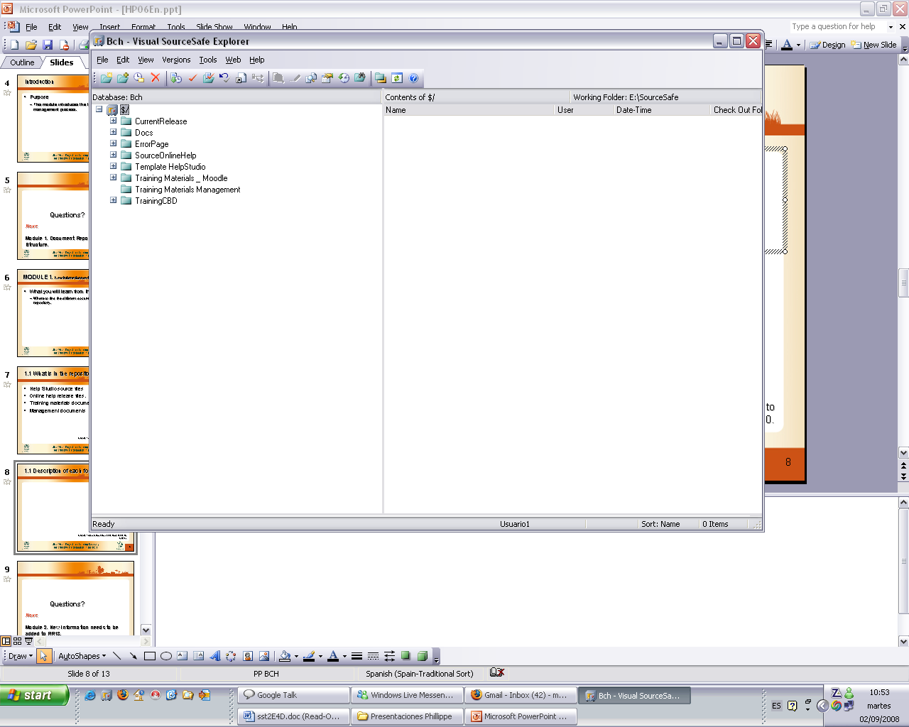
1.1 Description of each folder
Notes:
©2005 Microsoft Corporation. All rights reserved.
This presentation is for informational purposes only. Microsoft makes no warranties, express or implied, in this summary.
Current release:
Help studio procudes this files when the build command is selected. Is a mirror in each language of the files in the scbd server.
Docs
Portal interface: This is the interface that we use to interact with the scbd.
HelpStudio ficex: This are fixes sent by innovasys to fix some help studio bugs. (Search bug, Pdf bug)
Images: MO03 and 04 images. (in english)
Project documents: Procedures, forms, instructions and other documents regarding the project.We will talk more about this later.
Project Management: Management and planning documents.
Project plug-ins: Plug-ins to add new features to the online help, developed by the help team.
Release Notes: A documents reporting the last additions to the online help and the training materials…
Templates: Word templates for some documents. (Show the different documents)
Error Page: Another plug-in
Source Online help: Source files that feed help studio to produce help system.
Template help studio: Help studio Templates which define the style of the output…
Training Materials: Collections of the UNEP-Gef training materials..
Training Materials management: Documents used to manage those training materials. We will talk about this later.

Slide 9
Questions?
Next:
Module 2. Management documents.
Notes:
©2005 Microsoft Corporation. All rights reserved.
This presentation is for informational purposes only. Microsoft makes no warranties, express or implied, in this summary.

Slide 10
MODULE 2. Management documents.
What you will learn from this module:
  Which documents are used for management and how to maintain them.
Notes:
©2005 Microsoft Corporation. All rights reserved.
This presentation is for informational purposes only. Microsoft makes no warranties, express or implied, in this summary.

Slide 11
2.1 Help modules states spreadsheet.
Purpose
Phases
States
Current situation
Notes:
©2005 Microsoft Corporation. All rights reserved.
This presentation is for informational purposes only. Microsoft makes no warranties, express or implied, in this summary.
Purpose:
Track the state of each training module document and to what extent it has been integrated into the help system.
Phases
Is a workflow of tasks required to accomplish the integration of a training module into the help systems. The are 4 phases, to add a new training module to the help system you have to 1) gather the text , 2) Format it appropriately (as simple as possible) , 3) Integrate it into help studio , 4) publish it.
States
The color indicates the state of the document in each language.
Training Documents
Languages
Nowadays the documents published are MOs 1-4 and 10.

Slide 12
2.1 Training materials inventory.
List of all materials
Filenames
Brief descriptions
In all six languages
Notes:
©2005 Microsoft Corporation. All rights reserved.
This presentation is for informational purposes only. Microsoft makes no warranties, express or implied, in this summary.
This spreadsheet serves as an inventory of all training materials managed and gathers information about all of them.
The first page of the document is purely an inventory: it lists all training materials, each one with its corresponding code (as you know, each trainig material has a unique code) and a brief description.
The second “FILENAMES” page adds information on each training material (identified by its unique code):
Type of the document (word, pdf, ppt, html, etc.)
Filename of the material in each language
Title in each language
Here we have all the titles of all the training materials. This may useful for fast reference to know what each material is about and for copying the title of a training material into the help system. For example, if you have to create a link to a training material, you could easily get the title and put is as the caption of the link.

Slide 13
2.1 Materials states spreadsheet.
Track the status of materials
In all six languages
Notes:
©2005 Microsoft Corporation. All rights reserved.
This presentation is for informational purposes only. Microsoft makes no warranties, express or implied, in this summary.
This spreadsheet keeps track of the state of each training material, in each language. Training materials are categorized. This is probably one of the most important documents because it summarizes the status quo of all the training materials. For example, you can easily see that most modules in Chinese do not exist. This document serves as a high-level overview of the current situation, targeted to the project manager.
This document does NOT provide any information regarding which training materials are in the HelpSystem, or in which state the are in the HelpSystem, it olny provides information about the training materials themselves.

Slide 14
Questions?
Notes:
©2005 Microsoft Corporation. All rights reserved.
This presentation is for informational purposes only. Microsoft makes no warranties, express or implied, in this summary.
Keeping all management documents coherent and up-to-date, so that they depict the real situation, helps coordination of the team in charge of the help system.
Suppose that somebody needs to know if a document has already been integrated into help studio. Where to look?
Suppose that a document gets translated. Where to modifty?

