Slide 1
Process demo. Case Study: Corrections are needed to MO10 and RR13
8th September 2008

Slide 2
AGENDA
Introduction
Module 1. The process (20 minutes)
  Process diagram
  Web asyst process
Module 2. New information needs to be added to MO10. (10 minutes)
  Steps to follow
Module 3. New information needs to be added to RR13. (10 minutes)
  Steps to follow
Notes:
©2005 Microsoft Corporation. All rights reserved.
This presentation is for informational purposes only. Microsoft makes no warranties, express or implied, in this summary.

Slide 3
Introduction
Context
  This presentation is aimed at providing a practical development on the training materials management process.
Audience
  This module is designed to provide guidance to the training materials maintainers.
Notes:
©2005 Microsoft Corporation. All rights reserved.
This presentation is for informational purposes only. Microsoft makes no warranties, express or implied, in this summary.

Slide 4
Introduction
Purpose
  This module introduces the training materials management process.
Notes:
©2005 Microsoft Corporation. All rights reserved.
This presentation is for informational purposes only. Microsoft makes no warranties, express or implied, in this summary.

Slide 5
Questions?
Next:
Module 1. The process.
Notes:
©2005 Microsoft Corporation. All rights reserved.
This presentation is for informational purposes only. Microsoft makes no warranties, express or implied, in this summary.

Slide 6
MODULE 1. The process
What you will learn from this module:
  Understand the process and how to use it through webasyst.
Notes:
©2005 Microsoft Corporation. All rights reserved.
This presentation is for informational purposes only. Microsoft makes no warranties, express or implied, in this summary.

Slide 7
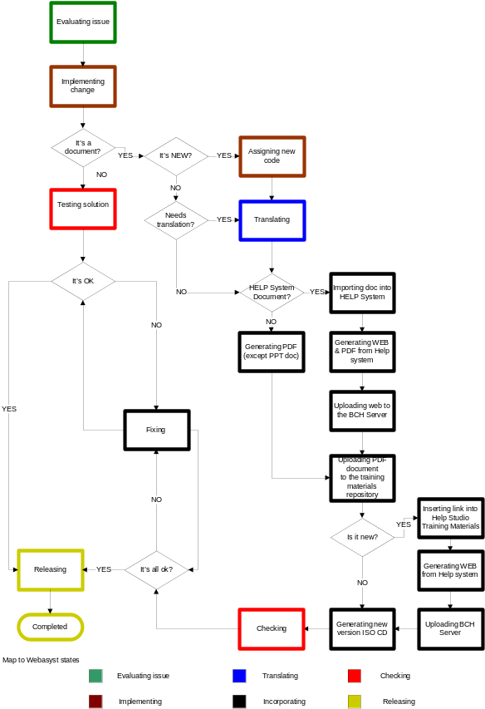
1.1 Diagram
Notes:
©2005 Microsoft Corporation. All rights reserved.
This presentation is for informational purposes only. Microsoft makes no warranties, express or implied, in this summary.
REMEMBER TO SHOW EVERYTHING WITH AN EXAMPLE.
Bring a printed version of the proces

Slide 8
1.1 Webasyst
http://scbd.webasyst.com
Create a new issue.
Follow the issue all over.
Notes:
©2005 Microsoft Corporation. All rights reserved.
This presentation is for informational purposes only. Microsoft makes no warranties, express or implied, in this summary.
REMEMBER TO SHOW EVERYTHING WITH AN EXAMPLE.

Slide 9
Questions?
Next:
Module 2. New information needs to be added to MO10.
Notes:
©2005 Microsoft Corporation. All rights reserved.
This presentation is for informational purposes only. Microsoft makes no warranties, express or implied, in this summary.

Slide 10
MODULE 2. New information needs to be added to MO10.
What you will learn from this module:
  The steps to follow in order to update a document that is part of the contextual help.
Notes:
©2005 Microsoft Corporation. All rights reserved.
This presentation is for informational purposes only. Microsoft makes no warranties, express or implied, in this summary.

Slide 11
2.1 Steps to follow (MO10)
Request a translations.
Determine if it is a Help Studio Document.
MO10 is a Help Studio Document!
Import to Help Studio
Notes:
©2005 Microsoft Corporation. All rights reserved.
This presentation is for informational purposes only. Microsoft makes no warranties, express or implied, in this summary.
REMEMBER TO SHOW EVERYTHING WITH AN EXAMPLE.

Slide 12
1.1 Steps to follow (MO10)
Build web output
Upload files to the BCH server.
Build pdf file
Upload to the training materials repository
Create a new cd iso.
Publish the changes in a release note.
Module 1. New information needs to be added to MO10.
Notes:
©2005 Microsoft Corporation. All rights reserved.
This presentation is for informational purposes only. Microsoft makes no warranties, express or implied, in this summary.
REMEMBER TO SHOW EVERYTHING WITH AN EXAMPLE.

Slide 13
Questions?
Next:
Module 3. New information needs to be added to RR13.
Notes:
©2005 Microsoft Corporation. All rights reserved.
This presentation is for informational purposes only. Microsoft makes no warranties, express or implied, in this summary.

Slide 14
MODULE 3. New information needs to be added to RR13.
What you will learn from this module:
  The steps to follow in order to update a document that is not part of the contextual help.
Notes:
©2005 Microsoft Corporation. All rights reserved.
This presentation is for informational purposes only. Microsoft makes no warranties, express or implied, in this summary.

Slide 15
3.1 Steps to follow (RR13)
Request translations.
Determine if it is a Help Studio Document.
RR13 is not a Help Studio Document!
Notes:
©2005 Microsoft Corporation. All rights reserved.
This presentation is for informational purposes only. Microsoft makes no warranties, express or implied, in this summary.
REMEMBER TO SHOW EVERYTHING WITH AN EXAMPLE.

Slide 16
3.2 Steps to follow (RR13)
Upload the file to the training materials repository
Create a new cd iso.
Publish the changes in a release note.
Notes:
©2005 Microsoft Corporation. All rights reserved.
This presentation is for informational purposes only. Microsoft makes no warranties, express or implied, in this summary.
REMEMBER TO SHOW EVERYTHING WITH AN EXAMPLE.

Slide 17
Questions?
Notes:
©2005 Microsoft Corporation. All rights reserved.
This presentation is for informational purposes only. Microsoft makes no warranties, express or implied, in this summary.

