Slide 1
Help Studio: Working with Booklets and Images
9th September 2008

Slide 2
AGENDA
Introduction
Module. Working with Booklets (20 minutes)
  Intro to Booklets.
  Booklets Basics.
  Other considerations.
  Booklets in the process.
Module. Working with Images (10 minutes)
  Images Basics.
Notes:
©2005 Microsoft Corporation. All rights reserved.
This presentation is for informational purposes only. Microsoft makes no warranties, express or implied, in this summary.

Slide 3
Introduction
Context
  This presentation is aimed at providing a practical development on the help studio features concerning Booklets and images.
Audience
  This module is designed to provide guidance to Help Studio Developers.
Notes:
©2005 Microsoft Corporation. All rights reserved.
This presentation is for informational purposes only. Microsoft makes no warranties, express or implied, in this summary.

Slide 4
Introduction
Purpose
  This module describes in full detail the help studio support to the creation of pdf documents and the usage of images within topics.
Notes:
©2005 Microsoft Corporation. All rights reserved.
This presentation is for informational purposes only. Microsoft makes no warranties, express or implied, in this summary.

Slide 5
Questions?
Next:
Module 1. Help Studio: Working with Booklets.
Notes:
©2005 Microsoft Corporation. All rights reserved.
This presentation is for informational purposes only. Microsoft makes no warranties, express or implied, in this summary.

Slide 6
MODULE 1. Working with Booklets
What you will learn from this module:
  To use Booklets in order to build PDF documents using the Help Studio topics Knowledge Base.
Notes:
©2005 Microsoft Corporation. All rights reserved.
This presentation is for informational purposes only. Microsoft makes no warranties, express or implied, in this summary.

Slide 7
1.1 Introduction to Booklets
Content in a printable format.
Content reutilization.
Granularity.
Booklets
Notes:
©2005 Microsoft Corporation. All rights reserved.
This presentation is for informational purposes only. Microsoft makes no warranties, express or implied, in this summary.
REMEMBER TO SHOW EVERYTHING WITH AN EXAMPLE.
HelpStudio Booklets contain one or more Topics and (optionally) the Table of Contents, Index and Glossary compiled into a PDF file suitable for printing. When you define a booklet, you define the properties of the booklet together with the Topics and headings you want included.
Booklets are a great way to provide your project content in a format that is designed to be printed. You can re-use some or all of your existing Topics, or create new Topics specifically for booklets.
You don't need to specifically design Topic content for inclusion in booklets. HelpStudio takes care of most of the issues with turning on-line help content into print material as an automatic part of the booklet build process:
A specific Template designed for printed output is used to generate the booklet output;
Any Glossary Items are marked up in Italic font;
Any hyperlinks to other Topics are supplemented with additional text to indicate whether the reference can be found within the booklet being printed, or in the accompanying on-line help;
Any hyperlinks to external URLs are supplemented with a textual reference of the URL or Topic linked to (you can alter the default hyperlink conversion preferences in the Booklet Editor);
Topics and headings are automatically numbered and a Table of Contents, Index and Glossary for the booklet generated (according to the settings you define in the Booklet Editor).
If you have content within a Topic that you do not want included in the booklet output, you can use a Build Flag to mark the content as not appropriate for booklet output (or vice versa). Within the booklet properties, tick 'Use Build Flags' and ensure the Build Flag for on-line documentation only content is not ticked.

Slide 8
1.2 Booklets Basics
Creating a new booklet.
Adding topics to a booklet.
Booklet properties.
Building Booklets
Notes:
©2005 Microsoft Corporation. All rights reserved.
This presentation is for informational purposes only. Microsoft makes no warranties, express or implied, in this summary.
Creating a new booklet
Click the New Booklet toolbar button;
The New Booklet Wizard will be displayed. The wizard will gather some basic properties for the new Booklet, such as the Booklet Name and Title;
Once you have completed the information in the New Booklet Wizard, the new Booklet will be created and opened for editing;
A default Output Filename for the Booklet will have been generated based on the Booklet name you specified in the New Booklet Wizard. You can modify this and any other Booklet property using the Properties page in the Booklet Editor.
Adding topics to a booklet
You can add as many Topics as you wish to the Booklet, or set the Booklet to use the same Topics and structure as the project Table of Contents. In addition to Topics, you can also include the Glossary in the Booklet.
Bear in mind that the Booklet is designed to be printed, so your help users may appreciate short sets of introductory Topics in a printable Booklet rather than a great deal of reference material.
Adding all Topics in the Table of Contents to a Booklet
If you want your Booklet to include the same Topics and structure as the project Table of Contents:
Open the Booklet that you would like to use the same Topics and structure as the project Table of Contents.
Click the Members view button on the Page Menu in the Booklet Editor.
Select the Use the same structure as the Table of Contents members option.
Adding a sub-set of all project Topics to a Booklet
Open the Booklet that you would like to add Topics to.
Click the Members view button on the Page Menu in the Booklet Editor.
Select the Use a custom structure containing the members below members option.
There are two ways to add entries to the Booklets members tree; adding Topics using Drag and Drop and adding members manually.
Adding Topic members to the Booklet using Drag and Drop
The quickest and easiest way to add Topics to the Booklet is using Drag and Drop.
With a Booklet open and active, activate the Project Explorer Window.
Click on the Topic or Topic Category you would like to add to the booklet.
Whilst holding down the primary mouse button, drag the Topic or Topic Category onto the Booklet Members tree.
If there are existing members on the tree, you can drop the Topic or Topic Category in a precise position using the Drop Highlight Bar.
Adding members to the Booklet manually
You can also add items to the Booklet by clicking on the Add Child Item or Add Sibling Item toolbar buttons. Using these buttons, you can also add additional section headings to the Booklet.
To add a Topic member to the Booklet:
You can add all Topics to the root level of the tree, or you can add members as children of other members. Click the Add Child Item to add a member as a child of an existing member or click the Add Sibling Item toolbar button to add a member at the same heading level as an existing member. The hierarchy in the members tree view translates to the headings hierarchy in the generated Booklet. If you want a member to appear as a sub-topic, add it as a child member.
Set the Booklet Member Type of the new member to The content of a Topic.
Click on the Select button to select the Topic for this member.
If you don't want to use the Topics title as the heading text, tick the Custom Title and enter the custom title.
To add a heading member to the Booklet:
Headings allow you to add custom groupings to Topics in your booklet.
You can add heading members on the root level of the tree, or you can add headings as children of other members. Click the Add Child Item toolbar button to add a heading as a child of an existing member or click the Add Sibling Item toolbar button to add a heading at the same heading level as an existing member.
Set the Booklet Member Type of the new member to Just a heading.
Type the title of the heading in the Entry Title text box.
To add the Glossary to the Booklet
If you have defined one or more Glossary terms in your project, you may wish to add the Glossary to the Booklet. To add the Glossary to a Booklet:
You can add the Glossary to the root level of the tree, or you can add the Glossary as a child of another member. Click the Add Child Item toolbar button to add the Glossary as a child of an existing member or click the Add Sibling Item toolbar button to add the Glossary at the same heading level as an existing member.
Set the Booklet Member Type of the new member to The Glossary.
Booklet properties
Edit Booklet properties to set the booklet output filename, title, paper size and many other aspects of the booklet output.
Open the Booklet that you would like to add Topics to.
Click the Properties view button on the side bar of the Booklet Editor.
General
Name: A descriptive name for this booklet. This name is used to identify this booklet in the HelpStudio User Interface.
Title: Title of the booklet. The title is used on the Title page of the generated booklet.
Notes: Notes you would like to store against this booklet. Notes are not used in the generated Booklet.
Template: The Print Template you would like to use. The Print Template determines the overall layout, look and feel of the generated booklet.
Output Filename: The full path and filename to which you would like the PDF Booklet file generated.
Open Mode: Determines which features (thumbnails, document outline) of the PDF viewer will be visible by default when the generated PDF Booklet is opened
Content
Generate Table of Contents: Set this property to True if you would like HelpStudio to automatically include a Table of Contents in the generated Booklet. If your booklet only contains a few Topics, you may wish to omit the Table of Contents.
Entry Numbering: Defines the entry numbering behavior for this Booklet. You can choose between a) No numbering (None), b) Automatically Number only the Topics (Topics Only) or c) Number the Topics and any headings in the Topic text. Automatically Numbering Topics makes it easier to follow related sections and allows users of your Booklets to find the sections of the Booklet identified in the generated Booklet Table of Contents.
Heading Tag: Specify the heading HTML tag used in your content for headings. This would normally be H1, H2 or H3.
Generate Index: Set this property to True if you would like HelpStudio to automatically include an Index in the generated Booklet. If your booklet only contains a few Topics, you may wish to omit the Index.
Page Breaks: Sets page break options. You can choose to include a page break only before top level Topics (Before Top Level Entries), or to include a page break before all Topics (Before All Entries), or to not include any page breaks (None).
Cover Page Topic: By default, HelpStudio generates a cover page containing just the Booklet Title. If you identify a Topic here, the HTML in that Topic will be included on the cover page of the generated Booklet. Your Cover Page Topic might include information such as revision versions / dates, description of the booklets purpose etc.
Raw Cover Page: By default, HelpStudio places the contents of the Cover Page Topic underneath an automatically generated underlined Booklet Title on the first page of the booklet. Tick this box to use the Cover Page Topic in it's entirety, without auto-generating the title.
Formatting
Paper Size: Choose the paper size for the generated Booklet.
Orientation: Choose the paper orientation for the generated Booklet.
Resolution: Choose the desired resolution for the generated Booklet. If your booklet contains high resolution images, you can increase the booklet resolution to improve image quality (also see the Optimization properties for further image quality options).
International Characters: Tick this property if your Booklet contains any non latin characters (e.g. Cryllic, Japanese, Chinese).
Start Page Numbers on Page: This property defines the physical page number on which page numbering will begin. Leave this property blank to start page numbers on the first content page (e.g. after Table of Contents and cover pages).
Optimization
Image Compression Level: This property allows you to choose the level of compression used on images in the generated booklet, balancing image size and image quality. "Good quality, Good compression" will usually provide a good balanced setting.
Downsample high-resolution images: If your booklet contains high resolution images, you can tick this box to optimize the images according to the chosen booklet resolution. Ticking this box will usually reduce booklet size but image quality will be marginally reduced.
Linearized: Tick this box to optimize the generated Booklet for viewing over an internet connection. Linearized booklets will allow the user to view pages of the booklet as they are downloaded, rather than having to wait for the whole booklet to download.
Embed Fonts: If your project stylesheets reference fonts that may not be available on your end users machines, or if you want to retain precise font information, tick this box. This option will marginally increase the size of the generated Booklet.
Margins
Left, Right, Top Bottom: Specifies the margins for the content area of generated booklet pages.
Header and Footer
Left Margin: Specifies the gap between the left hand edge of the page and the header / footer content.
Right Margin: Specifies the gap between the right hand edge of the page and the header / footer content.
Header Content (Odd / Even Pages): Any HTML you define in this property will be included in the header of each generated Booklet page. You can define just the "(Even Pages)" header if you don't require a different header on the odd numbered pages. You can include the following parameters in the Header or Footer HTML :
%%BookletTitle%% (Title of the booklet)
%PAGE% (Current Page Number)
%PAGETOTAL% (Total number of Pages)
Header Position: This value determines the gap between the top of the page and the top of the header content.
Footer Content: Any HTML you define in this property will be included in the footer of each generated Booklet page. You can define just the "(Even Pages)" footer if you don't require a different footer on the odd numbered pages. You can include the same parameters as listed above for Header Content.
Footer Position: This value determines the gap between the bottom of the page and the bottom of the footer content.
PDF Document Properties
The properties specified here will be included in the PDF document properties of the generated Booklet. PDF document properties are not usually visible to the end user, but can be viewed in the PDF viewer (File\Properties) and in the Windows Explorer file properties. The properties are free-format text and are entirely optional.
Subject: The subject of this booklet.
Creator: Booklet creator (by convention this property is set to the tool that created the PDF, in this case HelpStudio).
Author: Booklet Author.
Keywords: Booklet keywords.
Building Booklets
Building booklets along with other project outputs
Booklets can be built along with other project outputs using the Build toolbar button.
Click on the Build toolbar button;
On the displayed Build Options dialog, you can select which Booklets and Build Profiles you would like to build;
Click OK to start the build;
Once your Booklets have been successfully generated, the Build Results window will be opened. The Build Results dialog displays a summary of the build and a clickable link to open the created Booklet.
Quickly building a single Booklet
You can quickly build a single Booklet using the Booklet context menu in the Project Explorer;
Right click on a Booklet node in the Project Explorer;
Select Build this Booklet from the displayed context menu.

Slide 9
1.3 Other considerations
Build Flags
Hyperlink Designer
PDF review and corrections
Notes:
©2005 Microsoft Corporation. All rights reserved.
This presentation is for informational purposes only. Microsoft makes no warranties, express or implied, in this summary.
Build Flags
You can use HelpStudio Build Flags to include or exclude Topic content in generated Booklets. By default, every new HelpStudio project contains an 'Online only' and 'Booklet only' Build Flag that you can use to mark content as specific to either on-line or Booklet output.
Excluding specific content from Booklet output
If you have Topic content that you only want to appear in the generated Help System, you can use Build Flags to prevent it from appearing in Booklet output.
Mark the required Topic Content with the 'Online only' Build Flag. If this flag doesn't exist in your project, create it.
In the Booklet Editor, Build Flags page, tick the 'Booklet only' Build Flag. This tells HelpStudio that you only want content included that has no Build Flags set, or that has the 'Booklet only' Build Flag set. Any content marked with 'Online only' will not be included.
Excluding specific output from non-Booklet output
If you have Topic content that you only want to appear in the Booklet output, you can use Build Flags to prevent it from appearing in the generated Help System.
Mark the required Topic Content with the 'Booklet only' Build Flag. If this flag doesn't exist in your project, create it.
In the Booklet Editor, Build Flags page, tick the 'Booklet only' Build Flag. This tells HelpStudio that you only want content included that has no Build Flags set, or that has the 'Booklet only' Build Flag set.
In each Build Profile, Build Flags page, tick the 'Online only' Build Flag. This tells HelpStudio that you only want content included in non-Booklet output that has no Build Flags set, or that has the 'Online only' Build Flag set.
Any content that you marked with 'Booklet only' will not be included in the generated Help System, but will be included in the Booklet output.
Hyperlink Desginer
One of the problems traditionally associated with re-using on-line content for a readable or printable output is hyperlinks. Hyperlinks in Topic content can not be clicked in printed output and the target of the link is not visible to the person reading the material.
HelpStudio overcomes this problem by automatically translating hyperlinks into a readable format. The Booklet Editor allows you to customize the HTML HelpStudio uses to transform different types hyperlinks to a readable format. You may wish all links to appear as normal text, or with a specific explanatory suffix.
The following types of hyperlinks can be individually customized:
Links to Document! X Content
Links to a Topic in the same Booklet
Links to a Topic not in the same Booklet
Links to a URL with a Caption
Links to a URL without a Caption
Links to JavaScript
Links to a Bookmark in the same Topic
Customizing Booklet Hyperlink Conversion
Open the Booklet you wish to customize Booklet Hyperlink Conversion for;
Select Link Conversion from the Page Menu;
Select the link type you wish to customize;
Click the Edit button on the right hand side of the Link Conversion list;
Edit the Link Conversion format to the desired HTML. You can use the placeholders %%LinkCaption%% and / or %%LinkURL%% to include the original link properties;
If you don't want a particular type of link to be converted at all in Booklet output, untick the appropriate link type on the Link Conversion list.
PDF review and corrections
Sometimes the generated pdfs contain some style errors. Those mistakes are generally related to a dirty html. In order to correct those mistakes follow the procedure stated below for each error.
Open the topic that contains the error
Go to the html view of the topic.
Clean the html. Generally the errors are related with the following tags: borders, fonts or page breaks.
Build the booklet again and review it again.

Slide 10
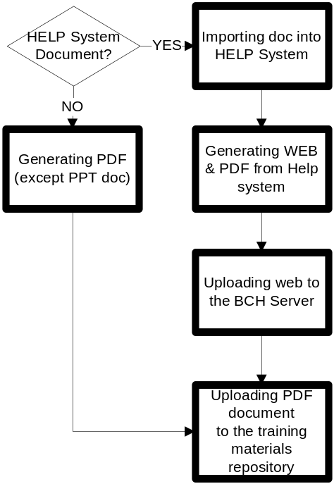
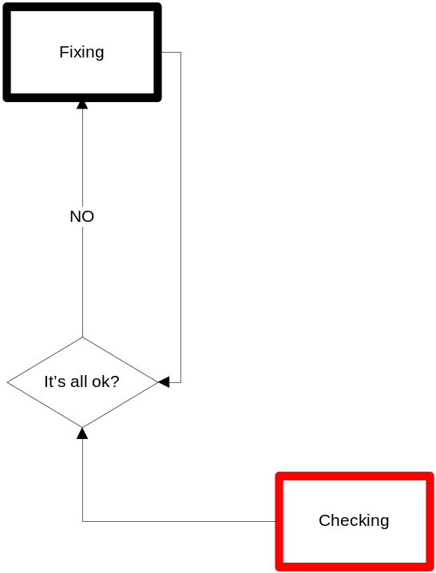
1.4 Booklets in the process
Notes:
©2005 Microsoft Corporation. All rights reserved.
This presentation is for informational purposes only. Microsoft makes no warranties, express or implied, in this summary.

Slide 11
Questions?
Next:
Module 2. Help Studio: Working with Images.
Notes:
©2005 Microsoft Corporation. All rights reserved.
This presentation is for informational purposes only. Microsoft makes no warranties, express or implied, in this summary.

Slide 12
1.1 Images Basics
Images in MO03 and MO04
Adding images
Images widgets
Lessons learned
Notes:
©2005 Microsoft Corporation. All rights reserved.
This presentation is for informational purposes only. Microsoft makes no warranties, express or implied, in this summary.
Modules 03 and 04 are full of images explaining the bch central portal. Currently they are only in english….
Inages widgets
Select the Image in the Project Explorer.
Right Click on the Image and select Create Thumbnail from the context menu.
A thumbnail image (saved using the original filename suffixed with _thumb) will be created and added to the project.
Lessons learned
Be careful when you erase figures from the Help Studio and you are working with source control. Sometimes happens that the figures are only erased on the local drive. This bug won’t let you add images with the same name until you erase them from the source control.

Slide 13
Questions?
Notes:
©2005 Microsoft Corporation. All rights reserved.
This presentation is for informational purposes only. Microsoft makes no warranties, express or implied, in this summary.

