Slide 1
Training material Kit: ISO Image maintenance
11th September 2008

Slide 2
AGENDA
Introduction
Module. Maintaining the training materials kit (30 minutes)
  ISO Image Structure.
  Materials Catalog.
  Maintaining the training materials kit in the process
  Case study
Notes:
©2005 Microsoft Corporation. All rights reserved.
This presentation is for informational purposes only. Microsoft makes no warranties, express or implied, in this summary.

Slide 3
Introduction
Context
  This presentation is aimed at providing a practical development on the training materials kit maintenance.
Audience
  This module is designed to provide guidance to Help Developers.
Notes:
©2005 Microsoft Corporation. All rights reserved.
This presentation is for informational purposes only. Microsoft makes no warranties, express or implied, in this summary.

Slide 4
Introduction
Purpose
  This module describes in full detail the structure and usage of the training material kit..
Notes:
©2005 Microsoft Corporation. All rights reserved.
This presentation is for informational purposes only. Microsoft makes no warranties, express or implied, in this summary.

Slide 5
Questions?
Next:
Module 1. Help Studio: Maintaining the training materials kit .
Notes:
©2005 Microsoft Corporation. All rights reserved.
This presentation is for informational purposes only. Microsoft makes no warranties, express or implied, in this summary.

Slide 6
MODULE . The training materials kit
What you will learn from this module:
  To update and deploy the training materials kit.
Notes:
©2005 Microsoft Corporation. All rights reserved.
This presentation is for informational purposes only. Microsoft makes no warranties, express or implied, in this summary.

Slide 7
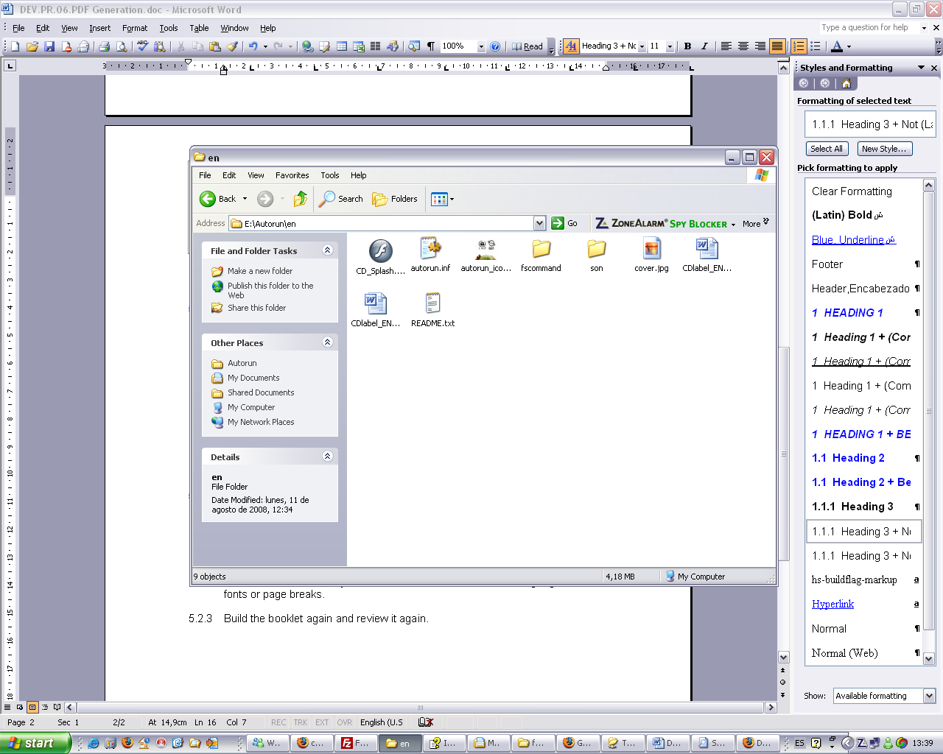
1.1 Structure
Overview
Folder by folder
Notes:
©2005 Microsoft Corporation. All rights reserved.
This presentation is for informational purposes only. Microsoft makes no warranties, express or implied, in this summary.
Welcome to the Training Materials, a substantial collection of documents to help you with the Biosafety Clearing-House (BCH) Central Portal and the Cartagena Protocol on Biosafety. Please feel free to browse through the sections visibles on the sidebar.

Slide 8
1.2 Materials catalog
Structure.
Updating.
Adding a link.
Notes:
©2005 Microsoft Corporation. All rights reserved.
This presentation is for informational purposes only. Microsoft makes no warranties, express or implied, in this summary.
Updating and adding a link
Copy the CD-ROM structure (containing files and folders) as-is and paste it to a local folder.
Update (Add, Delete, Modify files or folders) the CD-ROM content. The CD-ROM content is located in \fscommand\content\
If new files have been added then you will need to add some links to those files in the html files located in \fscommand\.
Create the CD-ROM ISO using a specialized software like Nero. Upload a zip file containing the ISO to UNEP-GEF ftp server.

Slide 9
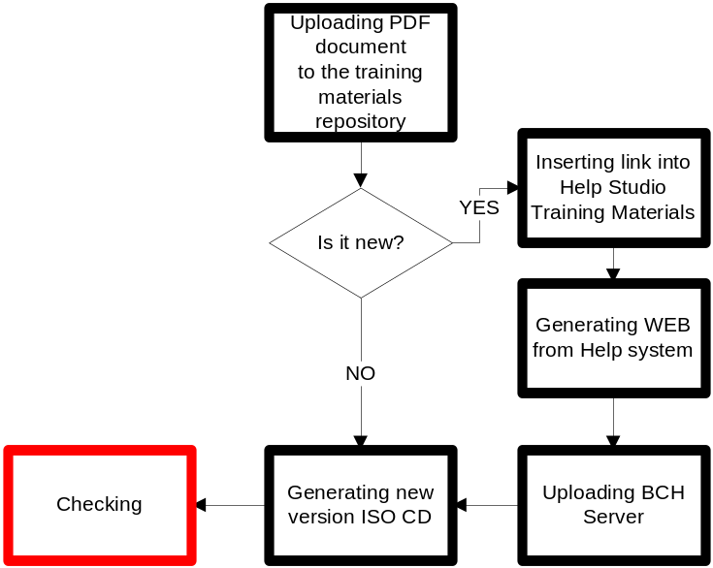
1.3 Training materials kit in the process

Slide 10
1.4 Case study
RR15 arrives in all languages.
Notes:
©2005 Microsoft Corporation. All rights reserved.
This presentation is for informational purposes only. Microsoft makes no warranties, express or implied, in this summary.

Slide 11
Questions?
Notes:
©2005 Microsoft Corporation. All rights reserved.
This presentation is for informational purposes only. Microsoft makes no warranties, express or implied, in this summary.

