Slide 1
PHP Project
Project Title: Bank Simulator
Date: 8th July

Slide 2
Points that we will be concentrating on:
Introduction-PHP, Purpose of the project
A brief walk through the project
Scope of PHP, conclusion

Slide 3
Introduction to PHP
What?
Why?

Slide 4
Purpose of the project
This project facilitates the manager and teller to maintain user account details and transactional details.

Slide 5

Modules

Slide 6
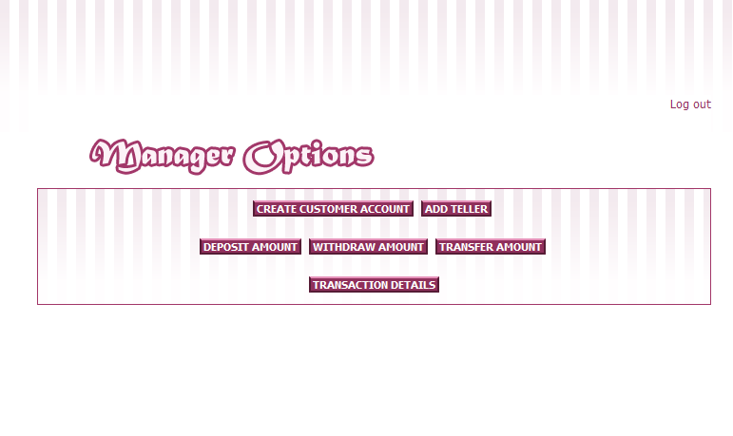
Functions

Slide 7
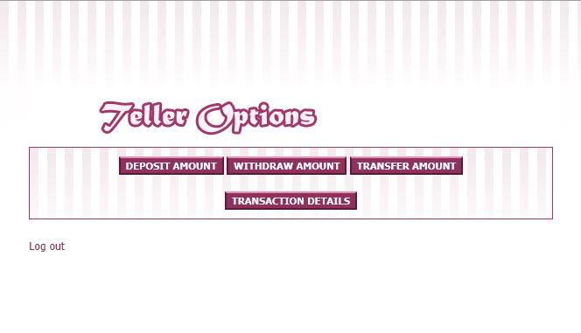

Slide 8
A Brief walk through the project…

Slide 9
Scope of PHP
High in demand these days

Slide 10
Thank You Project By: Puneet Jain Saurav Maheshwary Vikash Chand Kumar

