Slide 1
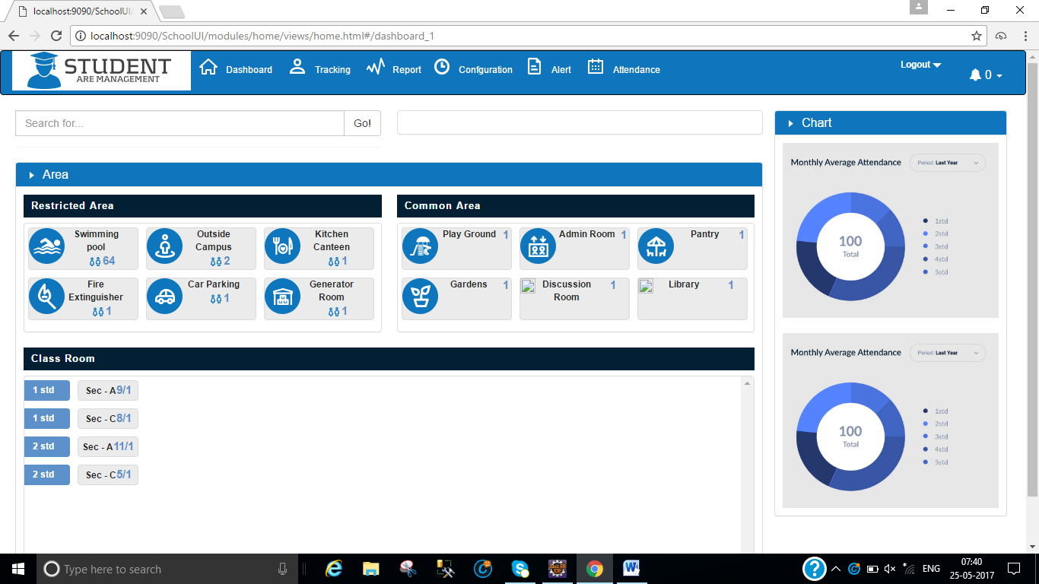
Header is need better look.
Bell , little big size , red color ,blink for alert
User Photo
No display down and read color, based on the scenario .
Orange color , more colorful graph
Remove people icon , number in red color
Light Orange color
Changing different color for icon, will be good or not UI need to see. Send sample
Font : over all font is not visible good, font name change …

Slide 2
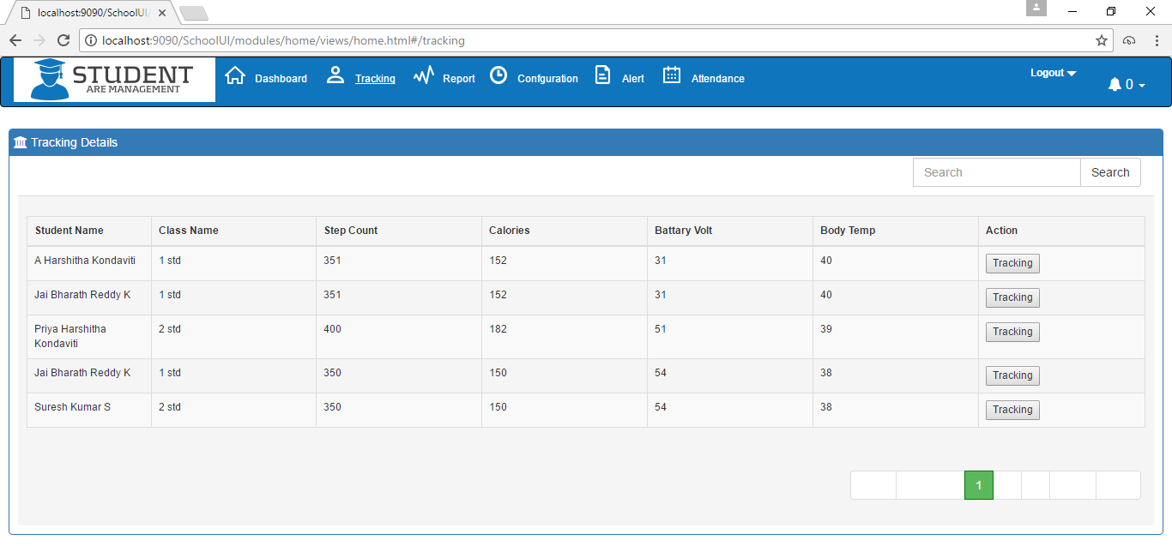
Keep nice icon
No of record increase to 10
Pagination text is not visible, text want to see.
Add student reg no/adm no

Slide 3
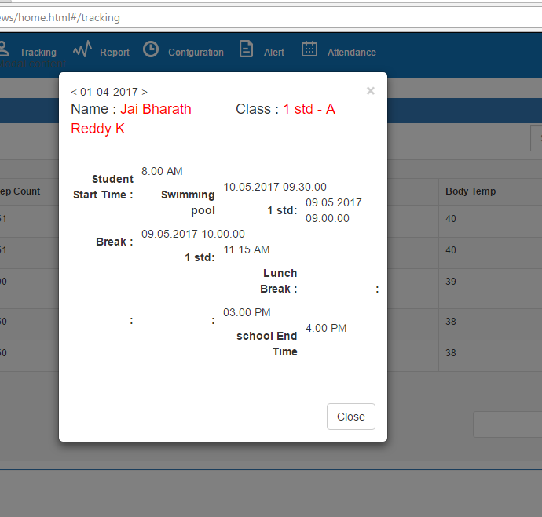
Header with good color combination

Slide 4
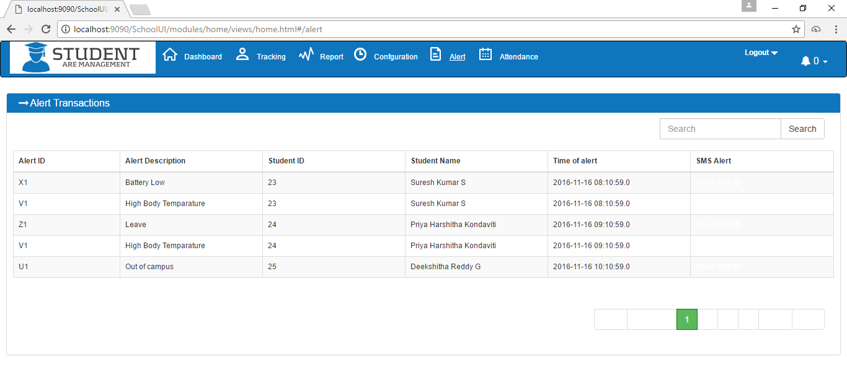
This report is not conveying the meaning, add relevant data
Multiple filler search , how to do…

Slide 5
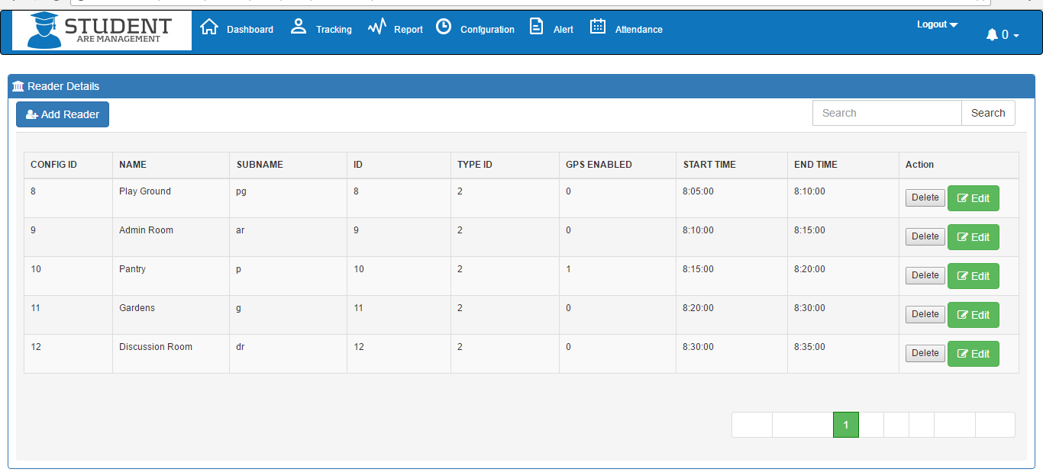
Type name need to display as a first column. And display order by type name.
Delete/edit button bring nice icon.

Slide 6
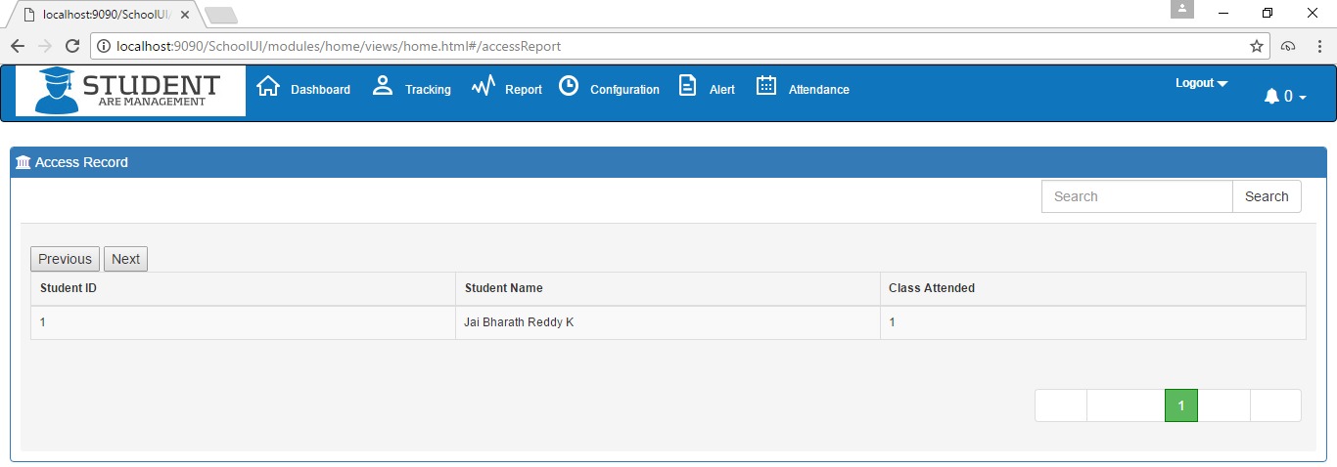
Where we can see student attendance report.

Slide 7
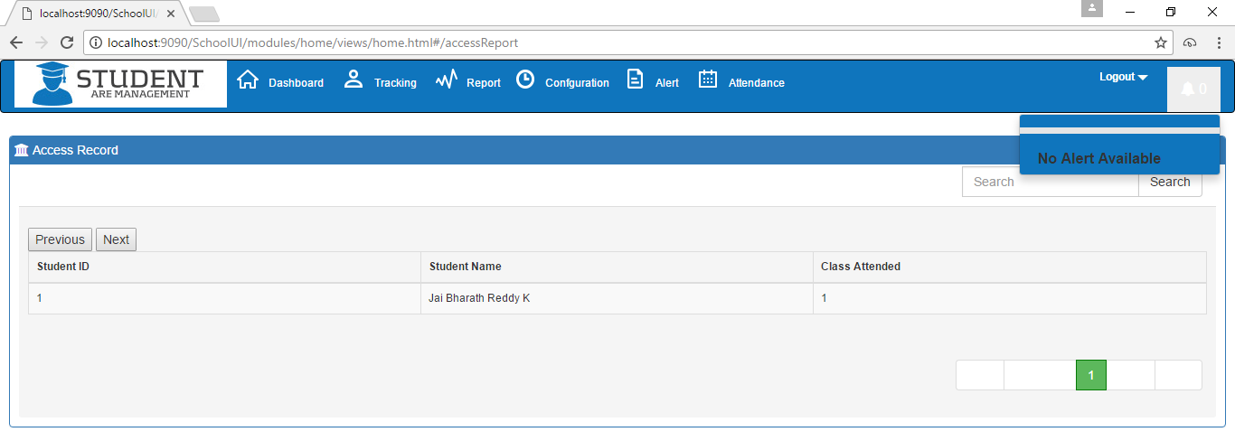
Alert: Dismiss all –ok, Dismiss not need

