Slide 1

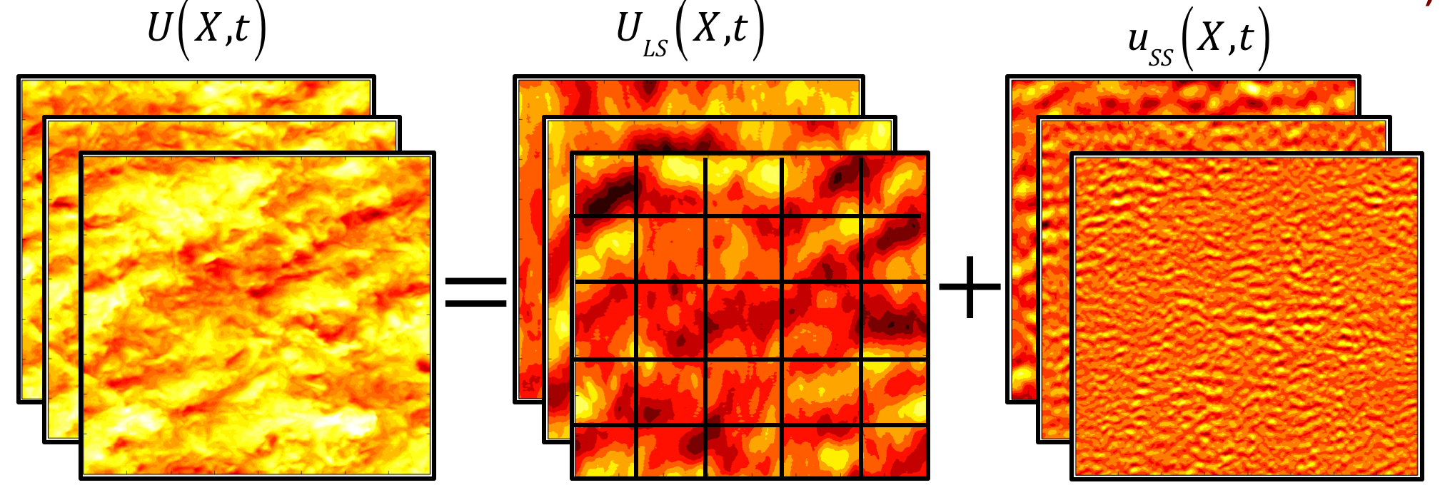
Trajectory
Generation
Trajectory
Tracking
Assume-Guarantee Contracts
=
+
Resolved Wind
Field
Large Scale
Features
Medium/Small Scale
Features

