Slide 1
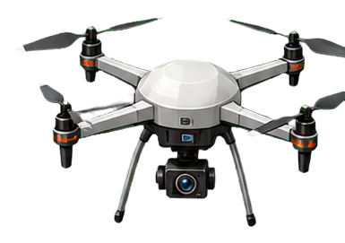

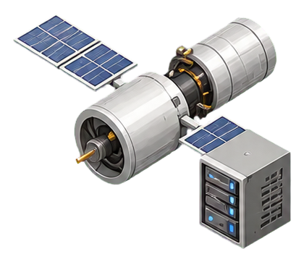









UAV self
Observation
CTDE Training
embeddings
contexts
Stage Value
Critic
GUs
$$V^{m}$$
Encoder
Attention
Layer
Value Loss
$$V^{s}$$
Satellites
Encoder
$$V^{b}$$
Encoder
Minimize Loss
And
Do Updates
Global relation graph
Peer-UAVs
Encoder
Encoder
Safety
Loss
Advantages
Auxiliary token
Aggregated contexts
Actor
Stage Returns
Rollout Buffer
Sequential Staged Actor
1
Mobility control
Safety
Topology refresh
2
Satellite-subset selection
Backhaul Context Update
3
BW allocation
Action Aggregation
$$a_{t}= (a^{m}, a^{s}, a^{b})$$
$$a^{m}$$
$$a^{s}$$
$$a^{b}$$
Environment Evolution
Execute
Joint Action
Dropped
Task Flow
Processed
Queue Update
Reward and Statistics
$$a_{t}= (a^{m}, a^{s}, a^{b})$$
Uploading
Backhaul
Computing
Next Observation

Slide 2




UAV self
Observation
embeddings
contexts
GUs
Encoder
Attention
Layer
Satellites
Encoder
Encoder
Peer-UAVs
Encoder
Encoder
Auxiliary token
Aggregated contexts
Sequential Staged Actor
1
Mobility control
Safety
Topology refresh
2
Satellite-subset selection
Backhaul Context Update
3
BW allocation
Action Aggregation
$$a_{t}= (a^{m}, a^{s}, a^{b})$$
$$a^{m}$$
$$a^{s}$$
$$a^{b}$$

Slide 3

Execute
Joint Action
Dropped
Task Flow
Processed
Queue Update
$$a_{t}= (a^{m}, a^{s}, a^{b})$$
Uploading
Backhaul
Computing

Slide 4
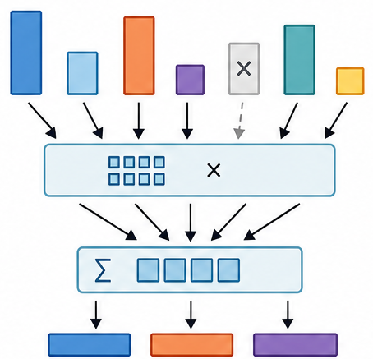
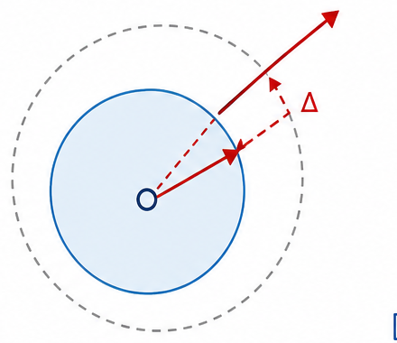
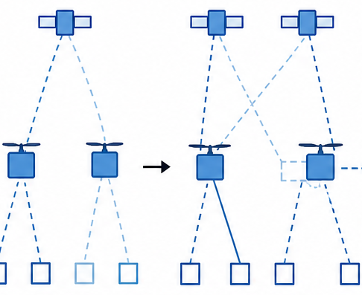
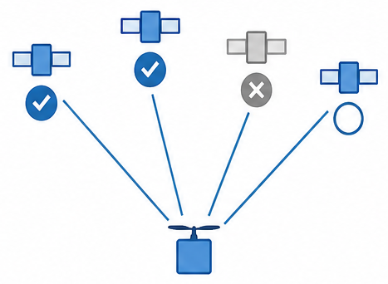
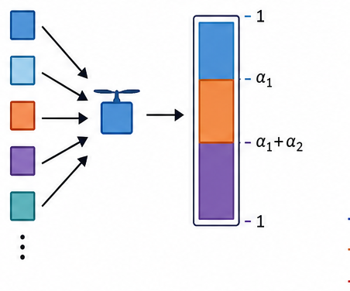
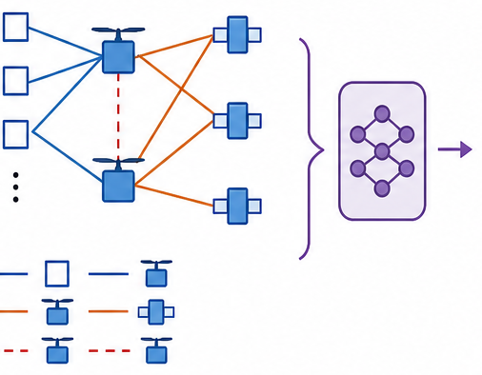
STARS: structured execution loop with CTDE training
Variable-size topology observations -> staged actor -> executable task flow -> relation-aware centralized training
Local observation
Masked entity attention
Executable action and transition
UAV self token
type-specific encoders
f_G, f_S, f_U
a_t = (a^m, a^s, a^b)
motion | relay queue | service stats
masked query attention
+ pooling over valid tokens
Access upload
GU token set
stage contexts
h^m, h^s, h^b
geometry | demand queue | access quality | assoc mask
Backhaul forwarding
Visible LEO token set
Sequential staged actor
Satellite processing
geometry | visibility/Doppler | backhaul | sat queue
Mobility
control
a^m
Topology
refresh
Satellite-subset
selection
a^s
Access-BW
allocation
a^b
Queue/drop update
Peer-UAV token set
relative motion | safety relation
Safety shield
executed ã^m
Workload-level reward
Queue states and feasibility masks are token attributes
bounded acceleration
+ safety-corrected target
post-motion access
and LEO visibility
feasible visible subset
nonempty unless none feasible
valid-GU simplex
nonnegative, sum = 1
served
drop
next observation
delay
safe-action imitation
queue
CTDE training signal
rollout buffer
local actions + team rewards
relation-aware
centralized critic
stage values
V^m / V^s / V^b
stage-chained
GAE + PPO
updated
shared actor heads
critic used only during training; deterministic evaluation uses local actor modules only

Slide 5
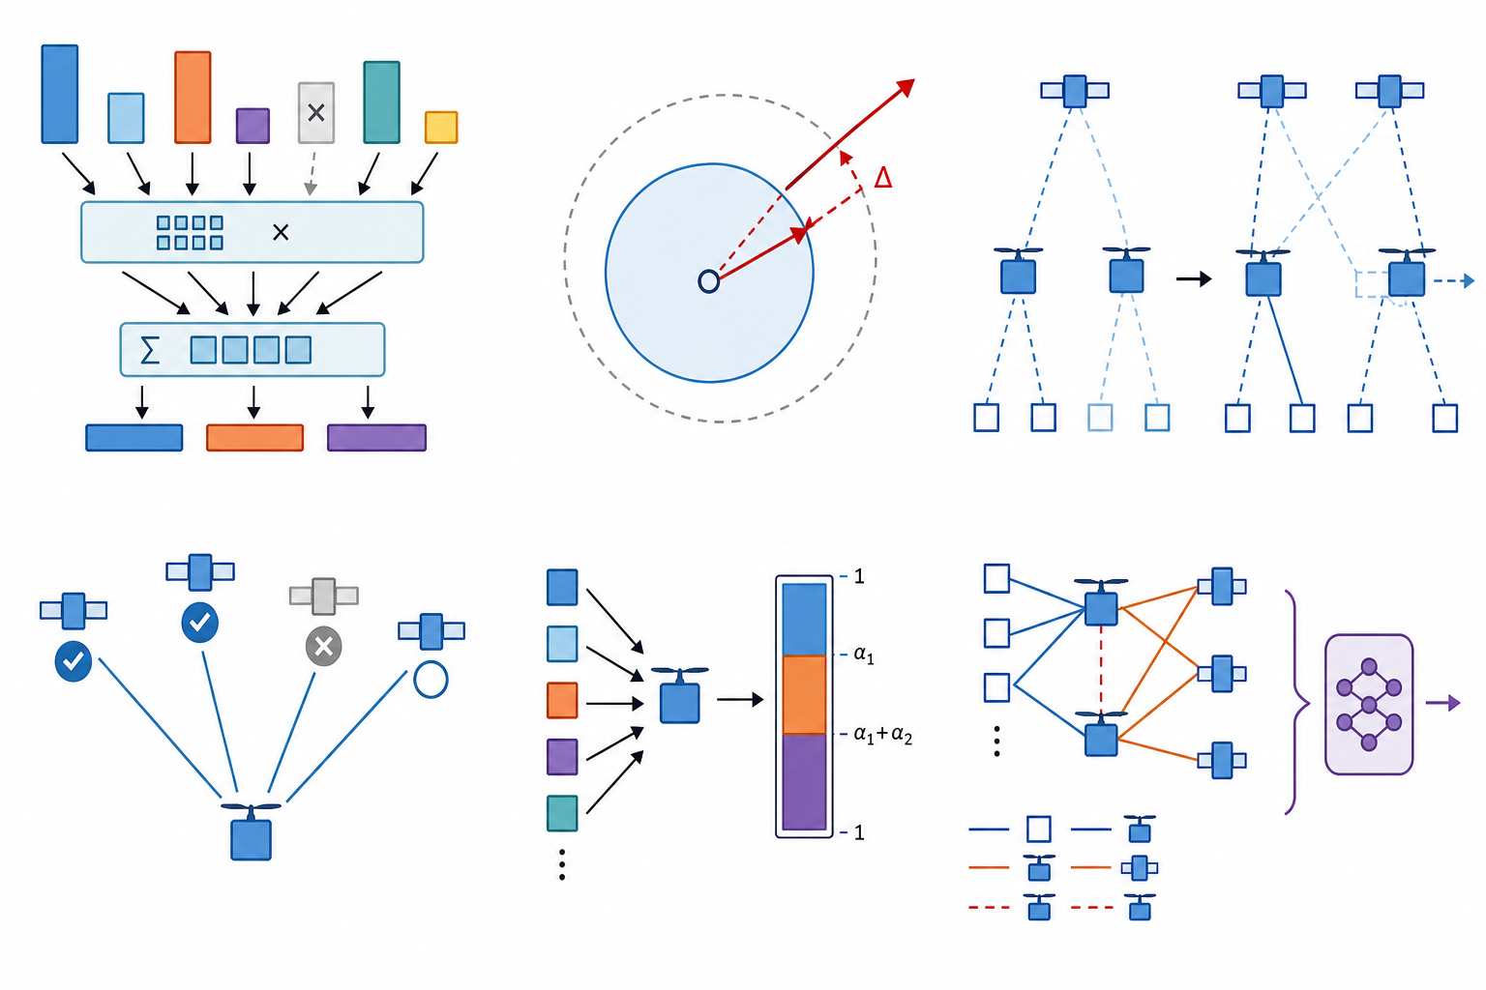
Mini-Diagram Semantic Review Sheet
Raster concept sheet for mechanism meaning only; final approved elements can be redrawn as editable vectors.
attention
safety
topology refresh
satellite subset
bandwidth allocation
relation critic

