Slide 1
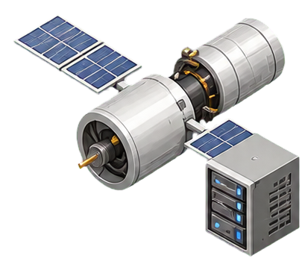
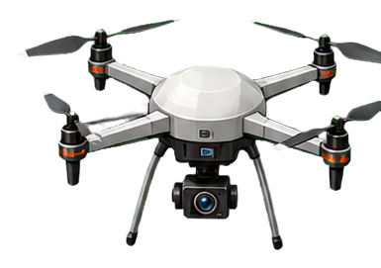
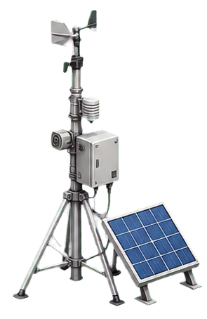
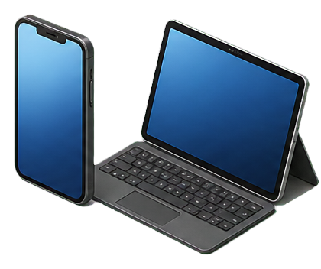

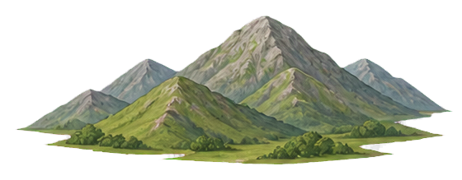


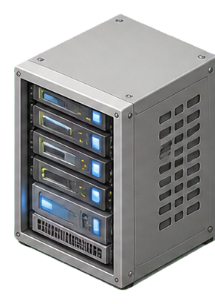
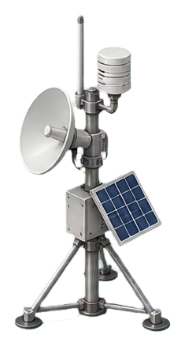
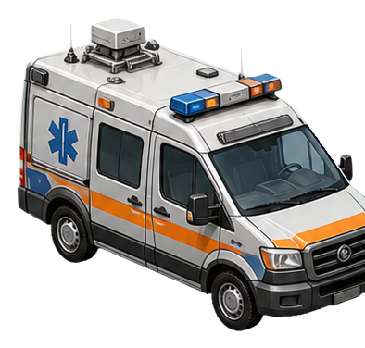

Backhaul link
GU / UAV / LEO queues
Access link
LEO satellite
UAV
Terminal
Mobile device
Task
LEO satellite layer
UAV layer
Ground user layer
Notes:
[Sources]\nSemi-realistic entity assets were generated from the user-provided SAGIN style reference and converted into project-local transparent PNG cutouts. The background, trajectories, coverage cones, queues, and links are editable PowerPoint shapes. The diagram represents the paper's GU--UAV--LEO multi-stage task scheduling model; it does not introduce a terrestrial BS service node.

Slide 2
System Model Asset Palette
Concrete objects are separate PNG layers. Queue cells, coverage regions, trajectories, and links are native PowerPoint shapes.
LEO satellite
UAV relay
Ground user
Vehicle
Ground terminal
Mobile devices
Edge server
Task cube
Comm/sensing tower
Tree cluster
Hill terrain
Shrub/rocks
Notes:
[Sources]\nAll asset cutouts are generated project assets stored under docs/paper/figure_sources/system_model/assets_20260817/ for PowerPoint-level reuse.

