Slide 1
Version 0
EEG-Dash
Metadata from GraphQL
Metadata from MongoDb?
Custom EEGDash processors
JSON
JSON
Modify HBNDataset class of eeg-ssl to process single datasets for braindecode (call it EEGDashDataset class)
BrainDecode Processor
Raw dataset file
.set, .vhdr, .edf
BrainDecode Object
S3 raw dataset
S3 reference
Transfer datasets or load from cache (if not on disk)
EEGprep
S3 reference
BIDS import
S3 derivative dataset
EEGprep MATLAB/Ptyhon
BIDS re-export
BIDS preprocessing & NEMAR

Slide 2

Version 1
Metadata from MongoDb?
User search
Custom EEGDash processors
Load cache vs signalstore
EEG-Dash
Signalstore
Writing
Signalstore search and reading into xArray
BrainDecode Processor
Dictionary
BrainDecode
EEGDash S3
NEMAR handling
BrainDecode object
Xarray to
Pytorch
Xarray
Deep Learning model
S3 reference
S3 raw dataset
NEMAR
S3 derivative dataset
BIDS import
BIDS re-export
EEGprep MATLAB/Ptyhon
BIDS preprocessing & NEMAR

Slide 3
EEG-Dash
Metadata from GraphQL
Custom EEGDash processors
JSON
Modify HBNDataset class of eeg-ssl to process single datasets for braindecode (call it EEGDashDataset class)
BrainDecode Processor
BrainDecode Object
S3 raw/preprocessed dataset BIDS
S3 reference
Transfer datasets or load from cache (if not on disk)

Slide 4
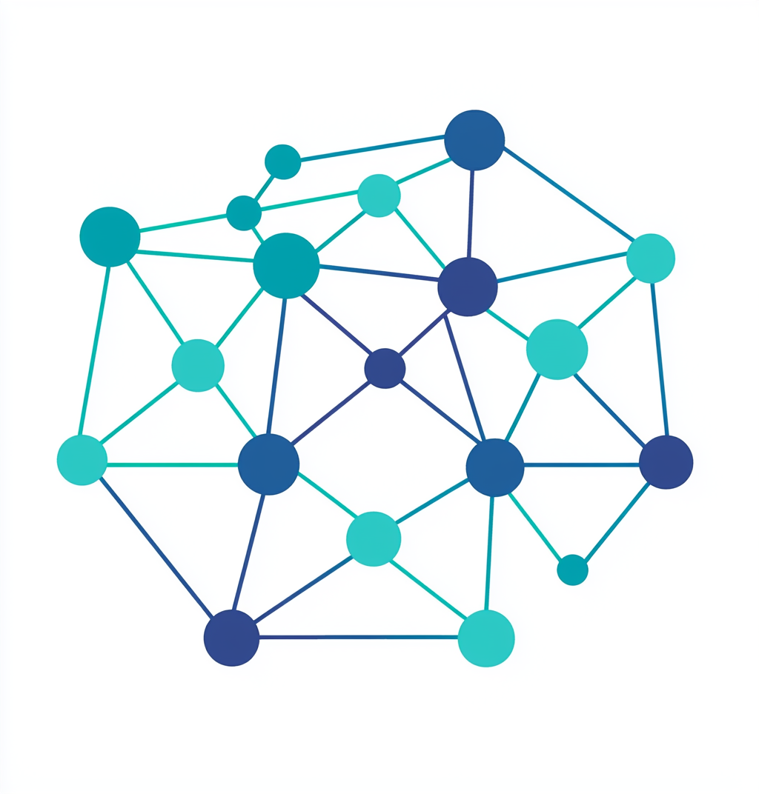
MEEG data samples
Channels
Labels
Deep learning /
Machine learning
Time points

Slide 5




