Slide 1
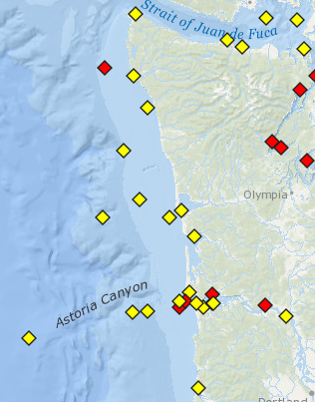
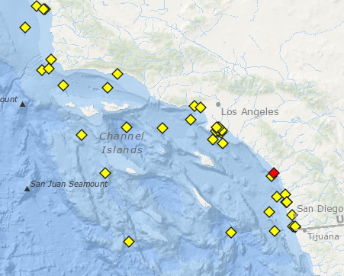
Observation Data Matrix
(Time Steps ∙ Frequency ∙ Num Buoys ∙ 5)
Wave Grid – resolution varies with size
Wind Grid – Typically at 6-36km resolution
Data inputs for Regional Model example
Observation Matrix: 24 x 36 x 20 x 5
Wave Grid: 1000 x 1000 cells
Wind Boundary: 30 x 30 cells
Wave Boundary: 1000 cells x 36 freq x 36 directions (Note we could use coarser spacing offshore, say just 30-100 cells)
Regional Models, e.g. WA and Southern CA, ~10-30 observation sites

Slide 2
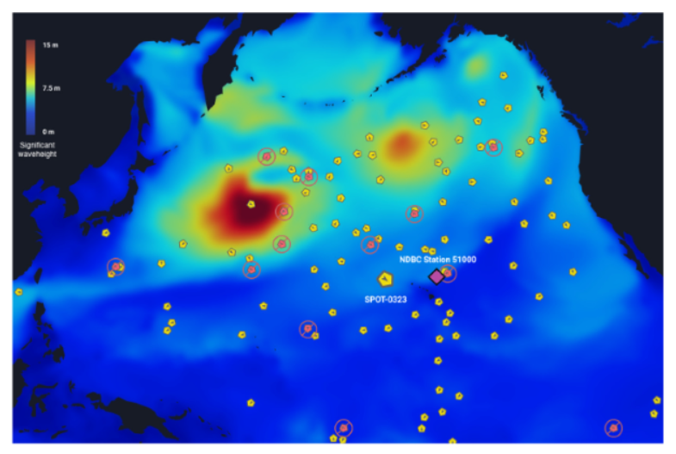
Data inputs for Regional Model example
Observation Matrix: 192 x 36 x 100 x 5
Wave Grid: 1000 x 1000 cells
Wind Boundary: 100 x 100 cells
Wave Boundary: None
Ocean-Basin Model100+ observation sites
*Note that sites drift

