Slide 1
Transforming Medical Transcripts: NLP for Enhanced Healthcare Data Management
Anna Dominic - amd9200@nyu.edu
Siri Desiraju - scd4156@nyu.edu
Sri Raksha Gubbihal - sg7374@nyu.edu

Slide 2
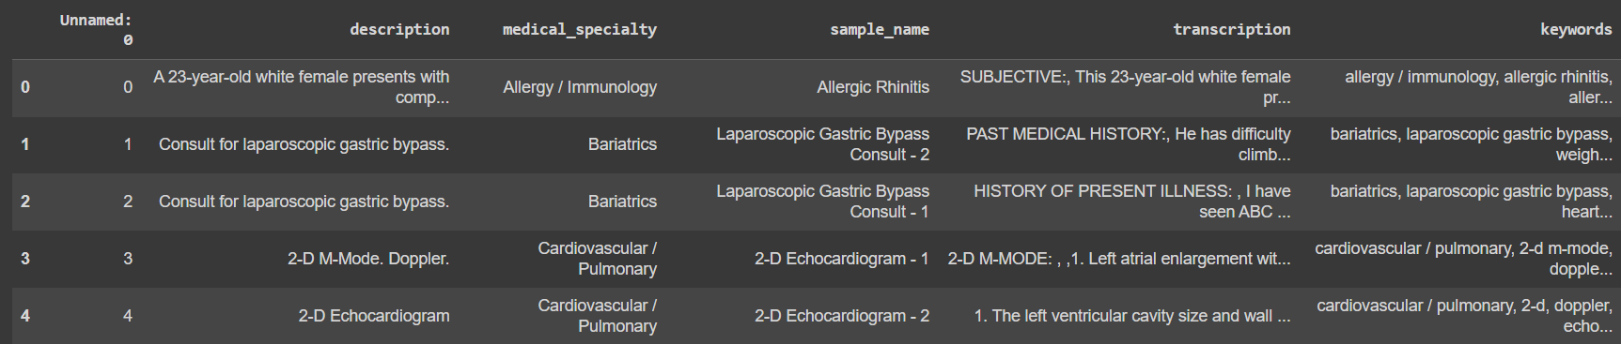
Project Goal
Original Data: Consisted of columns - Description, Medical Specialty, Sample Name, Transcription, and Keywords.
Aim: The aim of this project is to develop a sophisticated system for efficient extraction and synthesis of information from medical records.
Key objectives include:
Utilizing classifier models to categorize medical records by specialty, gender, and treatment types, enhancing healthcare providers' ability to quickly access and manage patient data.
Implementing the T5 model for detailed entity tagging and text generation, targeting an extensive range of medical entities to achieve enhanced structuring and entity tagging that proved challenging with SpaCy's NER and Regex
Extracted Columns: Age, Gender, Disease, Symptoms, Allergies, Addictions, Medical Conditions, Drug Usage, Past Procedures, Treatment Type.
Incomplete Data: Columns like Allergies and Addictions had substantial missing data, limiting their analytical utility.

Slide 3
Data Extraction
Identifying Key Headings: The initial phase involved identifying key headings within medical transcripts. This was achieved by recognizing capitalized words, considering them as potential headings.
Keyword Selection: To enhance the extraction process, a two-fold approach was taken. Firstly, an automated extraction of common capitalized headings was performed. Secondly, a manual selection of keywords, including headings such as "s ”CURRENT MEDICATION,” ”ALLERGIES,” and others, was conducted based on domain expertise.
Data Extraction: Using regular expressions (regex), data extraction for each selected keyword was implemented. The goal was to capture relevant information under each heading, ensuring precision in data retrieval.
Combining Similar Headings: To address variations in formatting and terminology, similar headings were combined. For instance, combining "PREOPERATIVE DIAGNOSIS_DETAIL" and "PREOPERATIVE DIAGNOSES_DETAIL" streamlined the data structure.
Statistical Overview: A statistical overview of the dataset was generated, providing insights into the number of non-'N/A' entries for each column. This step is crucial for assessing data completeness.

Slide 4
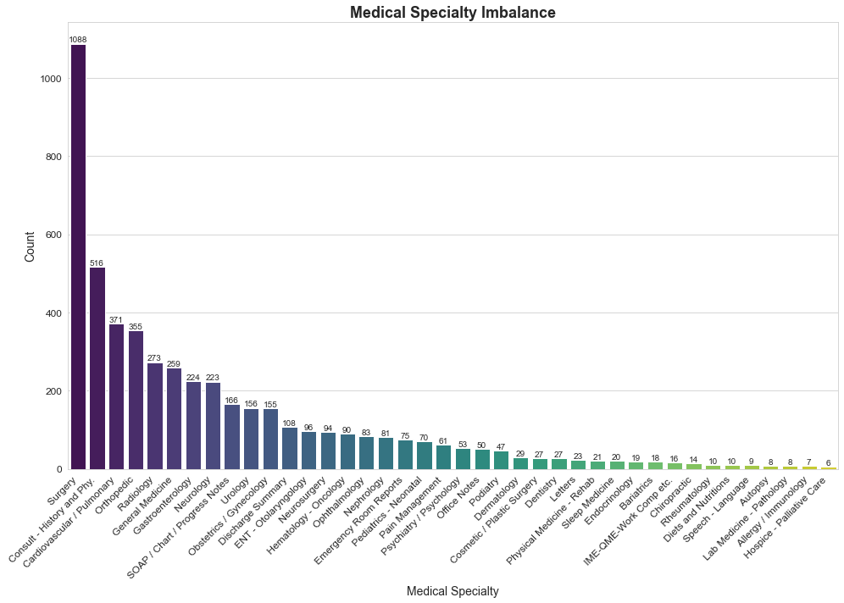
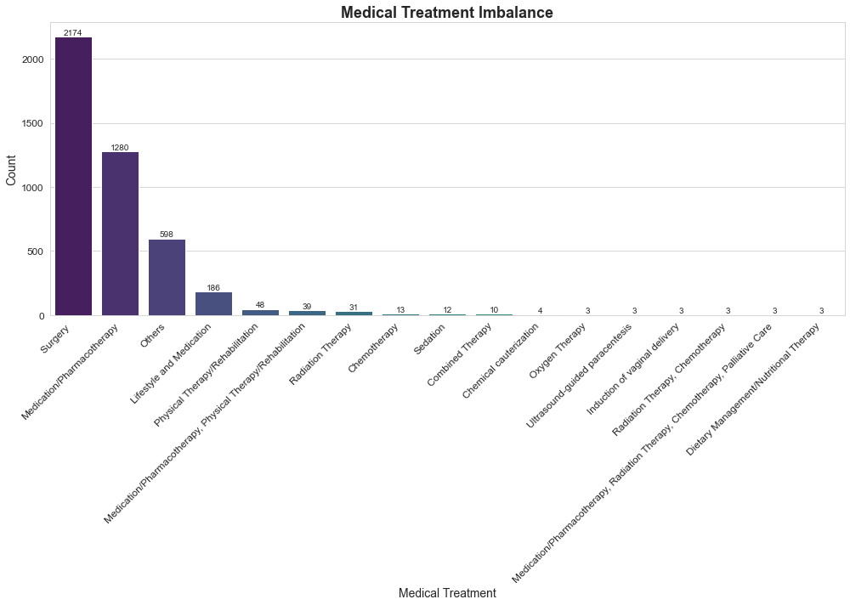
Data Engineering
GPT-3.5
Extracted key information from medical transcriptions complimenting the regex based extraction, refining prompts for accurate identification and categorization.
Gender: 'Female', 'Male', 'Other/Unknown'.
Treatment Type: 'Medication/Pharmacotherapy', 'Surgery', others aggregated under 'Others'.
Medical Specialty: Utilized pre-existing categories like 'Cardiology', 'Neurology'.
Data Engineering
Addressed missing/incomplete data for dataset accuracy.
Simplified treatment descriptions for categorization.
Example: Combined 'Medication/Pharmacotherapy' and 'Dietary Management/Nutritional Therapy' into 'Lifestyle and Medication'.

Slide 5
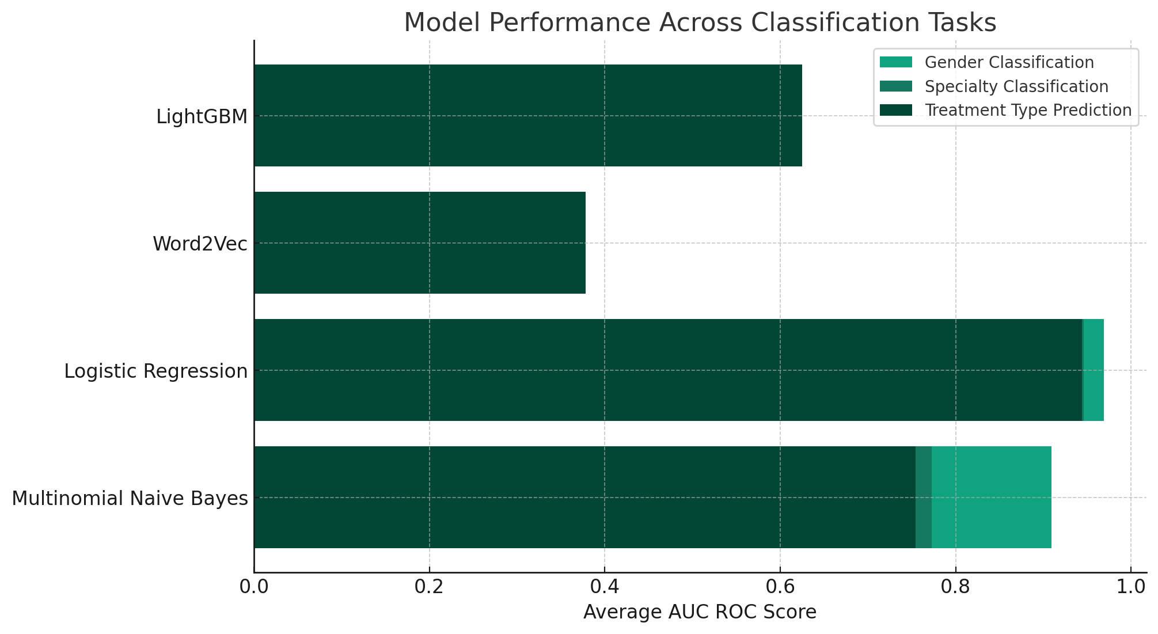
Classifier Models
Objective
Categorize data into Gender, Medical Specialty, and Treatment Type.
Data Transformation
Utilized TF-IDF to emphasize key terms and reduce noise.
AVERAGE AUC-ROC SCORES
Models Used
Word2Vec: Captures semantic context.
LightGBM: Efficient with categorical/text data.
Multinomial Naive Bayes: Effective for text data.
One-vs-Rest Logistic Regression: Manages multi-class data.
Performance Metric
Chose ROC AUC for its suitability in imbalanced datasets and accuracy in category differentiation.
Notes:
**Objective - Categorization:**
The primary objective is to categorize data into three classes: Gender, Medical Specialty, and Treatment Type. Each class represents a distinct aspect of the data, and accurate categorization is crucial for meaningful analysis and insights.
**Models Used:**
1. **Word2Vec:**
- *Reasoning:* Word2Vec is employed to capture semantic context in the data. This model excels in representing words in a vector space, preserving semantic relationships. It's beneficial for understanding the context and nuances within textual data, which is valuable for categories like Medical Specialty and Treatment Type.
2. **LightGBM:**
- *Reasoning:* LightGBM is chosen for its efficiency with categorical and text data. Its ability to handle categorical features well, along with efficient gradient boosting, makes it suitable for the varied nature of the categorization task, where different features may have different levels of importance.
3. **Multinomial Naive Bayes:**
- *Reasoning:* Multinomial Naive Bayes is known for its effectiveness with text data. It assumes that features are conditionally independent, making it appropriate for tasks involving the frequency of terms, which is crucial in understanding textual information related to Medical Specialty and Treatment Type.
4. **One-vs-Rest Logistic Regression:**
- *Reasoning:* One-vs-Rest Logistic Regression is chosen for managing multi-class data. Given that the categorization involves multiple classes (e.g., different Medical Specialties), this approach enables the creation of binary classifiers for each category, enhancing the model's ability to handle the diversity in the data.
**AVERAGE AUC-ROC SCORES:**
The choice of ROC AUC (Receiver Operating Characteristic - Area Under the Curve) as the performance metric is driven by specific considerations:
- *Imbalanced Datasets:* ROC AUC is robust in handling imbalanced datasets, common in categorization tasks where certain classes may be less frequent than others. It provides a more comprehensive evaluation by considering true positive rates across various thresholds.
- *Accuracy in Category Differentiation:* ROC AUC is well-suited for scenarios where distinguishing between different categories is crucial. It evaluates the model's ability to differentiate between classes, offering insights into its overall performance across all categories.
**Data Transformation - TF-IDF:**
The use of TF-IDF (Term Frequency-Inverse Document Frequency) for data transformation is motivated by its ability to emphasize key terms while reducing noise. TF-IDF assigns weights to terms based on their frequency in a document relative to their frequency across all documents. This helps highlight important terms that contribute to the categorization task while mitigating the impact of common terms that might introduce noise.

Slide 6
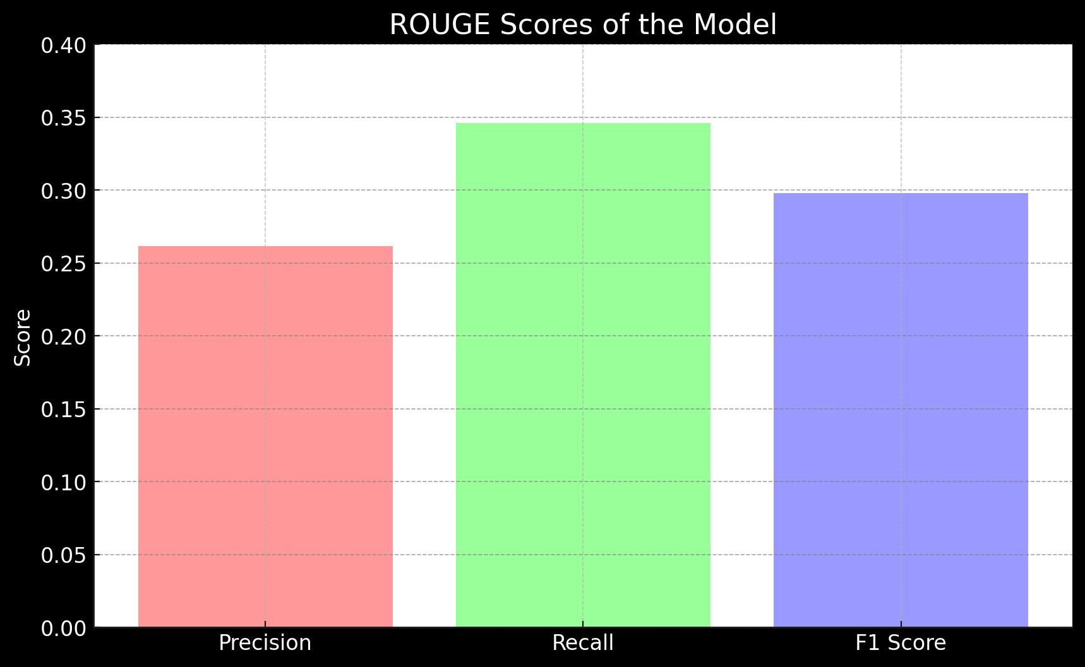
Model Fine-Tuning
Objective
Identify and tag entities in medical texts, including diseases, symptoms, medications, and procedures.
Initial Trials
Experimented with BioBERT and Spacy models. Outputs were largely nonsensical.
Advanced Approach
Shifted to the T5 model from Transformers for Entity tagging of Age, Disease, and Symptoms from medical transcriptions.
ROUGE - L SCORES
Progress
Notable reduction in loss over 10 epochs for around 2k rows with a learning rate of 1e-4 and an output token limit 50
Performance Metric
Chose ROUGE-L for its ability to quantify overlap between model output and gold standard, assessing both content accuracy and extraneous noise,

Slide 7
Thank you!

Slide 8
Data Transformation and Classification Models
Classification Task | Model | Average AUC ROC Score
Gender Classification | Multinomial Naive Bayes | 0.9092
 | Logistic Regression | 0.9693
Specialty Classification | Multinomial Naive Bayes | 0.7729
 | Logistic Regression | 0.9461
Treatment Type Prediction | Multinomial Naive Bayes | 0.7541
 | Logistic Regression | 0.9441
 | Word2Vec | 0.3783
 | LightGBM | 0.625
Objective: Categorize data into Gender, Medical Specialty, and Treatment Type.
Models Used:
Word2Vec: Captures semantic context.
LightGBM: Efficient with categorical/text data.
Multinomial Naive Bayes: Effective for text data.
One-vs-Rest Logistic Regression: Manages multi-class data.
Data Transformation: Utilized TF-IDF to emphasize key terms and reduce noise.
Performance Metric: Chose ROC AUC for its suitability in imbalanced datasets and accuracy in category differentiation.

Slide 9
Data Transformation and Classification Models
Developed classification models to categorize the data into specific classes such as Gender, Medical Specialty, and Treatment Type.
Selected TF-IDF for transforming medical transcriptions as it effectively highlights important terms while minimizing the influence of frequent but less relevant words, and it aligns well with the chosen classification models.
Implemented Multinomial Naive Bayes and Logistic Regression models.
Multinomial Naive Bayes : Chosen for its efficiency in handling text data.
One-vs-Rest Logistic Regression: Chosen to handle the multi-class nature of your data, especially given the class imbalance.
Chose the ROC AUC metric for its effectiveness in evaluating model performance in datasets with imbalanced classes and for its ability to measure a model’s capability to distinguish between different categories accurately.
Classification Task | Model | Average AUC ROC Score
Gender Classification | Multinomial Naive Bayes | 0.9092
 | Logistic Regression | 0.9693
Specialty Classification | Multinomial Naive Bayes | 0.7729
 | Logistic Regression | 0.9461
Treatment Type Prediction | Multinomial Naive Bayes | 0.7541
 | Logistic Regression | 0.9441

Slide 10
Data Transformations and Classification Models
Developed classification models to categorize the data into specific classes such as Gender, Medical Specialty, and Treatment Type.
Several approaches were implemented including a Word2Vec model, a LightGBM model, a Multinomial Naive Bayes model and a Logistic regression model
Selected TF-IDF for transforming medical transcriptions as it effectively highlights important terms while minimizing the influence of frequent but less relevant words, and it aligns well with the chosen classification models.
Chose the ROC AUC metric for its effectiveness in evaluating model performance in datasets with imbalanced classes and for its ability to measure a model’s capability to distinguish between different categories accurately.

