Slide 1
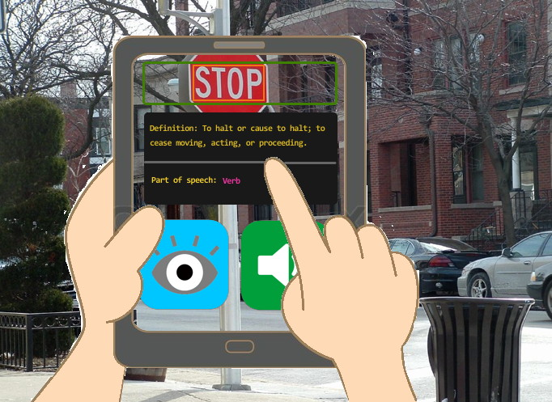
Word Scan is an interactive dictionary app that allows young learners to explore the world around them.

Slide 2
The average student learns about 8 words per day in the early school years.
Children who have not developed basic literacy skills by the time they enter school are 3 to 4 times as likely to drop out in later years.
More than 35% of teachers have access to tablets or e-readers in the classroom, up from 20% in 2012.
75% of teachers report technology is helping children become more motivated to learn, reinforcing and expanding lesson plans, and responding to a wide range of learning styles.

Slide 3
In response to a growing technology presence in classrooms and a
real need for children to learn basic literary skills at an early age,
Word Scan is an educational application tailored to young children
who wish to learn more about the world around them. It allows real
time scanning of words and provides intuitive and simple information
such as definition, part of speech, phonetic pronunciation, and related
images.

