Slide 1




Session 1, 13 Nov 2020, 10:30-12EST
What is the central message of my research?
This session follows on from the first video released by Mihaela Gruia from Research Retold on the 5 reasons for communicating research beyond academia.
Ahead of the session, please watch the short video and fill in
Page 1 of this worksheet. The rest of the worksheet will be used on Nov 13th.
Mihaela Gruia
Founder and Director of Research Retold
mihaela@researchretold.com
www.researchretold.com
Follow us: @researchretold
This workbook belongs to: [insert your name]

Slide 2
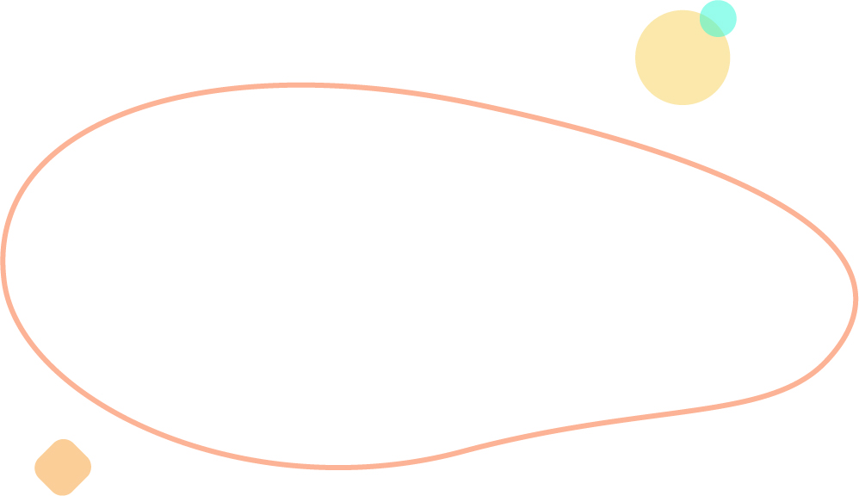





Worksheet
Fill this page in before the session
Why do I think it’s important to communicate my research beyond academia? Which of the 5 reasons from the video resonated with me? [write here]
How could communicating my research help my academic career? [write here]
What obstacles might I face when communicating my research? [write here]

Slide 3
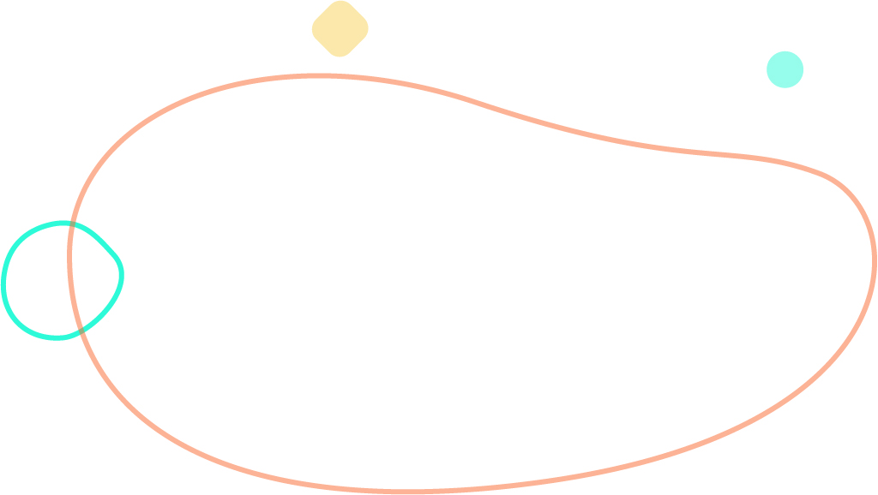

Central research message To be filled in during the session
This is a useful exercise to frame your writing efforts.
Articulating your work in 60 seconds forces you to be concise and focused.
Questions to consider when crafting your central research message:
A. What is the central message of my research?
B. What’s the problem/context of my research?
C. How am I going about solving this problem?
D. Why should people care about my research?
60 second pitch here: [write here]

Slide 4


Notes and questions
Jot down any notes or questions you have throughout the session:
[Write here]

