Slide 1
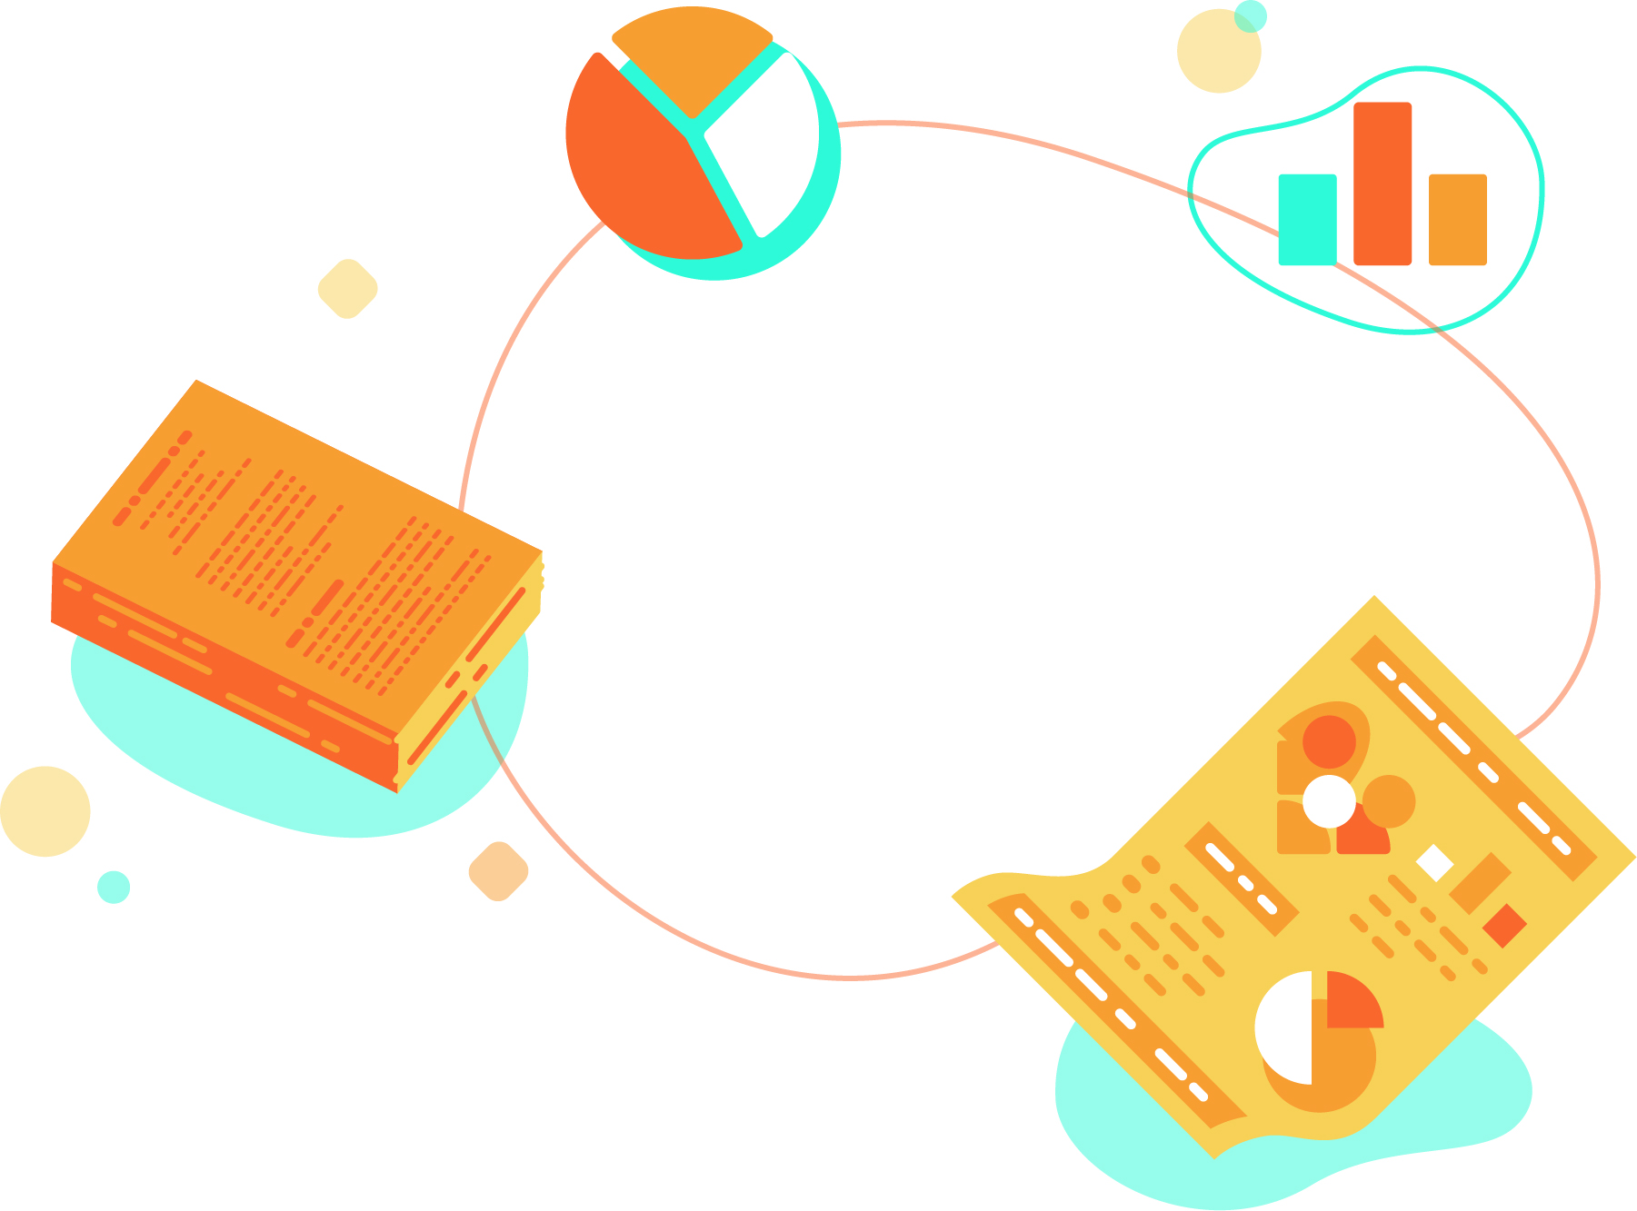



Session 2, 20 Nov 2020, 10:30-12EST
Designing a communications plan for my research
This session follows on from the second video released by Mihaela Gruia from Research Retold on the 5 building blocks of a research communications plan.
Ahead of the session, please watch the short video and fill in pages 2-6.
The rest of the worksheet will be used on Nov 20th.
Mihaela Gruia
Founder and Director of Research Retold
mihaela@researchretold.com
www.researchretold.com
Follow us: @researchretold
This workbook belongs to: [insert your name]

Slide 2
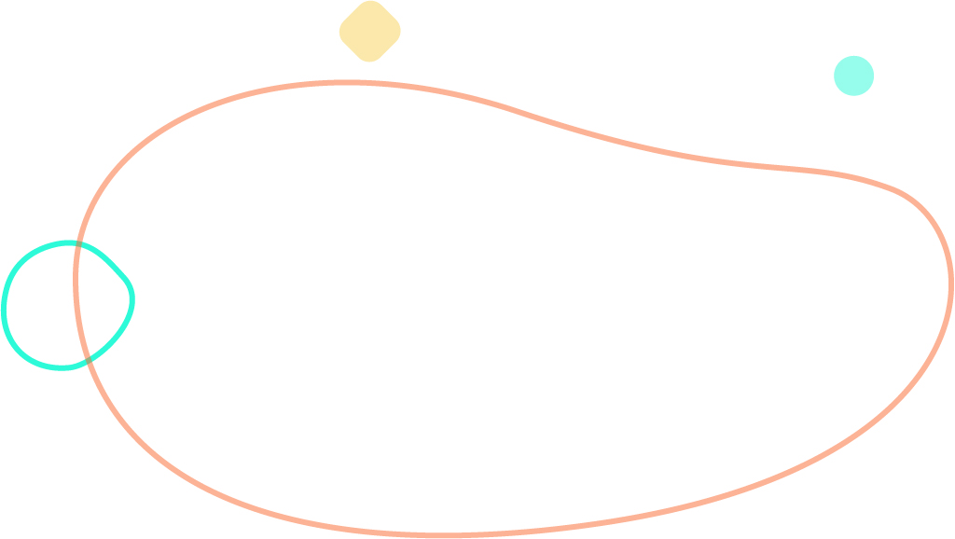

Developing my communications plan
1) Goals and objectives
What are you trying to achieve?
Be specific and measurable
This is an iterative process, expect your goals to change as your research develops
Focus on outputs and outcomes
Aim for three or less
[write here]

Slide 3


Developing my communications plan
2) Audience
Who are you targeting with your communications?
Focus on the three most important audiences
Who could you engage with to achieve your communications objective(s) and why?
Involve your colleagues in this exercise
Be as specific as possible, not just ’policymakers’ (what department, team, details)
[write here]

Slide 4

Developing my communications plan
3) Messages
What message will you aim to get across?
For each audience, ask yourself:
What is their current view or position on this topic?
What changes do I want to see happen as a result of them understanding my research?
What is my ‘hook’? What message from my research would capture their attention?
Audience 1:
View:
Changes:
Hook:
Audience 2:
View:
Changes:
Hook:
Audience 3:
View:
Changes:
Hook:

Slide 5

Developing my communications plan
4) Timing
When will you reach out to them?
Once you figure out what messages you want to send these individuals you want to think about when is the best time to reach them and reverse engineer your steps from your objectives
Timeline of activities

Slide 6
Developing my communications plan
5) Formats of communication
How are you going to distribute your message?
Where does your audience spends their time?
How do they usually get their information?
Food for thought:
Online: website, social media, direct email, online materials, blogs
Offline: advertising in magazines, publications, media (local, national, international), events, radio/podcasts, post
Static: policy briefs, visual summary, infographics, illustrations, brochures, fliers
Dynamic: social media content, video, animations
Audience 1:
Audience 2:
Audience 3:

Slide 7

Developing my communications plan
Resources you need
What resources (people, skills, equipment) can you access internally/ externally for your communication efforts?
Who do you ideally need to assist you? Who is actually available to assist you?
What funds do you need or have?
Do you need to bid for extra? From whom? When?
Are there conditions attached to the funding?
Prioritise and manage people’s expectations
[write here]

Slide 8
Developing my communications plan
Risks – what could go wrong?
Identify risks that could prevent you achieving your objectives
How you will deal with them?
Identify options – a plan A and a plan B
Prepare ‘lines to take’ – anticipate audiences’ reaction
[write here]

Slide 9
Developing my communications plan
Evaluate success
Involve your research team to figure out how you will measure success.
Quantitative metrics:
Event attendance, website visitors, donations, column inches
Qualitative metrics:
Feedback forms, focus groups, key messages in the media, evaluation with team
[write here]

Slide 10
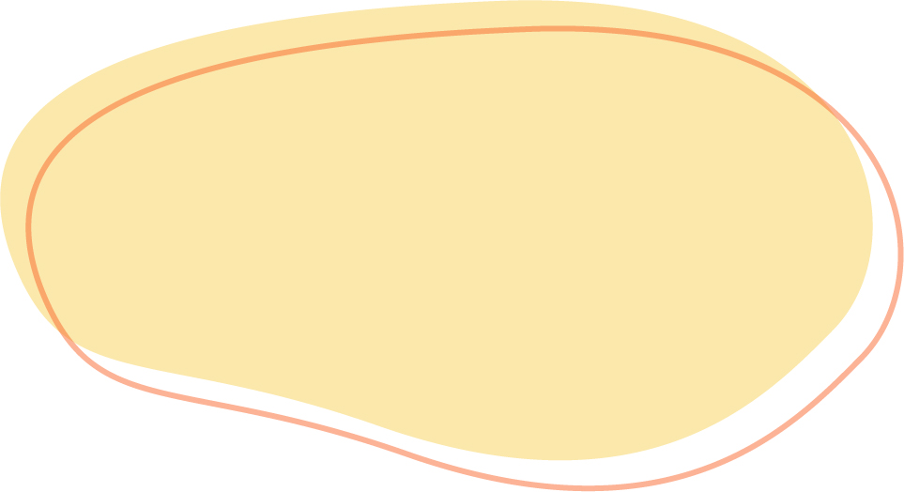

Research Communication Phases
Set-up phase
Identify key audiences and raise awareness of the study, objectives and potential relevance to them. Set up new channels (eg blog, Twitter). Look at resources needed for significant communications activity (e.g. film, infographic design or conferences). You can raise awareness of the research team’s knowledge and expertise in the area of study, build reputation as a ‘go to’ source of information on the subject.
Sustain phase
You have identified and engaged with your audiences, so you will need to maintain their interest. Keep your study front of mind without overburdening them with information. Some audiences may want to hear of any initial findings via engagement events. Others may just wish to keep up to date with the latest thinking to emerge from your study via Twitter, blogs or face-to-face networking at events and conferences.
Post-peer review dissemination phase
Findings are now available. Tailor the communication of findings to target audiences. Use the channels they engage with and the language that enables them to easily understand the implications of your findings for them. Use different channels simultaneously to reinforce messages.
Spread phase
After you have communicated your findings, can you amplify awareness and spread insights from your research? Are you able to demonstrate impact or influence? Are there other audiences who may benefit or learn from any aspect of the study? What news or events are coming up in the future where the findings may be relevant?
Source: Health Foundation

Slide 11
Notes and questions:
[Write here]
For any questions about this workbook, email mihaela@researchretold.com

