Slide 1
细胞分割问题汇报
2026年01月14日
汇报人：徐骏

Slide 2
对比试验
method | miou | dice | hd95
our model | 0.8960 | 0.9399 | 17.57
InSPyReNet_SwinB | 0.8383 | 0.9055 | 21.69
InSPyReNet_Res2Net50 | 0.8124 | 0.8901 | 24.61
auto_prompt | 0.7493 | 0.8489 | 48.58
random_prompt | 0.7404 | 0.8424 | 43.23
grabcut | 0.7023 | 0.8113 | inf
mst | 0.2737 | 0.3781 | 84.69
otsu | 0.1543 | 0.2492 | 57.45
kmeans | 0.1458 | 0.2360 | 57.36
watershed | 0.1302 | 0.2150 | 62.90
method | miou | dice | hd95
our model | 0.8075 | 0.8843 | 29.92
InSPyReNet_SwinB | 0.7938 | 0.8680 | 16.02
InSPyReNet_Res2Net50 | 0.6943 | 0.8004 | 21.83
random_prompt | 0.7205 | 0.8255 | 43.60
auto_prompt | 0.7095 | 0.8182 | 47.09
grabcut | 0.6223 | 0.7570 | 44.38
otsu | 0.2496 | 0.3801 | 52.22
kmeans | 0.2375 | 0.3636 | 51.44
mst | 0.2186 | 0.3183 | 93.32
watershed | 0.2137 | 0.3315 | 56.97

Slide 3
算法示意图

Slide 4
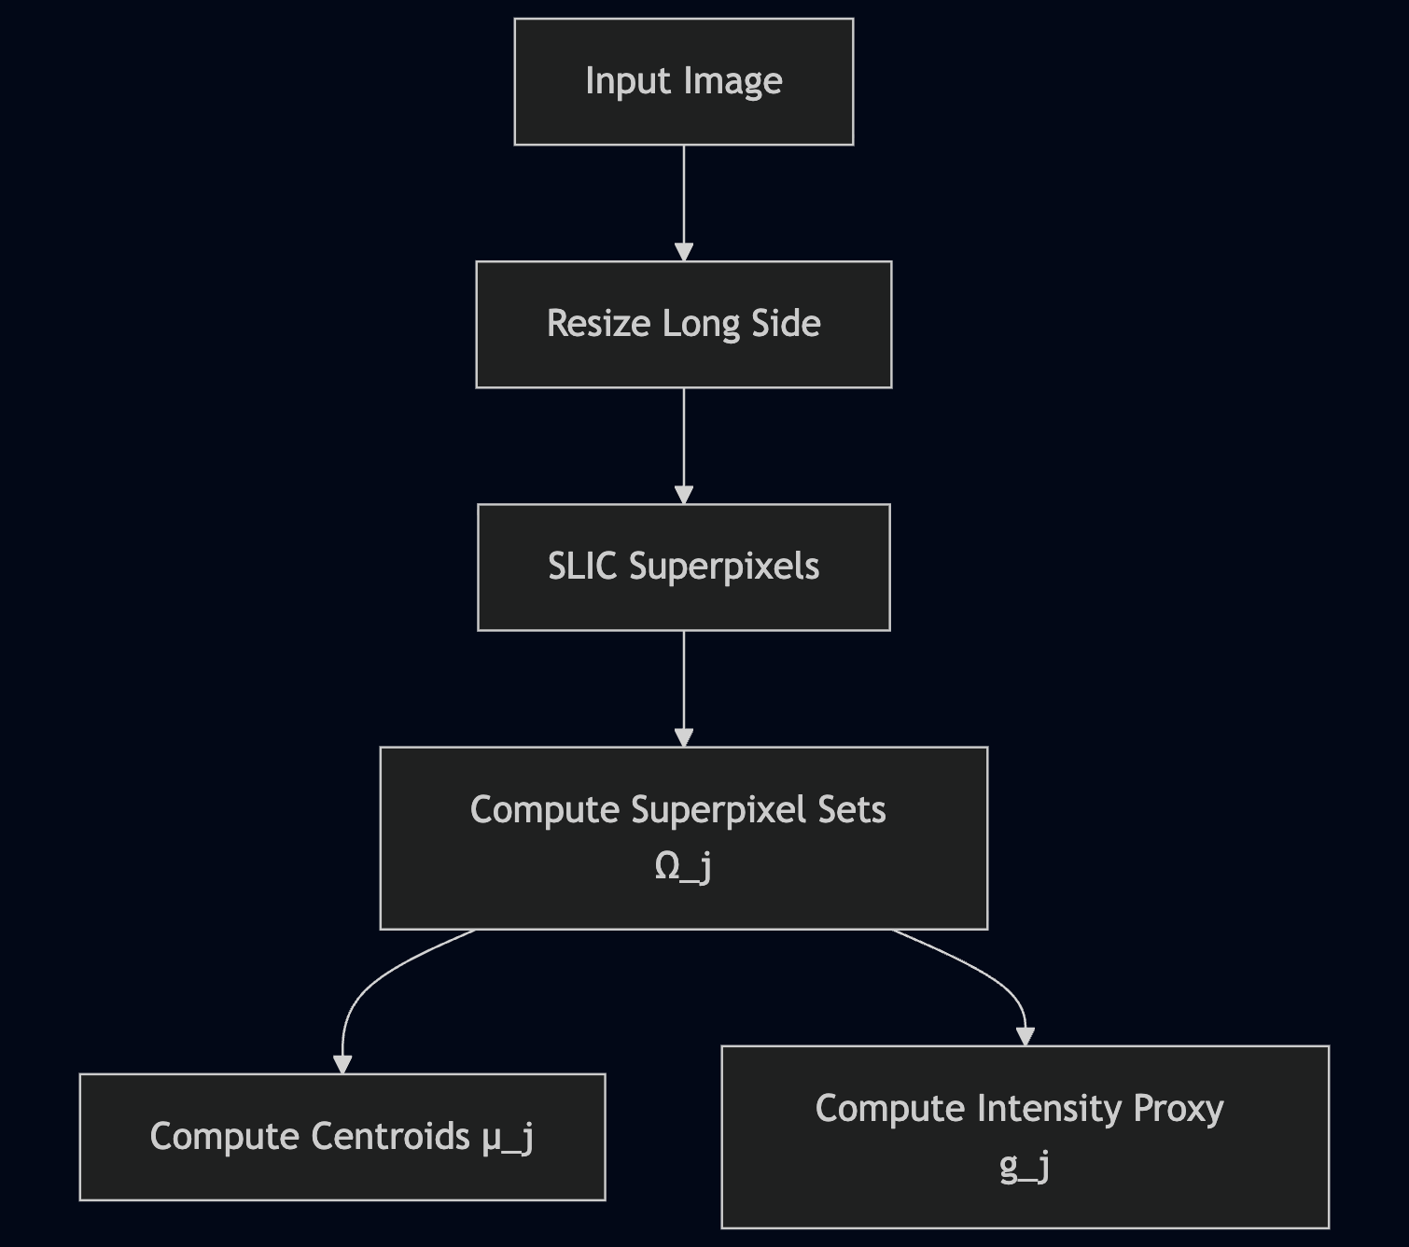
Preprocess & Superpixel Construction

Slide 5
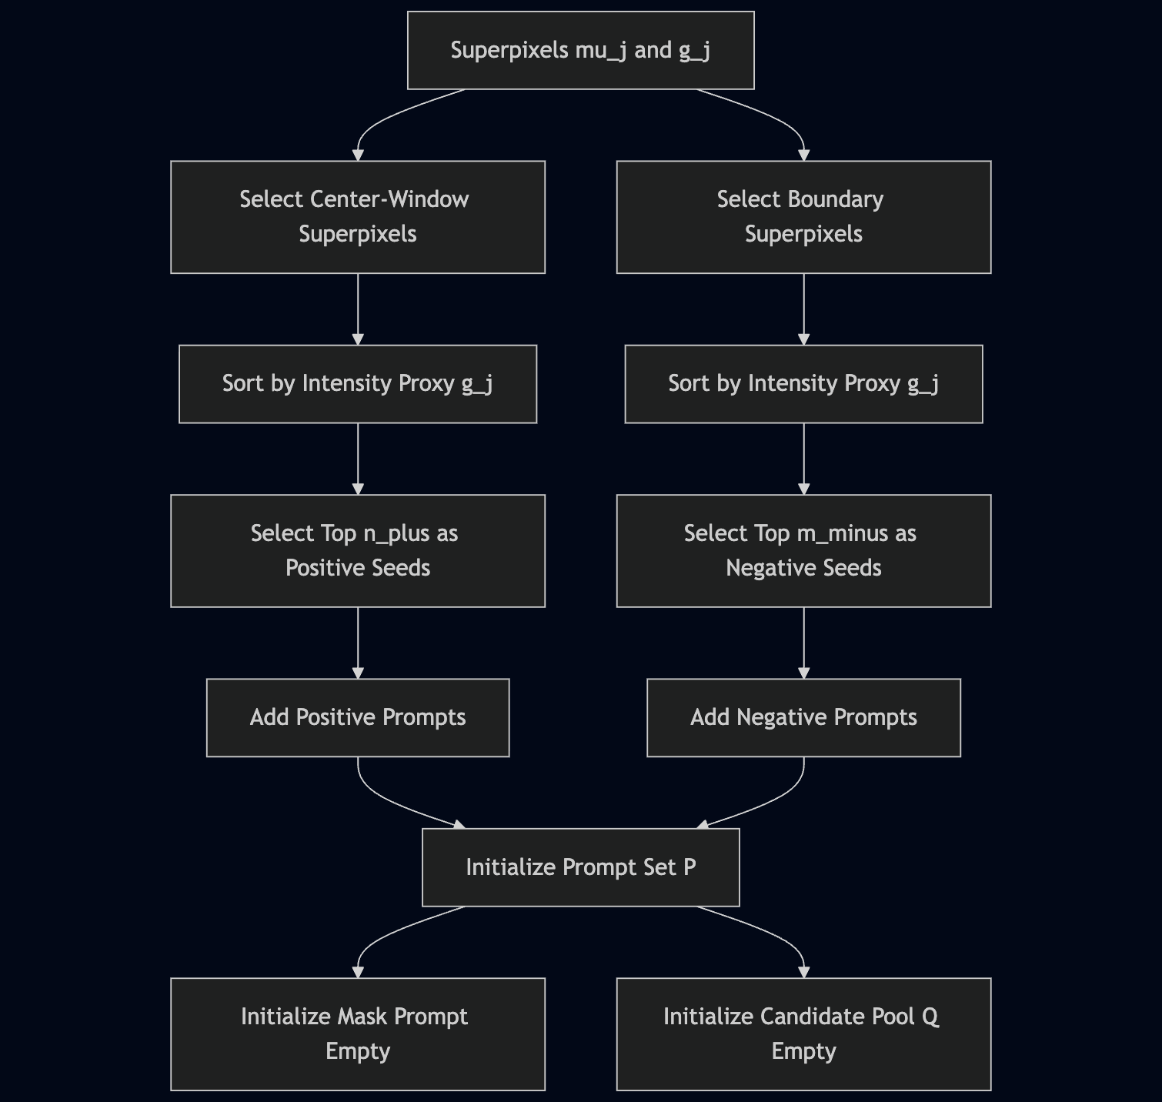
Initial Prompt Initialization

Slide 6
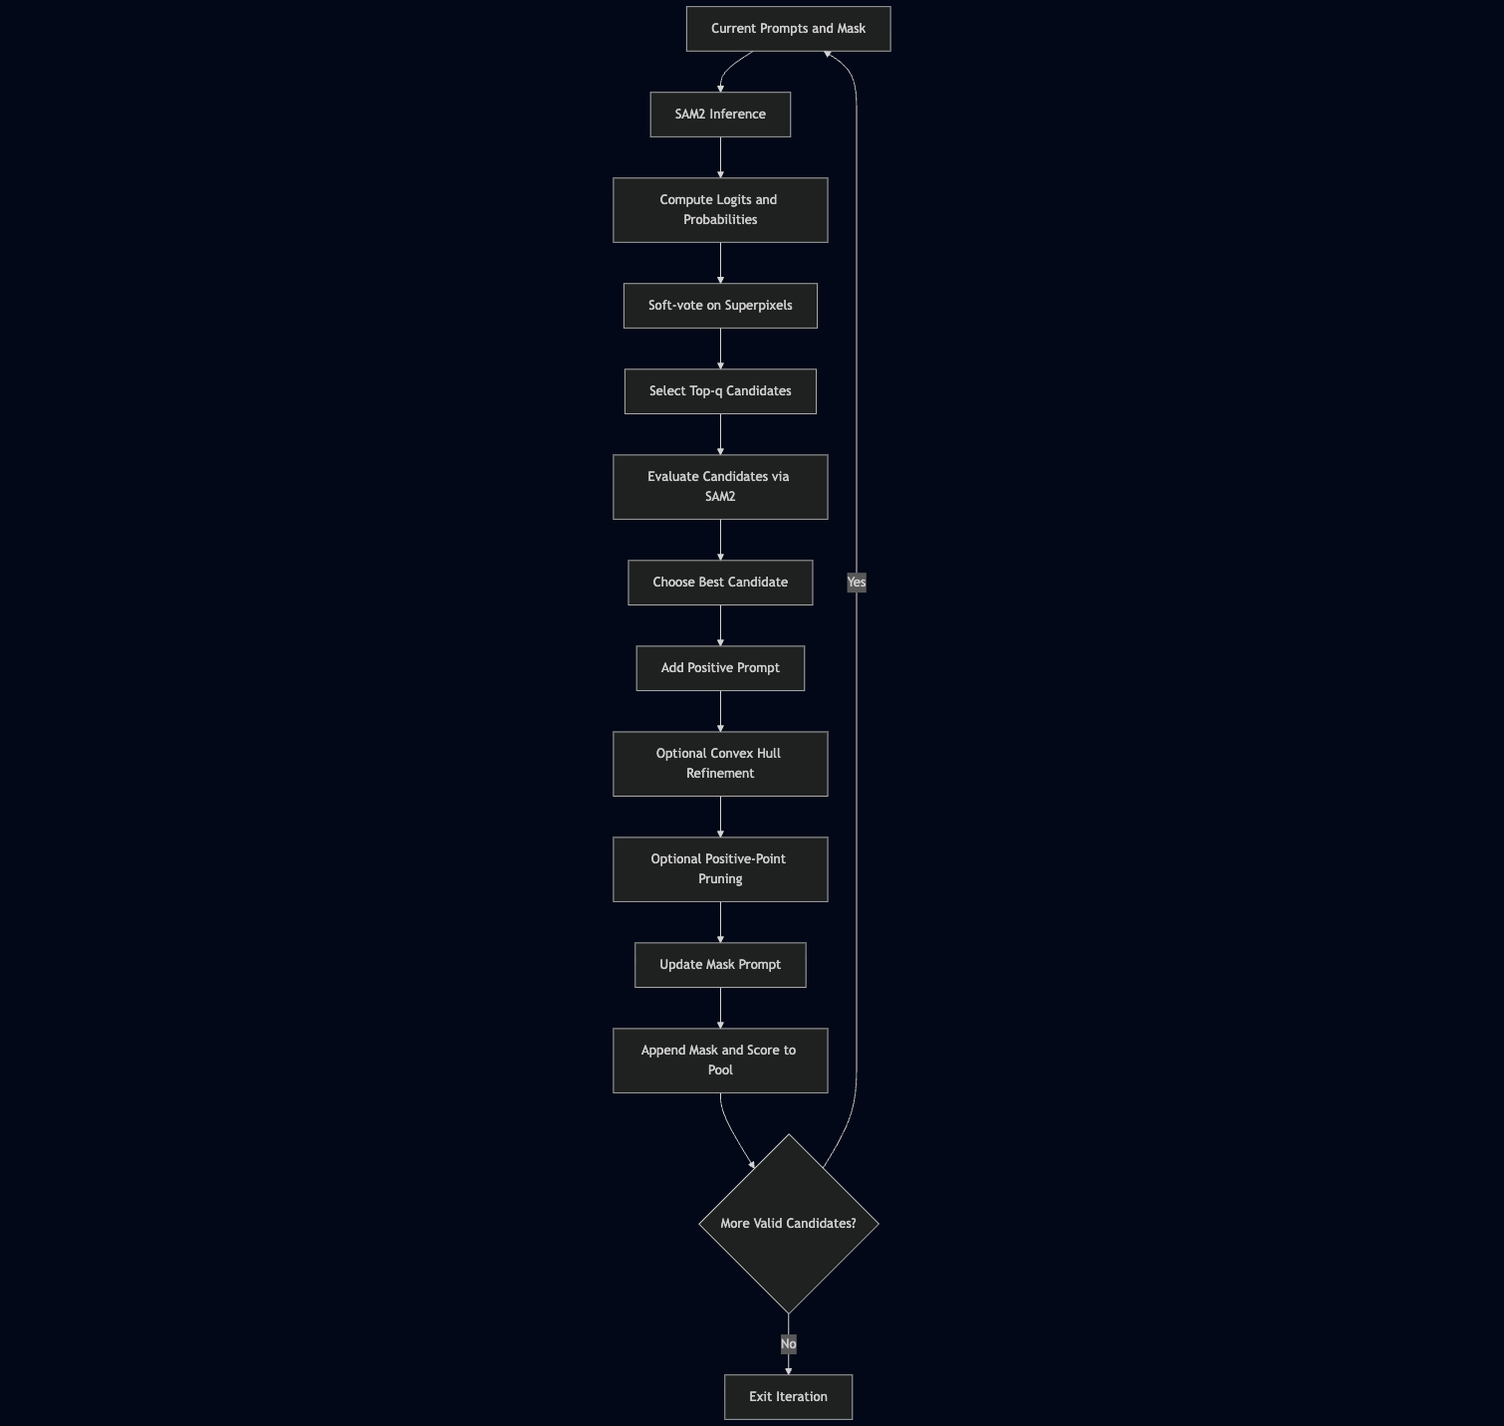
Iterative Prompting with Candidate Evaluation

Slide 7
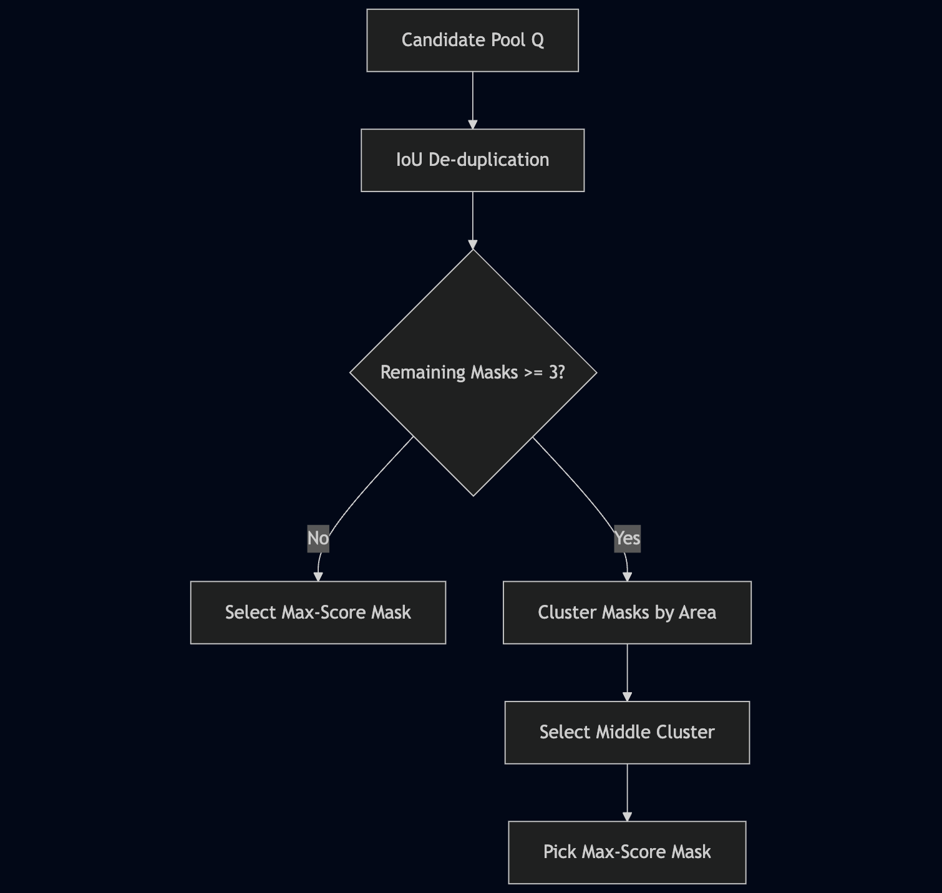
Final Mask Selection

Slide 8
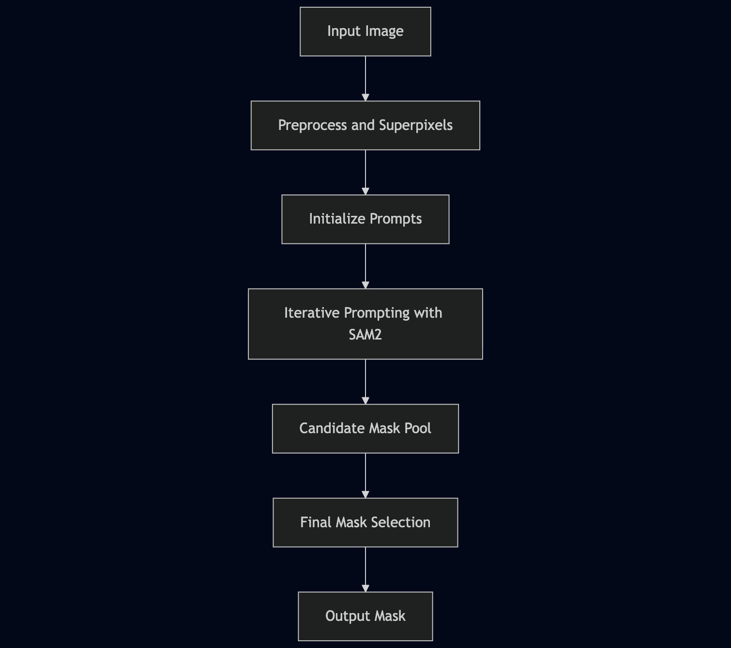
fnial

Slide 9
超参数敏感性分析

Slide 12
剥离实验

