Slide 1
High Impact Applicationsof Optimization and Statistics (Big-Data) on Multi-Petaflop Systems enabled by MPPLAB(e-Teacher )
2nd Workshop on
Software Challenges to Exascale Computing
(SCEC-2018) Workshop,
December 13-14, 2018 New Delhi, India
MPPLAB is acronym or
= Mathematical Programming in Parallel LABoratory
  By
  Dr.V.C.V. Rao (C-DAC, Pune)
  Dr.Narendra K Karmarkar

Slide 2

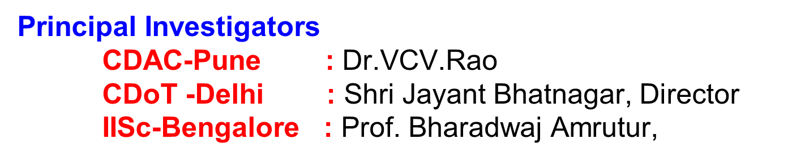
High Impact Applications of Optimization and Statistics (Big-Data) on Multi-Petaflop Systems enabled by MPPLAB(e-Teacher )
MPPLAB is acronym or
= Mathematical Programming in Parallel LABoratory
  Project Proposed To National Supercomputing Mission (NSM) as an Application

Slide 3
High Impact Applications of Optimization and Statistics (Big-Data) on Multi-Petaflop Systems enabled by MPPLAB(e-Teacher)
Overview
Object Oriented Programming
Fortran 2008

Slide 4
High Impact Applications of Optimization and Statistics (Big-Data) on Multi-Petaflop Systems enabled by MPPLAB(e-Teacher)
Outline
The project involves application of Unified architecture based methodology to very large scale problems of national importance, including in particular telecommunication traffic engineering.
e-Teacher is name of the system to be used for training manpower to under- stand concepts underlying the new system and use it effectively.

Slide 5
High Impact Applications of Optimization and Statistics (Big-Data) on Multi-Petaflop Systems enabled by MPPLAB(e-Teacher)
Origin of the Proposal
Optimisation & Statistics (Big Data) has several applications for large-scale problems in
Network optimization,
Distributed control,
Complex resource allocation and optimization problems,
Due to Large-Scale Systems and Big Data requirement, Top-down Design at HPC based on unified architecture necssary.

Slide 6
High Impact Applications of Optimization and Statistics (Big-Data) on Multi-Petaflop Systems enabled by MPPLAB(e-Teacher)
Outline
The overall project has three Stages
Stage 1 : Unified Object Oriented Interface
Stage 2 : Development of Scalable Libraries
Stage 3 : Implementation for Sample Application
Telecom

Slide 7
Stage 3
About Telecom Application
Math Model

Slide 8
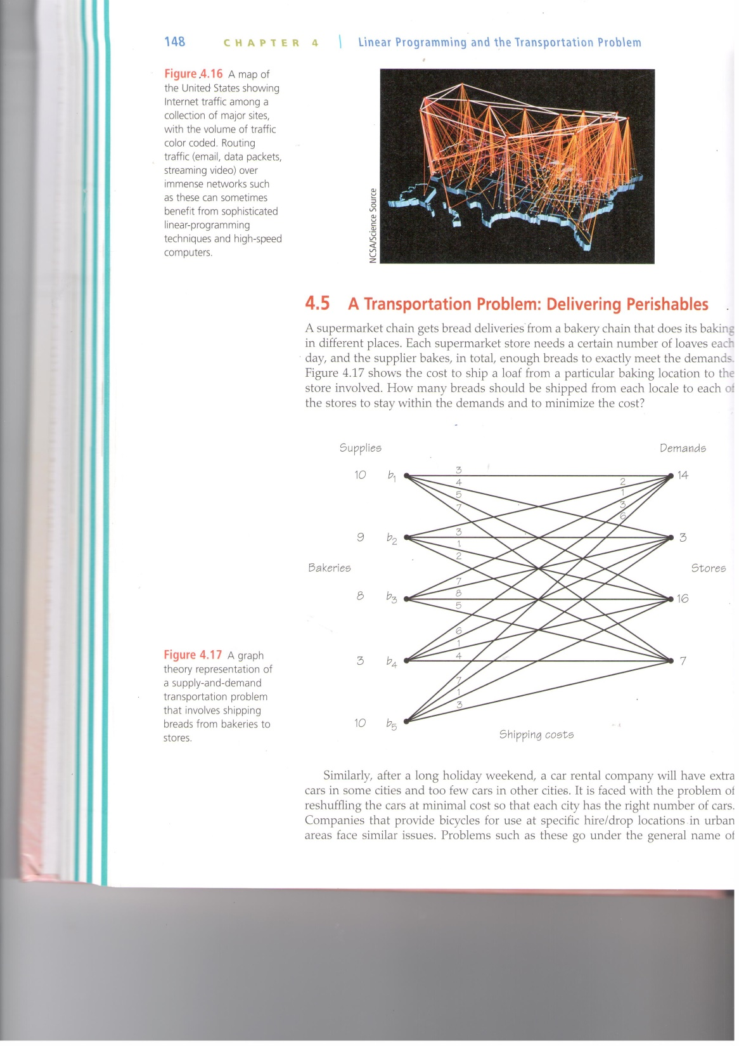
HPC-Big Data Processing:Linear Programming App.
A transportation Problem Delivering Perishables
Internet traffic among a collection of major sites, with the volume of traffic color coded. routing traffic over immense networks - Need of linear prog. tech. and high-speed computers.
●Email ● Data packets, ●Streaming video
  Challenge :
  Process Graphs (Directed /Undirected)
  Few Million to Billion
Source :
http://www.macmillanhighered.com/Catalog/product/forallpracticalpurposes-tenthedition-comap

Slide 9
MPPLabe-Teacher: An Overview of Application Framework
Examples of Systems represented by Graph
  Social Networks
  Internet, facebook, twitter, google plus, whatsapp etc.
  Communication Networks
  Telephone network, Mobile, email etc
  Biological Networks
  Genomes, Protein interactions, disease
  Electrical Networks
  Power grid, network on chip etc

Slide 10
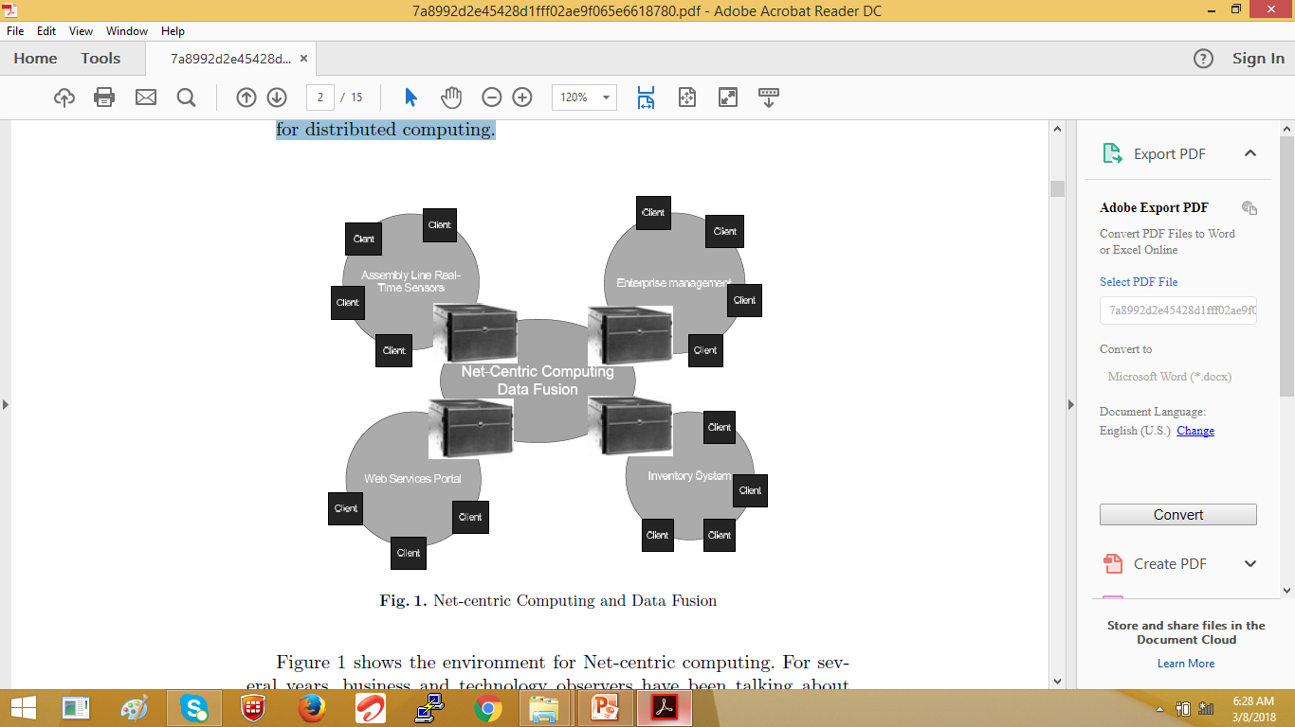
Network Centric Computing (NCC) : Environment
An emerging technology Architecture and an evolutionary stage of client/server computing.
Architecture : supports access to information through multiple electronic channels (personal/network computers, cell phones, kiosks, telephones, etc.).

Slide 11
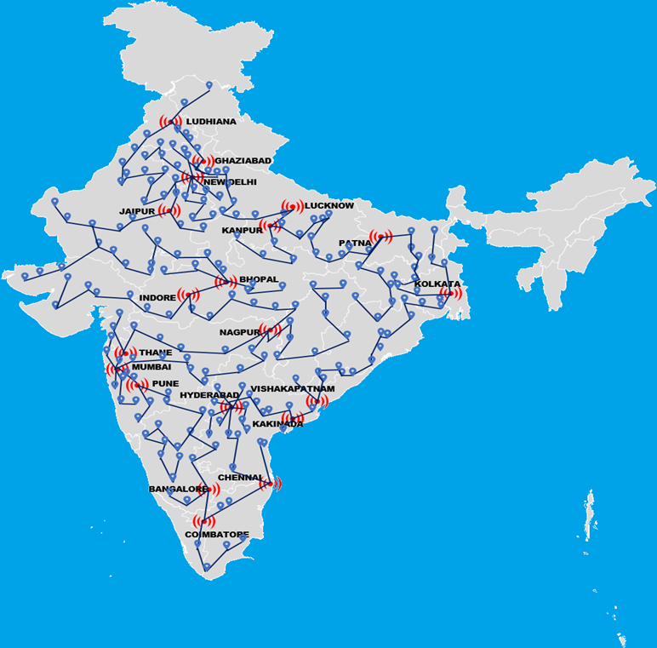
High Impact Applications of Optimization and Statistics (Big-Data) on Multi-Petaflop Systems enabled by MPPLAB(e-Teacher)
Mathematical Modeling – Alg./Lib; Telecomm App. in progress
App. Software Design : Map of India; Map Module; Activity Module; Time Zone; Activity Date Collection; Affinity Types – Data Collection
Mathematical Modeling – Alg./Lib; Telecomm App. in progress
Illustrative Example of Graph Representation of TeleComm Links
App. Software Design : Map of India; Map Module; Activity Module; Time Zone; Activity Date Collection; Affinity Types – Data Collection

Slide 12
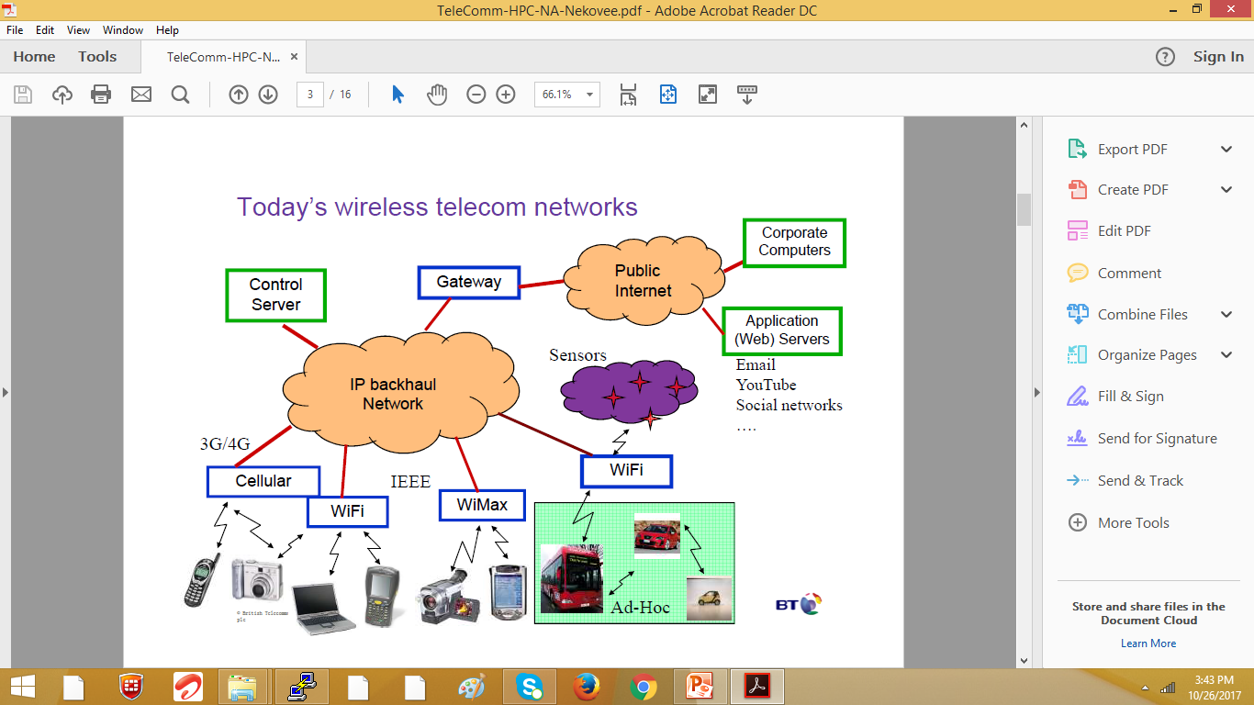
HPC-BIG Data : Computational modelling telecom
To-day’s wireless telecom Network
Integration of Sensors, Switches, Devices, Compute Servers
Real Time Data Processing – Data Analytics
Data Segregation, Data Fusion, Data Access

Slide 13
High Impact Applications of Optimization and Statistics (Big-Data) on Multi-Petaflop Systems enabled by MPPLAB(e-Teacher)
Telecommunications – HPC
  Telecom applications require higher class of machine providing hardware based cache-coherence.
Routers need hardware modification
  Extract Data from network as input to optimization algorithm on supercomputer
  Apply Control to the network based on output of the Algorithms
  Demonstrates the broader applicability of architecture based on Top-down approach being undertaken in implementation part of the project in combination with software from stage one.

Slide 14
MPPLabe-Teacher: An Overview of Application Framework
Examples of Systems represented by Graph
  Transportation Networks
  Railways, airways, roadways etc
  Financial transaction network
  Bank transactions, Trading Stock market
  Academic
  Publications / citation graph

Slide 15
Stage 2
Development of
Scalable Libraries
Object Oriented Programming
Fortran 2008

Slide 16
  Linear Programming Application to Telecom Traffic Engineering (LPATTE)
  Graph Theory Computations (GTC)
  Massively parallel iterative algorithm (MPIA)
  Linear Programming for telecom sector
  Linear Programming in Financial Modelling (LPFM)
  Linear Programming in a Big Data Framework (LPB)

Slide 17
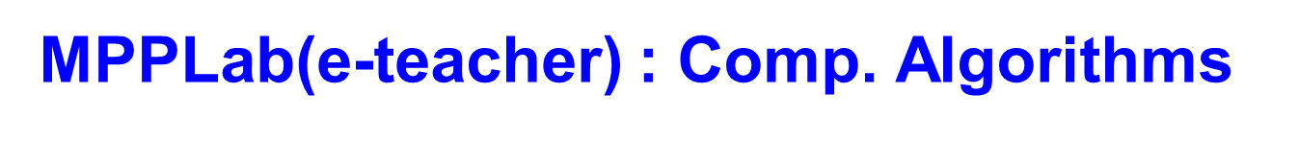
  The first stage focuses on generic applications of large -scale linear programming,
  Graph theory, and massively parallel iterative algorithms.
  These include Linear Programming-Generic Applications (LPGA, Graph Theory Computations (GTC) and Massively parallel iterative algorithm (MPIA)

Slide 18
Stage 1
Computing Systems
Unified Object Oriented Interface

Slide 19
High Impact Applications of Optimization and Statistics (Big-Data) on Multi-Petaflop Systems enabled by MPPLAB(e-Teacher)
Approach – Top-Down Approach is considered.
Bottom-Up and Top-Down
In the Bottom-Up approach,
  hardware aspects come first and
  constraints imposed by hardware dictate how application software is to be ”ported” or
  made to fit the peculiar features of hardware.
In the Top-Down,
  Algorithm-driven approach,
  implementation aspects of Application Algorithm come first and hardware system is built and
  Configured to fit the requirement for most effective implementation

Slide 20
MPPLAB(e-Teacher) : Unified Architecture - A single, highly integrated & Coherent Implementation framework
: Data Extraction
Powered By
Optimization
Algorithm
Volume of total Data from network is gigantic
needs reduction based on potential relevance
Preliminary analysis of relevance by
Smart Algorithms
Runtime support on special class of
"Data Extraction" servers
Data Extraction Server
Network
( Telcom / Internet )

Slide 21

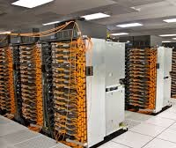
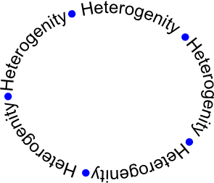

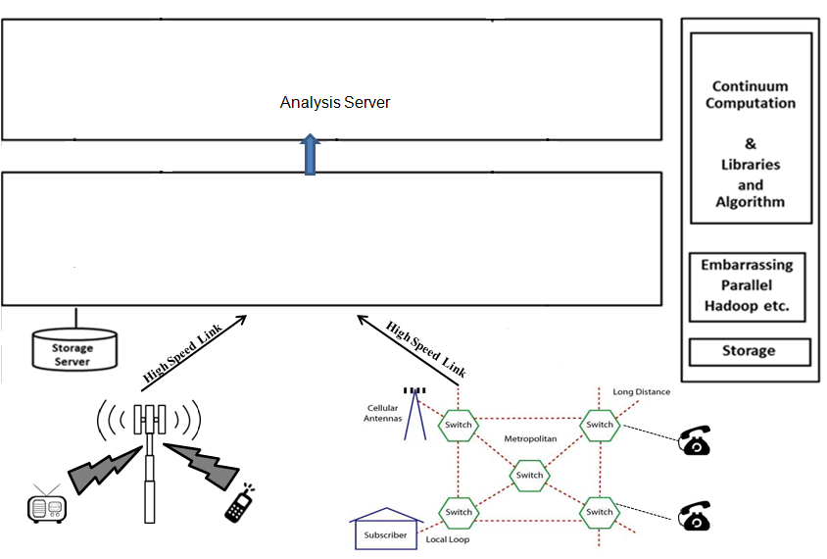
High Impact Applications of Optimization and Statistics (Big-Data) on Multi-Petaflop Systems enabled by MPPLAB(e-Teacher)
MPPLab (e-Techer) Architecture
CPU only Sector
Powered By
Optimization Algorithm
Insight for Human
Action
InterConnect
Data Extraction Server
Actionable
Information
Mission Critical Head Nodes
Network
( Telcom/ Internet )
InterConnect
InterConnect
Specially Architected system for Runtime Support
High Speed Link
Control Parameters
(Automatic)
InterConnect
High Speed Link
Smart Algorithm
For
Network Control
GPU Sector

Slide 22
MPPLab(e-Teacher) : Unified Architecture - A single, highly integrated & Coherent Implementation framework
Computational Sector
InterConnect
Central Complex
InterConnect
InterConnect
(Powerful Head Nodes)
InterConnect

Slide 23
MPPLab(e-Teacher) : Unified Architecture - A single, highly integrated & Coherent Implementation framework
The architecture consists of
GPU Sector
Central complex of powerful head nodes,
connected by global inter-connects of
low latency and high bandwidth to several computation sectors.
CPU only Sector
FPGA Sector
InterConnect
Central Complex
InterConnect
(Powerful Head Nodes)
InterConnect
Central Complex
Many-Core Accelerator Sector
Vector Processing
InterConnect
(Powerful Head Nodes)
DSP Sector
  Different Sectors can have Different Accelerators
    ●Vector Processors ●DSP ●GPUs ●FPGAs ●Many-core processors

Slide 24
Stage 2
Development of
Scalable Libraries
Object Oriented Programming
Fortran 2008

Slide 25
MPPLab(e-Teacher) : Unified Architecture - A single, highly integrated & Coherent Implementation framework
Telecommunication Application
Statistics
Library
Graph Theory
Library
Linear Algebra
Library
Other
Libraries
Unified Object Oriented Interface
Machine independent Portion
Machine dependent Portion
NVIDIA GPU Specific Modules
Intel X86 Specific Modules
IBM Power Specific Modules
Other Specific Modules
Refr Statisitcs
Refer Statistics
Tesla P100
Cascade Lake
SkyLake
Power8
Power9

Slide 26
MPPLabe-Teacher : Developing Parallel Software by Evolution
Parallel Application Software Composition : Chain of Step–Wise Refinements
For composing parallel software the system provides support for the following in a language independent manner
Static & automatic Parallel callable
Identifying communication patterns & Grouping them into :
point – to – point
Broadcast
Multicast
Make communication Groups
Operations :
Load Balancing
bin-packing algorithm
applied to fine-grain level
Data :
identify read only data single use/ multiple use
→ for a routine
→ global i.e. constant (parameter data)
data modified only once (hence by only one pro by multiple potential for conflict
Re-oraganize loop for all
Nested loops
single var → arrays
operators for cross product of sets

Slide 27
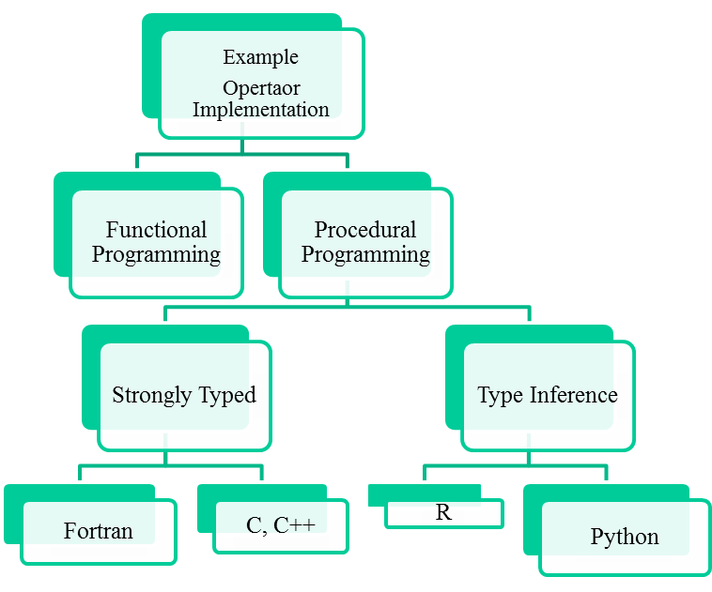
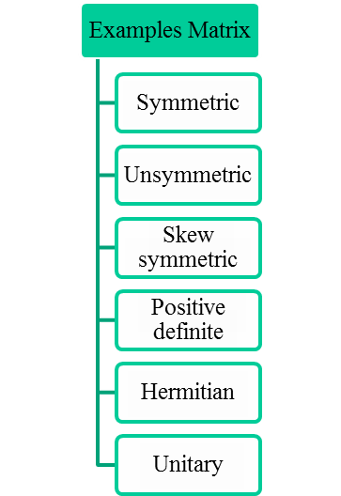
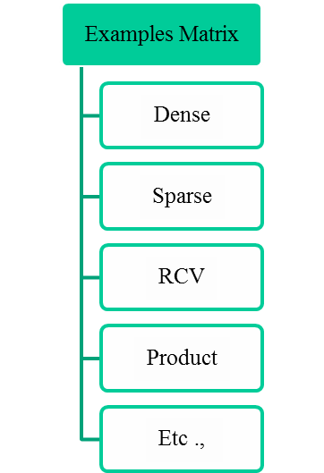
MPPLab e-Teacher:Parallel Application Software Composition
Sample Example
Abstract Forms Mathematical |  | Concrete Forms Data Representation |  | Classes Data + Operators |  | Derived Classes

Slide 28
MPPLab e-Teacher:Parallel Application Software Composition
Sample Example
Abstract Forms Mathematical |  | Concrete Forms Data Representation |  | Classes Data + Operators |  | Derived Classes
Linear Programming c^{T}x A * x ≤ b Matrix | Unsymmetric Matrix Concrete Data Representation | Sparse Storage Type Instantiate Generic Class (Programming language Independent) with desired choices Matrix < storage = Sparse, Symmetry = Unsymmetric, Ring = Real Numbers, precision = 16 bytes >
Example
Abstract Forms
Symmetric
Unsymmetric
Skew symmetric
Positive definite
Hermitian
Unitary
etc ..
Storage Types/ Classes
Dense
Sparse
RCV
Matrix Product
Tensor Product
Sum of Products
etc ..
Parallel Data Distribution
Programming Languages
Fortran
C
Python
R etc ..

Slide 29
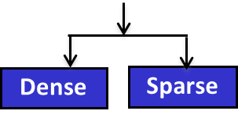
MPPLab(e-Teacher) : Numerical Linear Algebra Library
Supporting Libraries
(Internal dependencies)
LinAlgebraLibMod
Linear Algebra
(Advanced)
Statistics
(Advanced)
Graph Theory
(Advanced)
MatVecMod
LinEqMod
EigenValMod
SingularValMode
LinAlgebraUtilMod
Linear Algebra
(Basic)
Statistics
(Basic)
Graph Theory
(Basic)
LinAlgebraLibMod
MatVecMod
LinEqMod
EigenValMod
SingularValMode
Dense
Sparse
Dense
Sparse
Dense
Sparse
LinAlgebraUtilMod

Slide 30
Conclusions
An overview of the project titled “ High Impact Applications of Optimization and Statistics (Big-Data) on Multi-Petaflop Systems enabled by MPPLAB(e-Teacher)” is discussed

Slide 31

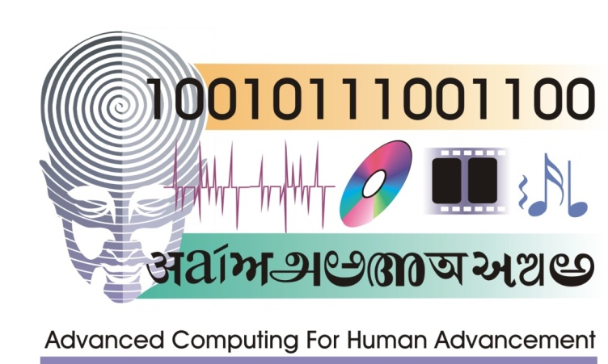
Thank You
Any Questions ?

