Slide 1

Analyzing IO Usage Patterns of User Jobs to Improve Overall HPC System Efficiency
Syed Sadat Nazrul*, Cherie Huang*, Mahidhar Tatineni,
Nicole Wolter, Dimitry Mishin, Trevor Cooper and Amit Majumdar
San Diego Supercomputer Center
University of California San Diego
* students at the time of project
SCEC2018, Delhi, Dec 13-14, 2018

Slide 2
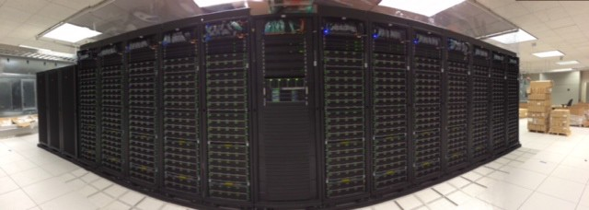
Comet
“HPC for the long tail of science”
iPhone panorama photograph of 1 of 2 server rows

Slide 3
Comet: System Characteristics
Total peak flops ~2.1 PF
Dell primary integrator
Intel Haswell processors w/ AVX2
Mellanox FDR InfiniBand
1,944 standard compute nodes (46,656 cores)
Dual CPUs, each 12-core, 2.5 GHz
128 GB DDR4 2133 MHz DRAM
2*160GB GB SSDs (local disk)
72 GPU nodes
36 nodes same as standard nodes plus Two NVIDIA K80 cards, each with dual Kepler3 GPUs
36 nodes with 2 14-core Intel Broadwell CPUs plus 4 NVIDIA P100 GPUs
4 large-memory nodes
1.5 TB DDR4 1866 MHz DRAM
Four Haswell processors/node
64 cores/node
Hybrid fat-tree topology
FDR (56 Gbps) InfiniBand
Rack-level (72 nodes, 1,728 cores) full bisection bandwidth
4:1 oversubscription cross-rack
Performance Storage (Aeon)
7.6 PB, 200 GB/s; Lustre
Scratch & Persistent Storage segments
Durable Storage (Aeon)
6 PB, 100 GB/s; Lustre
Automatic backups of critical data
Home directory storage
Gateway hosting nodes
Virtual image repository
100 Gbps external connectivity to Internet2 & ESNet

Slide 4
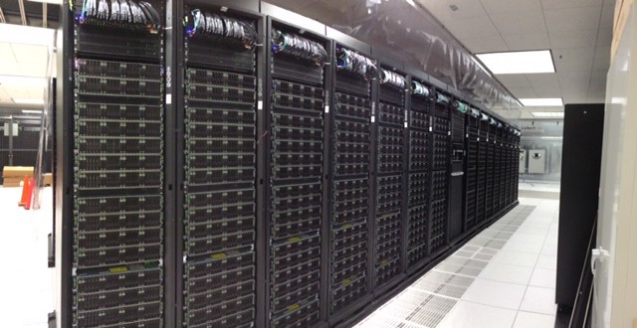
~67 TF supercomputer in a rack
1 rack = 72 nodes
= 1728 cores
= 9.2 TB DRAM
= 23 TB SSD
= FDR InfiniBand

Slide 5
And 27 single-rack supercomputers
27 standard racks
= 1944 nodes
= 46,656 cores
= 249 TB DRAM
= 622 TB SSD

Slide 6



Comet Network Architecture
InfiniBand compute, Ethernet Storage
Home File Systems
Node-Local
Storage
Management
Gateway Hosts
Login Data Mover
VM Image Repository
320 GB
72 HSWL
18
27 racks
 | FDR 36p
18 witches
 | FDR 36p
4
Core InfiniBand (2 x 108-
port)
Internet 2
FDR
FDR
72
320 GB
72 HSWL
s
2*36
FDR
 | IB-Ethernet Bridges (4 x 18-port each)
Research and Education
Network Access Data Movers
Juniper 100 Gbps
72
36 GPU
Mid-tier InfiniBand
4
4*18
40GbE
Arista 40GbE (2x)
4 Large- Memory
Arista 40GbE (2x)
Data Mover
64
40GbE
128
10GbE
72 HSWL
18
Additional Support Components (not shown for clarity) Ethernet Mgt Network (10 GbE)
7x 36-port FDR in each rack wired as full fat-tree. 4:1 over subscription between racks.
Performance Storage
7.7 PB, 200 GB/s 32 storage servers
Durable Storage
6 PB, 100 GB/s
64 storage servers

Slide 7
Comet: Filesystems
Lustre filesystems – Good for scalable large block I/O
Accessible from all compute and GPU nodes.
/oasis/scratch/comet - 2.5PB, peak performance: 100GB/s. Good location for storing large scale scratch data during a job.
/oasis/projects/nsf - 2.5PB, peak performance: 100 GB/s. Long term storage.
Not good for lots of small files or small block I/O.
SSD filesystems
/scratch local to each native compute node – 210GB on regular compute nodes, 285GB on GPU, large memory nodes, 1.4TB on selected compute nodes.
SSD location is good for writing small files and temporary scratch files. Purged at the end of a job.
Home directories (/home/$USER)
Source trees, binaries, and small input files.
Not good for large scale I/O.

Slide 8
Motivation
Currently HPC systems monitor/collect lots of data
Network traffic, file system traffic (I/O), CPU utilization etc.
Analyzing users’ job data can provide insight into static and dynamic loads on
File system
Network
Processors
How to analyze data, observe patterns, use those for improved system operation
Analysis of I/O usage patterns of users’ jobs
Insight into which jobs to schedule together or not
System admins perform I/O work coordinating with specific user jobs etc.

Slide 9
This work - preliminary
Looked at I/O traffic of users’ job on Comet for three months – early phase of Comet: June – November 2015
Analyze data and extract information
Monitor system operation
Improve system operation
Aggregate I/O usage pattern of users’ jobs
On NFS, Lustre and node-local SSDs
Data science applied to tie I/O usage pattern to users’ particular codes

Slide 10
Data Analysis
Data collected using TACC Stats (still being collected continuously)
~700,000 jobs that ran during the time period, and is around 500 GB in size
Collects user job’s I/O stats on file systems every 10 min interval
Looked at Compute and GPU queue (not shared queue for first pass)
Data can be quickly extracted as inputs for learning algorithms – NFS, Lustre, node local SSD I/O data
Ran controlled IOR for validating the data processing pipeline

Slide 11
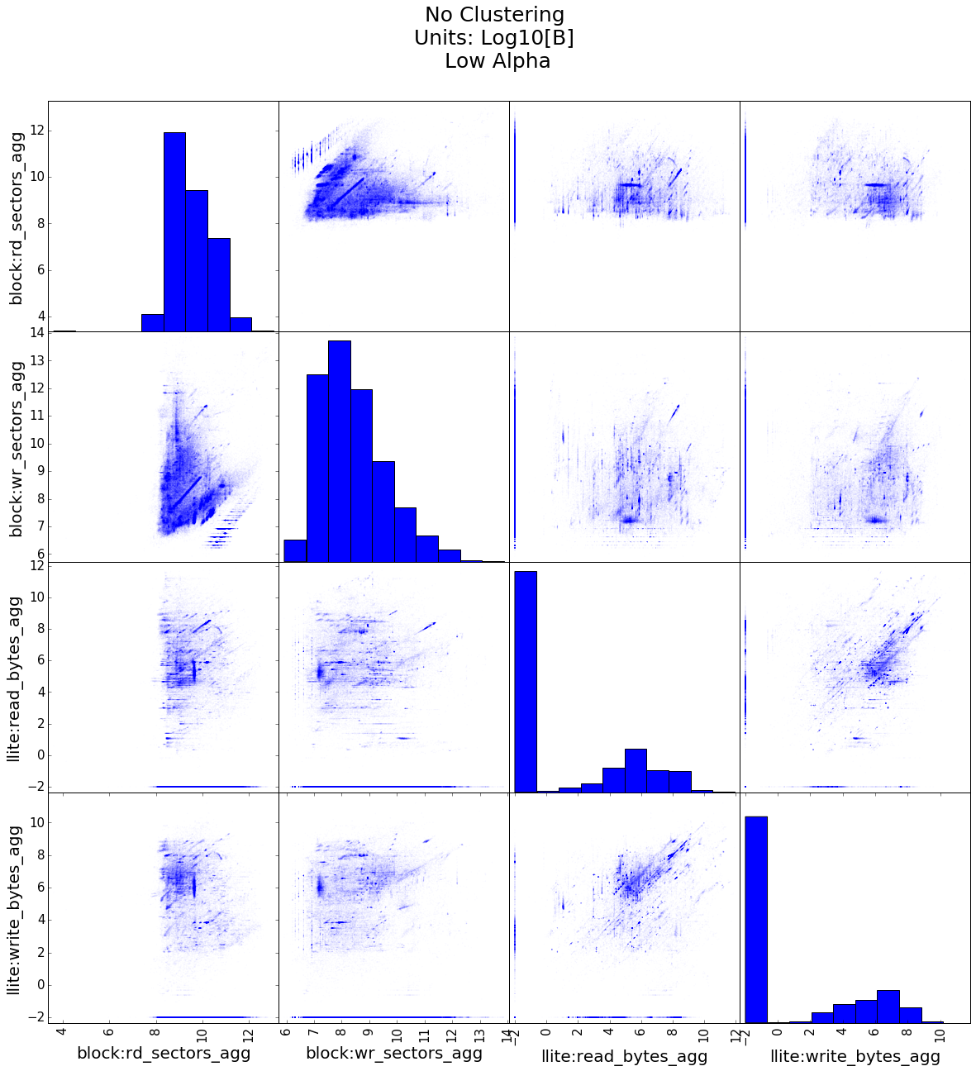
Scatter plot
scatter matrix from Scikit-learn
Block refers to SSD
llite refers to Lustre
Analyzed the linear patterns
Tried to tie to apps
Notes:
"SciKit" (SciPy Toolkit),

Slide 12
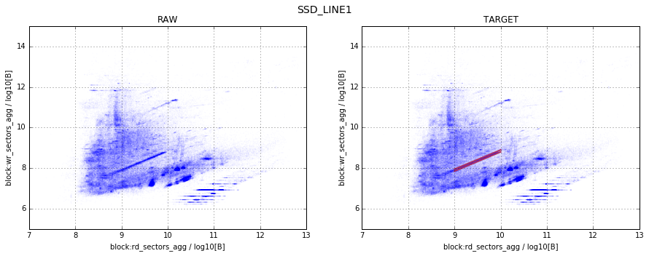
Linear Pattern Block read versus block write pattern
Linear patterns formed when analyzing aggregate write I/O and aggregate read I/O on the SSD
Pertaining to all the jobs that are part of this pattern, we have seen that 1,877 (76%) jobs are
Phylogentics Gateway (CIPRES running RXML code) and Neuroscience Gateway (was mostly running spiking neuronal simulation) jobs
We know that these jobs only produce I/O to NFS
However they used OpenMPI for their MPI communication.
This leads to runtime I/O activity (for example memory map information) in /tmp which is located on the SSDs

Slide 13
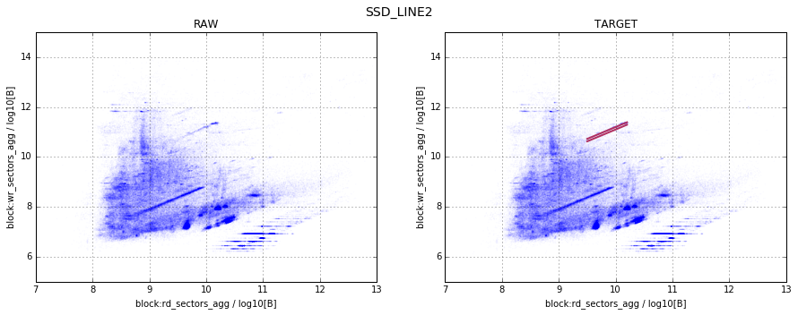
Linear Pattern Block read versus block write pattern
Another linear pattern formed when analyzing aggregate write I/O and aggregate read I/O on
the SSD
Pertaining to all the jobs that are part of this pattern, we have seen that 208 (82%) jobs have the same job name and from a particular project group
Further investigation and discussion with the user showed that these I/O patterns were produced by Hadoop jobs
On Comet, Hadoop is configured to use local SSD as the basis for its HDFS file system
Hence, as expected, there is a significant amount of I/O to SSDs from these jobs

Slide 14
Linear pattern SSD read vs Lustre write; SSD read vs Lustre read

Slide 15
Linear pattern SSD read vs Lustre write; SSD read vs Lustre read
Horizontal linear patterns on SSD read I/O against Lustre Write I/O and Lustre Read I/O respectively
Both show similar patterns.
This indicates that they were both created by similar applications
BRLW_LINE1 contains 232 (28%) VASP and CP2K jobs and 134 (16%) NAMD jobs
We can say these applications require ~4 GB of read from the local SSD (this includes both scratch and system directories) and between 100 kB and 10 MB Lustre I/O (both read and write) to run the job

Slide 16
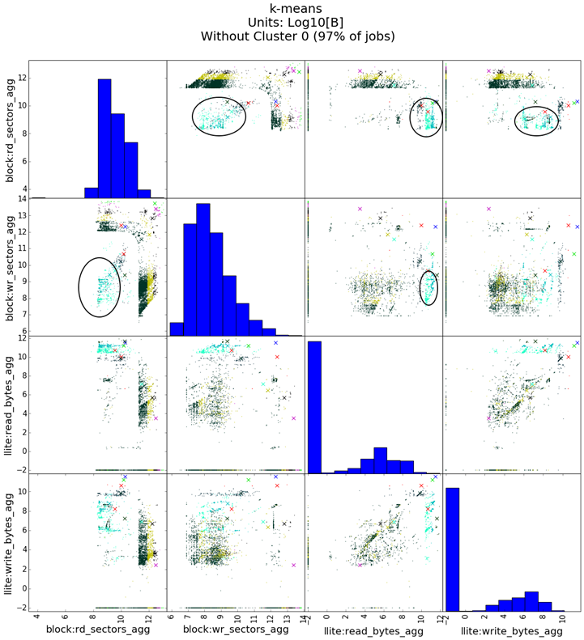
K-means analysis cluster center marks ‘X’ and cluster 10 encircled

Slide 17
K-means cluster analysis
The teal colored cluster as shown in Figure, is characterized by low SSD read and SSD write (100 MB - 1 GB)
However, this cluster shows very high Lustre read (>10 GB) and variable Lustre write (100 kB - 1 GB)
At least 324 (89%) of these jobs had projects that indicate that these are astrophysics jobs

Slide 18
Summary
We did some other analysis such as using DBSCAN, longer (than 10 mins) time window for data etc.
No distinct patterns
Presented work show we were able to analyze distinct patterns in the dataset caused by different applications
We only looked at aggregate data
In the future examine time series data - beginning, middle end of job
We can also analyze jobs separately based on parameters like run time of the job
Acknowledgement: Partial funding from Engility for student research internship
Notes:
Density-based spatial clustering of applications with noise (DBSCAN)

