Slide 1
How Has the Discourse Regarding the October 7 Attack Varied among Arab states?

Slide 2
Why Do Varying Discourses Matter?
Shape political behavior at the group level.
Increase or decrease international pressure on warring parties.
Affect the duration of war.

Slide 3
Background
- Before October 7:
Hostility between Israel and Arab states since the foundation of Israel.
Israeli-Arab Wars in 1948, 1967, 1973.
Abraham Accords between Israel, UAE, Bahrain and Morocco in 2020.
Normalization process between Saudi Arabia and Israel.
Qatar has been hosting Hamas leaders after the attack; conducted mediation efforts between Israel and Hamas.

Slide 4
Background
Saudi Arabia and Qatar’s varying stances toward Israel and Hamas.
News agencies as the mouthpieces of Arab states.

Slide 5
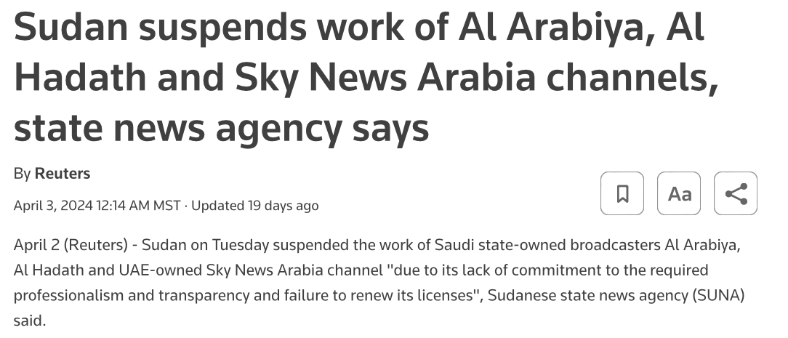
News Agencies
Al-Hadath:
Owned by Saudi-based MBC group.
MBC group; Saudi-state owned media conglomerate.
State owns 60% stake.
Al-Jazeera:
Owned by the state of Qatar via Qatar Media Corporation.

Slide 6
Hypotheses:
H.1. News agencies funded by different states have varying discourses.
H.2. Comments to the videos will vary accordingly.

Slide 7
Methodology
Searched October 7 attack in YouTube in Arabic.
Two dominant state-funded media in Arabic: MBC Media and Al Jazeera.
Two YouTube videos dated 8 October 2023 from al-Hadath and al-Jazeera.

Slide 8
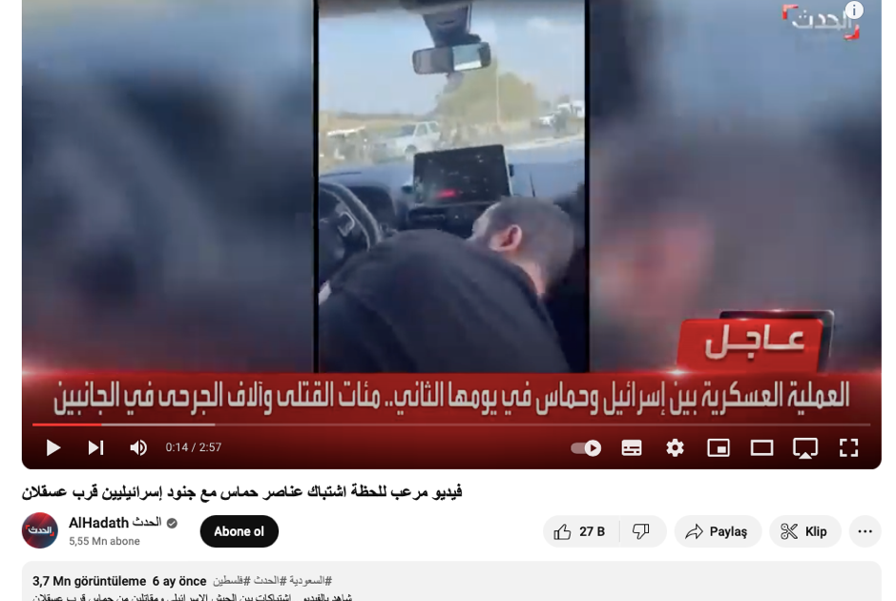
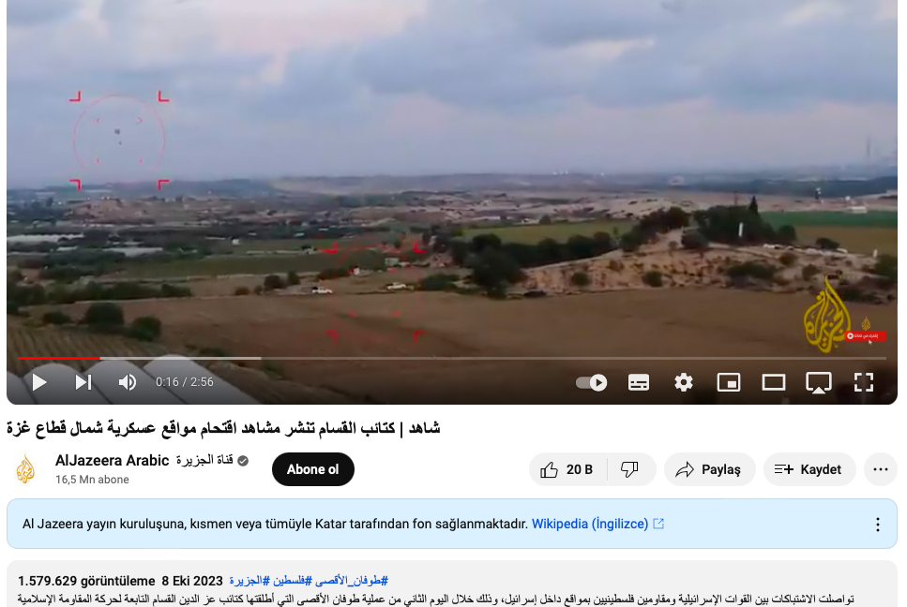
YouTube Videos

Slide 9
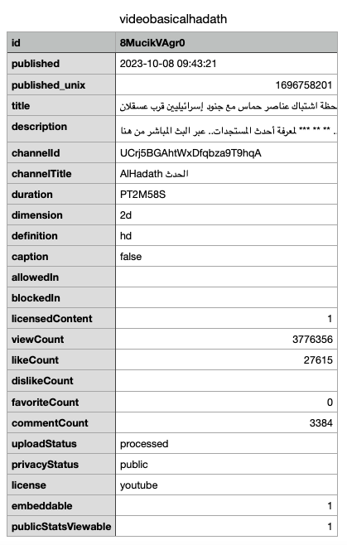
YouTube Videos
YouTube Data Tools to extract basic info, comments and authors.
Al-Hadath Video:
3 minutes long,
More than 3.7 million view count,
More than 27 thousand like count,
3384 comments.

Slide 10
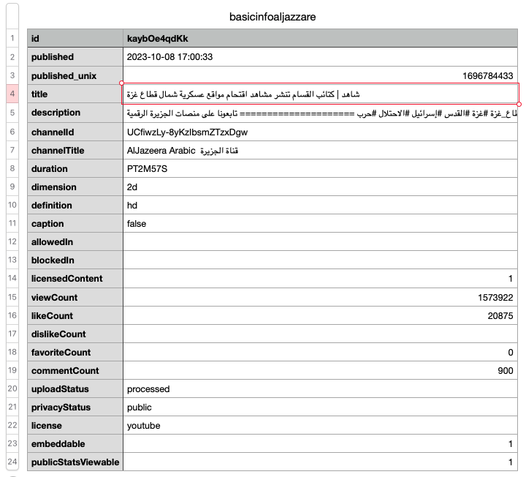
YouTube Videos
Al-Jazeera:
Almost 3 minutes long,
More than 1.5 million view count,
More than 20 thousand like count,
900 comments.

Slide 11
Creating Datasets in R:
Subset both datasets to include the first 250 comments.
df1a <- df[1:250, ]
df2a <- df2[1:250, ]
Translate comments via Deeplr.
translated_text3 <- translate2(text = df3a$text,
source_lang = "AR",
target_lang = "EN",
auth_key = "cc90f850-d2b6-4a9c-b9e7-dd9e22a3ca61:fx")

Slide 12
Creating Datasets in R:
Add a new column for the translated comments.
library(dplyr)
df1an <- df1a %>% mutate(translation = translated_text)
names(df1an)
Reordered the columns.
HamasPublicOpinion <- df_new %>% select(id, replyCount, likeCount, publishedAt, text, translation, authorName, authorChannelId, authorChannelUrl, isReply, isReplyTo, isReplyToName)

Slide 13
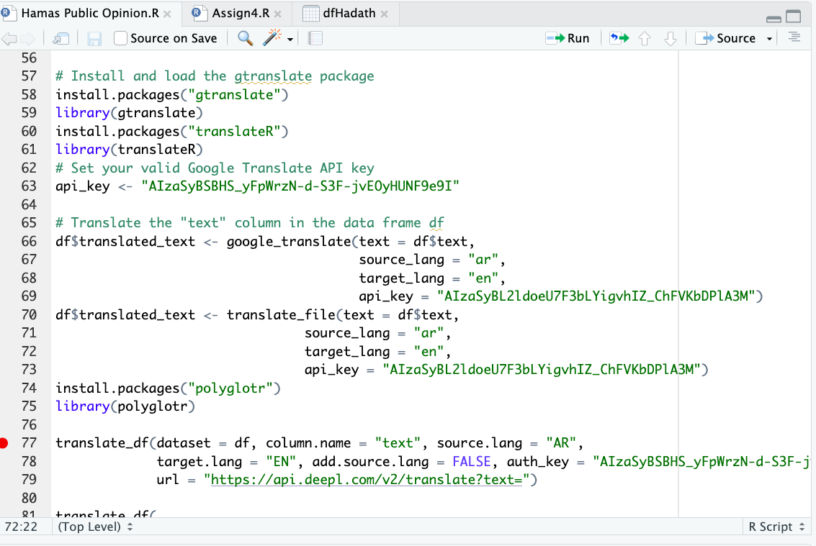
Creating Datasets in R:
Some of the translation packages that did not work:
“gtranslate”
”translateR”
“polyglotR”

Slide 14
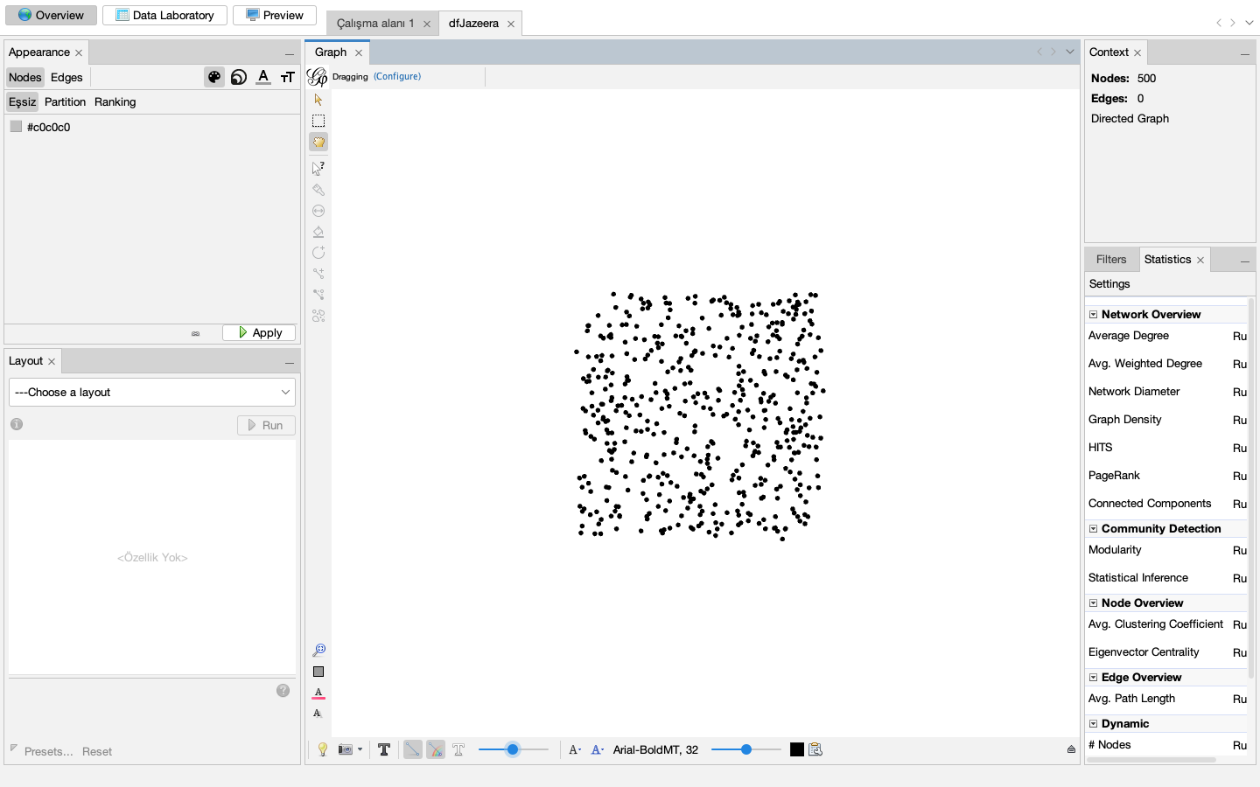
Gephi
500 nodes, 0 edges.
Implies no relation between two channels considering the first 250 comments.
Audiences are isolated.

Slide 15
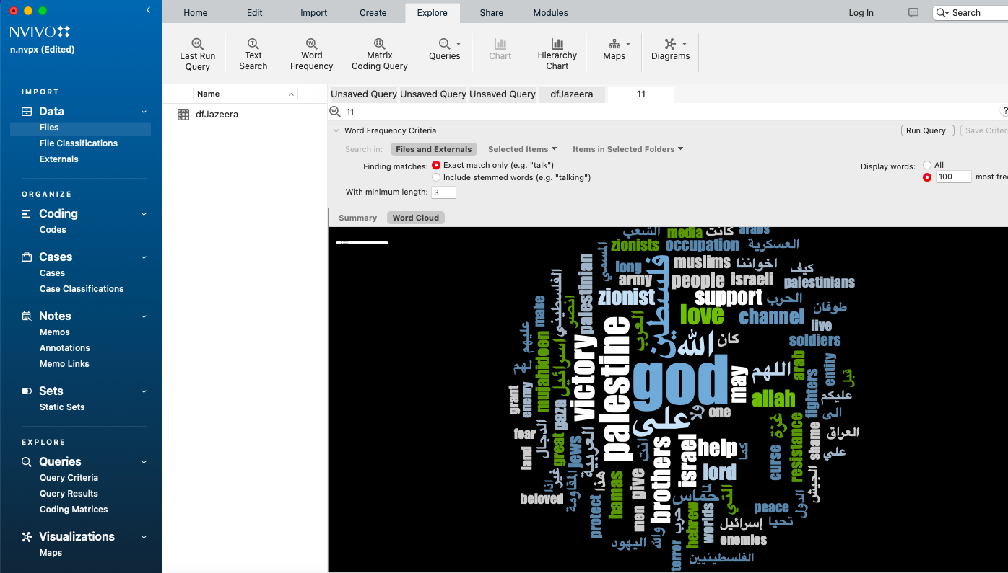
NVivo
Al-Jazeera

Slide 16
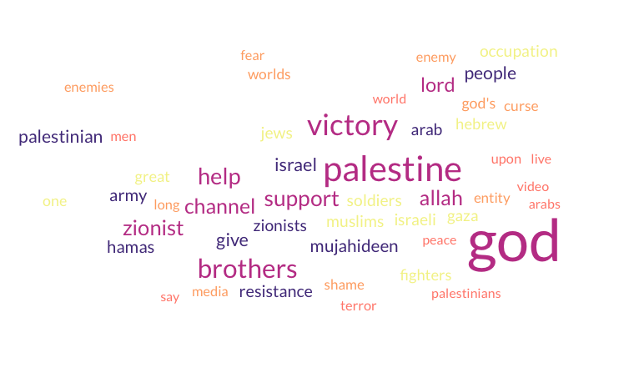
Wordcloudgenerator
Al-Hadath

Slide 17
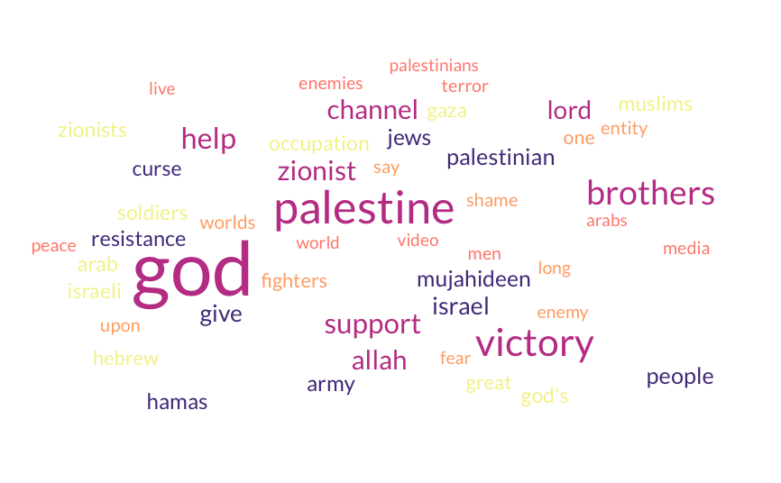
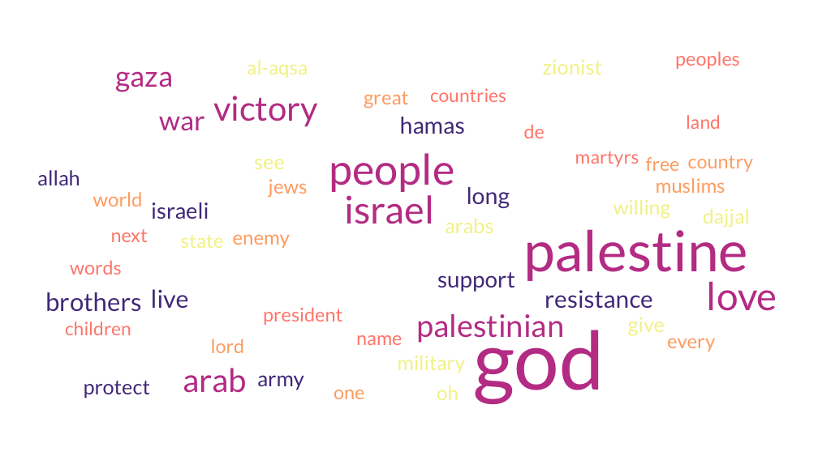
Al Hadath vs. Al Jazeera

Slide 18
Comparing Discourses:
Translating Arabic videos:
YouTube transcript; X
Sonic.ai; X
Google translate

Slide 19
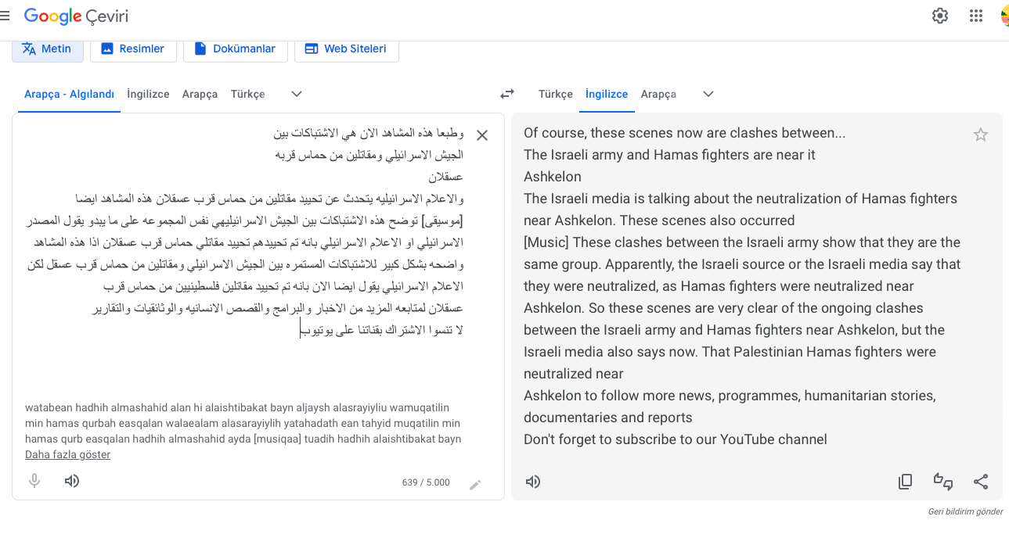
Al Hadath

Slide 20
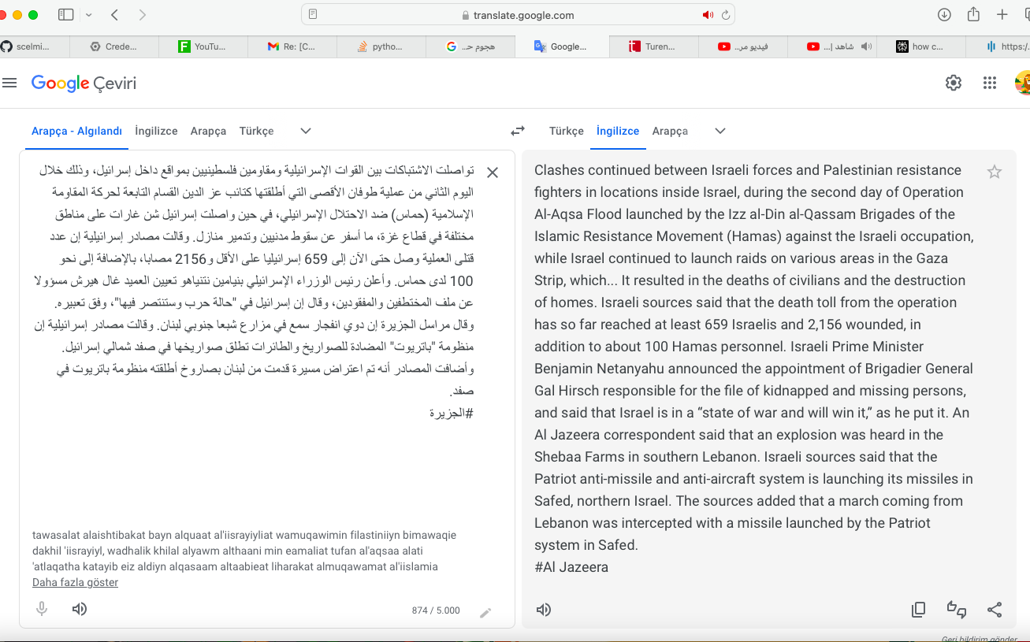
Al Jazeera

Slide 21
Discourses
Al Hadath
Neutral approach,
”Neutralization of Hamas fighters”
“Ongoing clashes between Israel army and Hamas fighters”
Al Jazeera
Pro-Hamas – Anti-Israel approach.
“Clashes continues between Israeli forces and Palestinian resistance fighters”
“During the second day of Operation al-Aqsa Flood launched by the Izz al-Din al-Qassam Brigades of the Islamic Resistance Movement (Hamas) against the Israeli occupation..”
“Death of civilians and destruction of homes”
“Death toll from the operation […] about 100 Hamas personnel.”

Slide 22
Comments
Manually coded 100 comments.
Although varying state approaches and media framing, audiences embraced predominantly Pro-Hamas and Anti-Israel discourse.

Slide 23
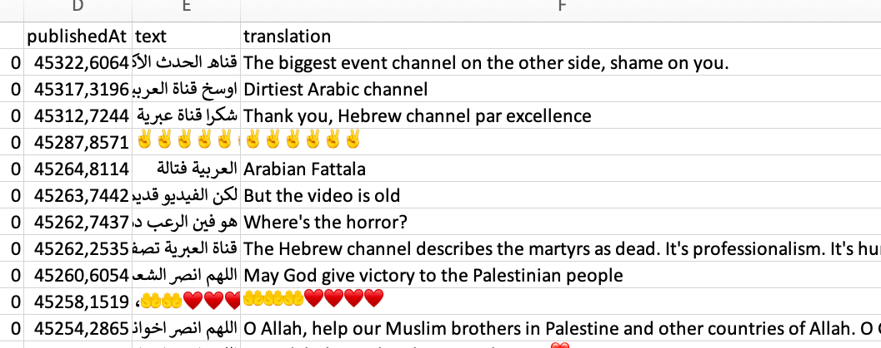
Findings:
Al Hadath:
Pro-Hamas, Anti-Israel sentiments.
Criticism toward Al-Hadath.

Slide 24
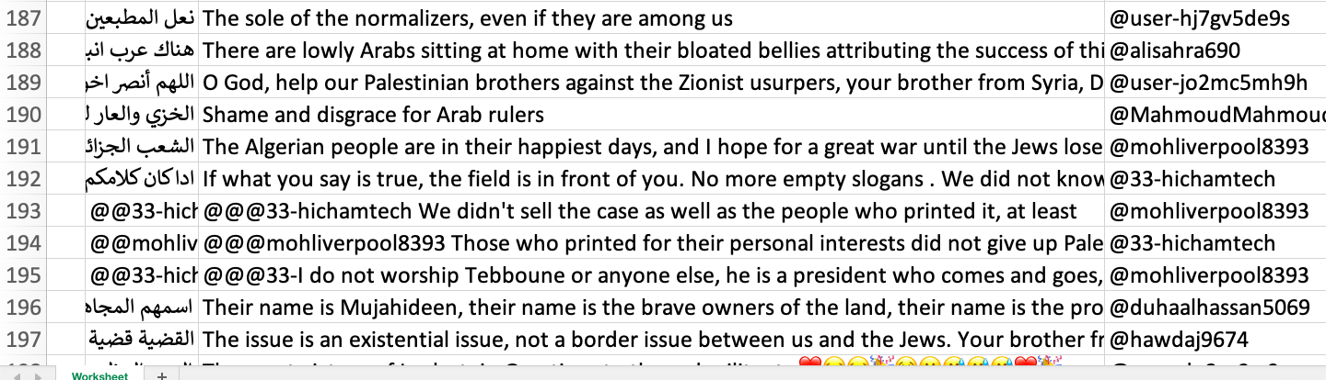
Findings:
Al Jazeera:
Pro-Hamas, anti-Israel sentiments
Criticism towards Arab states who are in normalization process.

Slide 25
