Slide 1
ITIV: Signal Selection for Multivariate DTW
Übergabe der Hiwi-Stelle

Slide 2
Content
Problem Statement/ Idea
Definition of Information/ Entropy
Statistical Moment Measures
Approximate Entropy

Slide 3
Problem Statement
Goal: Select independent signal which provides the most information
Cluster anaylsis of correlation/distance matrix groups the most correlated signals together
Select one signal out of each cluster for linear independency
In order to select only a few signals out of a cluster:
Define information
Identify methods measuring information
The developed score

Slide 4
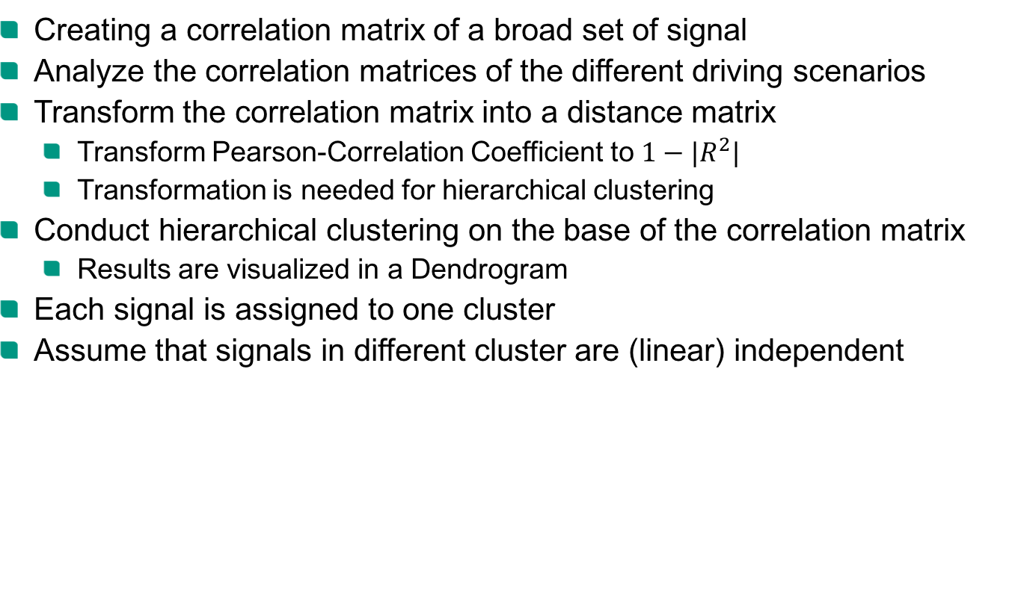
Correlation Analysis
Creating a correlation matrix of a broad set of signal
Analyze the correlation matrices of the different driving scenarios
Transform the correlation matrix into a distance matrix
Transform Pearson-Correlation Coefficient to $1−{|R}^{2}|$
Transformation is needed for hierarchical clustering
Conduct hierarchical clustering on the base of the correlation matrix
Results are visualized in a Dendrogram
Each signal is assigned to one cluster
Assume that signals in different cluster are (linear) independent

Slide 5
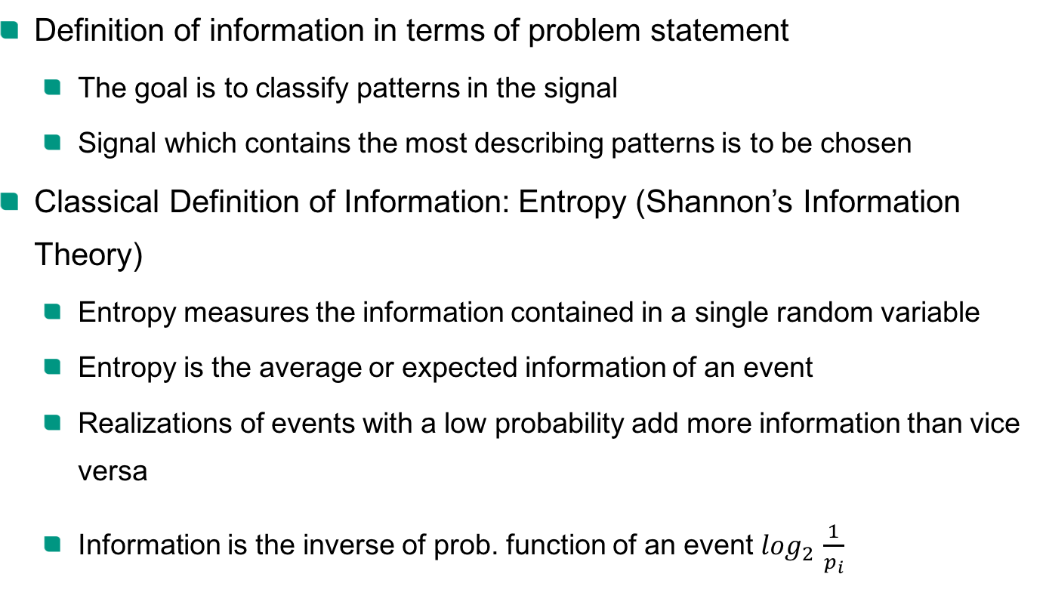
Definition of Information
Definition of information in terms of problem statement
The goal is to classify patterns in the signal
Signal which contains the most describing patterns is to be chosen
Classical Definition of Information: Entropy (Shannon’s Information Theory)
Entropy measures the information contained in a single random variable
Entropy is the average or expected information of an event
Realizations of events with a low probability add more information than vice versa
Information is the inverse of prob. function of an event $\log_{2 }\frac{1}{p_{i}}$

Slide 6
Statistical Moment Measures
The most common ways to describe data are the Measures of Moments
1. Moment: Mean
2. Moment: Variance
Mean and Variance can be used to determine fluctuations within the signal
Can be skewed by noise, No difference between one big drop and multiple smaller ones [2]
Ex: Coin throw: 010101010101, 011101010010
Both series have the same variance and mean, but the left one has a pattern

Slide 7
Approximate Entropy
Idea: Examine the marginal probabilities instead of the joint (whole) prob. distr.
Low values: signal is persistence, repetitive and predictive with apparent patterns that repeat themselves
High values: independence between the data, low number of repeated patterns
The higher the randomness, the higher the entropy, the fewer the information

Slide 8
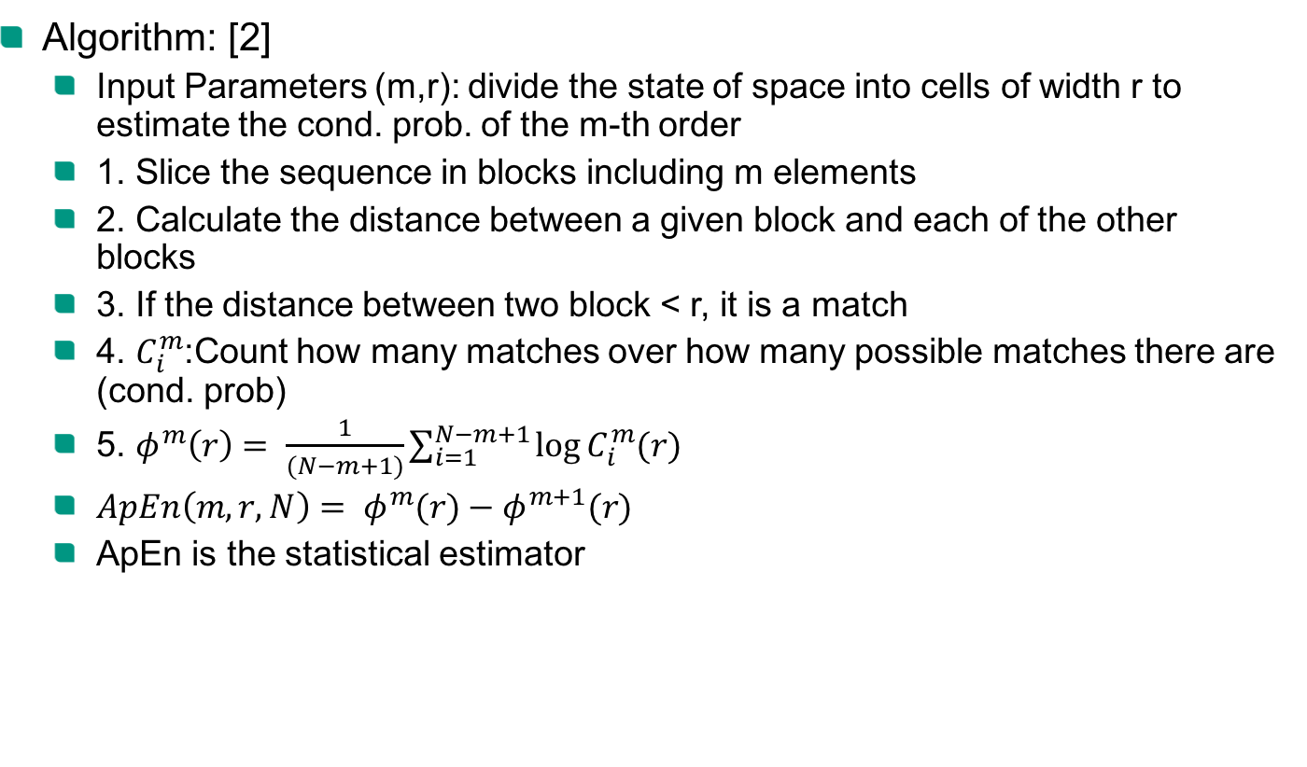
Approximate Entropy
Algorithm: [2]
Input Parameters (m,r): divide the state of space into cells of width r to estimate the cond. prob. of the m-th order
1. Slice the sequence in blocks including m elements
2. Calculate the distance between a given block and each of the other blocks
3. If the distance between two block < r, it is a match
4. $C_{i}^{m}$:Count how many matches over how many possible matches there are (cond. prob)
5. $φ^{m}\left(r\right)= \frac{1}{(N−m+1)}\sum_{i=1}^{N−m+1}{\log{C_{i}^{m}(r)}}$
${ApEn\left(m,r,N\right)= φ}^{m}(r)−φ^{m+1}(r)$
ApEn is the statistical estimator

Slide 9
Test of the ApEn
ApEn and Variance as metric for information were applied to different cases
Basic test, if ApEn gives clear outputs on the needed information
Various test cases:
Pattern Signal
Repetitive Pattern Signal
Mixed Pattern Signal
Flat line
Flat line
Flat line with slope
Noisy pattern
Repetitive Pattern
Mixed Pattern
White noise

Slide 10
Results from the test
ApEn metrics of 0 no randomness in system
ApEn metrics of → $∞$ total random system
Metrics | Flat Line | Flat Line with Slope | Clean Pattern | Mixed Pattern | Noisy clean pattern | Noisy mixed pattern | White Noise | Periodic White noise
Variance | 0.0 | 133.46 | 0.742 | 0.755 | 1.75 | 1.82 | 0.992 | 1.45
ApEN | 0 | 0.0005 | 0.029 | 0.072 | 0.0281 | 1.22 | 1.54 | 1.33

Slide 11
Evaluation of the test
Flat lines (with slope or not) achieve the best ApEn results, since no randomness occurs but actually no usable information is contained.
A clean pattern signal is optimal for detecting lane changes
Develop score which filters out the flat lines!
Additionally the variance is taken into consideration:
Flat lines without slope show zero variance
Flat lines with slope show a very high variance

Slide 12
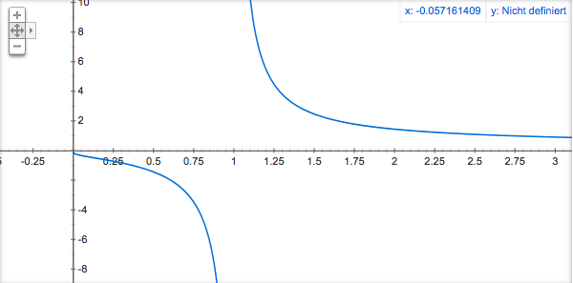

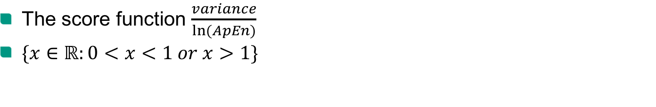
The Score
The score function $\frac{variance}{ln⁡(ApEn)}$
$\{x∈ℝ:0<x<1 or x>1\}$

Slide 13
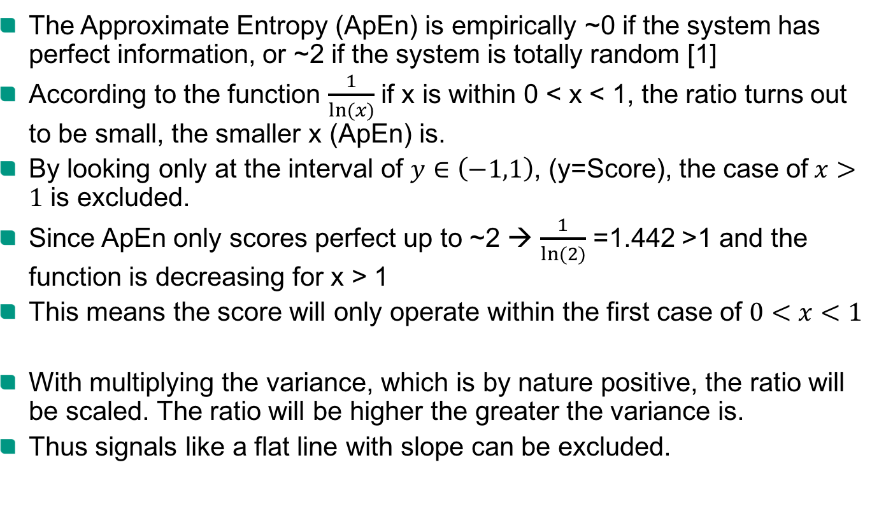
The Score
The Approximate Entropy (ApEn) is empirically ~0 if the system has perfect information, or ~2 if the system is totally random [1]
According to the function $\frac{1}{ln⁡(x)}$ if x is within 0 < x < 1, the ratio turns out to be small, the smaller x (ApEn) is.
By looking only at the interval of $y∈\left(−1,1\right)$, (y=Score), the case of$x>1$ is excluded.
Since ApEn only scores perfect up to ~2 → $\frac{1}{ln⁡(2)}$ =1.442 >1 and the function is decreasing for x > 1
This means the score will only operate within the first case of $0<x<1$
With multiplying the variance, which is by nature positive, the ratio will be scaled. The ratio will be higher the greater the variance is.
Thus signals like a flat line with slope can be excluded.

Slide 14
Evaluation
The DTW is evaluated with a binary classifier where the evaluation classifies:
if the range of the actual lane change is hit
To which extend the range of actual and detected the lane change overlap (True positive)
Actual lane change
Detected lane change
FN
TP
FP
Signal
FN: False Negative
FP: False Positive
TP: True Positive

Slide 15
The experimental data
Goal: Detect the lane change of a traffic object
Four scenarios in CarMaker were simulated
The scenarios simulated the lane change of one object
The lane change took place at different points of the road and with different durations of the lane change
Four cases
Ego Vehicle on right lane & Object Vehicle on right lane: Object changes left
Ego Vehicle on right lane & Object Vehicle on left lane: Object changes right
Ego Vehicle on left lane & Object Vehicle on right lane: Object changes left
Ego Vehicle on left lane & Object Vehicle on left lane: Object changes right
The signals were recorded with 20 Hz
For each scenario 20 different variation runs were simulated
Total of 80 runs
According to the 4 scenarios: 4 reference signals for the DTW used

Slide 16

Flowchart
Load in Data
Preprocessing
Calc. Aprox. Entropy
Clean Signals with zero ApEn
Calc. Variance of Signals
Extract Reference Signal
Create Dendogram
Create Correlation Matrix
Clean Signals: Score $∈(0,1)$
Calc. Score
DTW in four scenarios
Select Signals with min.
score per cluster
Assign Clusters to Signals
Clustered & scored Signals
DTW Results
Evaluation
Labelled orign. Data
Labelling Data

Slide 17
Class diagram
Files Classes
Test.py
------------------------------
Object: Sliding_Window
Function: Multi_Sliding_Window
Multi_DTW + z_norm
Class: Fast_Multi_DTW
------------------------------
Function:
Multi_DTW calls:
fastdtw
Read_in_Data.py
------------------------------
Object: Support_function
Function:
Read_in_Data
Class: Sliding_Windows
------------------------------
Function:
Multi_Sliding_Window
labelling.py
------------------------------
Object: Support_function
Function:
detect_obj_langechange
Class: Support functions
------------------------------
Function:
z_norm
detect_obj_lanechange
Read_in_Data
A-Score.py
------------------------------
Object: ApEN
Function:
ApEn
Class: ApEN
------------------------------
Function:
ApEn

Slide 18
Outlook
The results of the score as a selection criteria were not satisfying enough
More tests to be conducted
Find more appropriate selection criteria for signal selection within clusters
Add more noise and more object vehicles and more lane changes to the simulations → closer to real world application

Slide 19
Sources
[1] Yentes, J. M., Hunt, N., Schmid, K. K., Kaipust, J. P., McGrath, D., & Stergiou, N. (2013). The appropriate use of approximate entropy and sample entropy with short data sets. Annals of biomedical engineering, 41(2), 349-365.
[2] Delgado-Bonal, A., & Marshak, A. (2019). Approximate entropy and sample entropy: A comprehensive tutorial. Entropy, 21(6), 541.
[3] Pincus, S. M. (1991). Approximate entropy as a measure of system complexity. Proceedings of the National Academy of Sciences, 88(6), 2297-2301.
[4] Pincus, S. M., & Goldberger, A. L. (1994). Physiological time-series analysis: what does regularity quantify?. American Journal of Physiology-Heart and Circulatory Physiology, 266(4), H1643-H1656.

