Slide 1
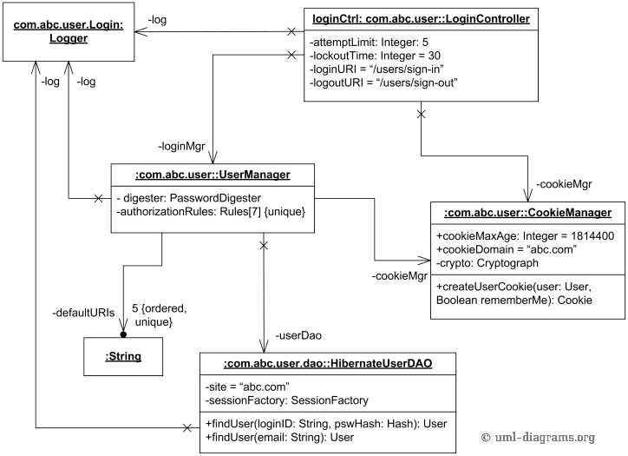
New Scenarioo DetailItem Model
value / id
type (for objects mandatory, for properties optional)
values
items = the arrows in the model =
relationships to other objects (links, item lists, trees, …)
labelKey
value / id
labelKey
properties= the object attributes in the model
Value = readable display text (may also contain special characters)
Id = only for objects with a type for internal reference, unique and is kept identical over several builds (MUST NOT allow special characters)

