Slide 1
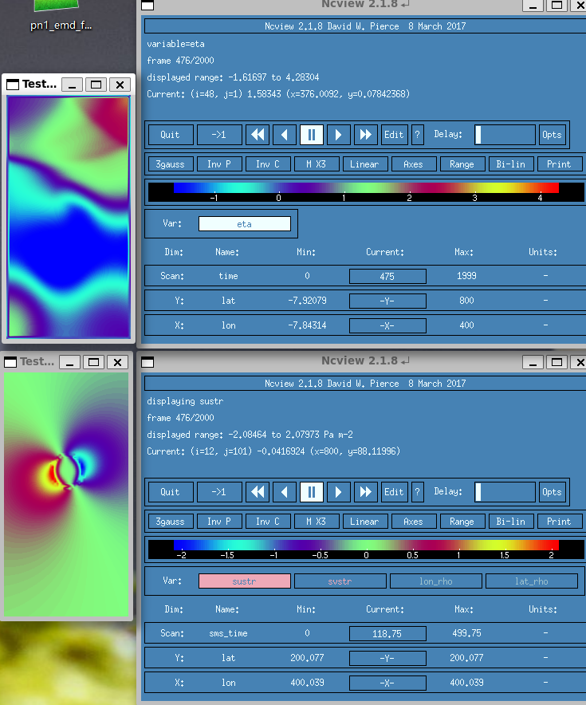

Slide 2
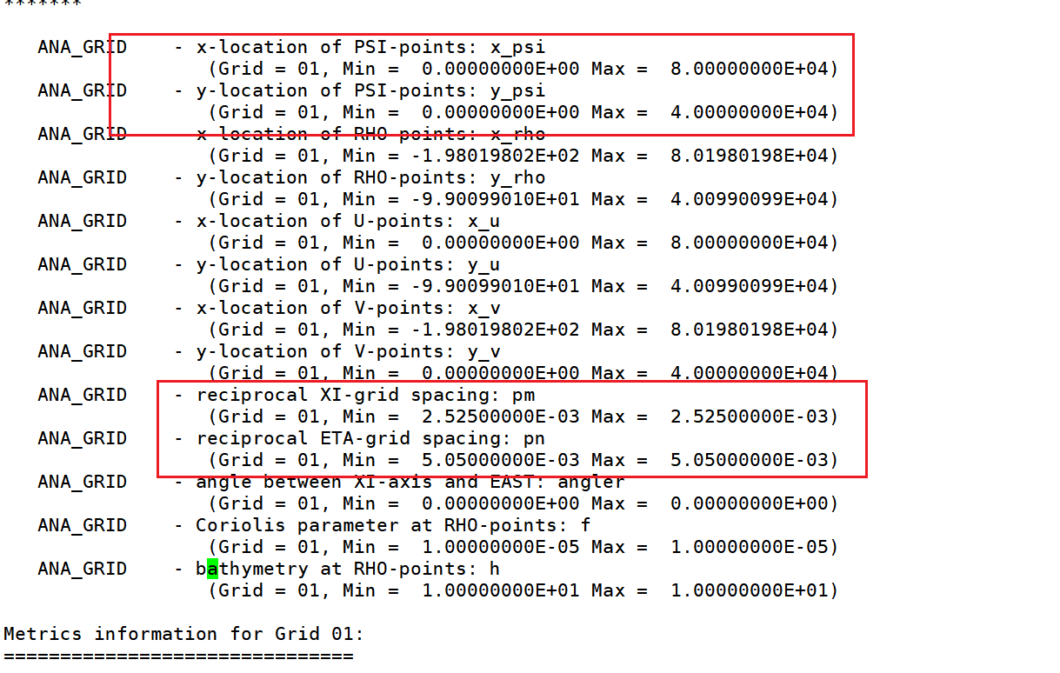
（40,20）
Lx = 80 # Length of domain in x-direction, in KM
Ly = 80 # Length of domain in y-direction, in KM
Nx = 101 # Number of grid points in x-direction
Ny = 101 # Number of grid points in y-direction
dx = Lx / Nx # Grid spacing in x-direction
dy = Ly / Ny # Grid spacing in y-direction
x = np.linspace(-Lx, Lx+dx*2 , 2*Nx + 1) # For the wind
y = np.linspace(-Ly, Ly+dy*2 , 2*Ny + 1) # For the wind
X, Y = np.meshgrid(x, y) # Meshgrid for plotting
X = np.transpose(X) # To get plots right
Y = np.transpose(Y) # To get plots right
NT= 30
Wr = 30
rMax = 20
Wx = np.zeros((NT, x.shape[0], y.shape[0]))
Wy = np.zeros((NT, x.shape[0], y.shape[0]))
Pa = 1000 + Wx
for itime in range(NT):
typhoon_Pos = [40, 20]
typhoon_Vec = [0,0]
Wx[itime], Wy[itime] = WindProfile(Wr, rMax, typhoon_Pos, typhoon_Vec, X, Y)
rho_water = 1025.0
rho_air = 1000.0
# get sustr svstr
Cd = 2.5e-3
windSpeed = np.sqrt(Wx * Wx + Wy * Wy)
sustr = rho_air / rho_water * Cd * windSpeed * Wx
svstr = rho_air / rho_water * Cd * windSpeed * Wy
sustr = np.concatenate((sustr[:,0:1,:], sustr), 1)
svstr = np.concatenate((svstr[:,:,0:1], svstr), 2)
lon_u = np.vstack([X[0, :] - 0.5 * (X[1, :] - X[0, :]), 0.5 * (X[:-1, :] + X[1:, :]), X[-1, :] + 0.5 * (X[-1, :] - X[-2, :])])
lat_u = np.vstack([Y[0, :] - 0.5 * (Y[1, :] - Y[0, :]), 0.5 * (Y[:-1, :] + Y[1:, :]), Y[-1, :] + 0.5 * (Y[-1, :] - Y[-2, :])])
lon_v = np.hstack([X[:, 0:1] - 0.5 * (X[:, 1:2] - X[:, 0:1]), 0.5 * (X[:, :-1] + X[:, 1:]), X[:, -1:] + 0.5 * (X[:, -1:] - X[:, -2:-1])])
lat_v = np.hstack([Y[:, 0:1] - 0.5 * (Y[:, 1:2] - Y[:, 0:1]), 0.5 * (Y[:, :-1] + Y[:, 1:]), Y[:, -1:] + 0.5 * (Y[:, -1:] - Y[:, -2:-1])])
ds_out = xr.Dataset(
{'sustr': (['sms_time','lon_u', 'lat_u'], sustr),
'svstr': (['sms_time','lon_v', 'lat_v'], svstr),
'lon_u': (['lon_u', 'lat_u'], lon_u),
'lat_u': (['lon_u', 'lat_u'], lat_u),
'lon_v': (['lon_v', 'lat_v'], lon_v),
'lat_v': (['lon_v', 'lat_v'], lat_v)},
coords={
'sms_time': np.arange(0, (NT)*dt,dt)} )
#写入字段
ds_out['sustr'].attrs['long_name'] = "sustr"
ds_out['sustr'].attrs['units'] = "N m-2"
ds_out['sustr'].attrs['coordinates'] = "lon_u lat_u"
ds_out['sustr'].attrs['time'] = "sms_time"
ds_out['svstr'].attrs['long_name'] = "svstr"
ds_out['svstr'].attrs['units'] = "N m-2"
ds_out['svstr'].attrs['coordinates'] = "lon_v lat_v"
ds_out['svstr'].attrs['time'] = "sms_time"
ds_out['sms_time'].attrs['units'] = "days since 0001-01-01 00:00:00"
ds_out.to_netcdf('WindStrFixed.nc')

Slide 3
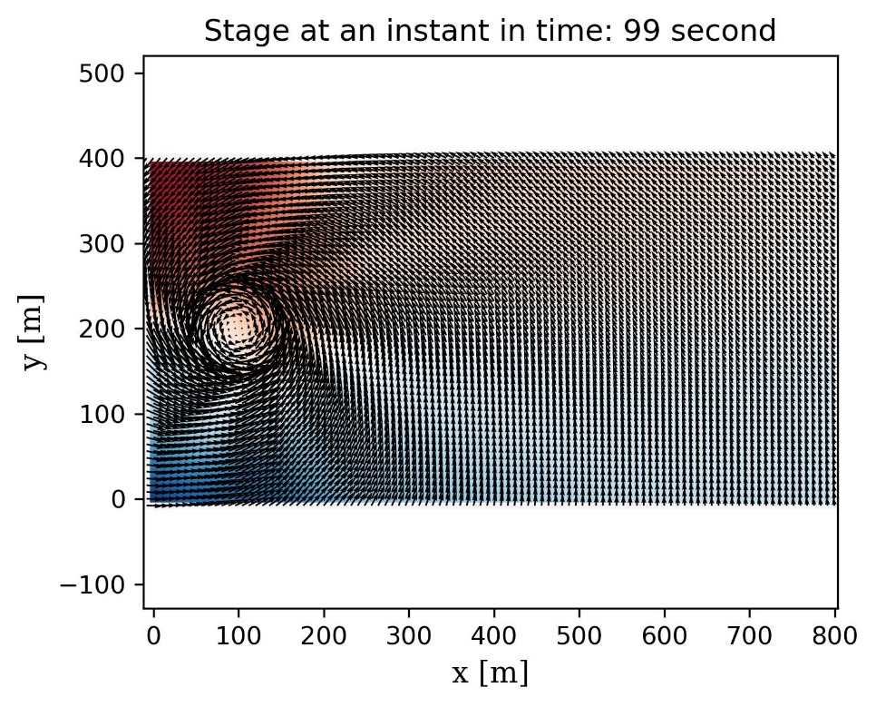
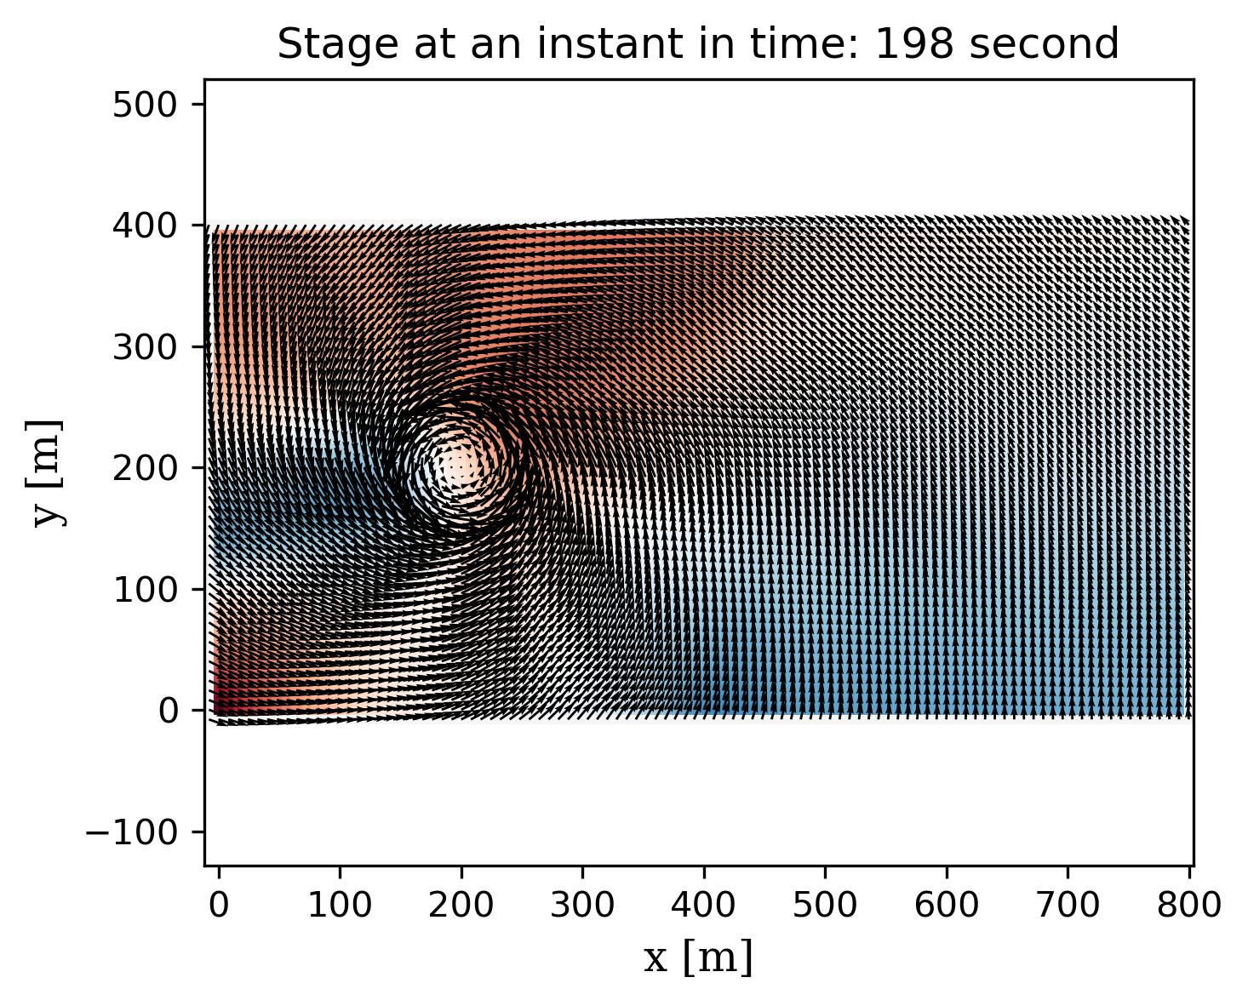
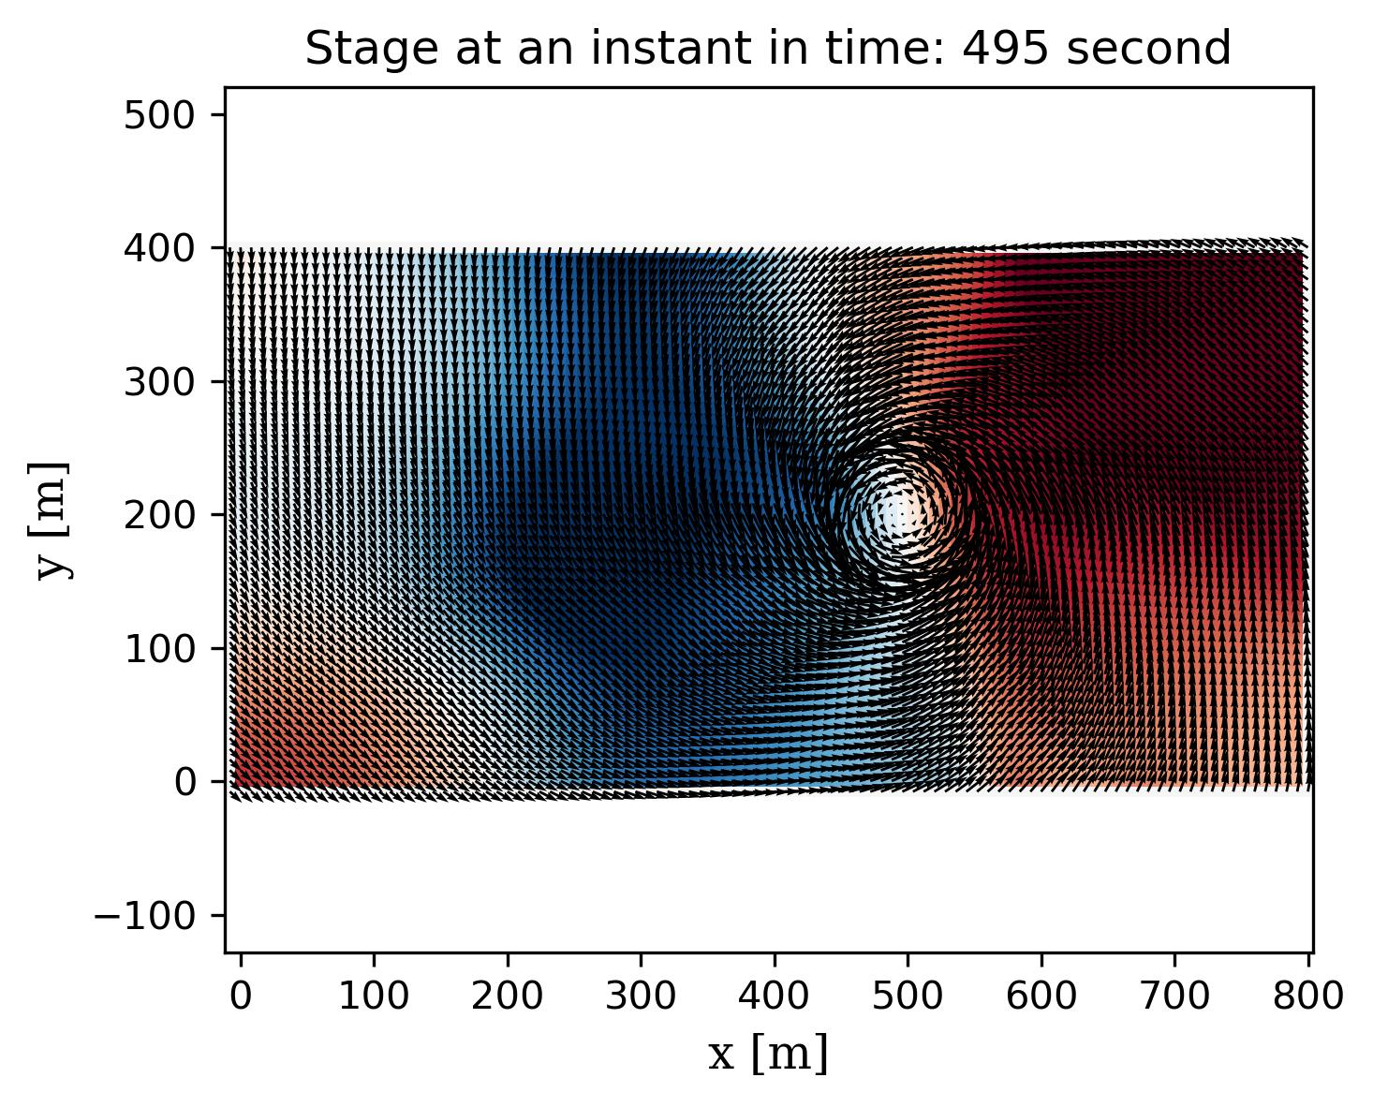
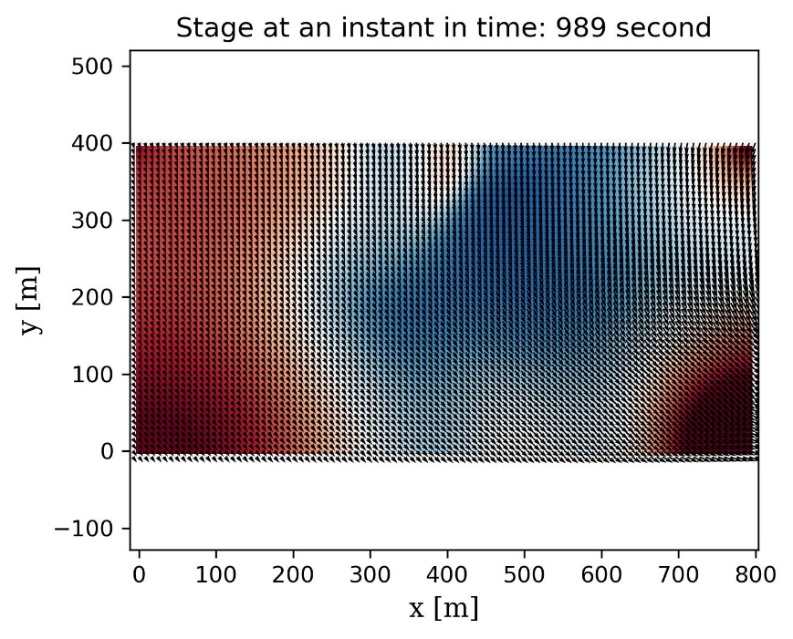

Slide 4
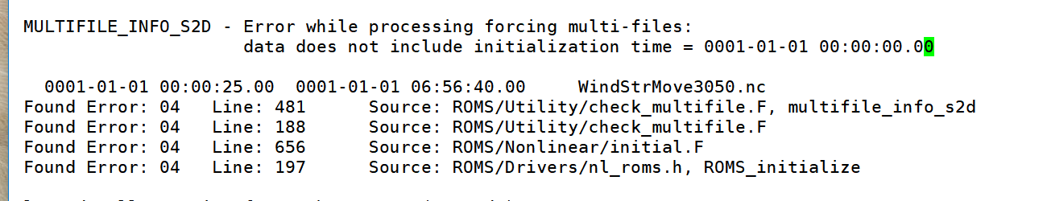
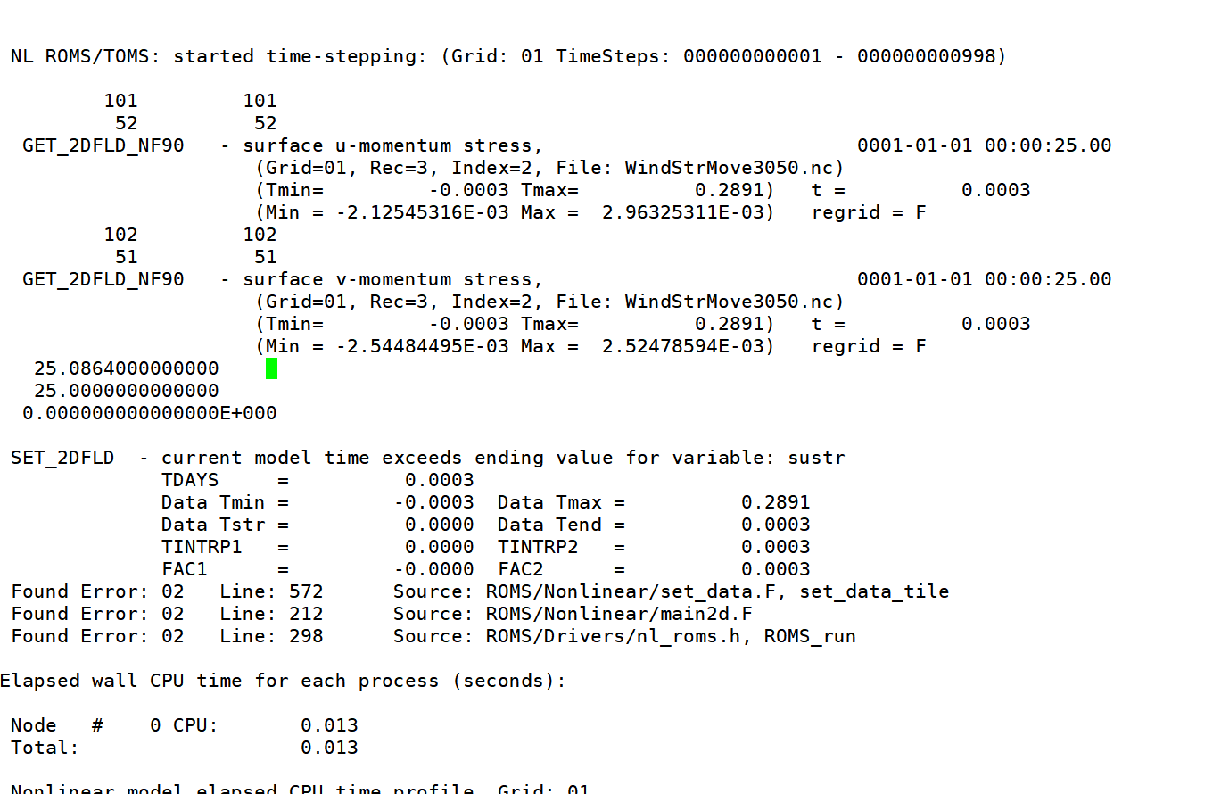
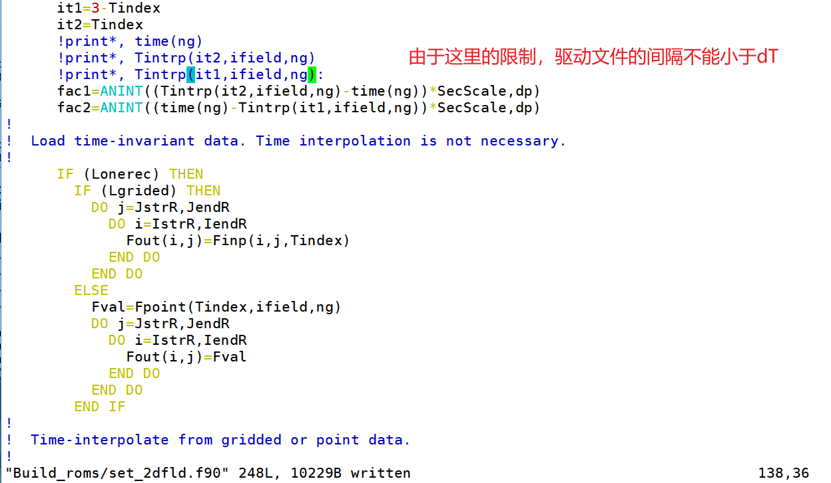

Slide 5
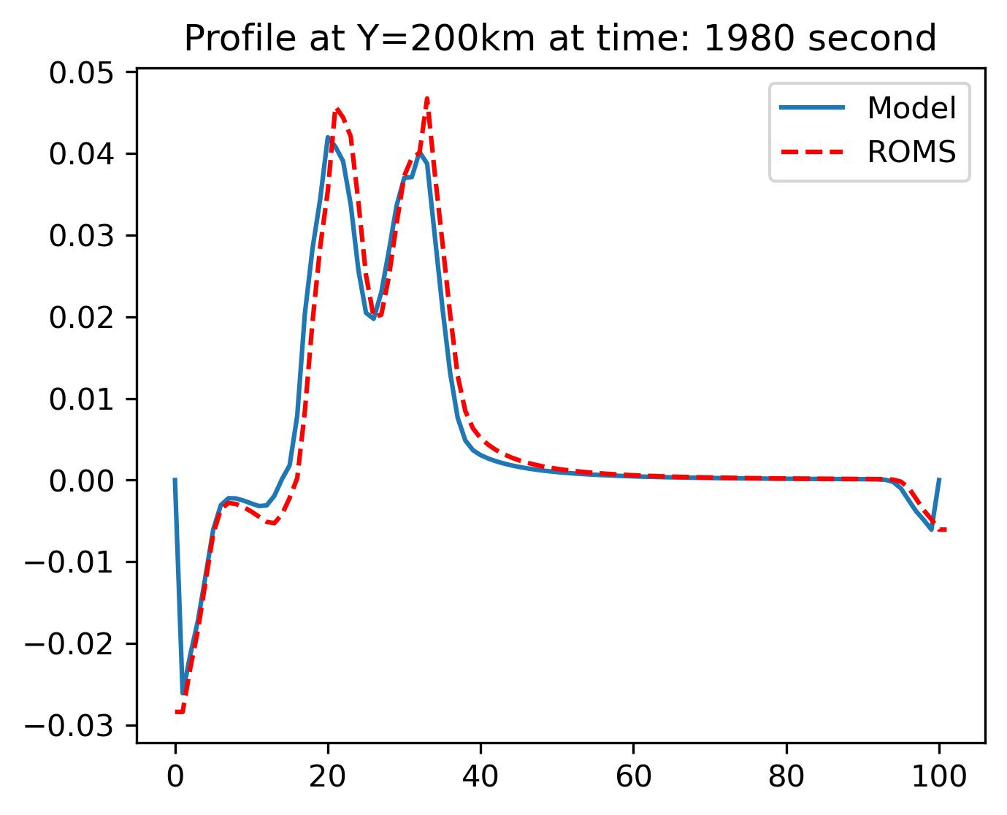
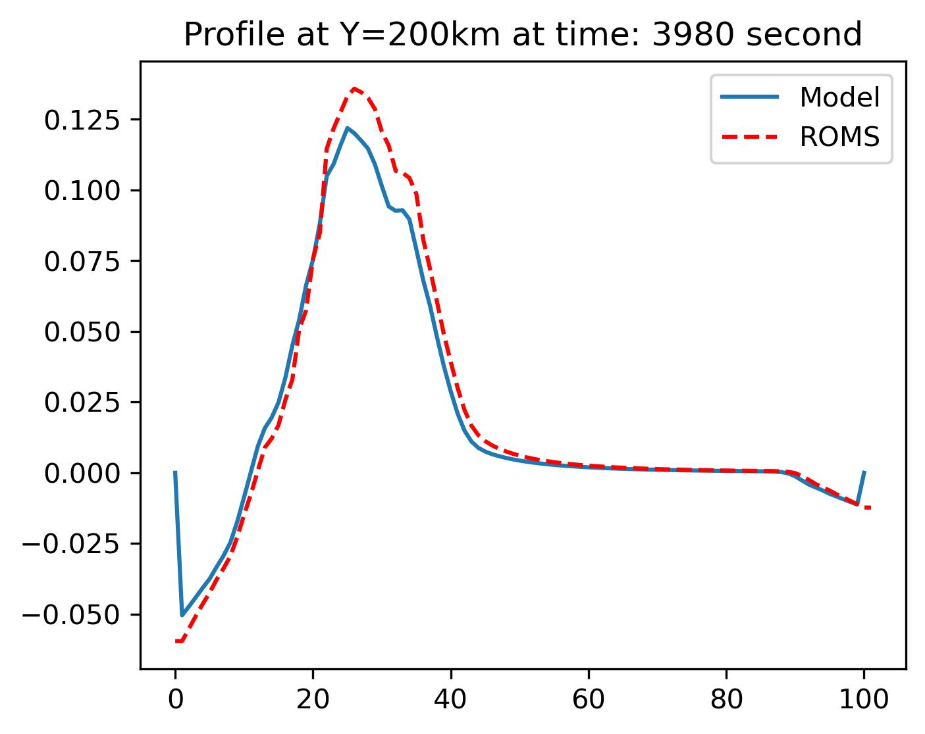
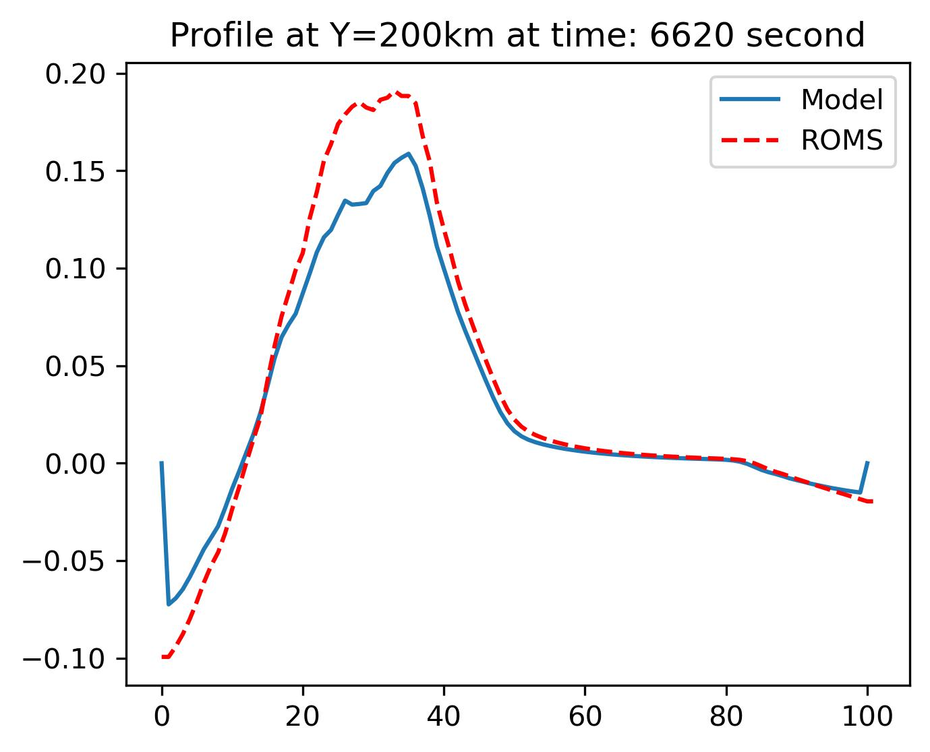
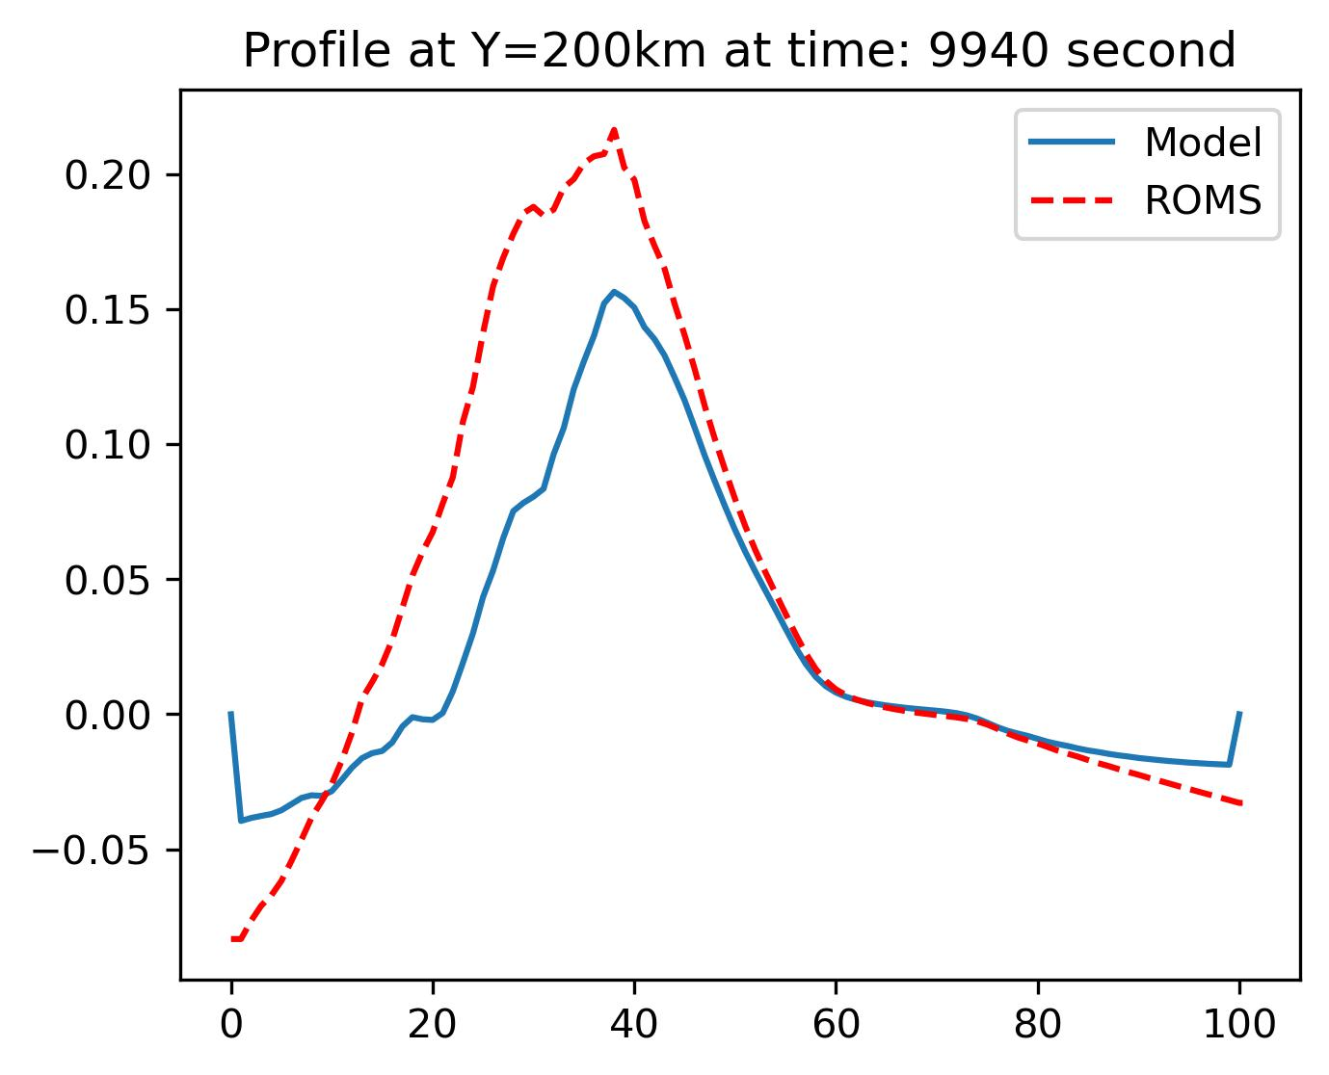
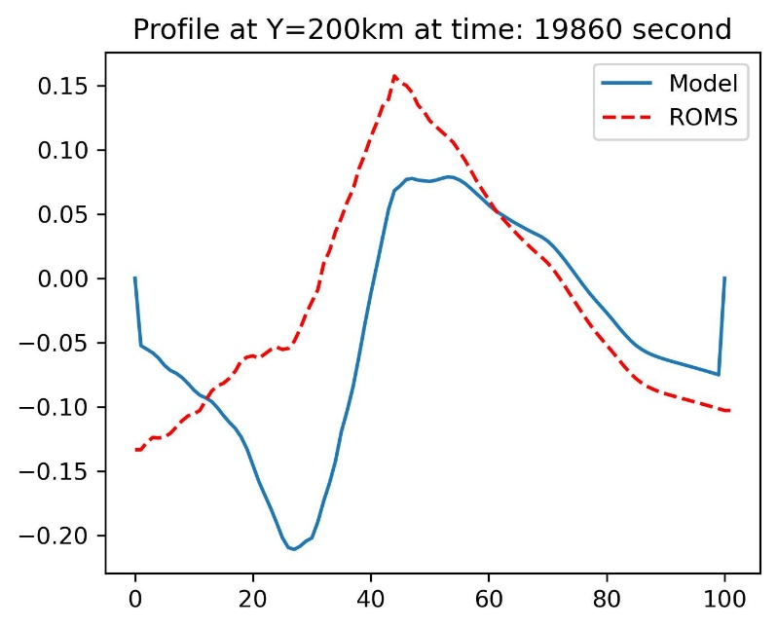
moving TC
（40,20）

Slide 6
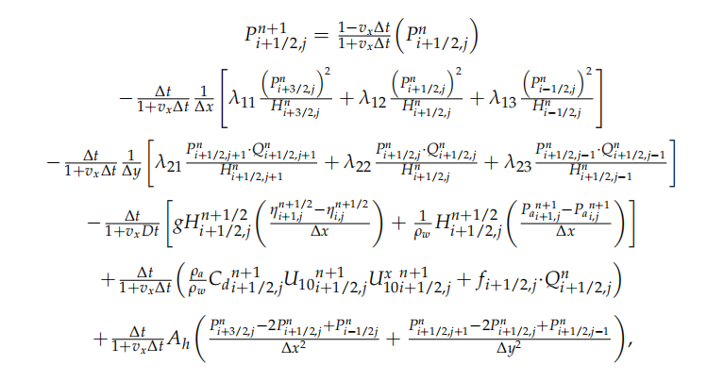
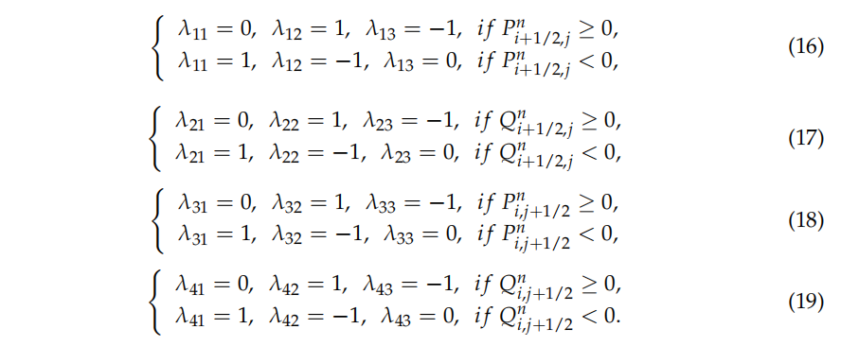
整、半为v
半、整为u
整、整为rho

Slide 7
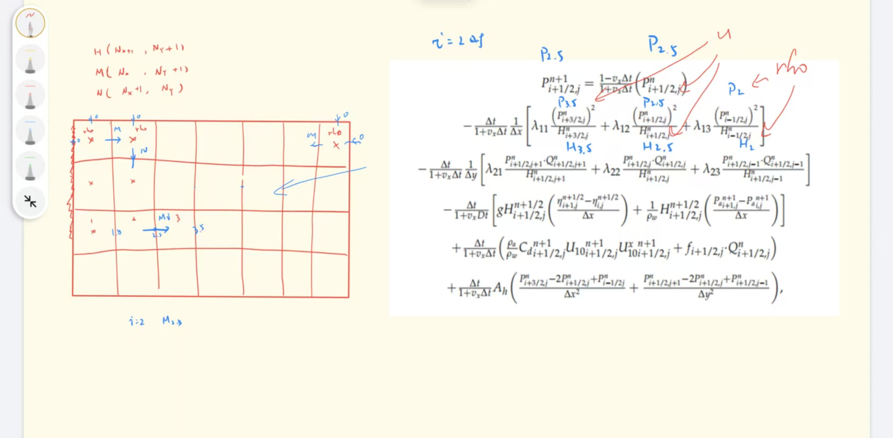
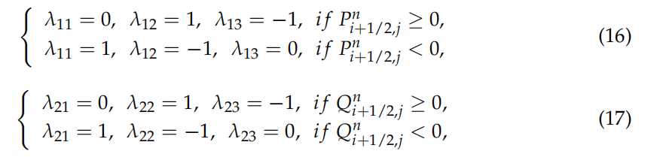

Slide 8
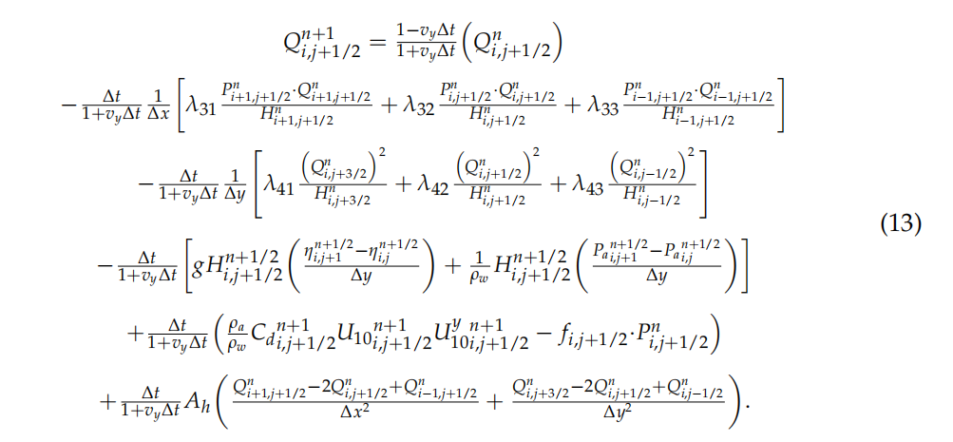
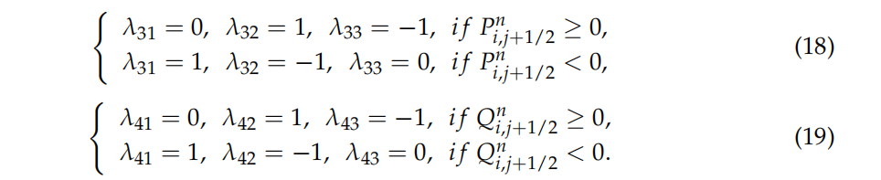

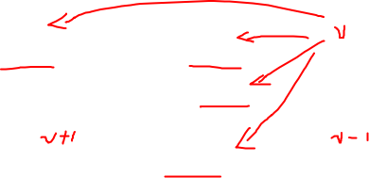


Slide 9
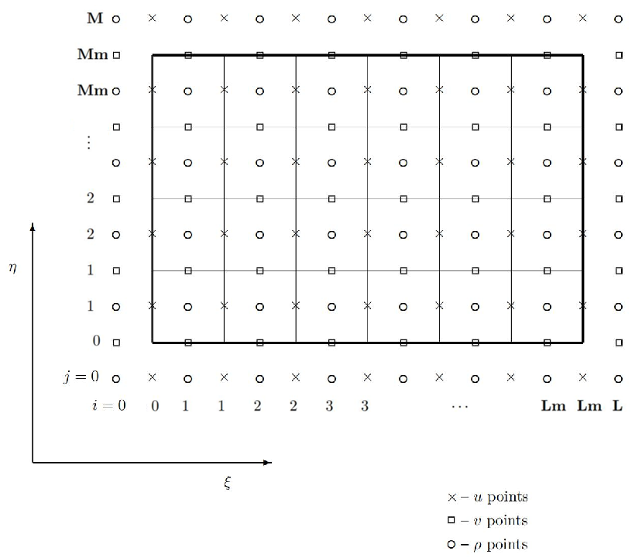
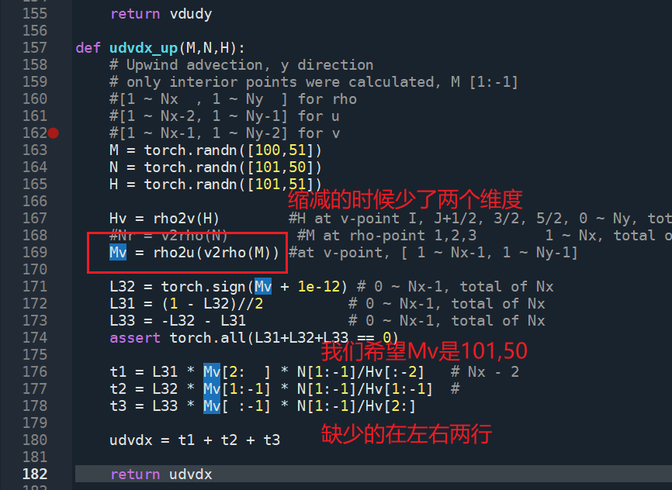
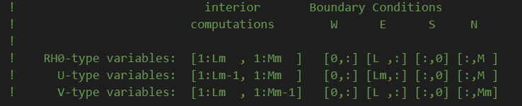


Slide 10
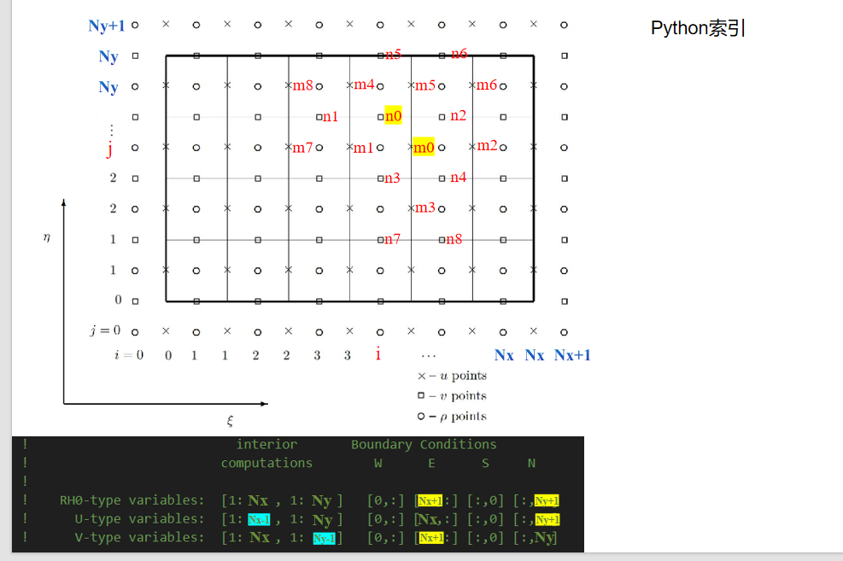

Slide 11
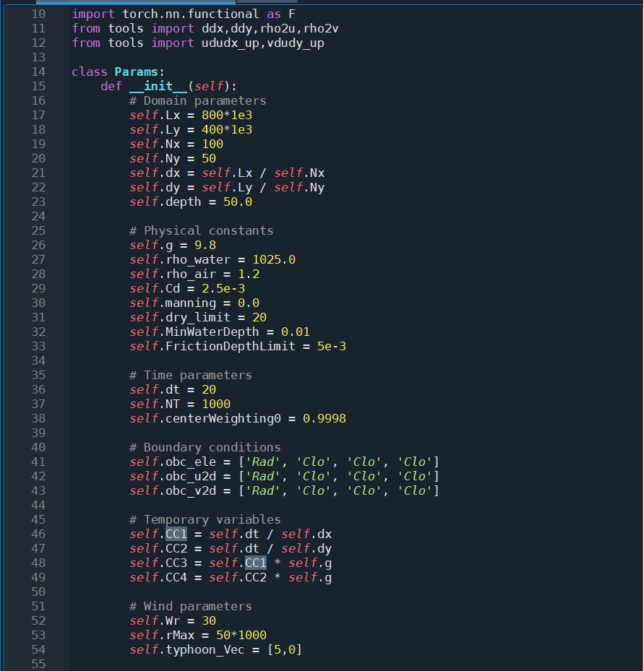
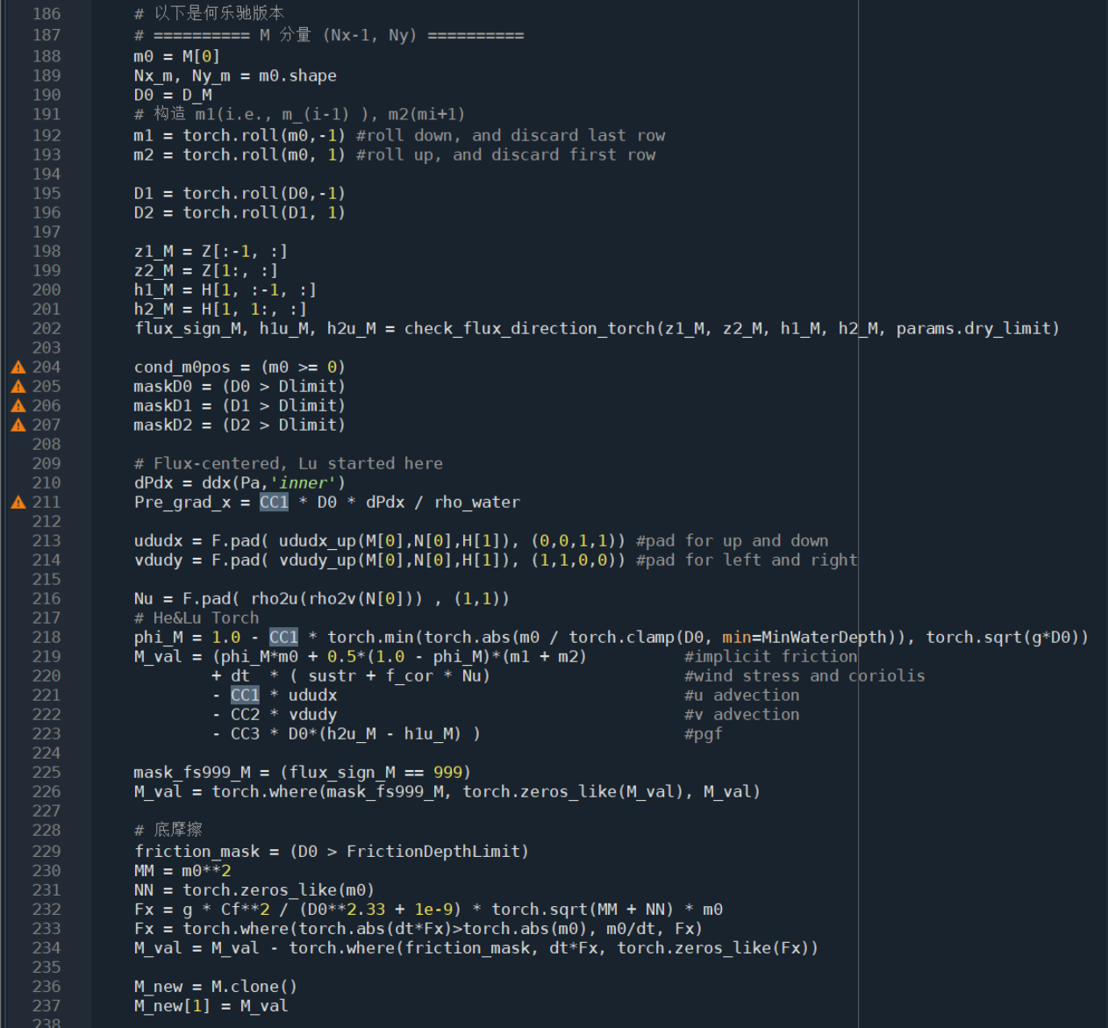

Slide 12
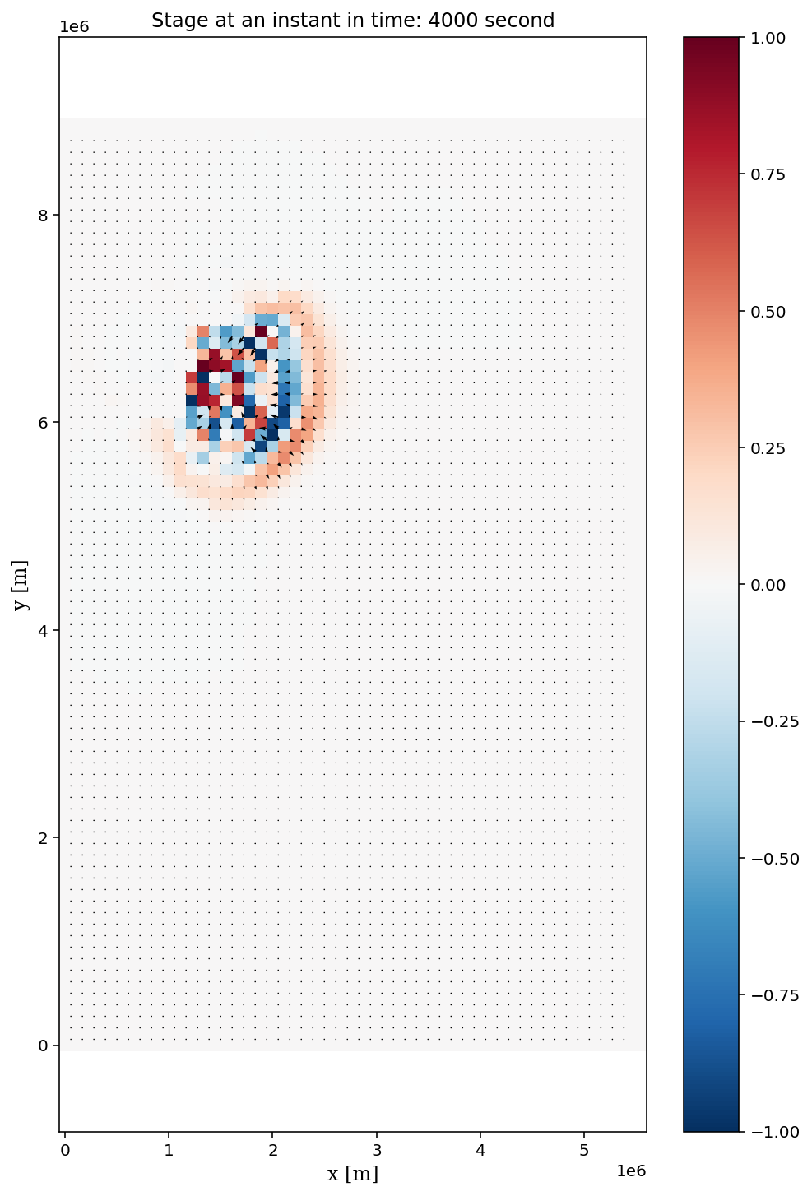

相速度 c = sqrt(g H)
目测估计为 2000s内传过400 km
对应的H为4000m

Slide 13
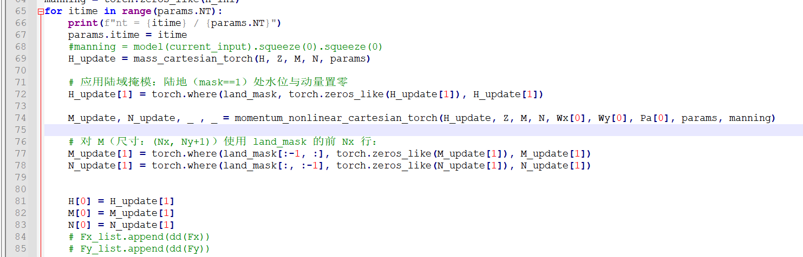
此时H[0]

Slide 14
