Slide 1

Ghost Touch
Sprint 2 Update
Sophia Evans & Tsani Rogers

Slide 2
Product Mission
Our mission is to investigate the possibility of devices being hacked via malicious charging ports.
First, we intend to replicate the attack using a WIFI-duck. A WIFI-Duck acts as an injection device (keyboard) and will be used to insert keystrokes into a target computer that's exposed.
Our primary aim is to determine a way of blocking or interfering with this attack which would help keep users’ phones and private data safe.
Notes:
Ghost touch - Someone can control your phone w/o physical contact
Focused more on product than experimenting

Slide 3
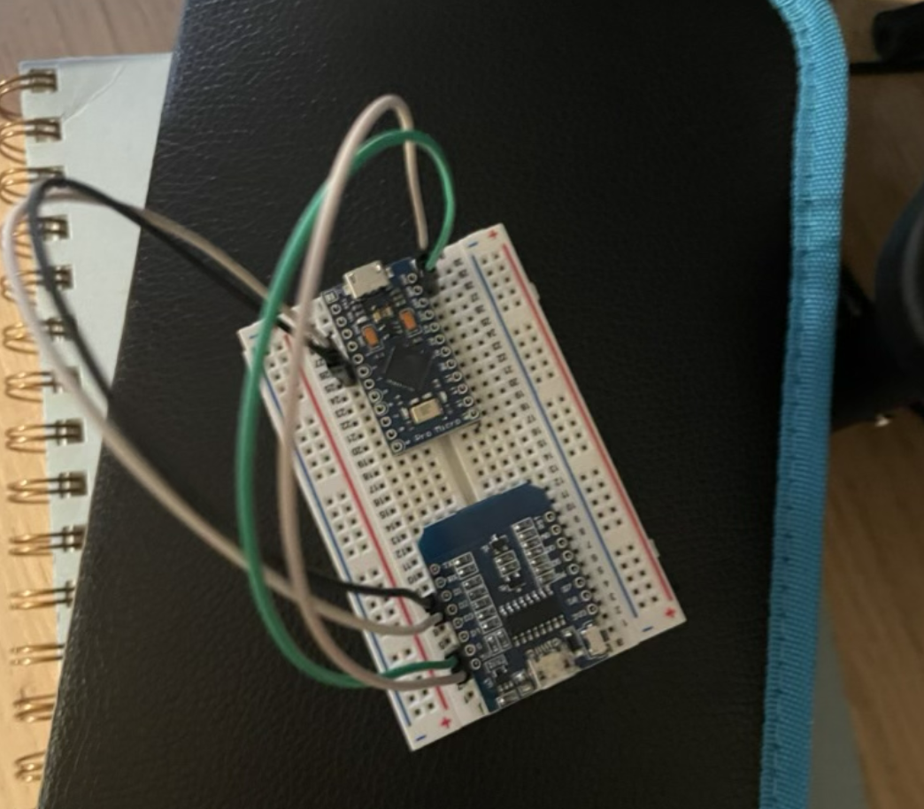
Sprint 2 Achievements
-Built WIFI-Duck. The WIFI-Duck includes a micro-Arduino, WIFI module, breadboard and wires.
-Set up lab space in Pho 113
-Set up Arduino and python environments
and created github.

Slide 4
Sprint 3 Goals

Slide 5
thank you

