Slide 1


Slide 2
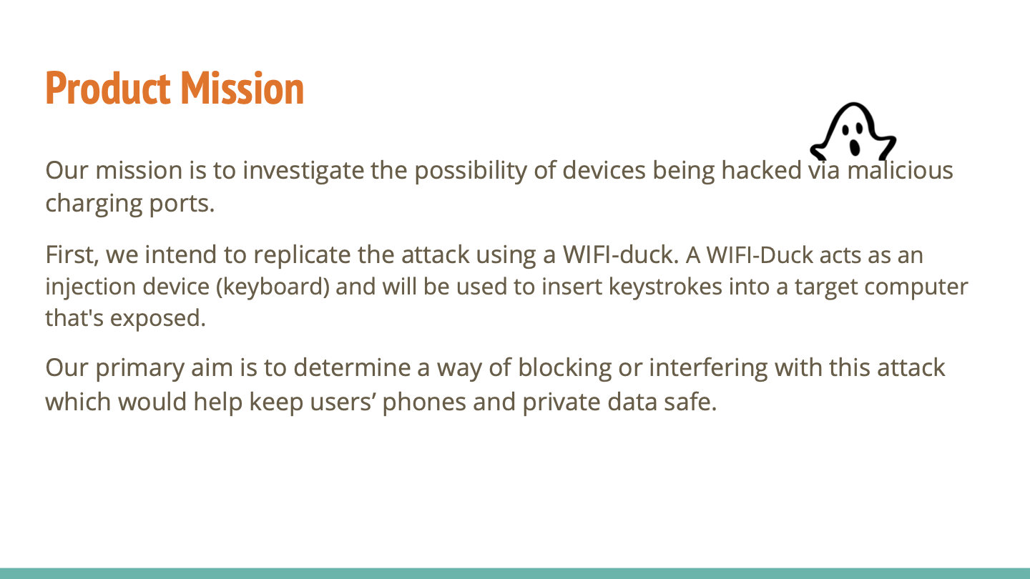

Slide 3
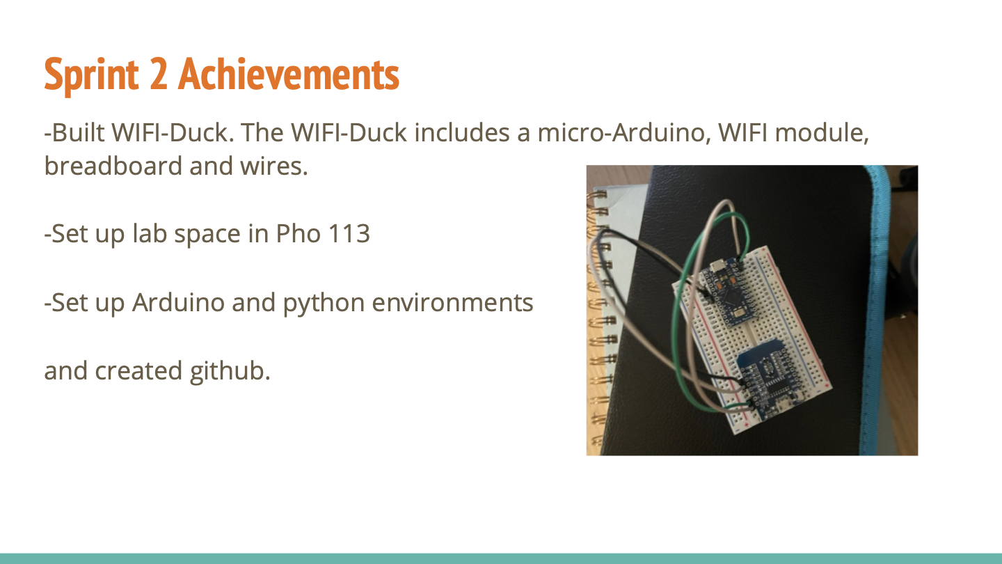

Slide 4

-Create a harmless script to run on target devices for testing purposes.
-Solder micro arduino, wifi module and custom pcb together.

Slide 5


