Slide 1
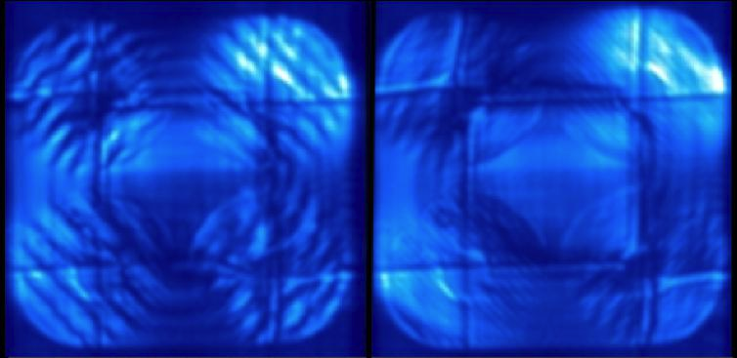
Fourier mode applied
Reference image

Slide 2
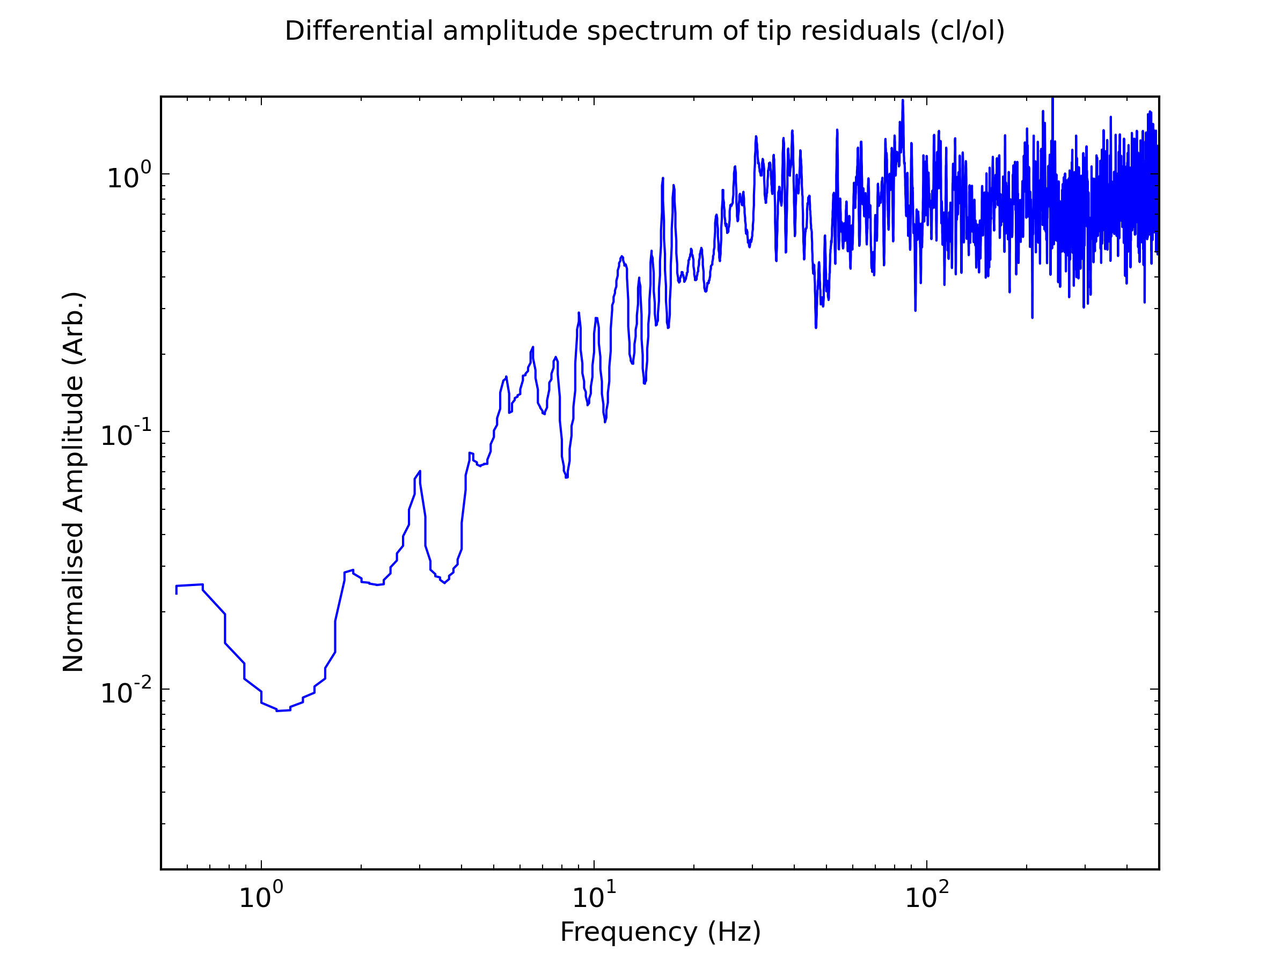
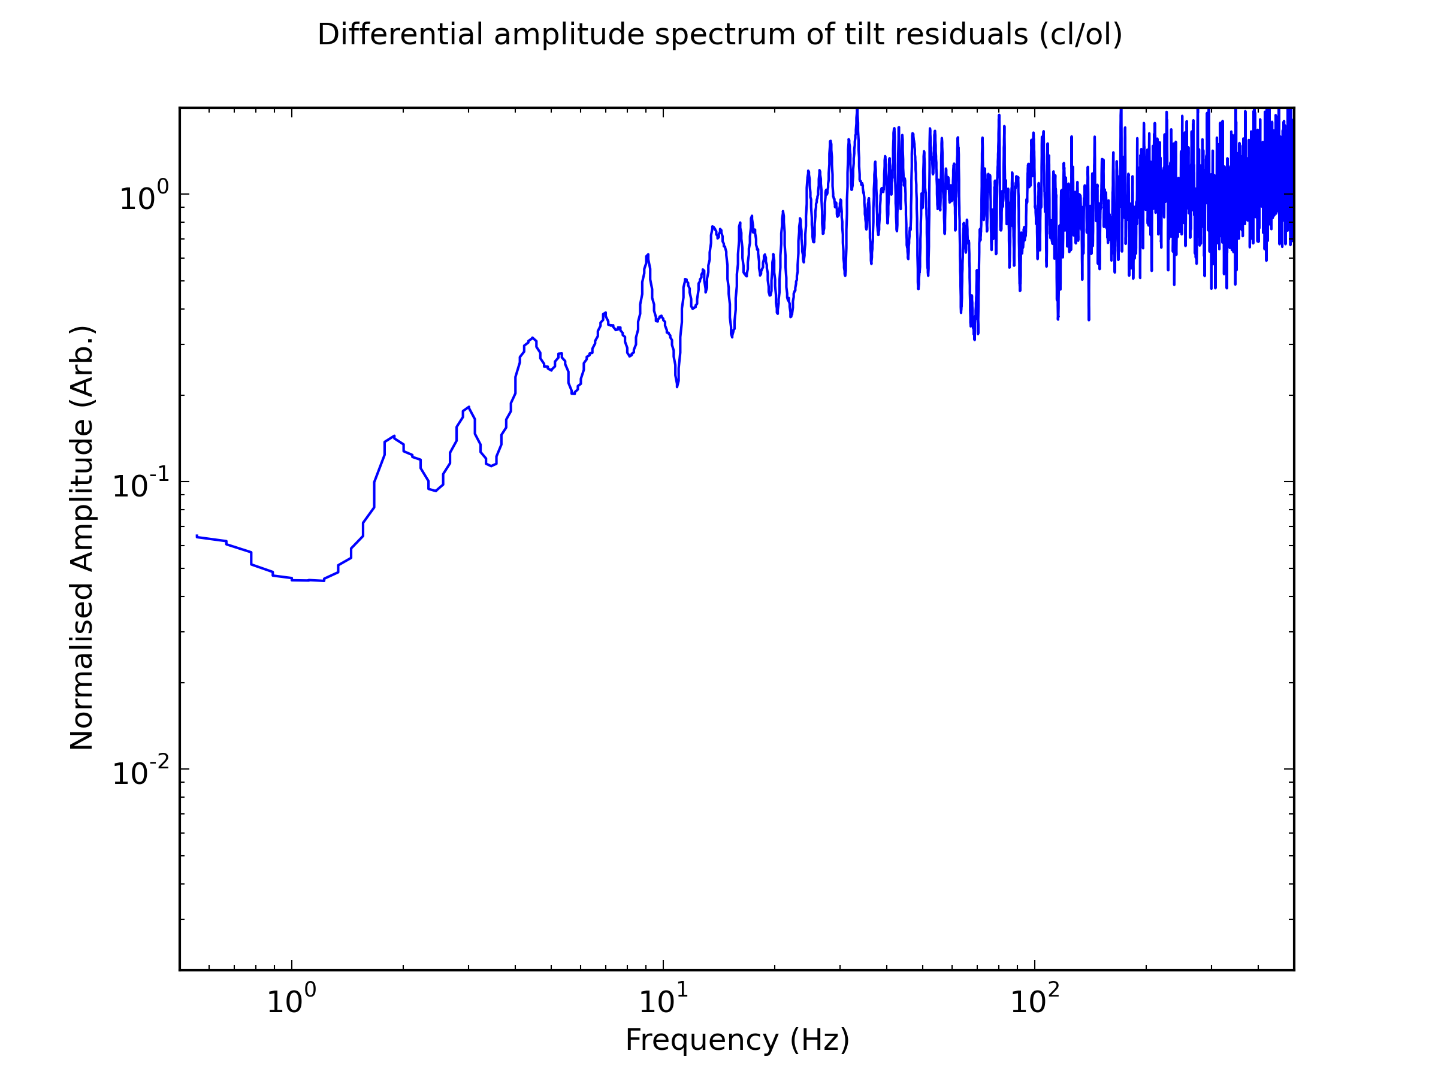
Tip
Tilt
0 dB frequency = 30 Hz

