Slide 1
SHApes Constraint Language (SHACL)
Sebastián Ferrada
May 4th, 2022
sebastian.ferrada@liu.se

Slide 2
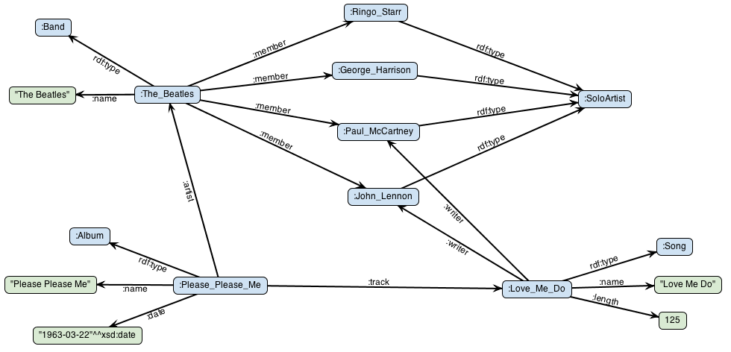
RDF Graphs
Image taken from Stardog Documentation
https://docs.stardog.com/tutorials/virtual-graph-mappings

Slide 3


RDF Graphs
Very flexible! Add entities and properties as needed, no mandatory fields, no primary keys, etc!
Very flexible! We can introduce inconsistent/incoherent/wrong/duplicate data without noticing

Slide 4
RDF Graphs
No obvious schema: we can add edges and nodes to the graph as we please
What happens with business rules?
What happens with consistency constraints?
“yesterday”
rdf:type
:released

Slide 5
RDF Schema
Allows to set a vocabulary for the data:
Class and property definition
Subclasses and subproperties
Range and domain definition
Limited expressivity
:track rdfs:range :Song

Slide 6
OWL
Web Ontology Language
Targets logic and inferencing:
max/min cardinality
Intersection/union/difference
Class and property equivalence
Property transitivity and symmetry, etc.
Can do validation using certain tools
:Song owl:disjointWith :SoloArtist

Slide 7
SHACL
Allows RDF data to be validated against shapes
Very expressive:
Constraints on cardinality, datatypes, ranges, patterns, etc.
There is a shapes graph and a data graph
In the example, we can define what a valid Song shape looks like

Slide 8
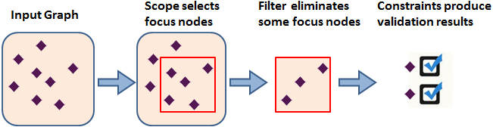
SHACL – Validation Process
Produces a validation report!

Slide 9
SHACL – Shapes
@prefix sh: <http://www.w3.org/ns/shacl#> .
ex:SongShape a sh:NodeShape ;
sh:targetClass ex:Song ;
sh:property [
sh:path ex:released ;
sh:datatype xsd:date .
] .
Square brackets indicate a blank node
Notes:
Node shapes and Property shapes

Slide 10
SHACL – Shapes
@prefix sh: <http://www.w3.org/ns/shacl#> .
ex:SongShape a sh:NodeShape ;
sh:targetClass ex:Song ;
sh:property [
sh:path ex:writer ;
sh:class ex:SoloArtist ;
sh:minCount 1 .
] .

Slide 11
SHACL – Targets
A shape can target all instances of a class, nodes participating in a given relationship, or specific nodes:
ex:SongShape a sh:NodeShape ;
sh:targetClass ex:Song .
ex:SongShape a sh:NodeShape ;
sh:targetNode ex:Love_Me_Do .
ex:SongShape a sh:NodeShape ;
sh:targetSubjectsOf ex:writer
ex:SongShape a sh:NodeShape ;
sh:targetObjectsOf ex:track .

Slide 12
SHACL – Validation Reports
All correct:
[
a sh:ValidationReport ;
sh:conforms true
] .

Slide 13
SHACL – Validation Reports
Invalid nodes found
[
a sh:ValidationResult;
sh:focusNode l:935;
sh:resultMessage
"Value does not have datatype <http://www.w3.org/2001/XMLSchema#string>";
sh:resultPath n0:birthday;
sh:resultSeverity sh:Violation;
sh:sourceConstraintComponent sh:DatatypeConstraintComponent;
sh:sourceShape [];
sh:value "1948-10-09"^^XML:date
].

Slide 14
SHACL – Core Constraints
Type | Constraints
Cardinality | minCount, maxCount
Property Value Type | class, datatype, nodeKind
Property Values | node, in, hasValue
Value Range | minInclusive, maxInclusive, minExclusive, maxExclusive
String Values | minLength, maxLength, pattern, uniqueLang
Logical | and, or, not, xone
Closed Shapes | closed, ignoredProperties
Property Pair Constraint | equals, disjoint, lessThan, lessThanOrEquals
Non-validating | name, value, defaultValue
Qualified Shapes | qualifiedValueShape, qualifiedMinCount, qualifiedMaxCount

Slide 15
SHACL – Core Constraints
Constraint the max and min amount of values a property can have
Type | Constraints
Cardinality | minCount, maxCount
Property Value Type | class, datatype, nodeKind
Property Values | node, in, hasValue
Value Range | minInclusive, maxInclusive, minExclusive, maxExclusive
String Values | minLength, maxLength, pattern, uniqueLang
Logical | and, or, not, xone
Closed Shapes | closed, ignoredProperties
Property Pair Constraint | equals, disjoint, lessThan, lessThanOrEquals
Non-validating | name, value, defaultValue
Qualified Shapes | qualifiedValueShape, qualifiedMinCount, qualifiedMaxCount

Slide 16
SHACL – Cardinality Constraints
ex:SongShape a sh:NodeShape ;
sh:targetClass ex:Song ;
sh:property [
sh:path ex:writer ;
sh:class ex:SoloArtist ;
sh:minCount 1 .
] .

Slide 17
SHACL – Core Constraints
Constraint the types of values a property can have
Type | Constraints
Cardinality | minCount, maxCount
Property Value Type | class, datatype, nodeKind
Property Values | node, in, hasValue
Value Range | minInclusive, maxInclusive, minExclusive, maxExclusive
String Values | minLength, maxLength, pattern, uniqueLang
Logical | and, or, not, xone
Closed Shapes | closed, ignoredProperties
Property Pair Constraint | equals, disjoint, lessThan, lessThanOrEquals
Non-validating | name, value, defaultValue
Qualified Shapes | qualifiedValueShape, qualifiedMinCount, qualifiedMaxCount

Slide 18
SHACL – Value Type Constraints
ex:SongShape a sh:NodeShape ;
sh:targetClass ex:Song ;
sh:property [
sh:path ex:name ;
sh:datatype xsd:string .
] .
ex:SongShape a sh:NodeShape ;
sh:targetClass ex:Song ;
sh:property [
sh:path ex:writer ;
sh:class ex:SoloArtist ;
sh:minCount 1 .
] .

Slide 19
SHACL – Core Constraints
Constraint the values that a property can have
Type | Constraints
Cardinality | minCount, maxCount
Property Value Type | class, datatype, nodeKind
Property Values | node, in, hasValue
Value Range | minInclusive, maxInclusive, minExclusive, maxExclusive
String Values | minLength, maxLength, pattern, uniqueLang
Logical | and, or, not, xone
Closed Shapes | closed, ignoredProperties
Property Pair Constraint | equals, disjoint, lessThan, lessThanOrEquals
Non-validating | name, value, defaultValue
Qualified Shapes | qualifiedValueShape, qualifiedMinCount, qualifiedMaxCount

Slide 20
SHACL – Core Constraints
Constraint the values a property can have to a given range
Type | Constraints
Cardinality | minCount, maxCount
Property Value Type | class, datatype, nodeKind
Property Values | node, in, hasValue
Value Range | minInclusive, maxInclusive, minExclusive, maxExclusive
String Values | minLength, maxLength, pattern, uniqueLang
Logical | and, or, not, xone
Closed Shapes | closed, ignoredProperties
Property Pair Constraint | equals, disjoint, lessThan, lessThanOrEquals
Non-validating | name, value, defaultValue
Qualified Shapes | qualifiedValueShape, qualifiedMinCount, qualifiedMaxCount

Slide 21
SHACL – Core Constraints
Constraint the types of values a property can have
Type | Constraints
Cardinality | minCount, maxCount
Property Value Type | class, datatype, nodeKind
Property Values | node, in, hasValue
Value Range | minInclusive, maxInclusive, minExclusive, maxExclusive
String Values | minLength, maxLength, pattern, uniqueLang
Logical | and, or, not, xone
Closed Shapes | closed, ignoredProperties
Property Pair Constraint | equals, disjoint, lessThan, lessThanOrEquals
Non-validating | name, value, defaultValue
Qualified Shapes | qualifiedValueShape, qualifiedMinCount, qualifiedMaxCount

Slide 22
SHACL – Patterns
ex:PersonShape a sh:NodeShape ;
sh:targetClass ex:Person ;
sh:property [
sh:path ex:personalNumber ;
sh:pattern “\\d{8}-\\d{4}”
].
ex:Alice a ex:Person;
ex:personalNumber “19990505-3221”
ex:Mike a ex:Person;
ex:personalNumber “012112-3244”

Slide 23
SHACL – Core Constraints
Logical operations among constraints
Type | Constraints
Cardinality | minCount, maxCount
Property Value Type | class, datatype, nodeKind
Property Values | node, in, hasValue
Value Range | minInclusive, maxInclusive, minExclusive, maxExclusive
String Values | minLength, maxLength, pattern, uniqueLang
Logical | and, or, not, xone
Closed Shapes | closed, ignoredProperties
Property Pair Constraint | equals, disjoint, lessThan, lessThanOrEquals
Non-validating | name, value, defaultValue
Qualified Shapes | qualifiedValueShape, qualifiedMinCount, qualifiedMaxCount

Slide 24
SHACL – Logical Operators
A song has to have at least one writer or be a track on an album
ex:SongShape a sh:NodeShape ;
sh:targetClass ex:Song ;
sh:or (
[sh:property [sh:path ex:writer ;
sh:class ex:SoloArtist ;
sh:minCount 1 .]]
[sh:property [sh:inversePath ex:track ;
sh:class ex:Album]]).

Slide 25
Tangent – SHACL Paths
sh:property [sh:path ex:name ; ...] .
sh:property [sh:inversePath ex:track ; ...]
target node
ex:name
value node
target node
ex:track
value node

Slide 26
Tangent – SHACL Paths
sh:property [sh:path (ex:writer ex:name) ; ...] .
sh:property [sh:path (rdf:type [ sh:zeroOrMorePath rdfs:subClassOf]; ...]
target node
ex:writer
interm. node
ex:name
value node
target node
value node
rdfs:subClassOf
value node
rdfs:subClassOf
value node
rdf:type
...

Slide 27
Tangent – SHACL Paths
sh:property [sh:alternativePath [ ex:father ex:mother ] ; ...]
target node
ex:father
value node
ex:mother
value node

Slide 28
SHACL – Core Constraints
Nodes can only have the properties mentioned in the shape
Type | Constraints
Cardinality | minCount, maxCount
Property Value Type | class, datatype, nodeKind
Property Values | node, in, hasValue
Value Range | minInclusive, maxInclusive, minExclusive, maxExclusive
String Values | minLength, maxLength, pattern, uniqueLang
Logical | and, or, not, xone
Closed Shapes | closed, ignoredProperties
Property Pair Constraint | equals, disjoint, lessThan, lessThanOrEquals
Non-validating | name, value, defaultValue
Qualified Shapes | qualifiedValueShape, qualifiedMinCount, qualifiedMaxCount

Slide 29
SHACL – Closed Shapes
ex:SongShape a sh:NodeShape ;
sh:targetNode ex:Love_Me_Do;
sh:property [
sh:path ex:writer ;
sh:class ex:SoloArtist ;
sh:minCount 1 .
] .
sh:closed true .
ex:Love_Me_Do ex:writer ex:John_Lennon .
ex:Love_Me_Do a ex:Song ;
ex:name “Love me do” ;
ex:length 145 ;
ex:writer ex:John_Lennon .

Slide 30
SHACL – Closed Shapes
ex:SongShape a sh:NodeShape ;
sh:targetNode ex:Love_Me_Do;
sh:property [
sh:path ex:writer ;
sh:class ex:SoloArtist ;
sh:minCount 1 .
] .
sh:closed true ;
sh:ingnoredProperties
(ex:name ex:length rdf:type) .
ex:Love_Me_Do a ex:Song ;
ex:writer ex:John_Lennon .
ex:Love_Me_Do a ex:Song ;
ex:name “Love me do” ;
ex:length 145 ;
ex:writer ex:John_Lennon .

Slide 31
SHACL – Core Constraints
Constraint on value nodes in relation to other properties
Type | Constraints
Cardinality | minCount, maxCount
Property Value Type | class, datatype, nodeKind
Property Values | node, in, hasValue
Value Range | minInclusive, maxInclusive, minExclusive, maxExclusive
String Values | minLength, maxLength, pattern, uniqueLang
Logical | and, or, not, xone
Closed Shapes | closed, ignoredProperties
Property Pair Constraint | equals, disjoint, lessThan, lessThanOrEquals
Non-validating | name, value, defaultValue
Qualified Shapes | qualifiedValueShape, qualifiedMinCount, qualifiedMaxCount

Slide 32
SHACL – Property Pair Constraints
ex:ExmployeeShape a sh:NodeShape ;
sh:targetNode (ex:Mike ex:Alice );
sh:property [
sh:path ex:birthDate ;
sh:lessThan ex:contractStart
].
ex:Alice a ex:Person;
ex:birthDate “1994-05-05” ;
ex:contractStart “2021-01-01”
ex:Mike a ex:Person;
ex:birthDate “2001-21-12” ;
ex:contractStart “2001-01-01”

Slide 33
SHACL – Core Constraints
Optional constraints for recommended values or to add metadata, not validated.
Type | Constraints
Cardinality | minCount, maxCount
Property Value Type | class, datatype, nodeKind
Property Values | node, in, hasValue
Value Range | minInclusive, maxInclusive, minExclusive, maxExclusive
String Values | minLength, maxLength, pattern, uniqueLang
Logical | and, or, not, xone
Closed Shapes | closed, ignoredProperties
Property Pair Constraint | equals, disjoint, lessThan, lessThanOrEquals
Non-validating | name, value, defaultValue
Qualified Shapes | qualifiedValueShape, qualifiedMinCount, qualifiedMaxCount

Slide 34
SHACL – Non-validating Characteristics
ex:PersonFormShape
a sh:NodeShape ;
sh:property [
sh:path ex:firstName ;
sh:name "first name" ;
sh:description "The person's given name(s)" ;
sh:order 0 ;
sh:group ex:NameGroup ;
] ;

Slide 35
SHACL – Core Constraints
Constraints to the number of value nodes that conform to a constraint
Type | Constraints
Cardinality | minCount, maxCount
Property Value Type | class, datatype, nodeKind
Property Values | node, in, hasValue
Value Range | minInclusive, maxInclusive, minExclusive, maxExclusive
String Values | minLength, maxLength, pattern, uniqueLang
Logical | and, or, not, xone
Closed Shapes | closed, ignoredProperties
Property Pair Constraint | equals, disjoint, lessThan, lessThanOrEquals
Non-validating | name, value, defaultValue
Qualified Shapes | qualifiedValueShape, qualifiedMinCount, qualifiedMaxCount

Slide 36
SHACL – Custom Constraints
Custom constraints can be defined by using SPARQL queries:
ex:LanguageExampleShape a sh:NodeShape ;
sh:targetClass ex:Country ;
sh:sparql [
a sh:SPARQLConstraint ; # This triple is optional
sh:message "Values are literals with German language tag." ;
sh:prefixes ex: ;
sh:select """
SELECT $this (ex:germanLabel AS ?path) ?value WHERE {
$this ex:germanLabel ?value .
FILTER (!isLiteral(?value) || !langMatches(lang(?value), "de"))}
""" ;] .
Notes:
Returns bindings for nodes that are not valid

Slide 37
Useful Resources
SHACL Specification: https://www.w3.org/TR/shacl/
SHACL By Example: https://www.slideshare.net/jelabra/shacl-by-example

Slide 38
Hands-on Exercises
Visit this URL: http://sferrada.com/exercises/shacl.txt

