Slide 1
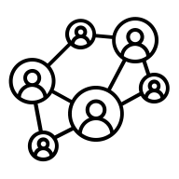

Knowledge Chunks
Knowledge Chuncks
(embeddings)
Knowledge Chunks
Knowledge Chuncks
(embeddings)
Knowledge Chunks
Knowledge Chuncks
(embeddings)
Knowledge Chunks
Knowledge Chuncks
(embeddings)
Knowledge-informed Generation
Knowledge Chunks
Knowledge Chunks
(embeddings)
Chunk Retriever
Relevant Chunks
(context)
LLM ✨
How is fraction addition taught in fourth grade?
User Prompt
User Prompt
(embedding)

Slide 2
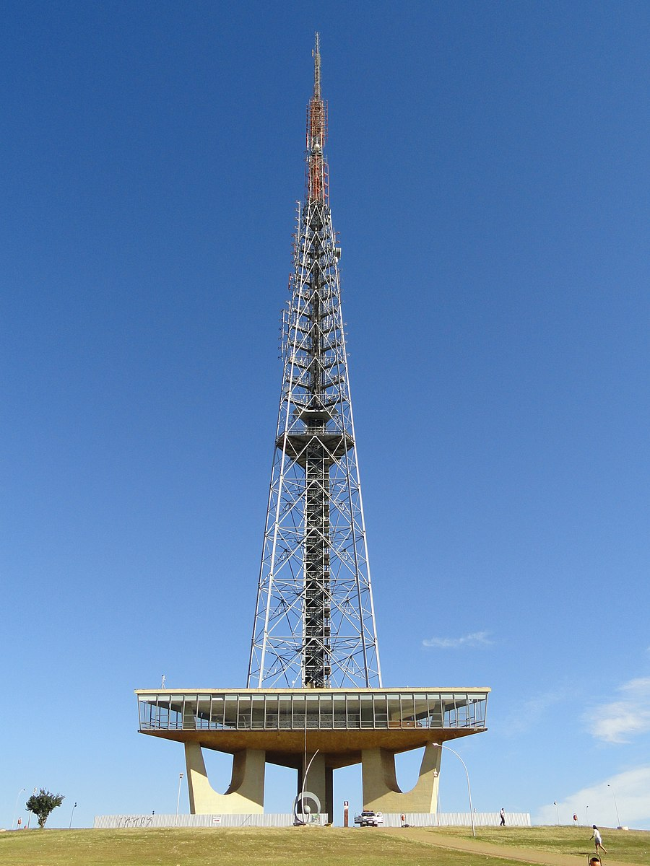
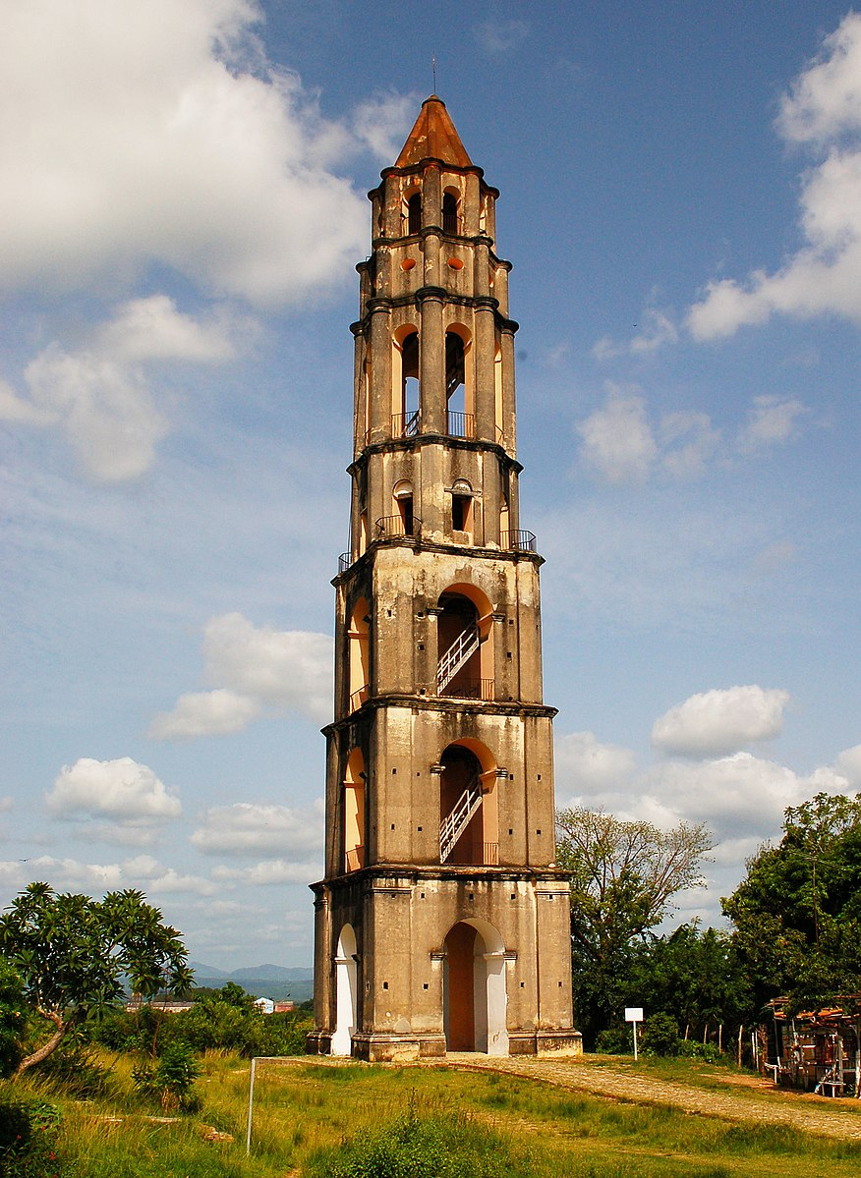
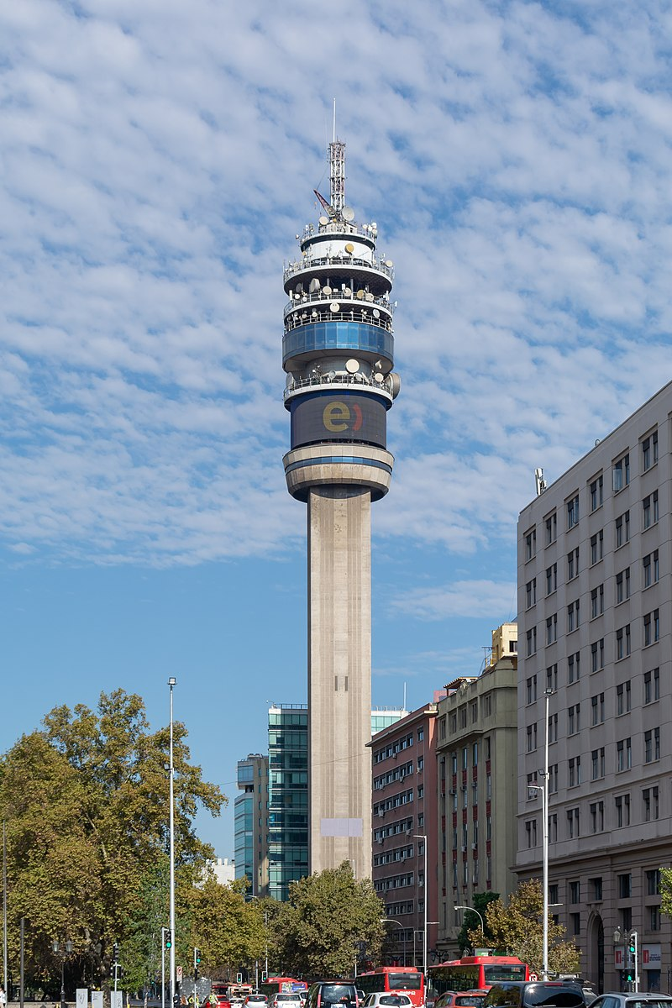
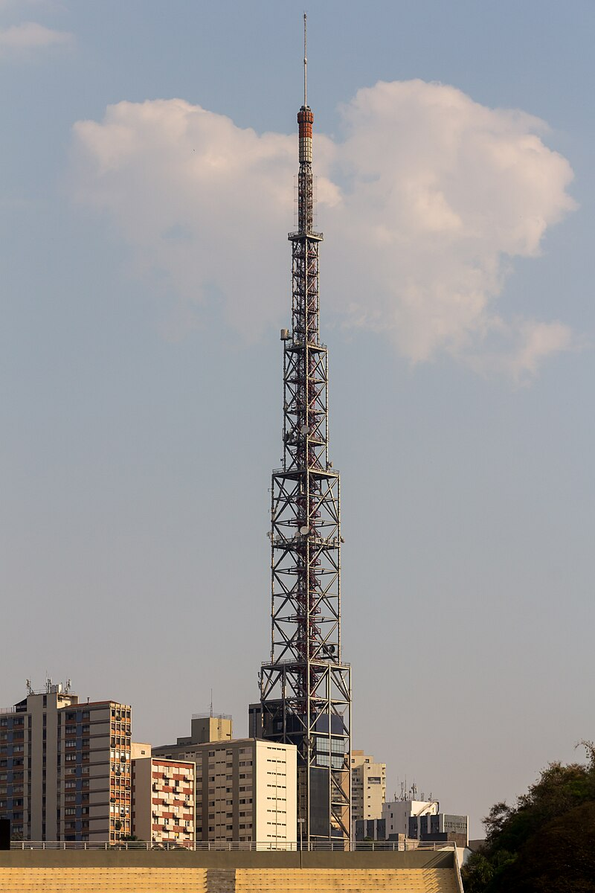
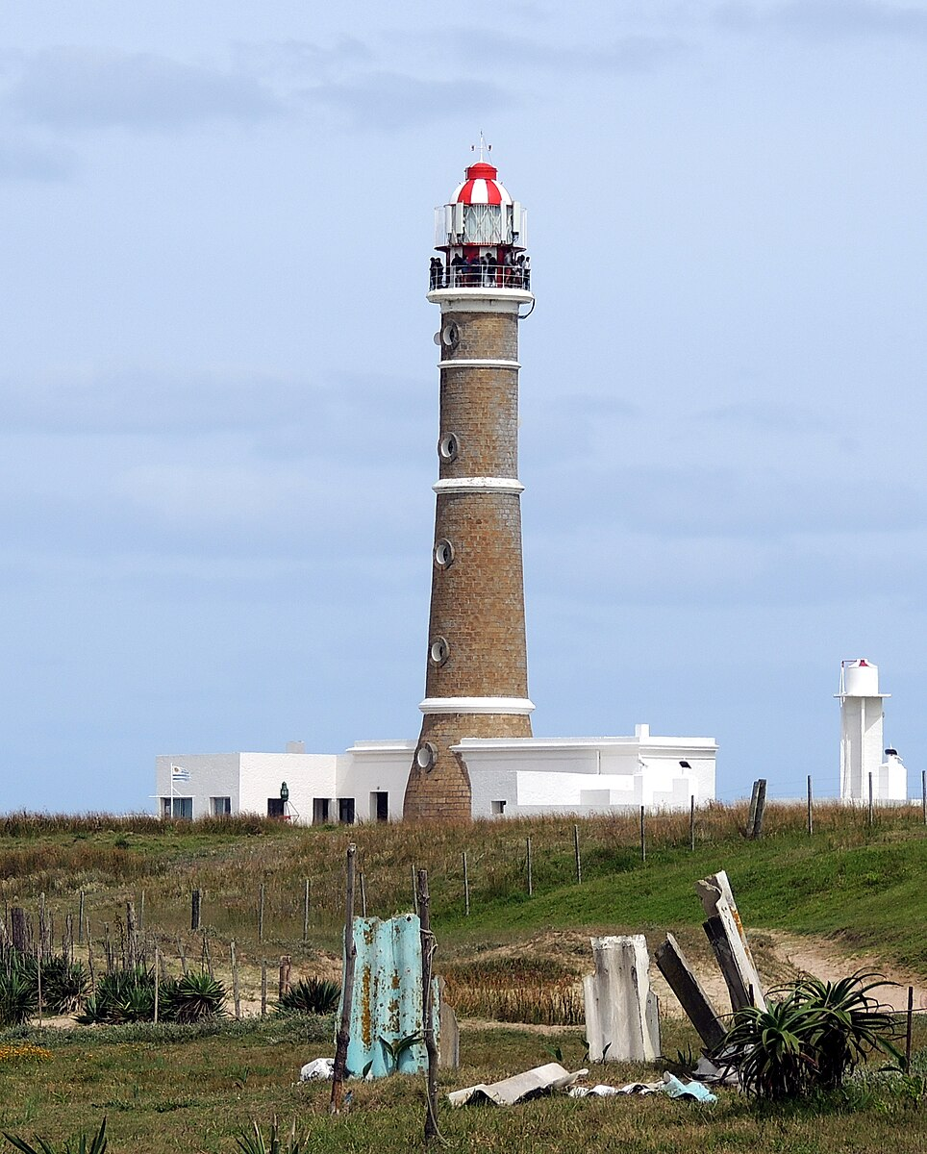
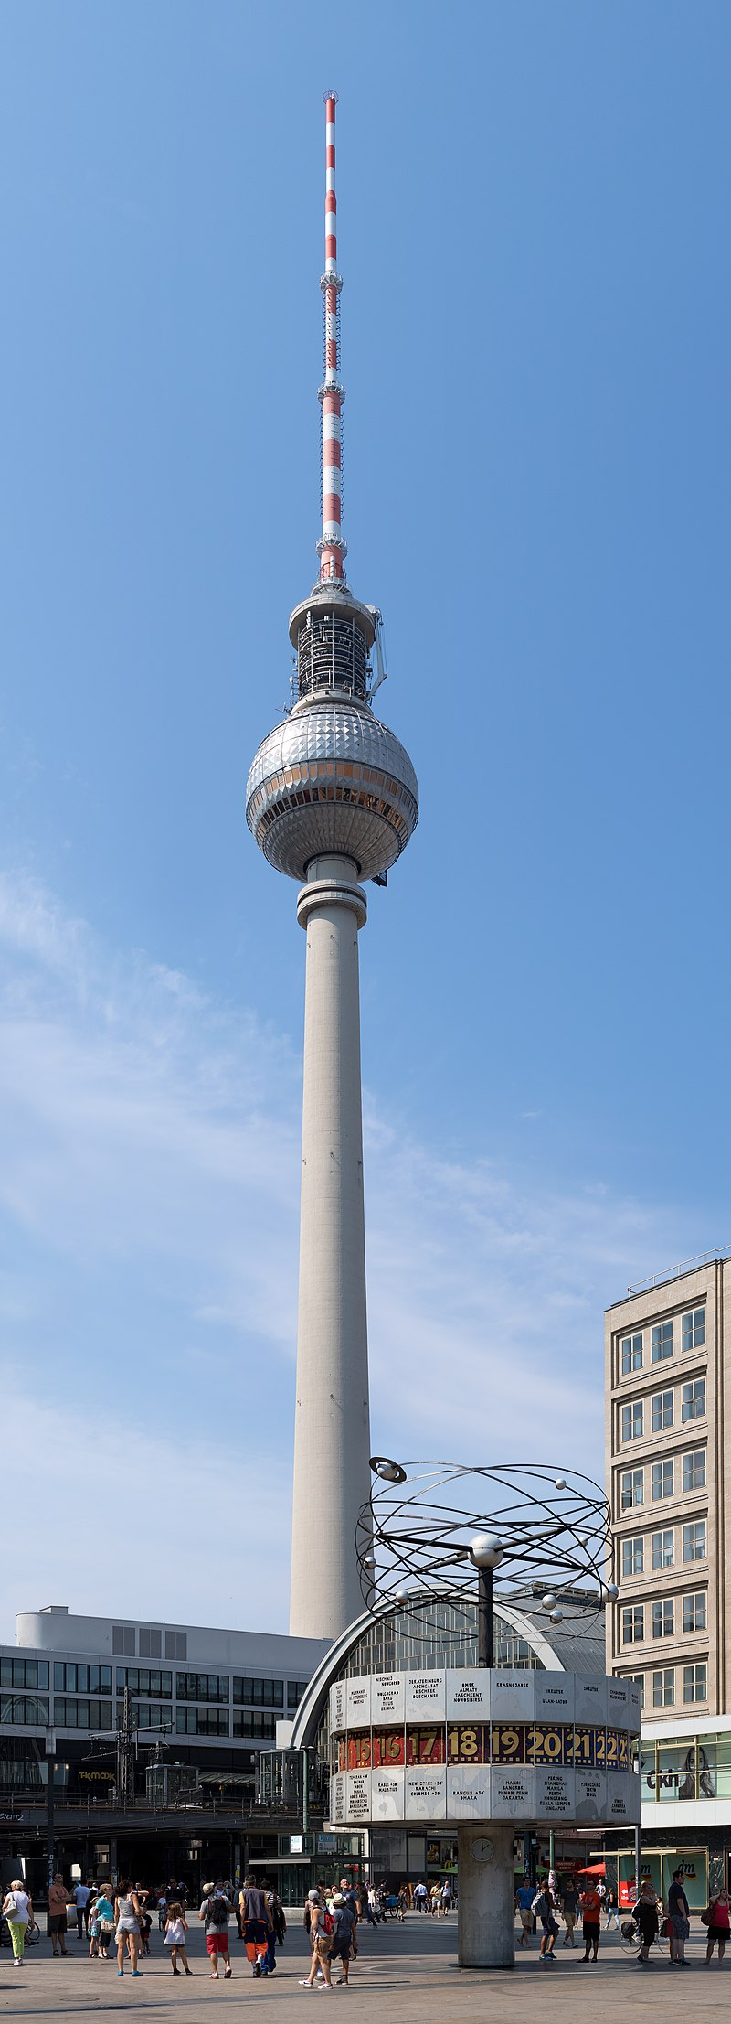
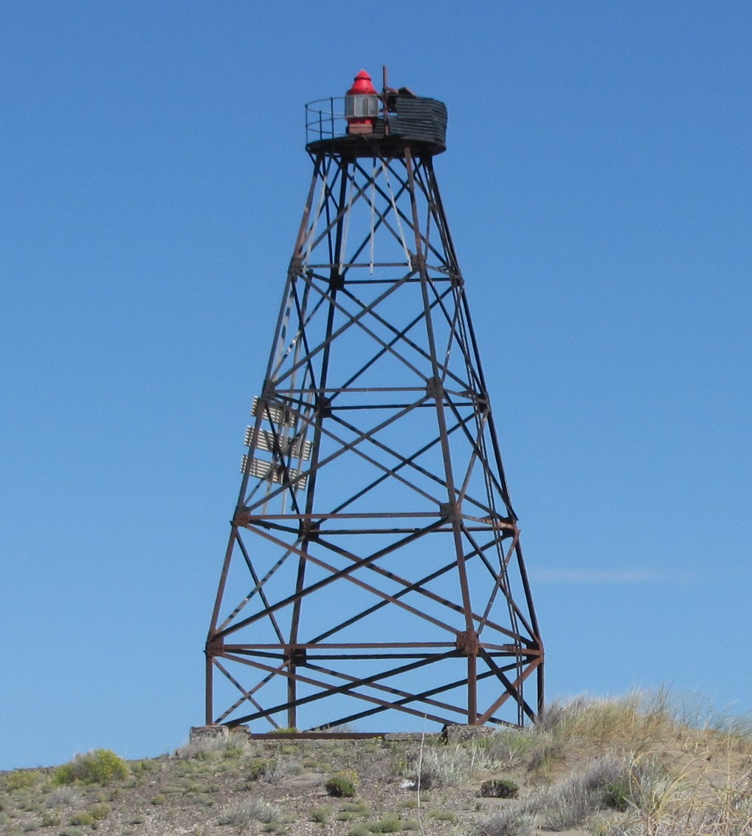
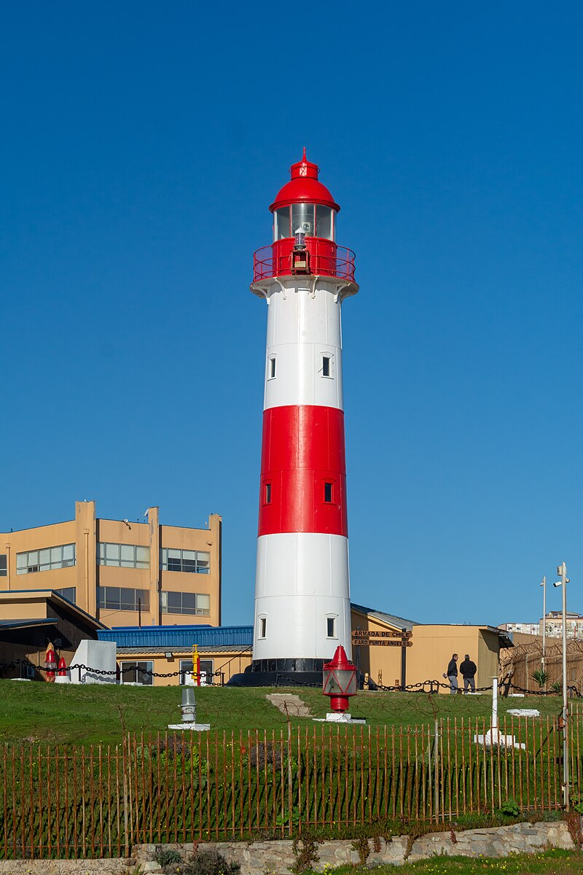
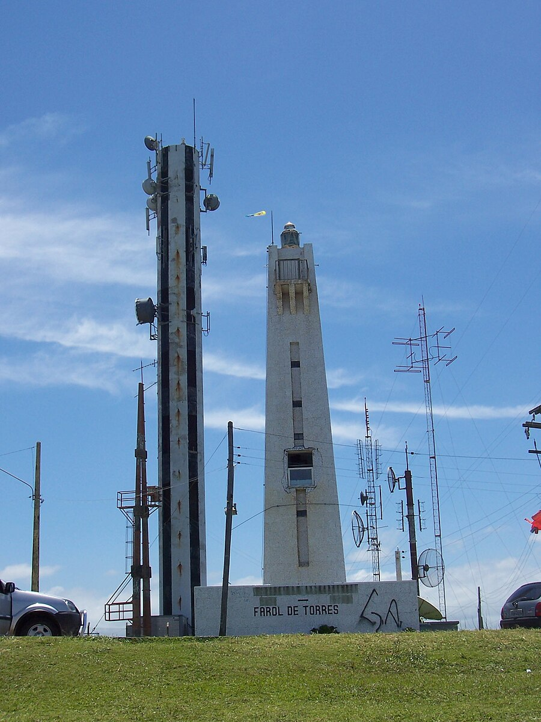
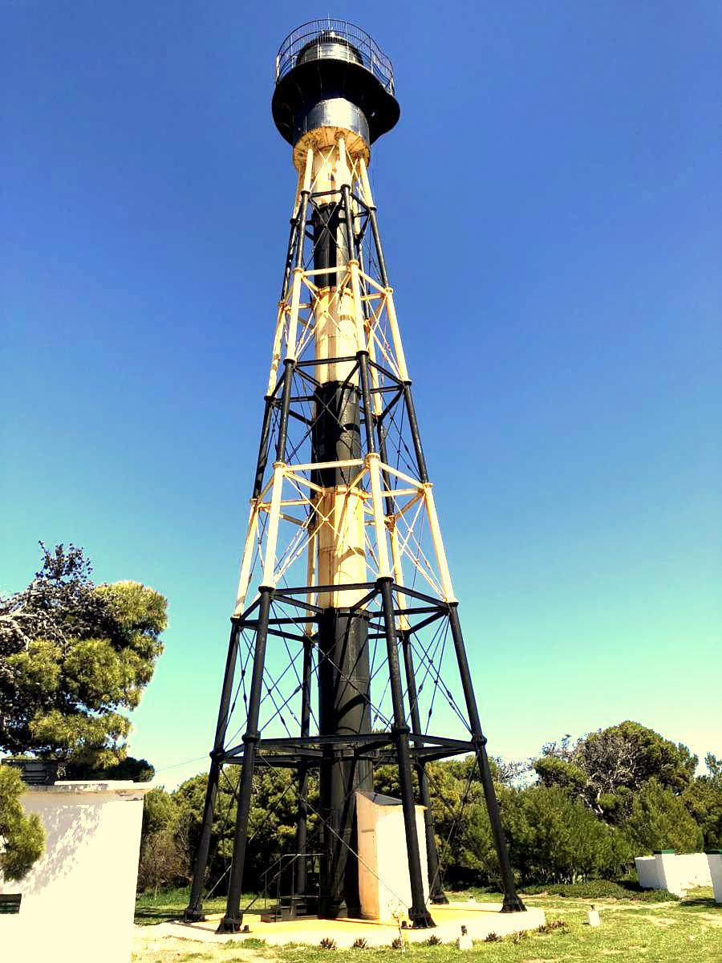
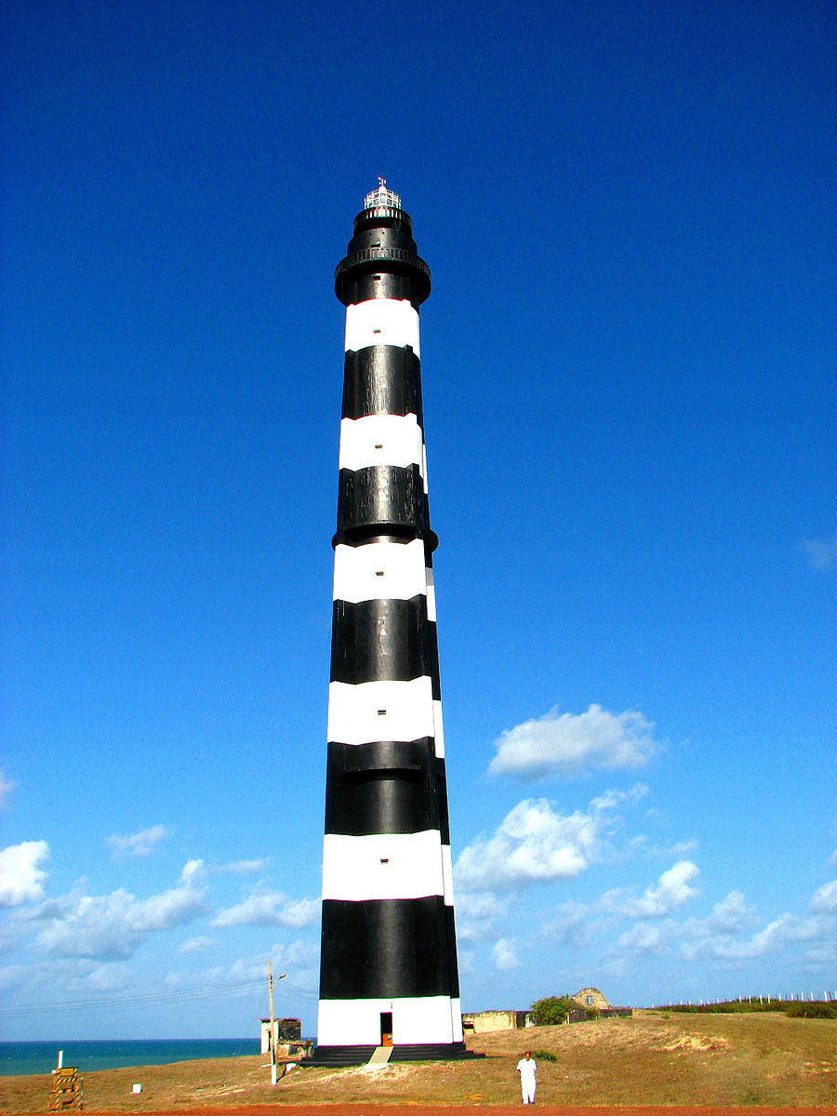
Find all Latin American towers that look similar to the Berlin TV Tower
0.723
0.727
0.727
0.722
0.717
query
0.710
0.708
0.708
0.703
0.702

Slide 3
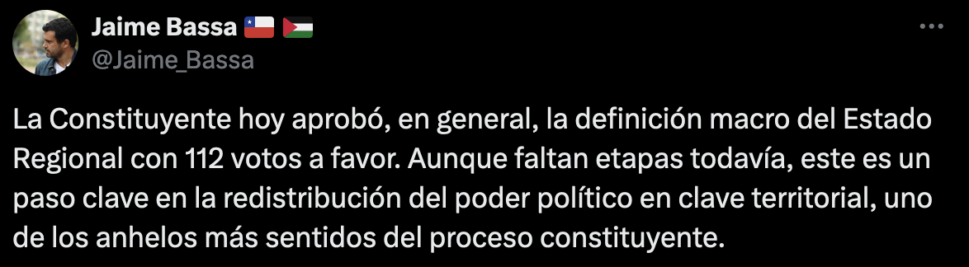
Find the average distance of each political pact with respect to the topic of regionalization
Bancada | COUNT | AVG(dist)
Mov. Soc Constituyentes | 51 | 0.423795
Indep. No Neutrales | 4 | 0.475289
Frente Amplio | 95 | 0.501312
Partido_Comunista | 41 | 0.513067
Ex LDP | 31 | 0.575289
Colectivo Socialista | 25 | 0.616303
Vamos por Chile | 27 | 0.646724
Pueblo Constituyente (ex LDP) | 11 | 0.673799
UDI | 11 | 0.686078
query (positive tweet resp. the topic)
(results: larger distances correlate with more right wing pact)

Slide 4
The Goal
Filter vectors by similarity and by semantic constraints simultaneously in a time efficient manner

Slide 5
Baseline Query-and-Select Algorithm
Query-and-select:
1.- Retrieves all answers to the graph query
2.- Retrieves vectors associated to each answer
3.- Computes similarity from query vector to each other vector
4.- Returns the most similar
Computes as many similarities as answers to the graph query
Impossible to pre-index relevant vectors
can we do better?

Slide 6
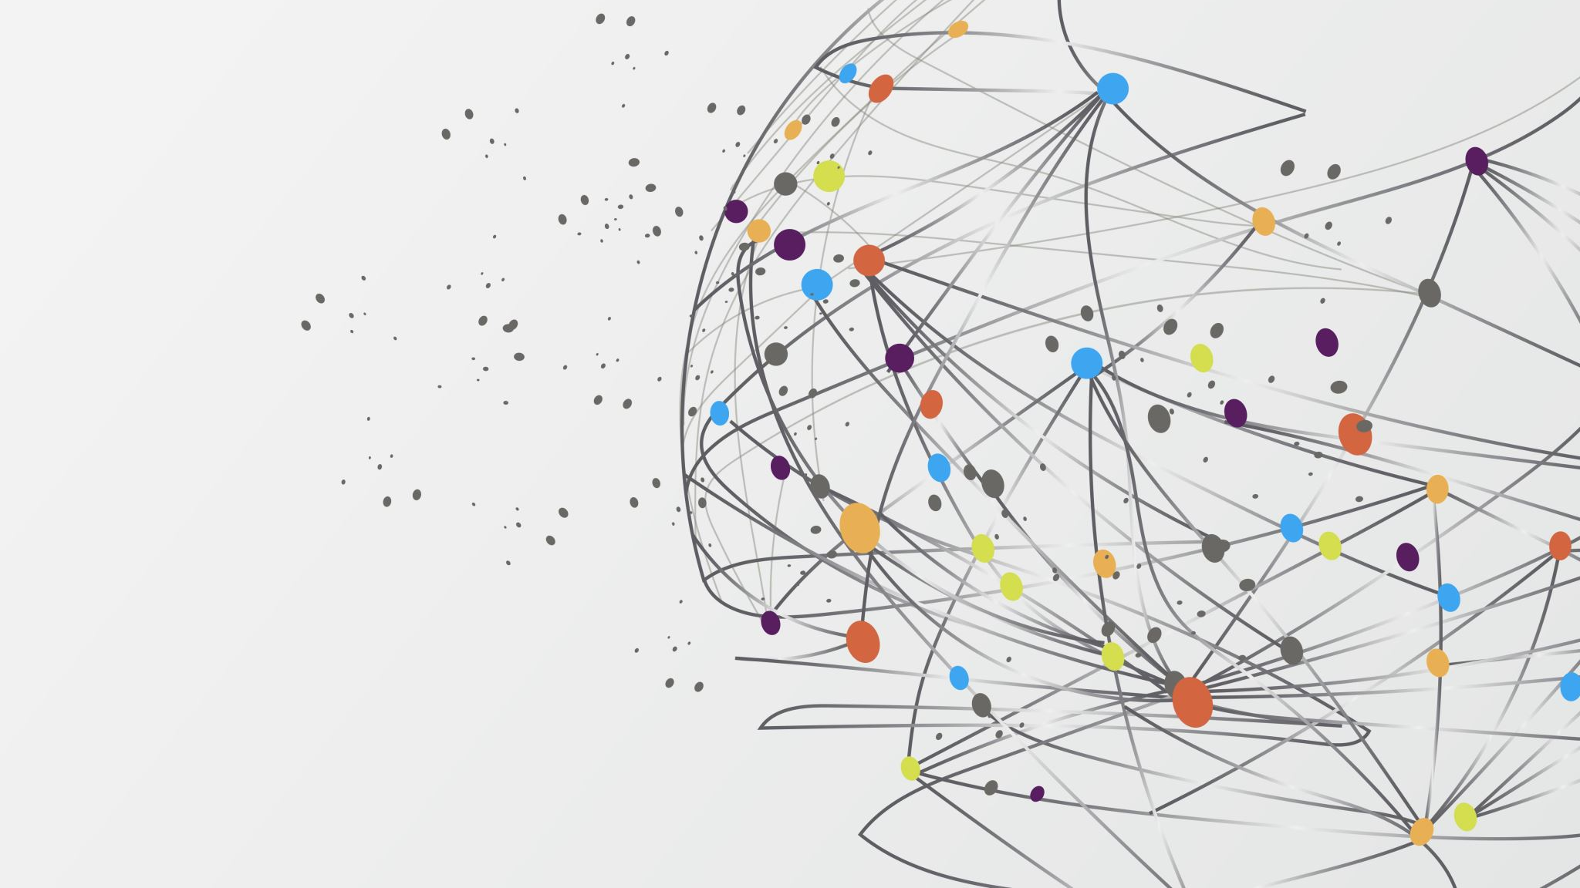


Graph Querying or Similarity Search?
Both!
Vicente Calisto, Sebastián Ferrada,
Gonzalo Navarro, Juan L. Reutter,
Juan Pablo Sweet, and Domagoj Vrgoč.
ISWC 2025 – Nara Japan

Slide 7
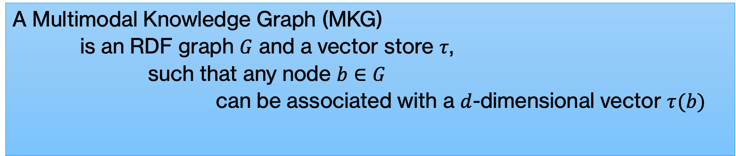
Definitions – Multimodal Knowledge Graph
A Multimodal Knowledge Graph (MKG)
is an RDF graph $G$ and a vector store $τ$,
such that any node $b∈G$
can be associated with a $d$-dimensional vector $τ(b)$

Slide 8
Definition: Worst-case Optimal Joins in Graph Databases
A join algorithm that guarantees running time proportional to the theoretical worst-case output size of the join.
It avoids generating unnecessary intermediate tuples and achieves asymptotically optimal performance for multi-way joins.
Let $Q^{∗}$ be an upper bound to $\left|Q\left(G\right)\right|$, then a wco algorithm runs in time $\tilde{O}\left(Q^{∗}\right)$

Slide 9
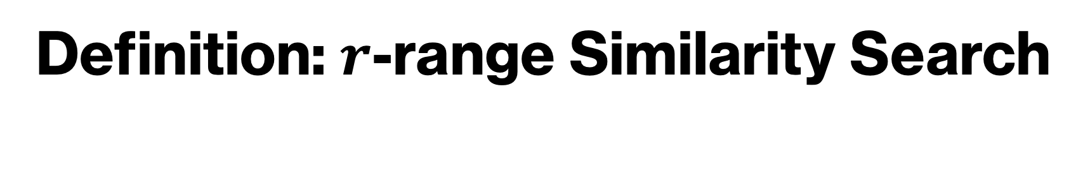
Definition: $r$-range Similarity Search
r
Query Ball

Slide 10
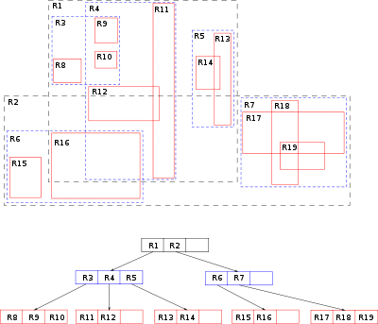
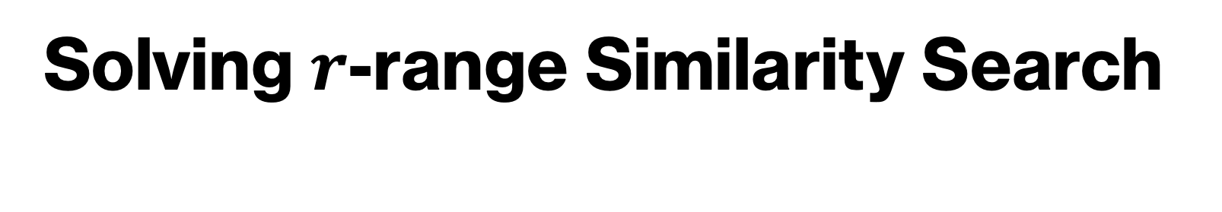
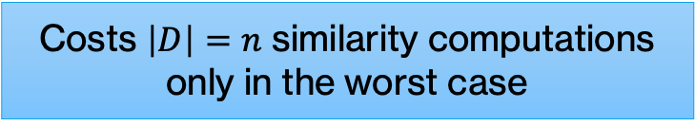
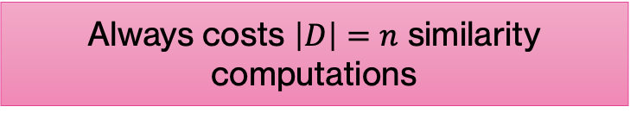

Solving $r$-range Similarity Search
Naïve Algorithm
Metric Index-based Algorithm
For $v∈ D$:
if $δ\left(v,q\right)≤r$:
output $v$
Traverse the structure, prunning zones known to be too far (using triangle inequality)
Always costs $\left|D\right|=n$ similarity computations
Costs $\left|D\right|=n$ similarity computations only in the worst case

Slide 11
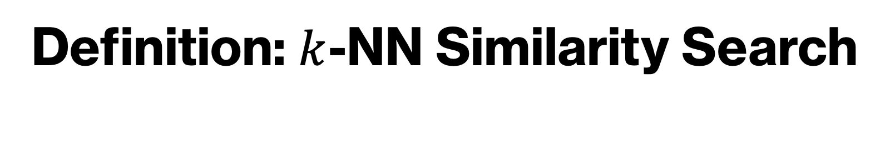
Definition: $k$-NN Similarity Search
Query point + k=3

Slide 12
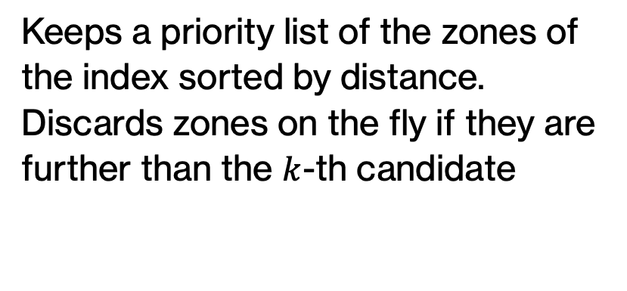
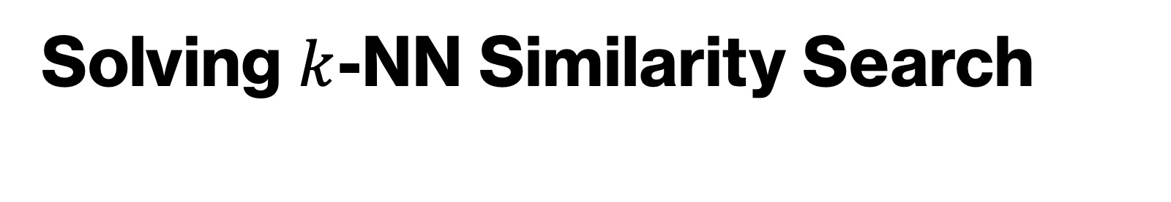

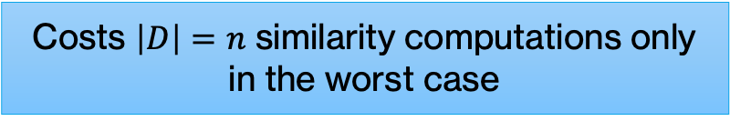
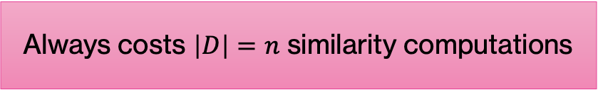
Solving $k$-NN Similarity Search
Naïve Algorithm
Metric Index-based Algorithm
  candidates = Max-Heap()
  foreach $u_{i}∈R$ do:
  dist = $d\left(u_{i},q\right)$
  if candidates.size()<k then:
  candidates.add(dist,$u_{i}$)
  else if candidates.max().dist > dist
  then:
  candidates.remove()
  candidates.add(dist,$u_{i}$)
  return candidates
Keeps a priority list of the zones of the index sorted by distance. Discards zones on the fly if they are further than the $k$-th candidate
Always costs $\left|D\right|=n$ similarity computations
Costs $\left|D\right|=n$ similarity computations only in the worst case

Slide 13
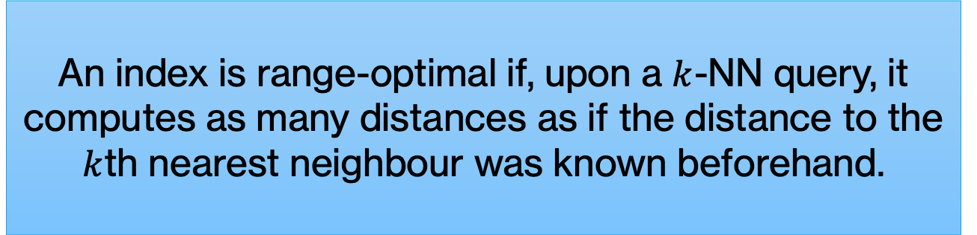
Range Optimal Algorithms
As most indexes are meant to solve range-based similarity; however,
An index is range-optimal if, upon a $k$-NN query, it computes as many distances as if the distance to the $k$th nearest neighbour was known beforehand.

Slide 14
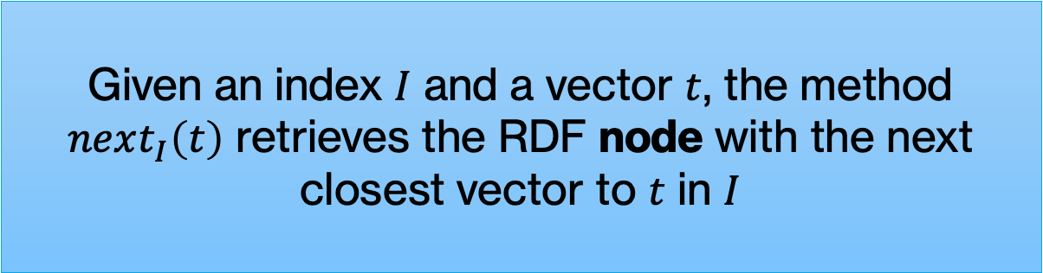
INNs, Iterators and next(t)
We further assume an iterator over the index, such that:
Given an index $I$ and a vector $t$, the method $next_{I}\left(t\right)$ retrieves the RDF node with the next closest vector to $t$ in $I$

Slide 15

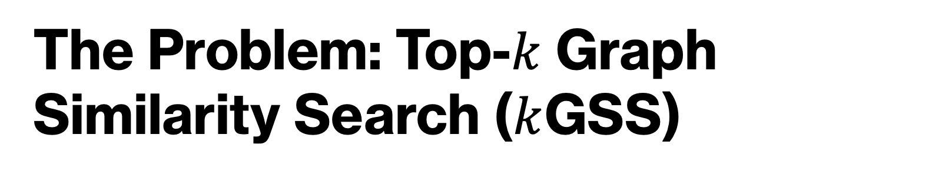
The Problem: Top-$k$ Graph Similarity Search ($k$GSS)
Given: Knowledge Graph $G$, distance function $δ$, vector store $τ$.
Input: Graph pattern $(Q, ?x)$ with similarity, vector $t$ and integer $k$.
Output: $k$ best answers $\left(\overline{a}, b\right)∈Q\left(G\right)$, ordered by $δ\left(t, τ\left(b\right)\right)$
$?x$ is a variable in $Q$, w.r.t. which we compute the similarities between $t$ and $τ(?x)$
$(\overline{a},b)$ is a solution mapping in $Q\left(G\right)$ such that $b$ is bound to $?x$ and $\overline{a}$ are the rest of the bindings

Slide 16
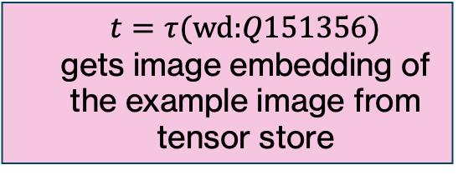

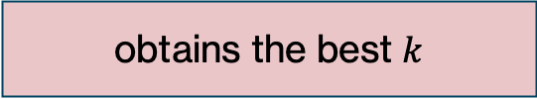
As a SPARQL Query
SELECT ?tower ?img ?dist WHERE {
?tower wdt:P31/wdt:P279* wd:Q12518;
wdt:P17 ?country;
wdt:P18 ?img.
?country wdt:P361 wd:Q18.
wd:Q151356 :hasTensor ?tensor.
?img proc:hnswIterator
("vectorIndex" ?vector ?dist)
}LIMIT 10
$$\left(Q,?x\right)=(𝒬, ?tower)$$
towers (with images) in a country in Latin America
$$t=τ(\text{wd}\text{:}Q151356)$$
gets image embedding of the example image from tensor store
iterates through the images of towers w.r.t. their similarity to the given example
obtains the best $k$

Slide 17
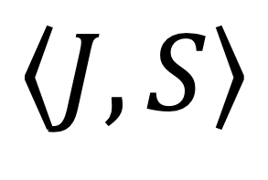
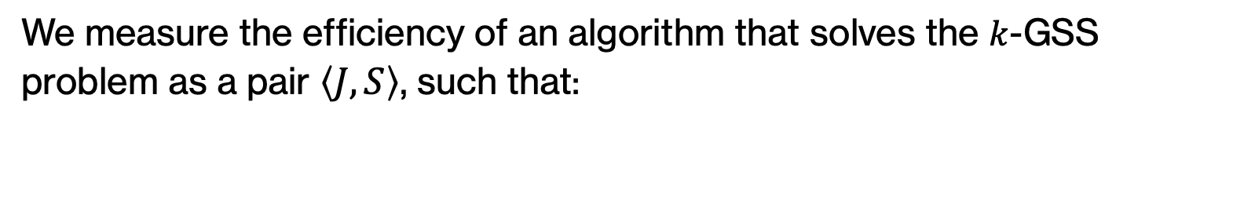
Cost Model
We measure the efficiency of an algorithm that solves the $k$-GSS problem as a pair $\left\langle J,S\right\rangle$, such that:
Is the cost of retrieving the answers to the graph pattern
Is the number of distances/similarities computed
$$\left\langle J,S\right\rangle$$

Slide 18
Query-and-Select Costs
Query-and-select:
1.- Retrieves all answers to the graph query
2.- Retrieves vectors associated to each answer
3.- Computes similarity from query vector to each other vector
4.- Returns the most similar

Slide 19

Query-and-Select Costs
$$\left\langle \tilde{O}\left(Q^{∗}\right), \left|Q\left(G\right)\right|\right\rangle$$
wco cost to get the answers to the graph pattern.
computes similarities to all answers to the graph pattern
Computes as many similarities as answers to the graph query
Impossible to pre-index relevant vectors
can we do better?

Slide 20
Our Algorithms

Slide 21







Query-and-iterate
$$Q\left(G\right)$$
$$(\overline{a}, b)$$
$$next_{INN}\left(t\right)$$
$$t=$$
$$t_{1}$$
$$t_{2}$$
$$…$$
$$t_{d}$$
INN

Slide 22
Query-and-iterate
$$Q\left(G\right)$$
$$(\overline{a}, b)$$
$$next_{INN}\left(t\right)$$
$$t=$$
$$t_{1}$$
$$t_{2}$$
$$…$$
$$t_{d}$$
INN

Slide 23
Query-and-iterate
$$Q\left(G\right)$$
$$(\overline{a}, b)$$
$$next_{INN}\left(t\right)$$
$$t=$$
$$t_{1}$$
$$t_{2}$$
$$…$$
$$t_{d}$$
INN

Slide 24

Query-and-iterate
Repeat until $k$ are found
$$Q\left(G\right)$$
$$(\overline{a}, b)$$
$$next_{INN}\left(t\right)$$
$$t=$$
$$t_{1}$$
$$t_{2}$$
$$…$$
$$t_{d}$$
INN
output:

Slide 25


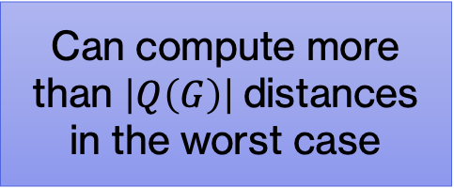
Query-and-iterate – Cost
$$\left\langle \tilde{O}\left(Q^{∗}\right), \left|D\left(G\right)\right|\right\rangle$$
wco cost to get the answers to the graph pattern.
only computes the similarities required to output $k$ answers
Can compute more than $\left|Q\left(G\right)\right|$distances in the worst case

Slide 26
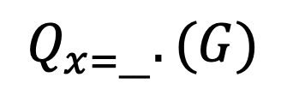








Iterate-and-query (iaq)
Repeat until $k$ are found
$$t=$$
$$t_{1}$$
$$t_{2}$$
$$…$$
$$t_{d}$$
$$Ans$$
$$next_{INN}\left(t\right)$$
$$Q_{x=__}.(G)$$
INN
.
.
.

Slide 27


Iterate-and-query – Cost
$$\left\langle \tilde{O}\left(Q_{x∈R(d)}^{∗}\right), \left|D\left(G\right)\right|\right\rangle$$
wco cost to get the answers to the restricted versions of the graph pattern.
only computes the similarities required to output $k$ answers

Slide 28
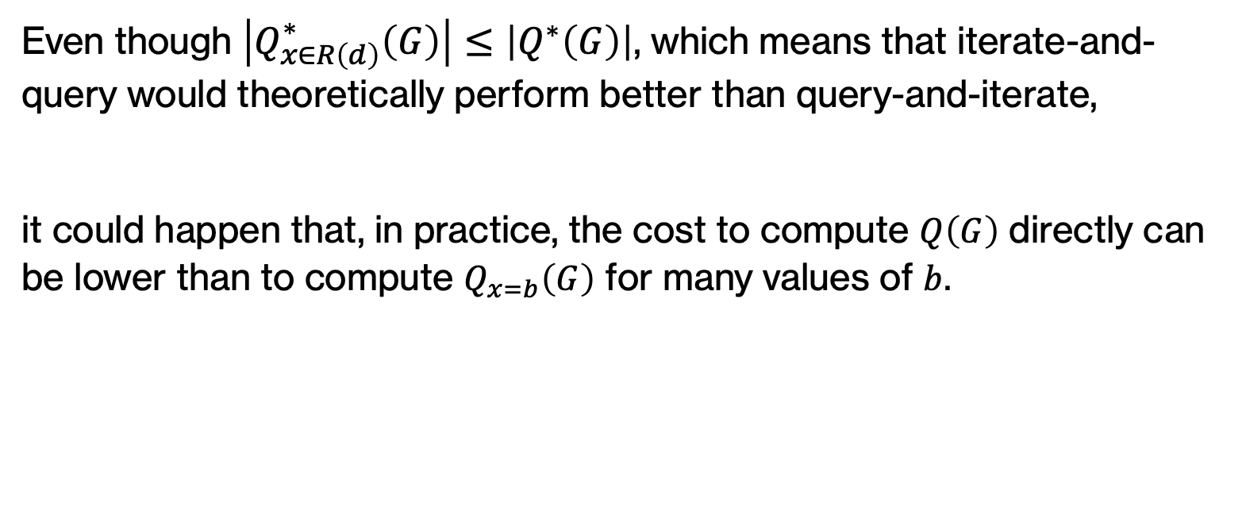
Theoretical Cost Comparison
Even though $\left|Q_{x∈R\left(d\right)}^{∗}\left(G\right)\right|≤\left|Q^{∗}\left(G\right)\right|$, which means that iterate-and-query would theoretically perform better than query-and-iterate,
it could happen that, in practice, the cost to compute $Q\left(G\right)$ directly can be lower than to compute $Q_{x=b}\left(G\right)$ for many values of $b$.

Slide 29
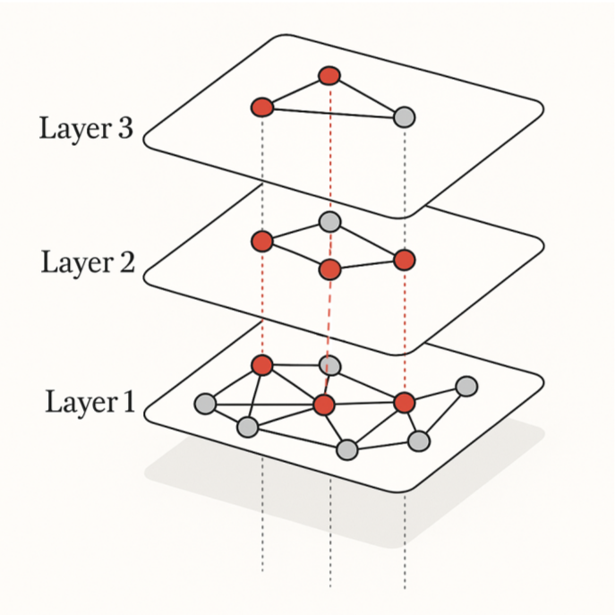

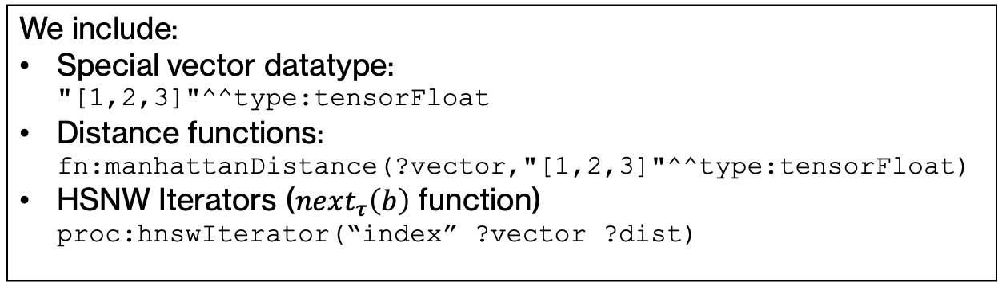
Implementation
SELECT ?person ?dist WHERE {
?person :won :Turing_Award .
:Geoffrey_Hinton :hasVector ?vector.
?person proc:hnswIterator("indexName" ?vector ?dist)
} LIMIT 100
HSNW
MillenniumDB
We include:
Special vector datatype:
"[1,2,3]"^^type:tensorFloat
Distance functions:
fn:manhattanDistance(?vector,"[1,2,3]"^^type:tensorFloat)
HSNW Iterators ($next_{τ}\left(b\right)$ function)
proc:hnswIterator(“index” ?vector ?dist)
Leapfrog Triejoin

Slide 30
Experiments
Q1: How much faster can Query-and-Iterate and Iterate-and-Query be for solving k-GSS in practice?
Q2: For increasing values of k, when does the baseline become a better algorithm? Regarding the number of answers, what is the selectivity range where our alternatives perform better?
Q3: How does the ANN version of Query-and-Iterate and Iterate-and-Query compare to the baseline in terms of the quality of the answers?

Slide 31
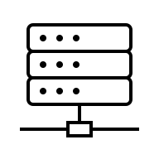




Setup, Data and Queries
Intel® Xeon® Silver 4110 @ 2.10GHz
118GB of RAM, Devuan Chimaera 4.
Query Logs – Took 200 queries involving images
and converted them in a k-GSS query

Slide 32

Query Evaluation Time

Slide 33

Query Evaluation Time - Selectivity Analysis
We see an improvement when selectivity is low: $\left|Q\left(G\right)\right|>250.000$

Slide 34

Quality of Answers

Slide 35
Conclusions
Algorithms for graph patterns and similarity search combined evaluation present better theoretical times than the baseline (current implementation on most systems)
Our algorithms perform well in practice when selectivity is low, baseline is more straightforward when there are fewer answers
We offer an open-source implementation with modern indices and worst-case-optimal join algorithms
Further research on indices that can manage semantically-filtered distance pruning is needed
We can intervene the functioning of the LTJ algorithm to better utilize the inputs of these combined algorithms, in hopes of better performace at higher selectivities

