Slide 1
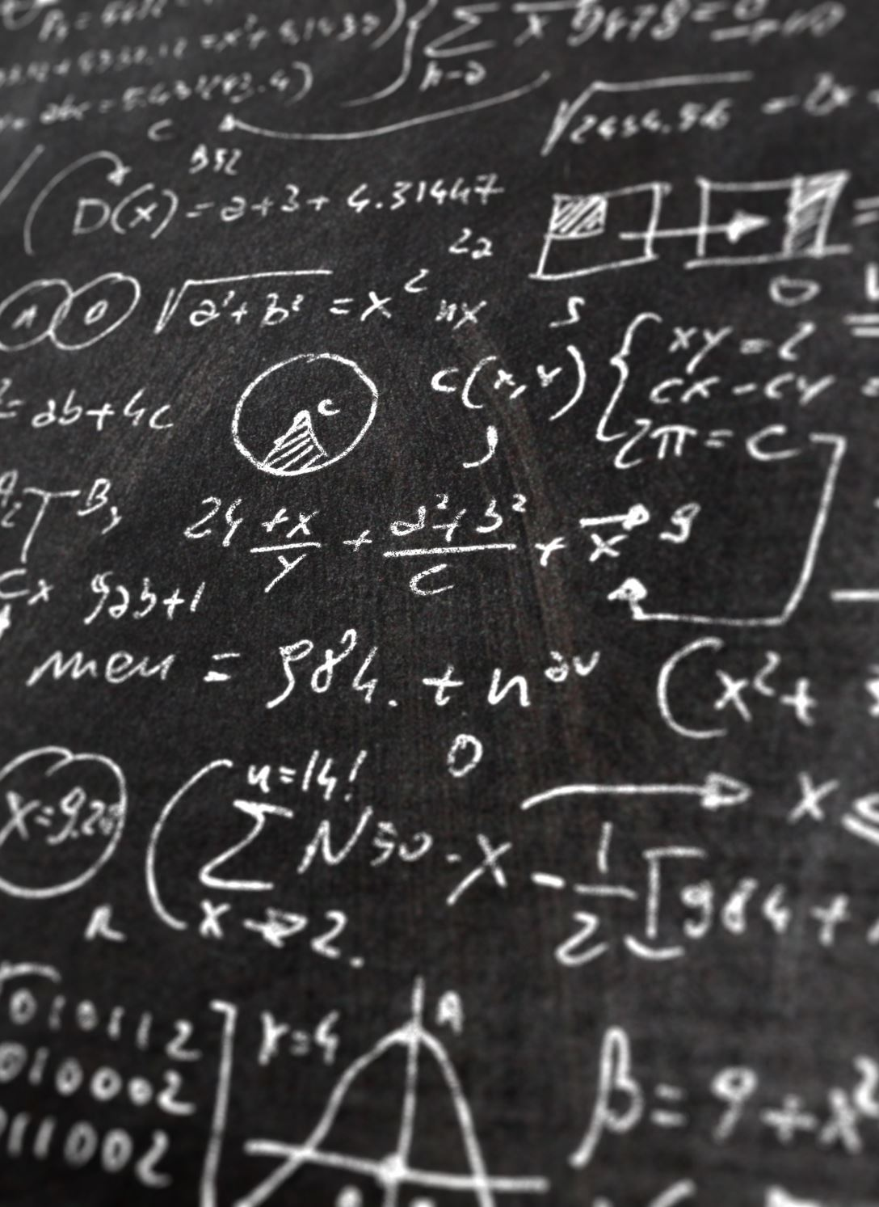
An Algebra for Evaluating Path Queries
17th TUC Meeting LDBC @ SIGMOD/PODS ‘24
Renzo Angles, Sebastián Ferrada, Roberto García y Vicente Rojas.
IMFD Chile – UTalca – UChile

Slide 2
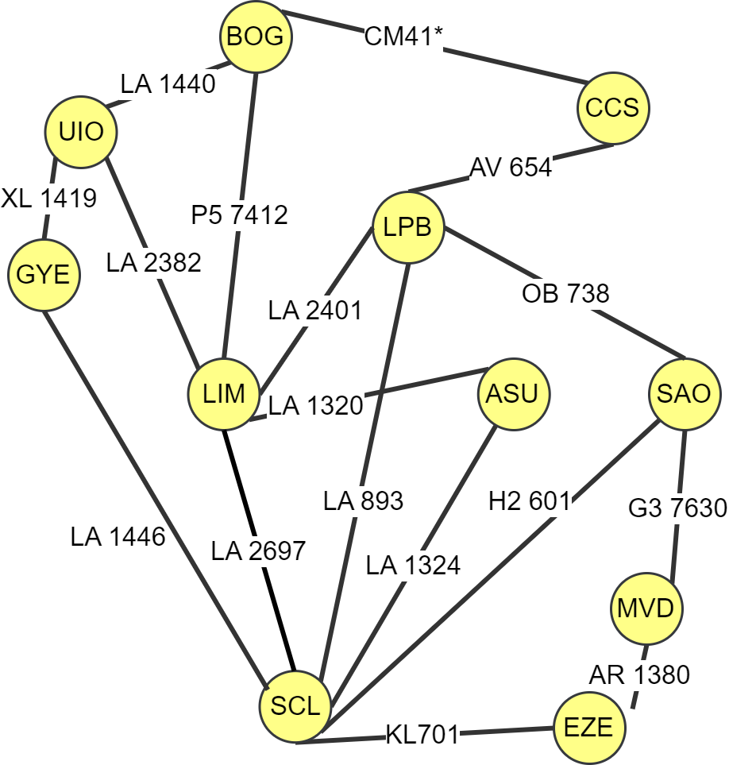
Motivation
How many ways do I have to go from Santiago (SCL) to Bogotá (BOG)?
MATCH p=(x {name:'Santiago'})-[:flight+]->(y {name:’Bogotá'})
RETURN p
[{SCL}, {LA 1446}, {GYE}, {XL 1419}, {UIO}, {LA 1440}, {BOG}]
…
The path cannot be further used in the query
Goal 1: Define an algebra to operate on paths

Slide 3
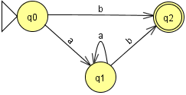
Motivation
How many ways do I have to go from Santiago (SCL) to Bogotá (BOG)?
MATCH p=(x {name:'Santiago'})-[:flight+]->(y {name:’Bogotá'})
RETURN p
[{SCL}, {LA 1446}, {GYE}, {XL 1419}, {UIO}, {LA 1440}, {BOG}]
…
+ BFS/DFS

Slide 4
Motivation
How many ways do I have to go from Santiago (SCL) to Bogotá (BOG)?
MATCH p=(x {name:'Santiago'})-[:flight+]->(y {name:’Bogotá'})
RETURN p
[{SCL}, {LA 1446}, {GYE}, {XL 1419}, {UIO}, {LA 1440}, {BOG}]
…
The algebra could be used to evaluate path queries
Goal 2: Use the algebra to generate logical plans for RPQs

Slide 5
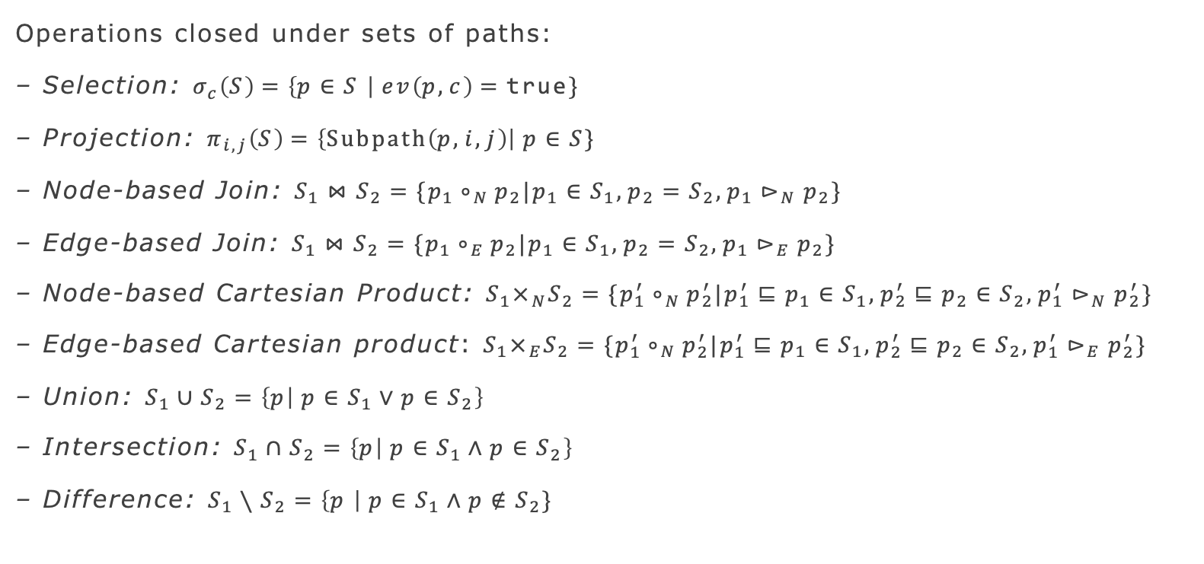
Path Manipulation Algebra
Operations closed under sets of paths:
– Selection: $σ_{c}\left(S\right)=\left\{p∈S \right| ev\left(p,c\right)=\text{true}\}$
– Projection: $π_{i,j}\left(S\right)=\left\{\text{Subpath}\left(p,i,j\right)\right| p∈S\}$
– Node-based Join: $S_{1}⋈S_{2}=\{p_{1}∘_{N}p_{2}|p_{1}∈S_{1}, p_{2}=S_{2}, p_{1}⊳_{N}p_{2}\}$
– Edge-based Join: $S_{1}⋈S_{2}=\{p_{1}∘_{E}p_{2}|p_{1}∈S_{1}, p_{2}=S_{2}, p_{1}⊳_{E}p_{2}\}$
– Node-based Cartesian Product: $S_{1}×_{N}S_{2}=\{p_{1}^{′}∘_{N}p_{2}^{′}|p_{1}^{′}⊑p_{1}∈S_{1}, p_{2}^{′}⊑p_{2}∈S_{2}, p_{1}^{′}⊳_{N}p_{2}^{′}\}$
– Edge-based Cartesian product: $S_{1}×_{E}S_{2}=\{p_{1}^{′}∘_{N}p_{2}^{′}|p_{1}^{′}⊑p_{1}∈S_{1}, p_{2}^{′}⊑p_{2}∈S_{2}, p_{1}^{′}⊳_{E}p_{2}^{′}\}$
– Union: $S_{1}∪S_{2}=\left\{p | p∈S_{1}∨p∈S_{2}\right\}$
– Intersection: $S_{1}∩S_{2}=\left\{p | p∈S_{1}∧p∈S_{2}\right\}$
– Difference: $S_{1}∖S_{2}=\left\{p \right| p∈S_{1}∧p∉S_{2}\}$
García, R., Angles, R. (2022). An Algebra for Path Manipulation in Graph Databases. In: Advances in Databases and Information Systems. ADBIS 2022. Springer, Cham.

Slide 6
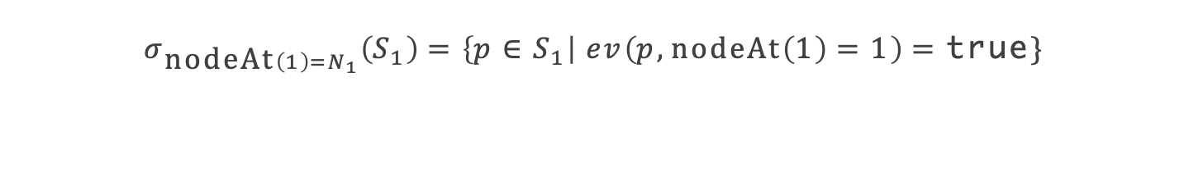
Path Manipulation Algebra – Selection
$$σ_{\text{nodeAt}\left(1\right)=N_{1}}\left(S_{1}\right)=\left\{p∈S_{1}\right| ev\left(p, \text{nodeAt}\left(1\right)=1\right)=\text{true}\}$$

Slide 7
Path Manipulation Algebra – Selection
$$σ_{\text{nodeAt}\left(1\right)=N_{1}}\left(S_{1}\right)=\left\{p∈S_{1}\right| ev\left(p, \text{nodeAt}\left(1\right)=1\right)=\text{true}\}$$

Slide 8

Path Manipulation Algebra – Node Join
$$S_{1}⋈_{N}S_{2}$$

Slide 9
Path Manipulation Algebra – Node Join
$$S_{1}⋈_{N}S_{2}$$

Slide 10
Path Manipulation Algebra – Node Join
$$S_{1}⋈_{N}S_{2}$$

Slide 11
Path Manipulation Algebra – Node Join
$$S_{1}⋈_{N}S_{2}$$

Slide 12
Path Manipulation Algebra – Node Join
$$S_{1}⋈_{N}S_{2}$$

Slide 13
Path Manipulation Algebra – Node Join
$$S_{1}⋈_{N}S_{2}$$

Slide 14
Path Manipulation Algebra – Node Join
$$S_{1}⋈_{N}S_{2}$$

Slide 15
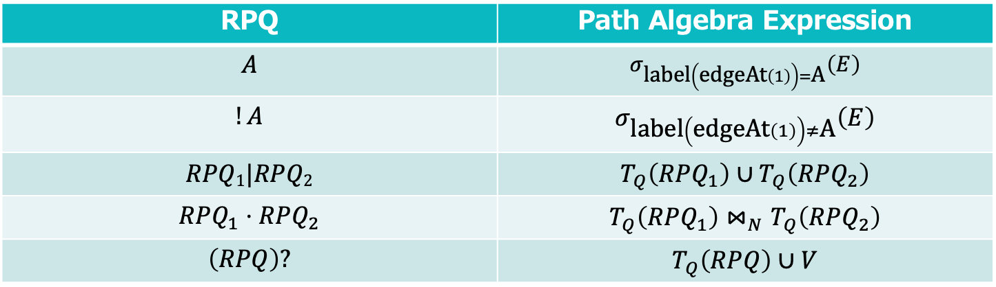
Using the Algebra to Evaluate RPQs
We evaluate RPQs over a Labeled Graph $G=\left(V,E, λ \right)$
RPQ | Path Algebra Expression
$$A$$ | $$σ_{\text{label}\left(\text{edgeAt}\left(1\right)\right)=\text{A}}\left(E\right)$$
$$!A$$ | $$σ_{\text{label}\left(\text{edgeAt}\left(1\right)\right)≠\text{A}}\left(E\right)$$
$$RPQ1|RPQ2$$ | $$T_{Q}\left(RPQ_{1}\right)∪T_{Q}\left(RPQ_{2}\right)$$
$$RPQ_{1}⋅RPQ_{2}$$ | $$T_{Q}\left(RPQ_{1}\right)⋈_{N}T_{Q}\left(RPQ_{2}\right)$$
$$\left(RPQ\right)?$$ | $$T_{Q}\left(RPQ\right)∪V$$

Slide 16
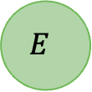
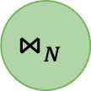
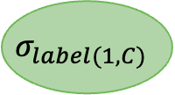

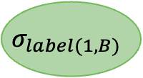
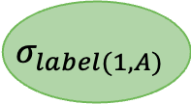
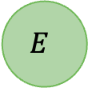
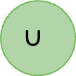
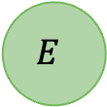
Using the Algebra to Evaluate RPQs
B
N₁
A
N₂
C
N₃
$$σ_{label(1, B)}$$
$$E$$
$$∪$$
A•(B|C) $→$
$$⋈_{N}$$
$$σ_{label(1, C)}$$
$$E$$
$$σ_{label(1, A)}$$
$$E$$

Slide 17
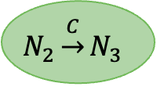
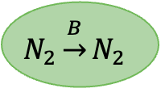
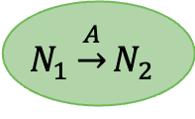
Using the Algebra to Evaluate RPQs
B
N₁
A
N₂
C
N₃
$$N_{2}\underset{→}{B}N_{2}$$
$$∪$$
A•(B|C) $→$
$$⋈_{N}$$
$$N_{2}\underset{→}{C}N_{3}$$
$$N_{1}\underset{→}{A}N_{2}$$

Slide 18
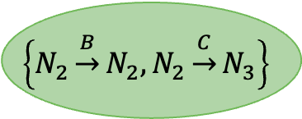
Using the Algebra to Evaluate RPQs
B
N₁
A
N₂
C
N₃
$$\left\{N_{2}\underset{→}{B}N_{2},N_{2}\underset{→}{C}N_{3}\right\}$$
A•(B|C) $→$
$$⋈_{N}$$
$$N_{1}\underset{→}{A}N_{2}$$

Slide 19
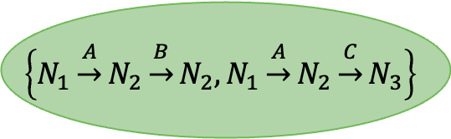
Using the Algebra to Evaluate RPQs
B
N₁
A
N₂
C
N₃
$$\left\{N_{1}\underset{→}{A}N_{2}\underset{→}{B}N_{2},N_{1}\underset{→}{A}N_{2}\underset{→}{C}N_{3}\right\}$$
A•(B|C) $→$

Slide 20
What about + and *?

Slide 21

The Recursive Operator
Base case: $φ_{0}\left(S\right)=S$
Recursive case: $φ_{i+1}\left(S\right)=\left(φ_{i}\left(S\right)⋈_{N}S\right)∪φ_{i}\left(S\right)$
Fixpoint end condition $\left|φ_{i+1}\right|=\left|φ_{i}\right|$.

Slide 22
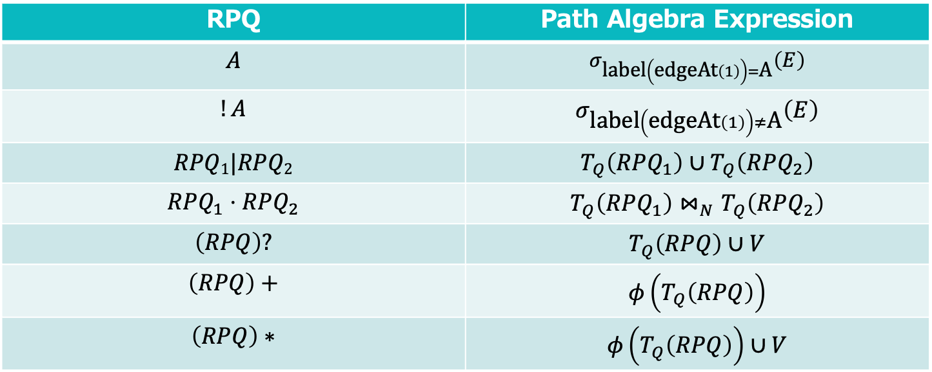
Using the Algebra to Evaluate RPQs
We evaluate RPQs over a Labeled Graph $G=\left(V,E, λ \right)$
RPQ | Path Algebra Expression
$$A$$ | $$σ_{\text{label}\left(\text{edgeAt}\left(1\right)\right)=\text{A}}\left(E\right)$$
$$!A$$ | $$σ_{\text{label}\left(\text{edgeAt}\left(1\right)\right)≠\text{A}}\left(E\right)$$
$$RPQ1|RPQ2$$ | $$T_{Q}\left(RPQ_{1}\right)∪T_{Q}\left(RPQ_{2}\right)$$
$$RPQ_{1}⋅RPQ_{2}$$ | $$T_{Q}\left(RPQ_{1}\right)⋈_{N}T_{Q}\left(RPQ_{2}\right)$$
$$\left(RPQ\right)?$$ | $$T_{Q}\left(RPQ\right)∪V$$
$$\left(RPQ\right)+$$ | $$φ\left(T_{Q}\left(RPQ\right)\right)$$
$$\left(RPQ\right)∗$$ | $$φ\left(T_{Q}\left(RPQ\right)\right)∪V$$

Slide 23
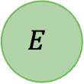
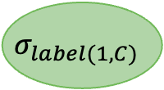

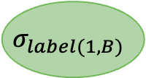
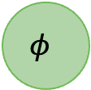
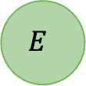
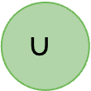
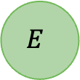
Using the Algebra to Evaluate RPQs
B
N₁
A
N₂
C
N₃
$$σ_{label(1, B)}$$
$$E$$
$$φ$$
$$∪$$
$$⋈_{N}$$
$$σ_{label(1, C)}$$
$$E$$
A•(B|C)+ $→$
$$σ_{label(1, A)}$$
$$E$$

Slide 24
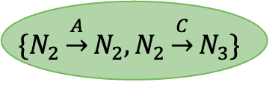
Using the Algebra to Evaluate RPQs
B
N₁
A
N₂
C
N₃
$$φ$$
$$\{N_{2}\underset{→}{A}N_{2},N_{2}\underset{→}{C}N_{3}\}$$
A•(B|C)+ $→$
$$⋈_{N}$$
$$σ_{label(1, A)}$$
$$E$$

Slide 25
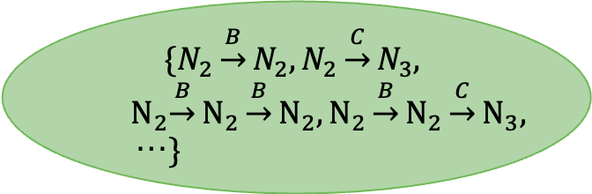
Using the Algebra to Evaluate RPQs
B
N₁
A
N₂
C
N₃
$$\{N_{2}\underset{→}{B}N_{2},N_{2}\underset{→}{C}N_{3},$$
$${ N}_{2}{\underset{→}{B}N}_{2}{\underset{→}{B}N}_{2},N_{2}{\underset{→}{B}N}_{2}{\underset{→}{C}N}_{3},$$
…$\}$
A•(B|C)+ $→$
$$⋈_{N}$$
$$N_{1}\underset{→}{A}N_{2}$$

Slide 26
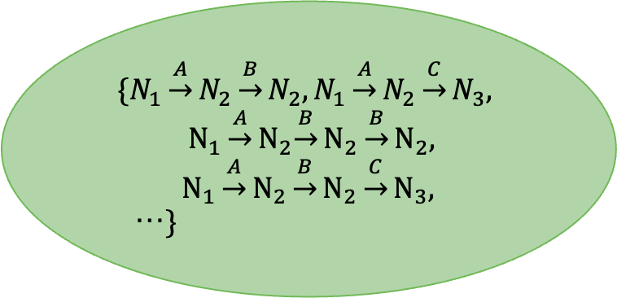
Using the Algebra to Evaluate RPQs
B
N₁
A
N₂
C
N₃
$$\{N_{1}\underset{→}{A}N_{2}\underset{→}{B}N_{2},{N_{1}\underset{→}{A}N}_{2}\underset{→}{C}N_{3},$$
$${ N_{1}\underset{→}{A}N}_{2}{\underset{→}{B}N}_{2}{\underset{→}{B}N}_{2},$$
$$N_{1}\underset{→}{A}N_{2}{\underset{→}{B}N}_{2}{\underset{→}{C}N}_{3},$$
…$\}$
Does it ever end?
A•(B|C)+ $→$
Depends on the Semantics

Slide 27
Implementation
RPQ Parser
RPQ to Logical Plan
Logical Plan Optimizer
Logical Plan to Physical Plan
Iterator-based executors
https://github.com/ramhgarcias/PathDatabase

Slide 28
Future Steps
Implement non-naïve physical operators
Implement dedicated physical operators for the different semantics
Compare with automaton-based evaluation
Study optimization rules
Study parallelization opportunities

Slide 29
Conclusions
Paths as fundamental datatypes in graph query languages
A path manipulation algebra to evaluate RPQs
The algebra can allow for optimization, parallelization, etc., of RPQs.
Ad-hoc algorithms can be developed to provide better physical operators
Specialized algorithms that consider the structure the graph is stored in can further improve performance

