Slide 1
Tissue network modelling

Slide 2
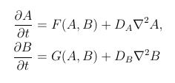
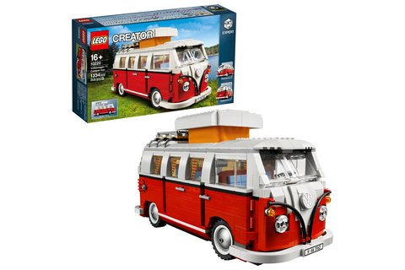
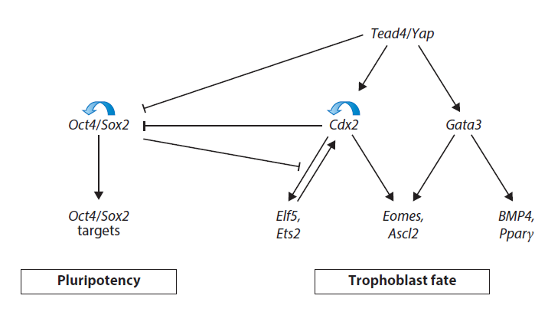
Model ≠ Simulation
Reaction-Diffusion/Turing mechanism:
Model:
Illustration to demonstrate certain properties of a complex system
Simplification
Goal-oriented (For whom? When? What for?)
Simulation:
Acting out processes (if using the real system is too expensive, too dangerous, ethnically unacceptable, too complex or not possible)
Rossant Annu. Rev. Genet. 2018
Wind tunnel simulations
Molecular dynamics simulations
Tissue growth
Crash tests

Slide 3
Models are not descriptions of reality; they are descriptions of our assumptions about reality.
Models should be determined by the questions being asked and the data that are available.
(Gunawardena, MPoC 2011)

Slide 4
Tasks for models and simulations in biology
Visualisation of hypotheses
Formalising hypotheses (different degrees of precisison: image, formula)
Testing hypotheses
Testing of different parameters and parameter values
Sometimes predictions

Slide 5
Approach for simulations
Question, experimental design
Select a suitable model
Implement the model in the computer
Identify important parameters
Use simulations to investigate the behaviour of the model for the important parameters
Compare the results of the simulations with the experiment
Test the predictions of the simulations in the experiment

Slide 6
What models are there for tissue networks?
Notes:
Einzelne Zellen
Zellform
Zelltyp
Genexpression
Proteinexpression
Mechanische Interaktionen zwischen den Zellen
Chemische Interaktionen zwischen den Zellen
Zellteilung
Zellbewegung
Rechenzeit möglichst kurz

Slide 7

Tissue network models
Markov model

Slide 8

Tissue network models
Markov model
Agent-based models
Centroid model

Slide 9
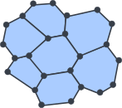
Tissue network models
Markov model
Agent-based models
Centroid model
Vertex model

Slide 10

Tissue network models
Markov model
Agent-based models
Centroid model
Vertex model
Continuous growth model

