Slide 1
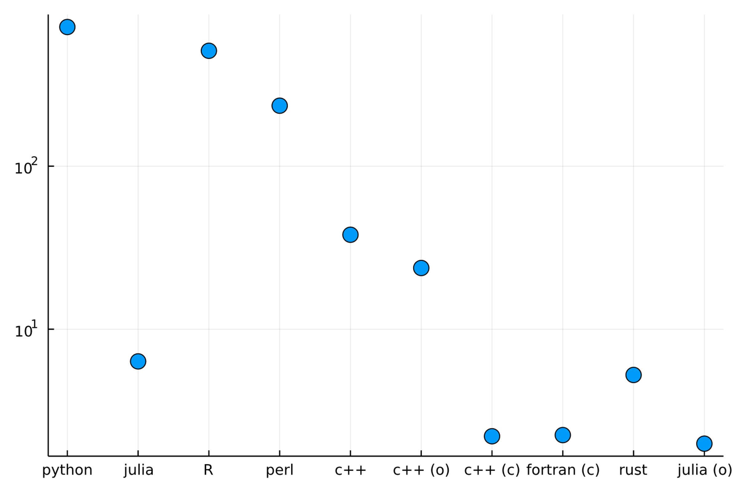
How to get the best performance?
It depends
Should I optimize performance?
It depends
What is performance, anyway?
It depends
What should I do now?
It depends,
in case of doubt: use Julia!
µs per iteration (log scale)

