Slide 1

Ithaca
ESE 2016 – Team 3

Slide 2
Table of contents
Features
Demo of the product
Development process
Challenges
Prospects
Questions

Slide 3
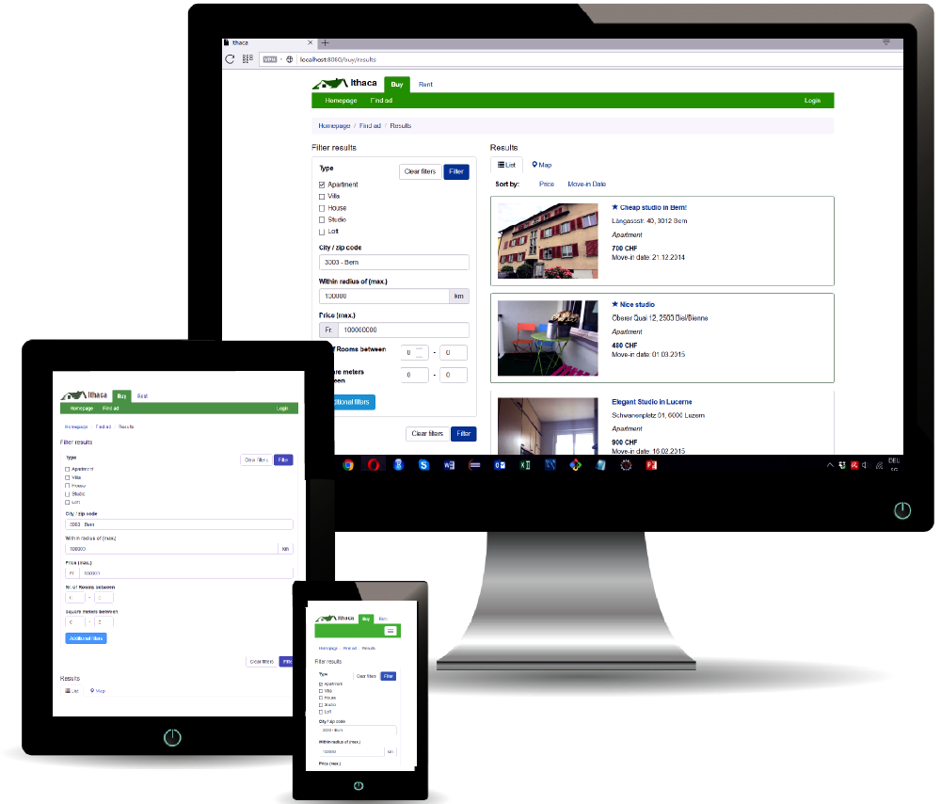
Features
Responsive Design (mobile ready)
Search: List view / Map view
Auctions / Auction Management
Messaging System (Mails)
Google Signup/Login
Premium users
Earlier mail notification
Ads are highlighted

Slide 4

Demo of product

Slide 5
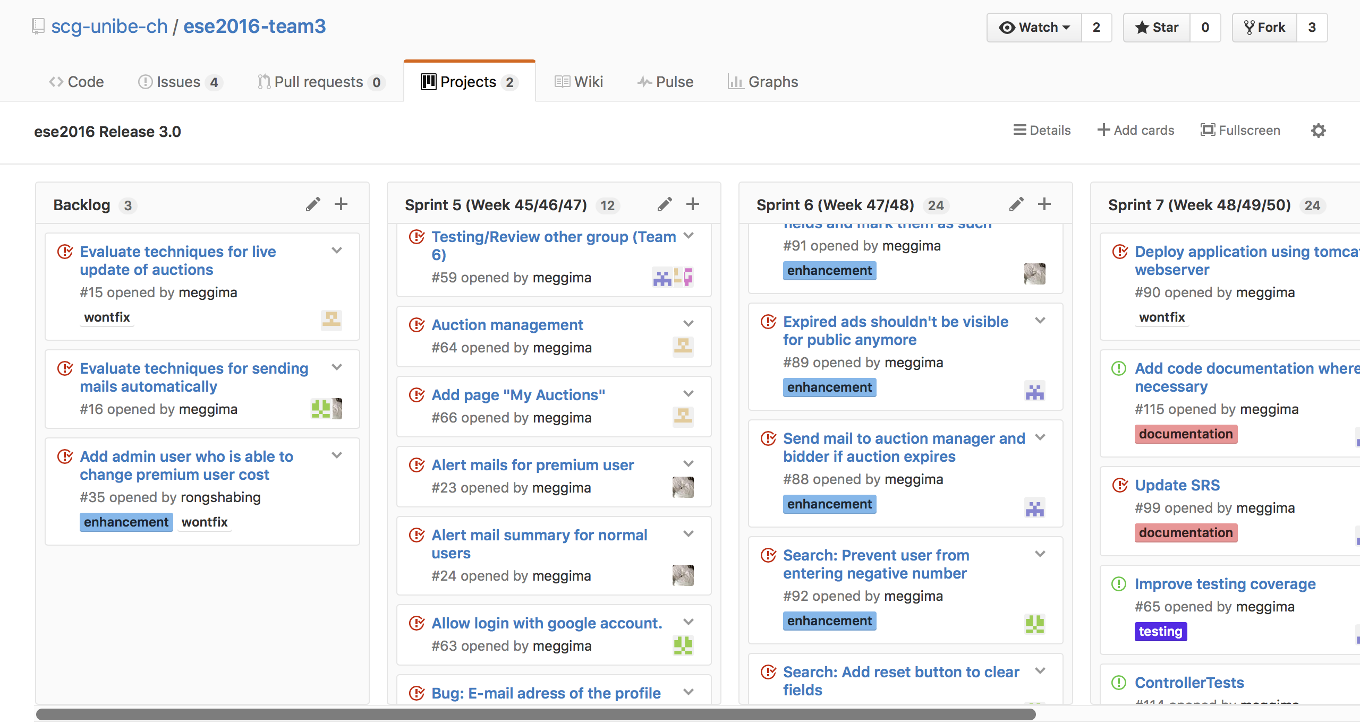
Development process
Weekly Meetings
Github project
Issues

Slide 6
Challenges
Understanding existing code
Steep learning curve
Legacy bugs
Usage of bootstrap

Slide 7
Prospects
Additional benefits for premium users
Rating of ads, users, auctions ...
Additional real estate management functions

Slide 8
Questions?

